Slide 1
An Introduction to Lipids
-Storage Lipids-
Chapter 10 (Page 343-348)

Slide 2
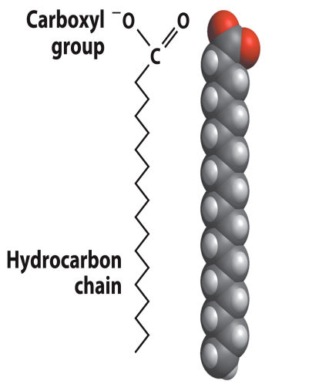
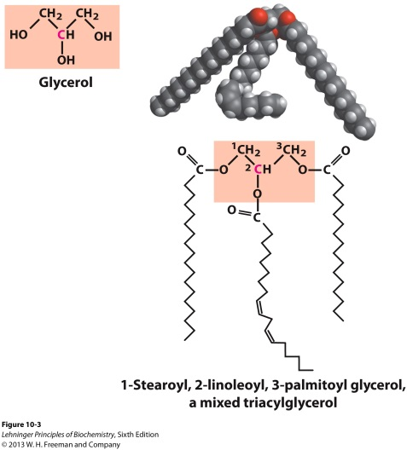
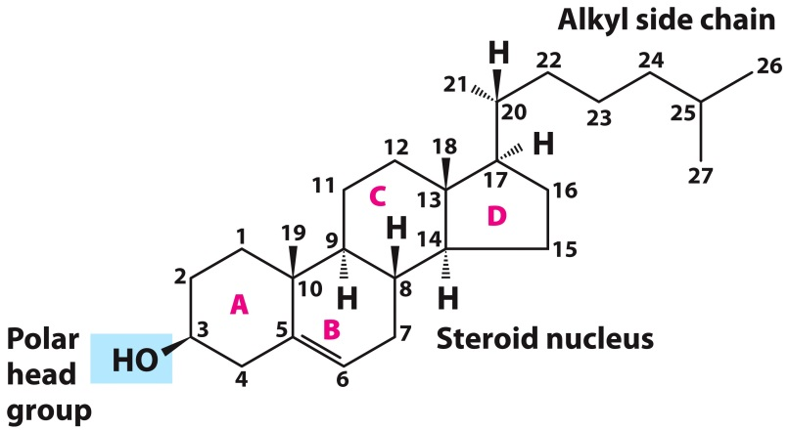
Lipids: Structurally Diverse Class of Molecules
Lipids are organic molecules that are characterized by low solubility in water and relative hydrophobicity.

Slide 3
1. Biological Functions of Lipids (Storage)
Storage of energy
Reduced compounds (with respect to carbon) that release lots of energy upon oxidation
Their hydrophobic nature allows for efficient packing
Insulation from environment
Low thermal conductivity
High heat capacity (can absorb heat)
Mechanical protection (can absorb shocks)

Slide 4
1. Biological Functions of Lipids (Storage)
Water repellant
Hydrophobic nature helps to keep surface of the organism dry
Prevents excessive wetting (birds)
Prevents loss of water via evaporation
Buoyancy control in marine mammals
Increased density of lipids in greater water depths helps sinking

Slide 5
2. Biological Functions of Lipids (Nonstorage)
Membrane structure
Main structure of cell membranes
Cofactors for enzymes
Vitamin K: Blood clot formation
Coenzyme Q: ATP synthesis in mitochondria
Signaling molecules
Paracrine hormones (act locally)
Steroid hormones (act body-wide)
Growth factors
Vitamins A and D (hormone precursors)

Slide 6
2. Biological Functions of Lipids (Nonstorage)
Pigments
Color of tomatoes, carrots, pumpkins, some birds
Antioxidants
Vitamin E

Slide 7
3. Classification of lipids
Lipids can be classified based on structure in addition to function:
Lipids that do not contain fatty acids
Lipids that contain fatty acids (complex lipids)
-Further divided into storage lipids and membrane lipids

Slide 8
Storage Lipids

Slide 9
1A. Fatty Acids
Fatty acids are carboxylic acids with hydrocarbon chains containing between 4 to 36 carbons.
A. Almost all natural fatty acids have an even number of carbons (typically 12 to 24 C).
B. Most natural fatty acids are unbranched.
C. Some are saturated: no double bonds between carbons in the chain.
D. Some are unsaturated
Monounsaturated: one double bond between carbons in the alkyl chain
Polyunsaturated

Slide 10
1A. Fatty Acids
In most monounsaturated fatty acids the double bond is between C-9 and C-10
The same is true for polyunsaturated fatty acids in addition to between C-12 and C-13 and between C-15 and C-16 (exceptions such as arachidonic acid)
In nearly all natural unsaturated fatty acids, the double bonds are in the cis configuration.
trans
cis

Slide 11
1B. Fatty Acid Nomenclature
A simplified nomenclature for these compounds specifies:
The chain length
The number of double bonds in the hydrocarbon chain separated by a colon
The position of the double bond using the delta symbol Δ and a superscript to specify the carbon number
12:0

Slide 12
1B. Fatty Acid Nomenclature
12:1(Δ⁴)
12:2(Δ^{4,8})

Slide 13
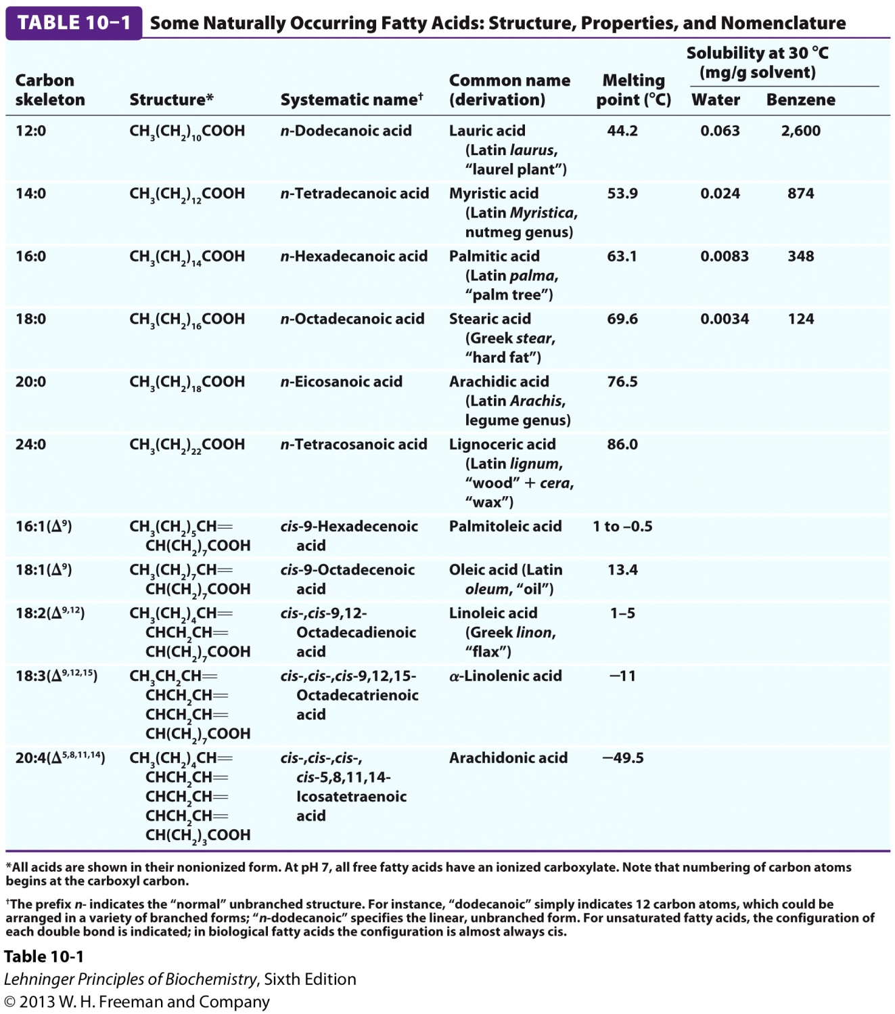
1B. Fatty Acid Nomenclature

Slide 14
1C. The Physical Properties of the Fatty Acids
The physical properties of the fatty acids, and of compounds that contain them, are largely determined by the length and degree of unsaturation of the hydrocarbon chain.
The nonpolar hydrocarbon chain accounts for the poor solubility of fatty acids in water. Solubility decreases:
With longer fatty acyl chain
With fewer double bonds
Melting points are also strongly influenced by:
The length of the hydrocarbon chain
↑ length, ↑ melting point
Degree of unsaturation
↑ unsaturation, ↓ melting point

Slide 15
1C. The Physical Properties of the Fatty Acids
C. Structure
Saturated chains tends to adopt extended conformations.
- Pack in fairly orderly way with extensive favorable hydrophobic interactions

Slide 16
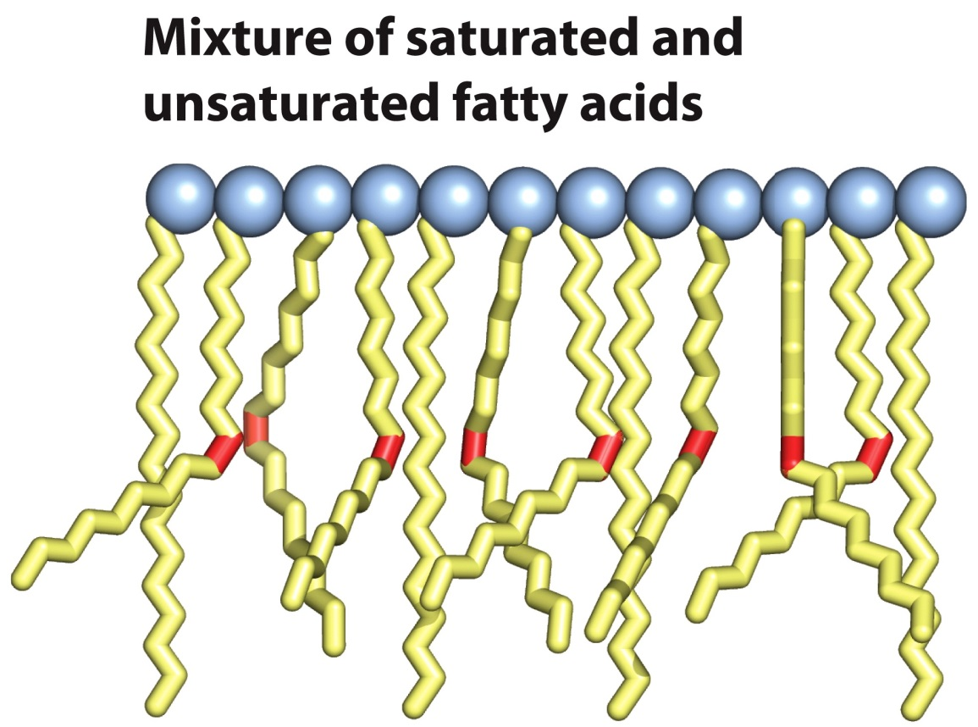
1C. The Physical Properties of the Fatty Acids
The cis configuration of double bonds in unsaturated chains kinks the chains.
- These chains pack less orderly and have less extensive favorable interactions
- Requires less thermal energy to disrupt (lower melting
point)

Slide 17
1C. The Physical Properties of the Fatty Acids
D. Physiological location
Free fatty acids (free carboxylate group) circulate in the blood bound noncovalently to a protein carrier, serum albumin
Fatty acids are present in blood plasma mostly as carboxylic acid derivatives such as esters or amides, which are even less water soluble.

Slide 18
1C. The Physical Properties of the Fatty Acids
E. Trans Fatty Acids
Form by partial dehydrogenation of unsaturated fatty acid
-Done to increase the shelf life of oils
Trans fatty acid chains adopt an extended conformation , pack more regularly, and have higher melting points
Consuming trans fats increases risk of cardiovascular disease

Slide 19
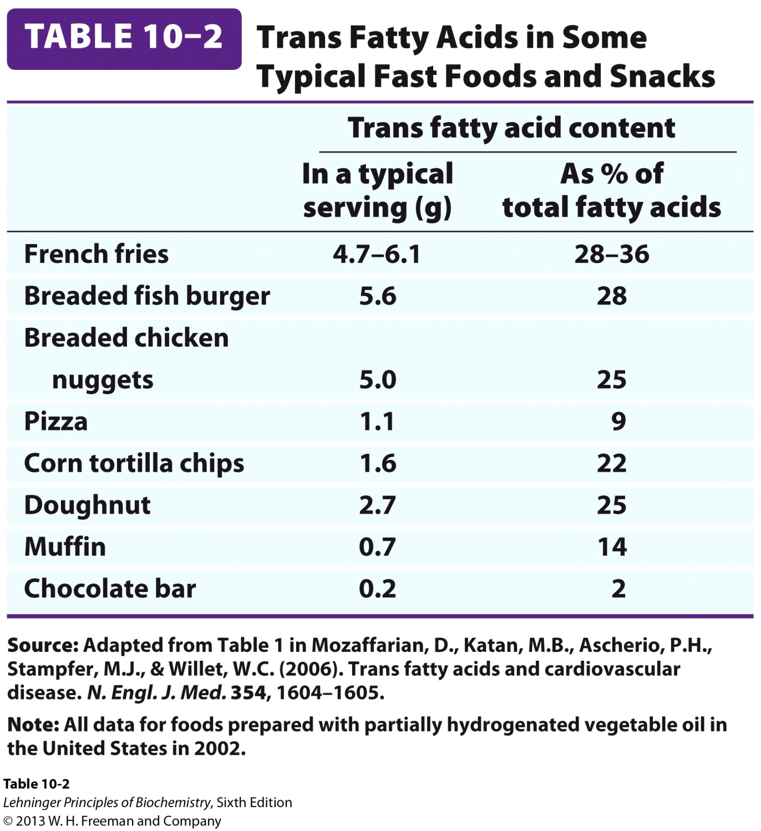
1C. The Physical Properties of the Fatty Acids

Slide 20
You can make Mofongo with no trans fats!!!

Slide 21
2. Triacylglycerols
Triacylglycerols are fatty acid esters of glycerol.

Slide 22
2A. Properties of Triacylglycerols
The fatty acids of triacylglycerols can be:
The same kind in all three positions and are named after the fatty acid
Mixed with two or three different ones as is common for most naturally occurring triacylglycerols
Name and position of each fatty acid must be specified
Nonpolar, hydrophobic molecules
The polar hydroxyls of glycerol and the polar carboxylates of the fatty acids are bound in ester linkages
Very water insoluble

Slide 23
2A. Properties of Triacylglycerols
Solid ones are called fats
Liquid ones are called oils
Less dense than water: fats and oils float
The primary storage form of lipids

Slide 24
2B. Triacylglycerols Provide Efficient Fuel Storage
In most eukaryotic cells, triacylglycerols form a separate phase of microscopic, oily droplets in the cytosol, which serve as depots of metabolic fuel.
In vertebrates, specialized cells called adipocytes, or fat cells, store large amounts of triacylglycerols as fat droplets that nearly fill the cell.
- Adipocytes contain lipases, enzymes that catalyze the hydrolysis of stored triacylglycerols, releasing fatty acids for export to sites where they are required for fuel.

Slide 25
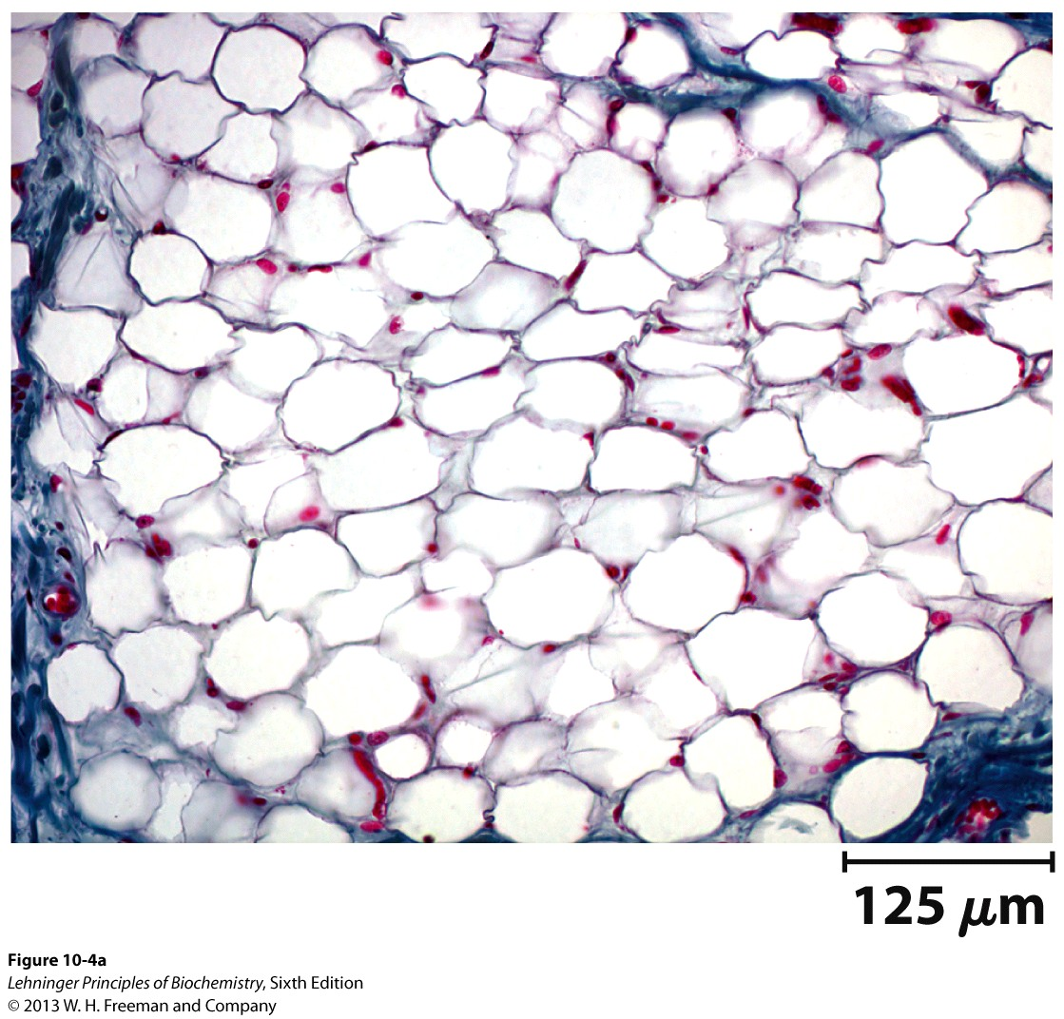
2B. Triacylglycerols Provide Efficient Fuel Storage

Slide 26
2B. Triacylglycerols Provide Efficient Fuel Storage
Fats offer advantages over polysaccharides for fuel storage.
Fatty acids carry more energy per carbon because they are more reduced
Fatty acids carry less water per gram because they are nonpolar
Glucose and glycogen are for short-term energy needs, quick delivery
Fats are for long-term (months) energy needs as they offer good storage, slow delivery

Slide 27
2C. Other functions of triacylglycerols
In some animals, triacylglycerols stored under the skin serve as insulation against low temperatures
Polar animals are stuffed with triacylglycerols
Bears have huge fat reserves during hibernation for both insulation and energy storage
The change in density of triacylglycerols due to temperature help sperm whales swim in deep ocean depths

Slide 28
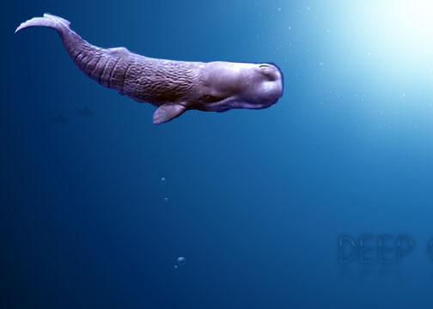
2CI. Spermaceti
Large deposit of spermaceti is found in the head of sperm whales.

Slide 29
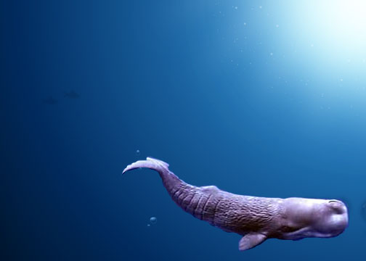
2CI. Spermaceti
In great depths of the ocean, the temperature is colder and causes for spermaceti to freeze and become more dense. This helps the whale to remain at that depth to wait for prey by having the buoyancy of its body match the surroundings.

Slide 30
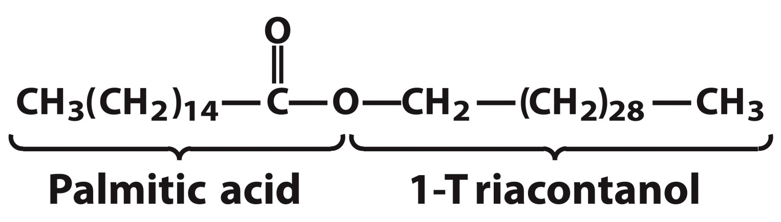
3. Waxes
Waxes are esters of long-chain (C₁₄ to C₃₆) saturated and unsaturated fatty acids with long-chain (C₁₆ to C₃₀) alcohols.
Melting points (60 to 100 °C) are higher than triacylglycerols.
Also water insoluble.

Slide 31
3A. Function of Waxes
Storage of metabolic fuel in plankton
Protection and pliability for hair and skin in vertebrates
Waterproofing of feathers in birds
Protection from evaporation in tropical plants and ivy
Used by people in lotions, ointments, and polishes

Slide 32
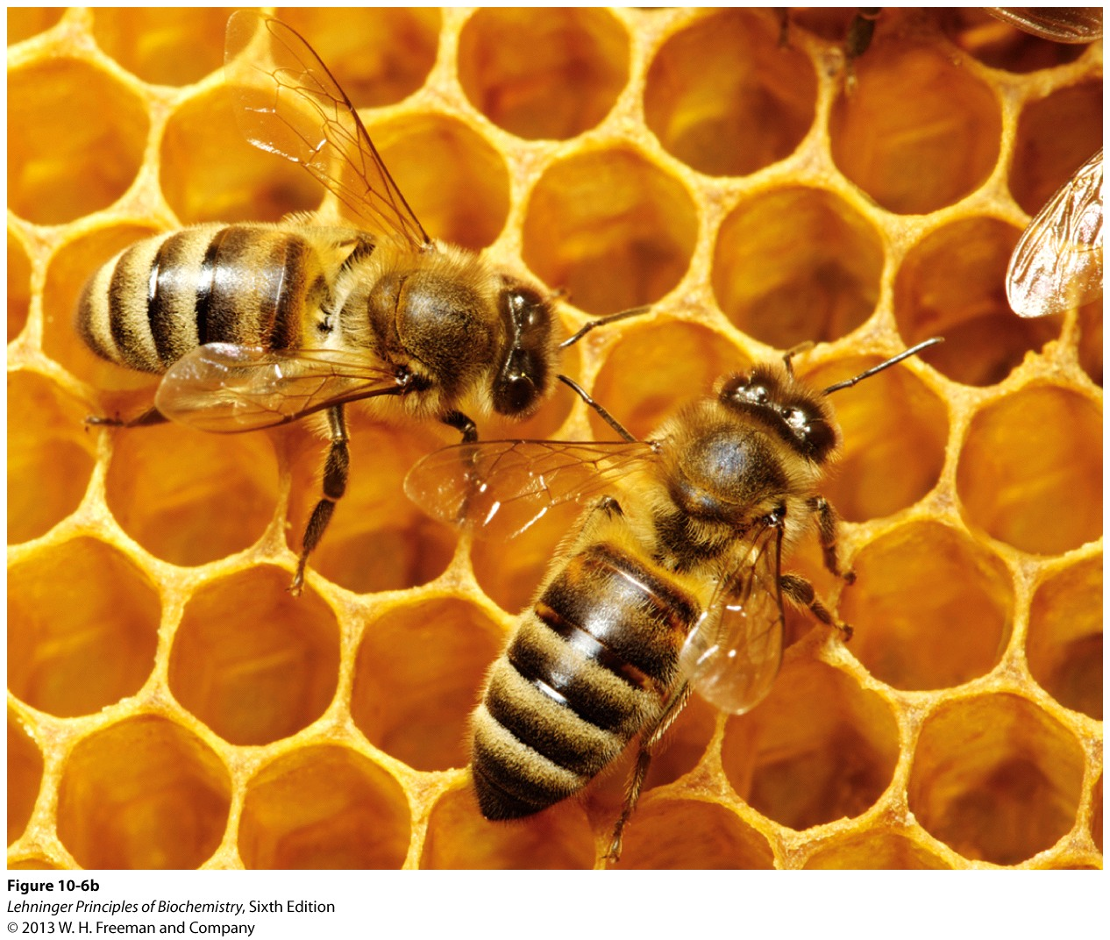
3AI. Wax: The Material of the Honeycomb
Beeswax is a mixture of a large number of lipids, including esters of triacontanol, and a long-chain alkane hentiacontane.

