Slide 1
Nonstorage Lipids
and
Lipid Isolation, Fractionation, and Identification
Chapter 10 (Page 348-366)

Slide 2
Membrane (Structural) Lipids

Slide 3
1. Membrane Lipids
The central architectural feature of biological membranes is a double layer of lipids, which acts as a barrier to the passage of polar molecules and ions.
Membrane lipids make up 5 to 10% of the dry mass of most cells.
Note that storage lipids make up more than 80% of the mass of adipocytes

Slide 4
1. Membrane Lipids
Are amphiphatic containing polar head groups and nonpolar tails (usually attached fatty acids).
Hydrophilic exterior interacts with water
Hydrophobic interior comprise the membrane bilayers
Diversification can come from:
Modifying the backbone
Changing the fatty acids
Modifying the head groups

Slide 5
1. Membrane Lipids
The properties of head groups determine the surface properties of membranes.
Different organisms have different membrane lipid head group compositions
Different tissues have different membrane lipid head group compositions

Slide 6
2. Membrane Lipid Divisions
Fatty acids:
Glycerol-based lipids
Contain phosphate derivatives
Contain sugar derivatives
Contain ether-linked groups
Sphingosine-based lipids
Contain phosphate derivatives
Contain sugar derivatives
Nonfatty acids:
Sterols

Slide 7
3. Glycerol-based lipids
or
Ether linked group
Phospholipids
Glycolipids
Glycerol
as backbone

Slide 8
3A. Glycerol-based lipids are chiral
*
Glycerol
A prochiral molecule
L-Glycerol 3-phosphate

Slide 9
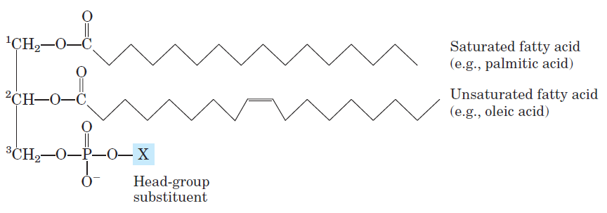
3B. Glycerophospholipids
The primary constituents of cell membranes.
General Structure

Slide 10
3B. Glycerophospholipids
Saturated fatty acids (C₁₆ or C₁₈) commonly found connected to C1.
Unsaturated fatty acids (C₁₈ or C₂₀) are commonly found connected to C2.
A polar head group is joined to the hydrophobic moiety by a phosphodiester linkage (phospholipid) via esterification by an alcohol.
Phosphatidic acid is the structural parent of all
glycerophospholipids.

Slide 11
3BI. Examples of Glycerophospholipids
+
The polar alcohol may be negatively charged, neutral, or positively charged.
These charges contribute greatly to the surface properties of membranes.

Slide 12
3BI. Examples of Glycerophospholipids

Slide 13
3BII. Phosphatidylcholine
Phosphatidylcholine is the major component of most eukaryotic cell membranes.
Many prokaryotes, including E. coli, cannot synthesize this lipid; their membranes do not contain phosphatidylcholine.

Slide 14
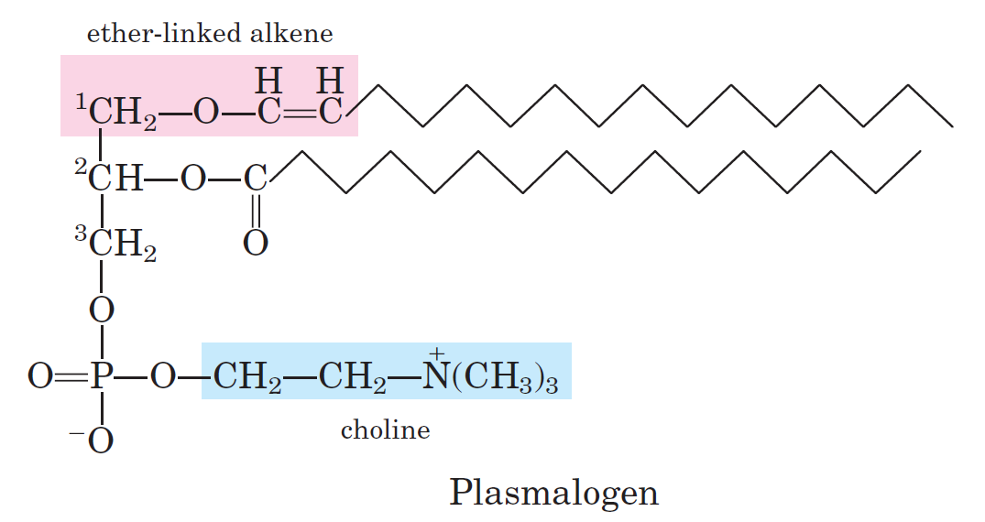
3C. Ether Lipids
One of the two acyl chains is attached to glycerol in ether, rather than ester, linkage.
The chains may be saturated or unsaturated.
Some animal tissues and some unicellular organisms are rich in ether lipids.

Slide 15
3CI. Ether Lipids: Plasmalogen
Common in vertebrate heart tissue
Also found in some protozoa and anaerobic bacteria
Function is not well understood
Resistant to cleavage by common lipases but cleaved by few specific lipases
Increase membrane rigidity?

Slide 16
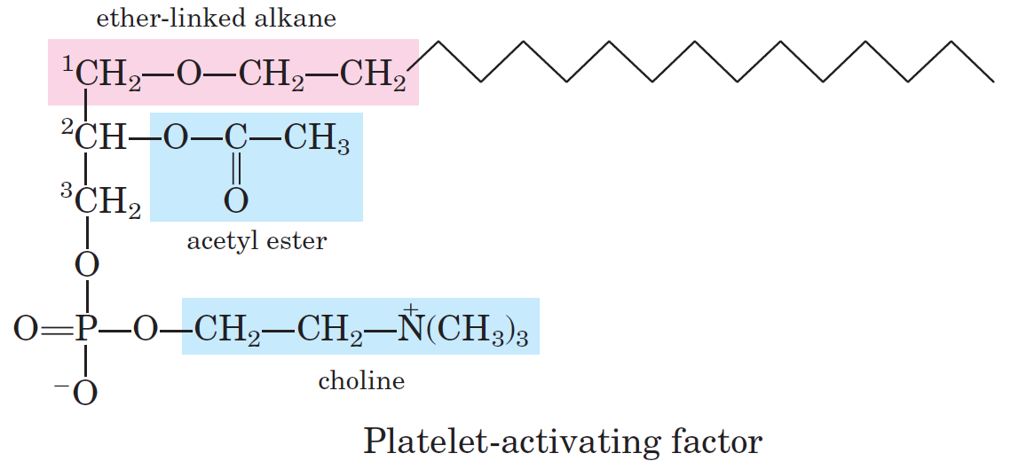
3CII. Ether Lipids: Platelets-Activating Factor
First signaling lipid to be identified
Stimulates aggregation of blood platelets
Plays role in mediation of inflammation

Slide 17
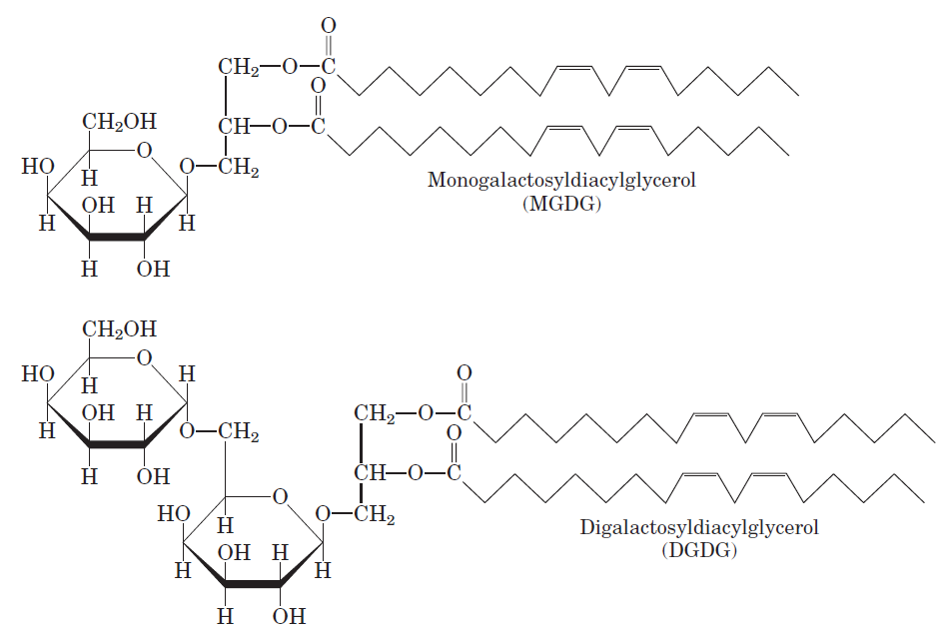
3DI. Glycolipids-Galactolipids
The most abundant membrane lipids in plant cells and the most abundant in the biosphere.
One or two galactose residues are connected by a glycosidic linkage to C-3 of glycerol and not through phosphate.

Slide 18
3DI. Glycolipids-Sulfolipids
A glucose residue is sulfonated.
The sulfonate bears a negative charge.

Slide 19
4. Sphingosine-based lipids
as backbone
The backbone is NOT glycerol, it is a long-chain amino alcohol called sphingosine.
Found by the physician-chemist Johann Thudichum and named after the Sphinx, for their mysterious functions.

Slide 20
4. Sphingosine-based lipids
A fatty acid is joined to sphingosine via an amide linkage rather than an ester linkage as usually seen in lipids.
The resulting compound is a ceramide, the structural parent of all sphingolipids.
The fatty acid (C16, 18, 22, or 24) is usually saturated or monounsaturated.
A polar head group is connected to sphingosine by a glycosidic (glycolipid) or phosphodiester linkage (phospholipid).
The sugar-containing glycosphingolipids are found largely in the outer face of plasma membranes (glycolipid).

Slide 21
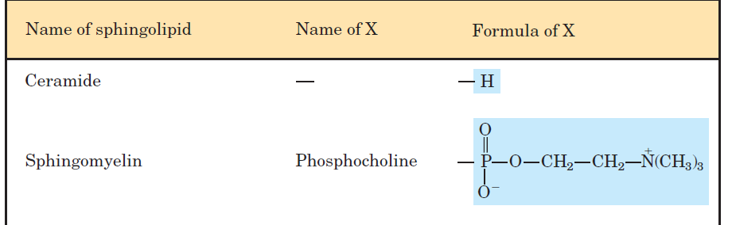
4A. Examples of Sphingolipids
+
Sphingomyelin:
Contains phosphocholine as polar head group and is structurally similar to phosphatidylcholine.
Is abundant in myelin sheath that surrounds some nerve cells in animals.

Slide 22
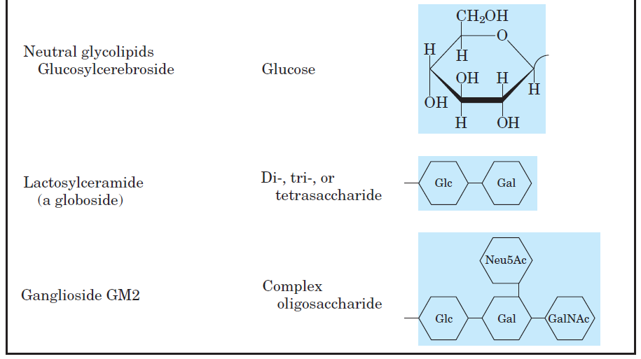
4A. Examples of Sphingolipids
+
These are glycosphingolipids.

Slide 23
4B. Glycosphingolipids
Cerebrosides are neutral and have a single sugar linked to ceramide.
Those with galactose are typically found in the plasma membrane of cells in neural tissue.
Those with glucose in nonneural tissue.
Globosides are neutral and have two or more sugars.
Gangliosides have oligosaccharides as their polar head groups and one or more residues of N-acetylneuramic acid (Neu5Ac), which is negatively charged.

Slide 24
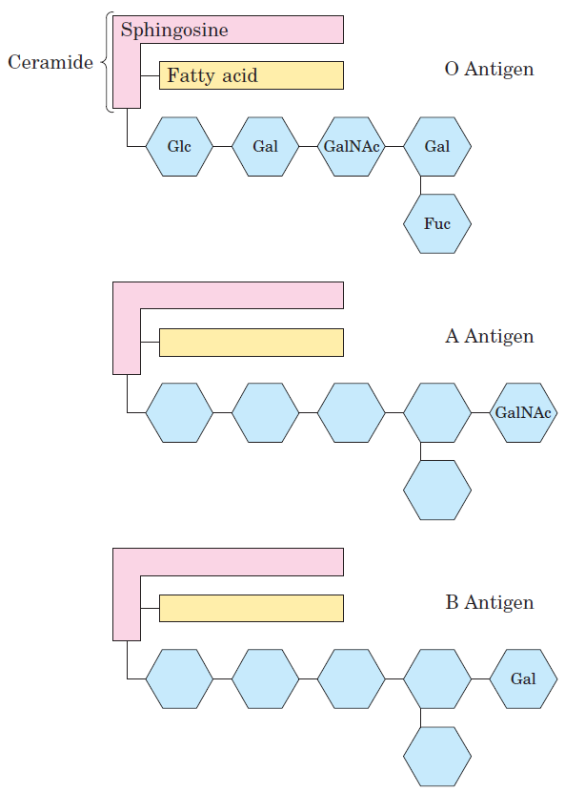
4B. Glycosphingolipids and Blood Groups
The blood groups are determined in part by the type of sugar located on the head groups in glycosphingolipids.
The oligosacchardies are found attached to certain blood proteins.

Slide 25
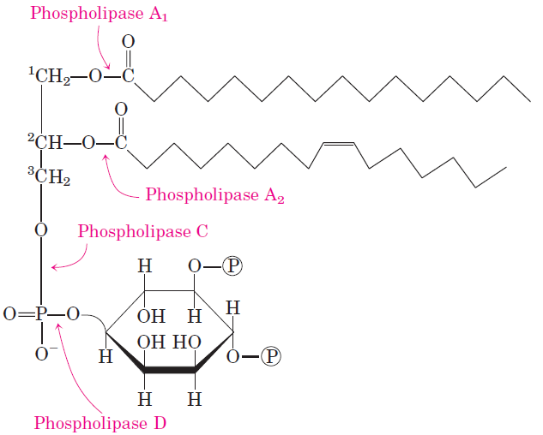
5. Phospholipids and Sphingolipids are Degraded in Lysosomes
Most cells continually degrade and replace their membrane lipids.
A. For each hydrolyzable bond in a glycerophosholipid, there is a specfic hydrolytic enzyme in the lysosome.

Slide 26
5. Phospholipids and Sphingolipids are Degraded in Lysosomes
B. Gangliosides are degraded by a set of lysosomal enzymes
that catalyze the stepwise removal of sugar units, finally yielding a ceramide.
C. A genetic defect in any of these hydrolytic enzymes leads
to the accumulation of gangliosides in the cell, with
severe medical consequences.
Mental retardation
Paralysis
Blindness
Early Death

Slide 27
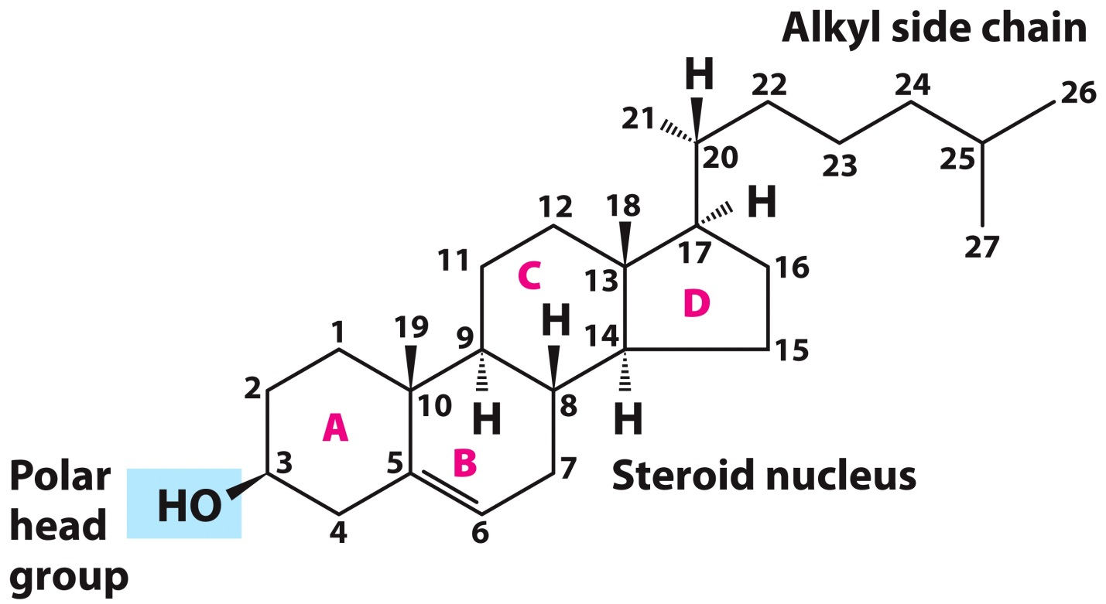
6. Sterols-Nonfatty acid Membrane Lipids
General Structure:
Steroid Nucleus: four fused rings
Three with 6 C and one with 5 C
Hydroxyl group in the A-ring
Various nonpolar side chains
Almost planar

Slide 28
6A. Physiological Roles of Sterols
Cholesterol and related sterols are present in the membranes of most eukaryotic cells.
Modulate fluidity and permeability
Thicken the plasma membrane
Most bacteria lack sterols
Mammals obtain cholesterol from food or synthesize it de novo in the liver.
Cholesterol, bound to proteins, is transported to tissues via blood vessels.
- Cholesterol in low-density lipoproteins tend to deposit and clog arteries.
Many hormones are derivatives of sterols.

Slide 29
Biologically Active Lipids

Slide 30
1A. Lipids as Signals- Phosphatidylinositol 4,5- bisphosphate
Roles of phosphatidylinositol 4,5-bisphosphate (a glycerophospholipid):
In the cytoplasmic (inner) face of plasma membranes phosphatidylinositol 4,5-bisphosphate serves as a specific binding site for certain cytoskeletal proteins and for some soluble proteins involved in membrane fusion during exocytosis.
Also serves as a reservoir of messenger molecules that are released inside the cell in response to extracellular signals interacting with specific receptors on the outer surface of the plasma membrane.

Slide 31
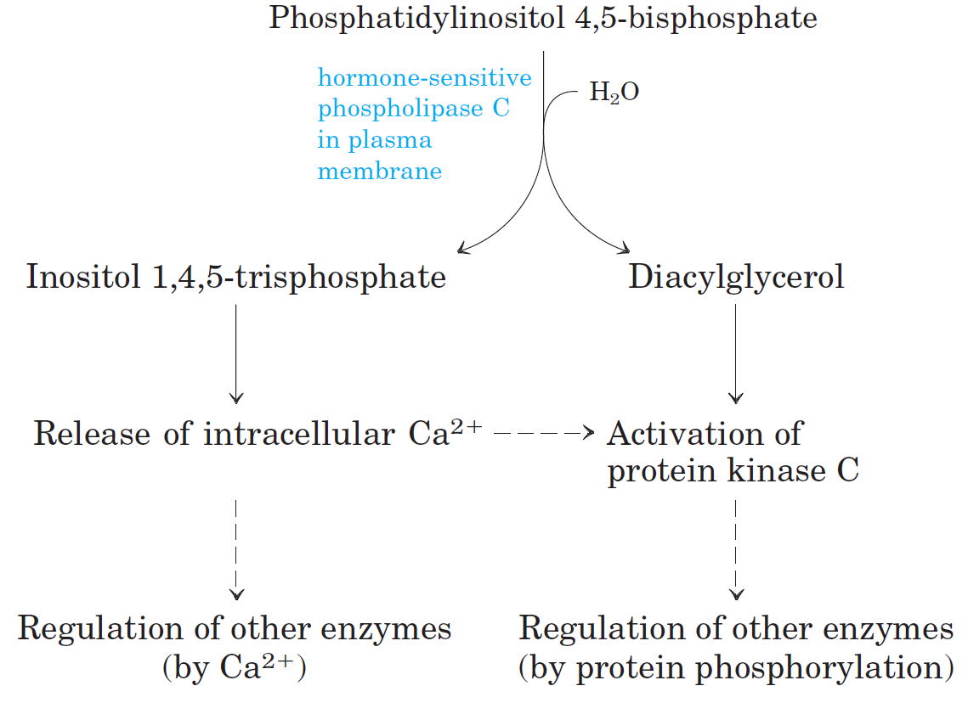
1A. Lipids as Signals- Phosphatidylinositol 4,5- bisphosphate
(Water soluble)
(Remains in plasma membrane)
from endoplasmic reticulum
+ ATP
Change in Ca²⁺ levels usually involved in signaling.

Slide 32
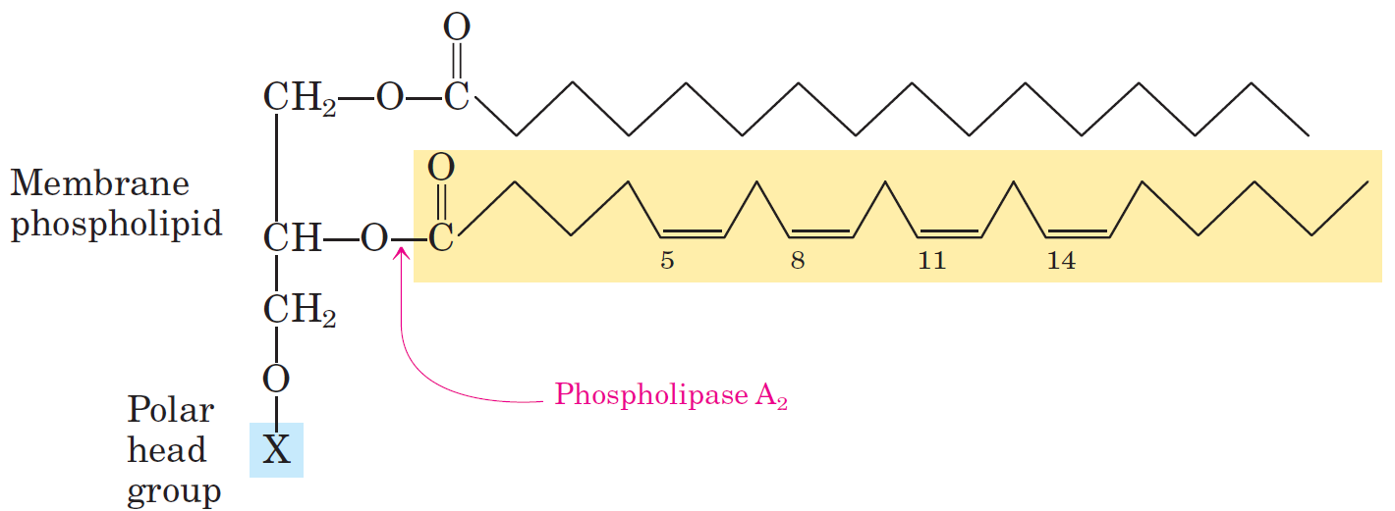
1B. Lipids as Signals- Eicosanoids (Local Hormones)
Eicosanoids are paracrine hormones, substances that act only on cells near the point of hormone synthesis instead of being transported in the blood to act on cells in other tissues or organs.
Are derived from arachidonic acid.
Arachidonic acid source

Slide 33
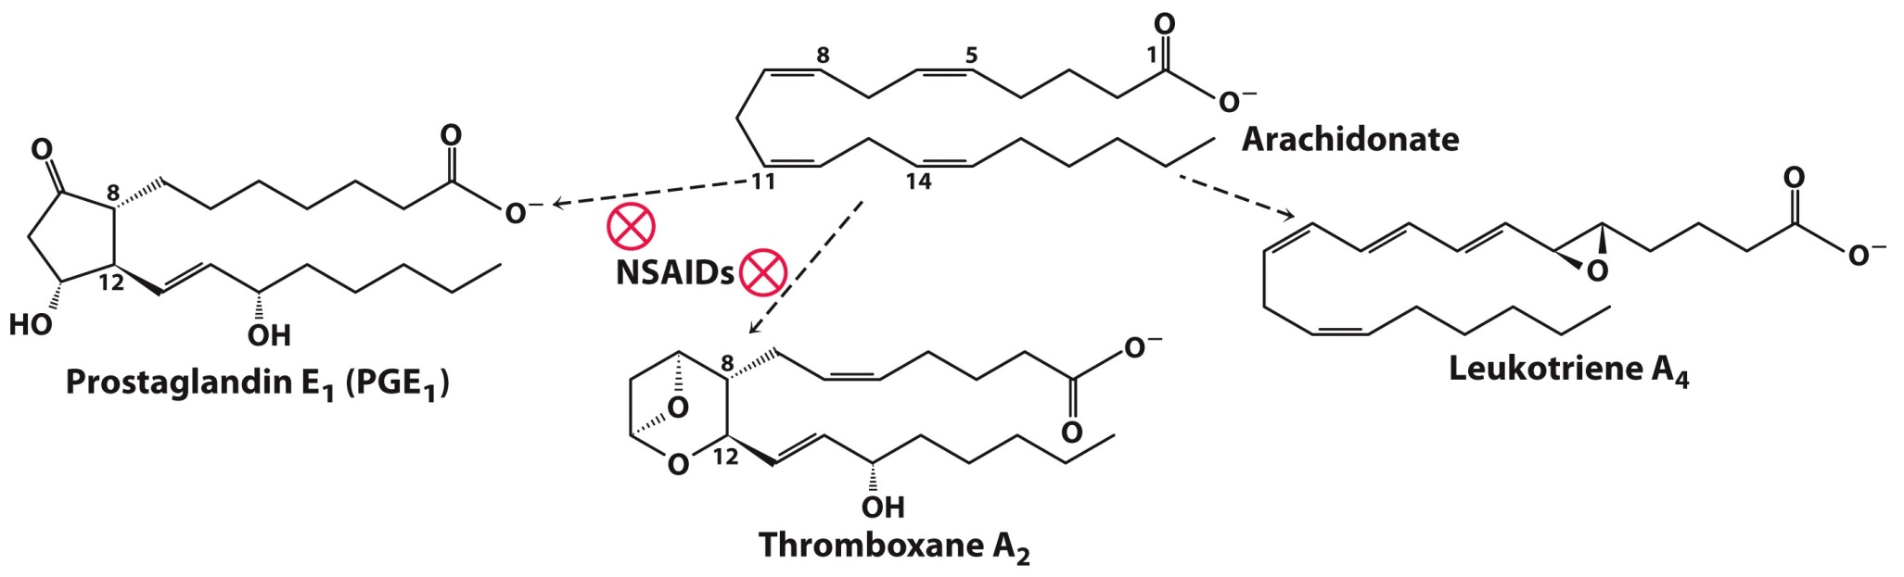
1B. Lipids as Signals- Eicosanoids (Local Hormones)
Enzymatic oxidation of arachidonic acid yields
- Prostaglandins (inflammation and fever)
- Thromboxanes (formation of blood clots)
- Leukotrienes (smooth muscle contraction in lungs)
Nonsteroidal antiinflammatory drugs (NSAIDS)-aspirin, ibuprofen, etc.- inhibit prostaglandin H₂ synthase, which is involved in prostaglandin and thromboxane formation.

Slide 34
1C. Steroid Hormones (Body-wide Hormones)
Steroids are oxidized derivatives of sterols.
- Have the sterol nucleus but lack the alkyl chain
More polar than cholesterol.
Steroid hormones are synthesized from cholesterol in gonads and adrenal glands.
They are carried through the body in the bloodstream, usually attached to carrier proteins.
Many of the steroid hormones are male and female sex hormones.

Slide 35
1C. Steroid Hormones (Body-wide Hormones)
Male sex hormone
Synthetic steroids used as antiinflammatory agents.
Female sex hormone

Slide 36
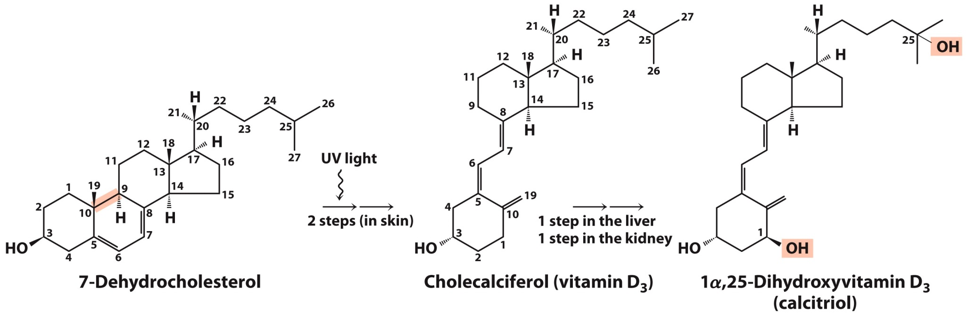
1D. Lipids as Signals- Vitamin D (Hormone precursor)
Vitamin D is converted by enzymes in the liver and kidney to 1,25-dihydroxycholecalciferol, a hormone that regulates calcium uptake in the intestine and calcium levels in kidney and bone.

Slide 37
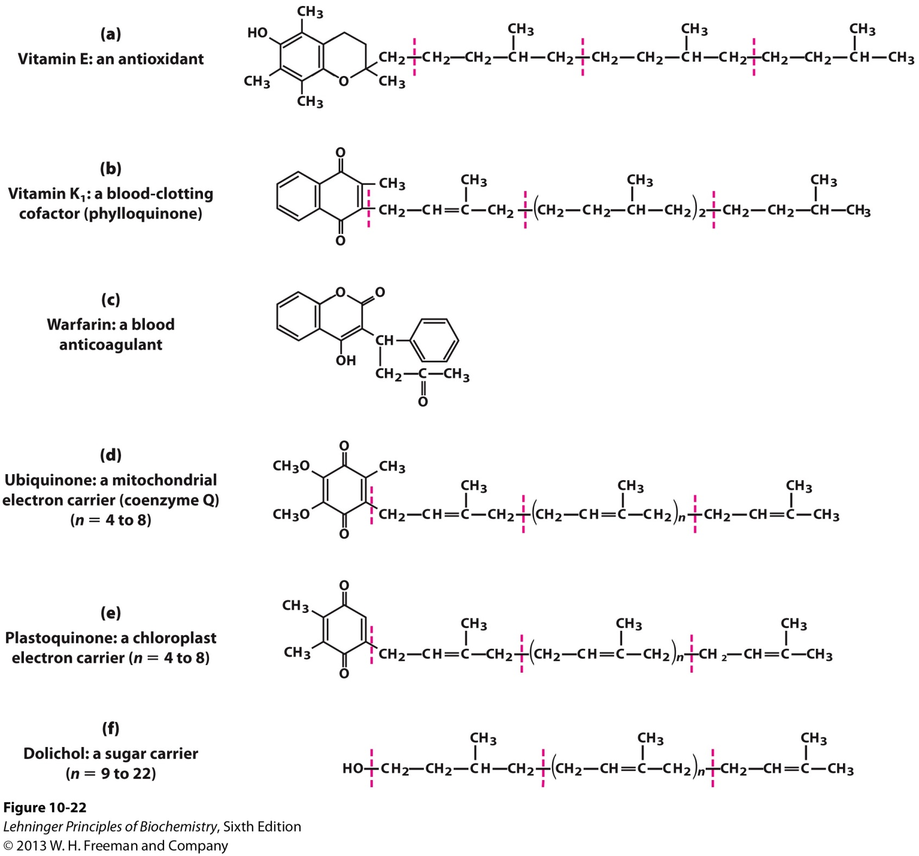
2. Vitamin E, K, and other lipid quinones are antioxidants
Destroys reactive oxygen species.

Slide 38
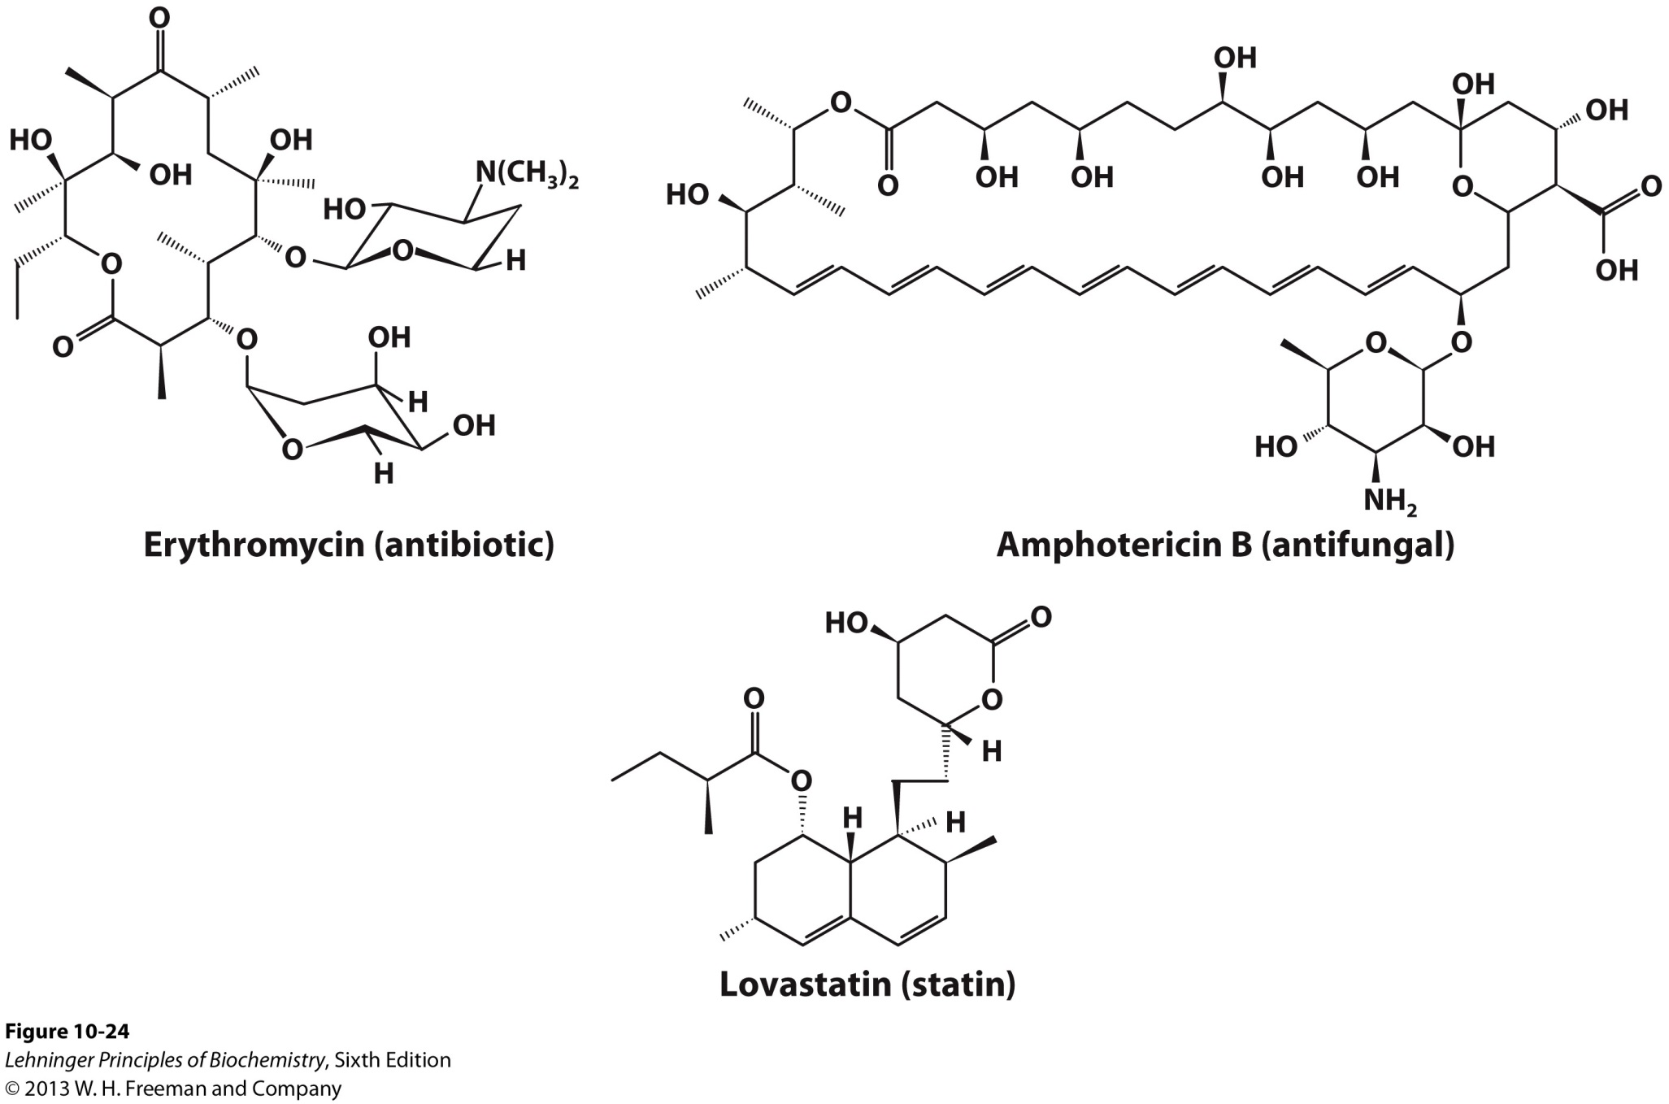
3. Polyketides in Biomedicine

Slide 39
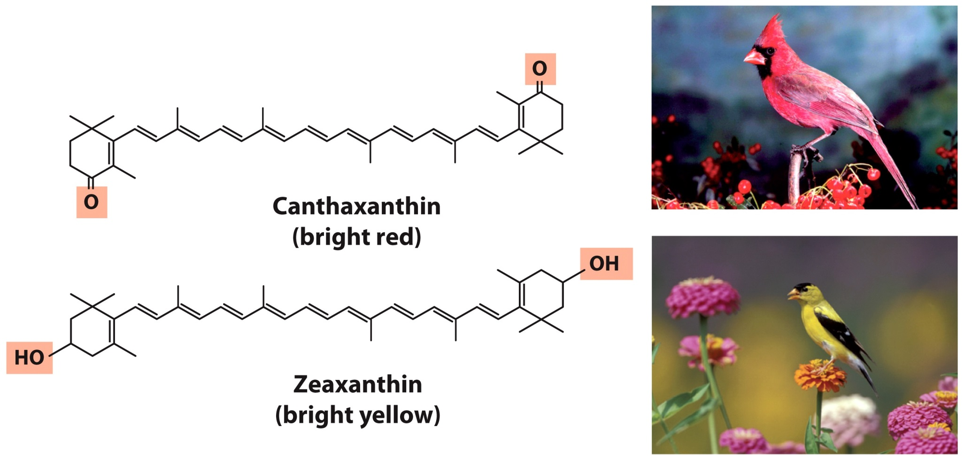
4. Lipids can provide Pigment

Slide 40
Lipid Isolation, Fractionation, and Identification

Slide 41
1. Working with Lipids
Lipids are insoluble in water and must be extracted in organic solvents.
Fractionation of lipids requires techniques not used in the purification of water-soluble molecules.
Complex mixtures of lipids are separated by differences in the polarity or solubility of the components in nonpolar solvents.
Gas-liquid chromatography
C. Lipids must be treated to yield their component parts for analysis.

Slide 42
2. Lipid Extraction
Neutral lipids (i.e. triacylglycerols) are readily extracted from tissues with ethyl ether, chloroform, or benzene which interfere with hydrophobic interactions.
Membrane lipids are more effectively extracted by more polar organic solvents, such as ethanol and methanol, which reduce hydrophobic interactions, hydrogen bonds, and electrostatic interactions between lipids and membrane proteins.

Slide 43
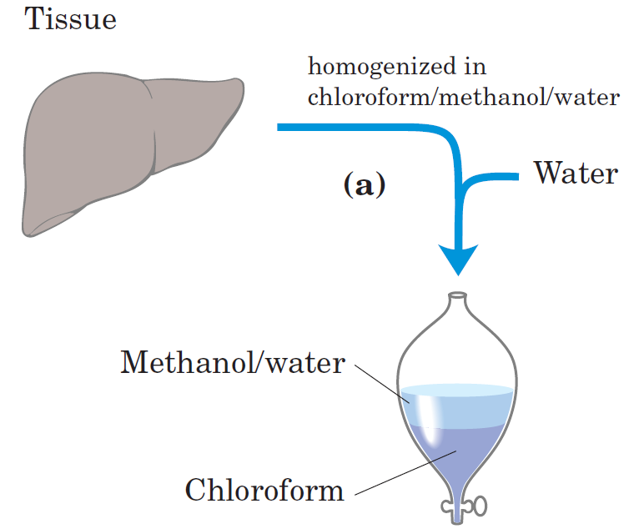
2. Lipid Extraction
1:2:0.8
Lipids will remain in the chloroform layer.

Slide 44
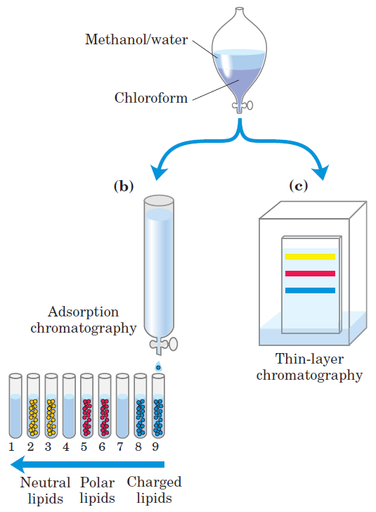
3. Lipid Fractionation

Slide 45
3A. Adsorption Chromatography
In adsorption chromatography, also known as normal phase liquid chromatography (NP-LC):
An insoluble, polar material such as silica gel (a form of silicic acid, Si(OH)₄) is the stationary phase.
The lipid mixture in chloroform is applied to the top of the column. The polar lipids bind tightly.
The mobile phase is initially chloroform and then solvents with progressively higher polarity (acetone and methanol).
Neutral lipids elute first in the chloroform wash.
Uncharged, polar lipids then elute in acetone.
Very polar or charged lipids elute last in methanol.

Slide 46
3B. High-Performance Liquid Chromatography
High-performance liquid chromatography (HPLC) can be applied to many of the chromatographic techniques that we have talked about in general.
Column is of smaller diameter.
Solvents are forced through the column under high pressure.
Results in faster and more efficient fractionation of samples.

Slide 47
3C. Thin-Layer Chromatography (TLC)
TLC is more of an analytical technique but employs the same principle as NP-LC.
A thin layer of silica is spread and adhered to a glass plate.
A small sample of lipids in chloroform or solvent mixture is applied near one edge of the plate in a closed-chamber.
As solvent rises on the plate by capillary action, it carries lipids with it.
Less polar lipids move farthest as they have less tendency to bind to silicic acid
A number of spray reagents are useful in detecting specific lipids.

Slide 48
3C. Thin-Layer Chromatography (TLC)
Lipids will have a characteristic R_{f} value
D. For subsequent analysis, regions containing separated lipids can be scraped from the plate and the lipids recovered by extraction with an organic solvent.

Slide 49
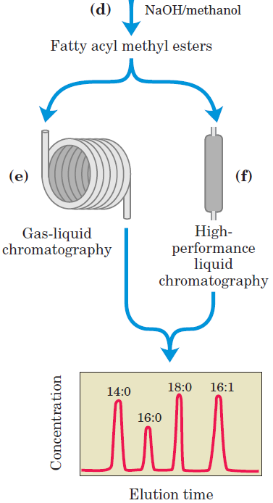
4. Lipid Treatment for 2D-fractionation
Fractionated Lipids

Slide 50
4A. Gas-Liquid Chromatography (TLC)
Gas-liquid chromatography separates volatile components of a mixture:
A. According to their relative tendencies to dissolve in the inert material packed in the column
B. And to volatilize and move through the column via a stream of inert gas such as helium
Some lipids are naturally volatile
Others have to be derivatized to increase their volatility
- Fatty acids in phospholipids are heated in methanol/HCl or methanol/NaOH to yield fatty acyl methyl esters.

Slide 51
5. Specific Hydrolysis Aids in Determination of Lipid Structure
Certain classes of lipids are susceptible to degradation under specific conditions.
Mild acid or base treatment
Treatment with specific hydrolysis enzymes
Following hydrolysis, the degradation products can be fractionated by chromatographic techniques.
The resulting purified products can be analyzed to determine lipid structure by NMR and mass spectrometry.

Slide 52
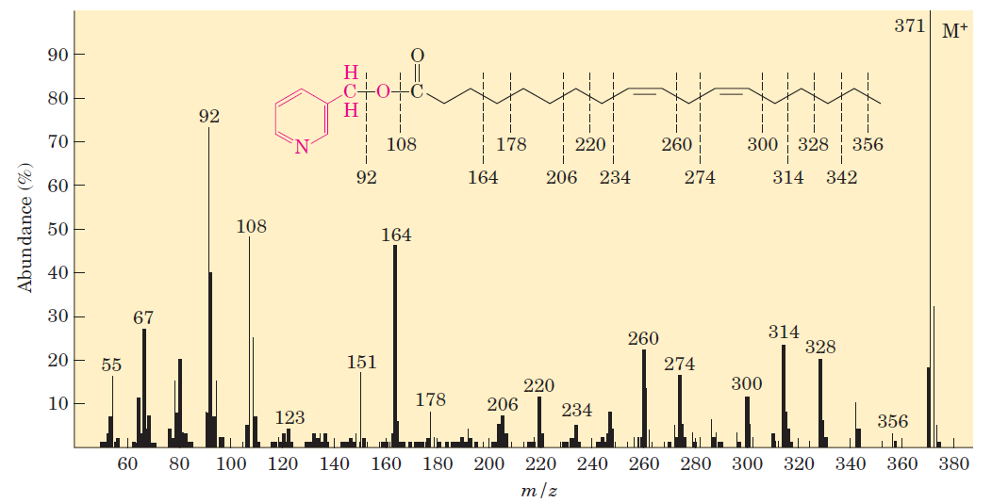
4. Lipid Mass Spectrometry
Base
Peak
MS can be taken of fractionated lipids.
MS can tell you the MW of the lipid (Base Peak).
Unique pattern of fragmentation can tell you the length of a hydrocarbon chain or the position of double bonds.

Slide 53
Happy Easter!!!!

