Slide 1
Continuation of Membrane Dynamics
And
Introduction to
Membrane Interaction and Transport
Chapter 11 (Page 383-398)

Slide 2
Membrane Dynamics

Slide 3
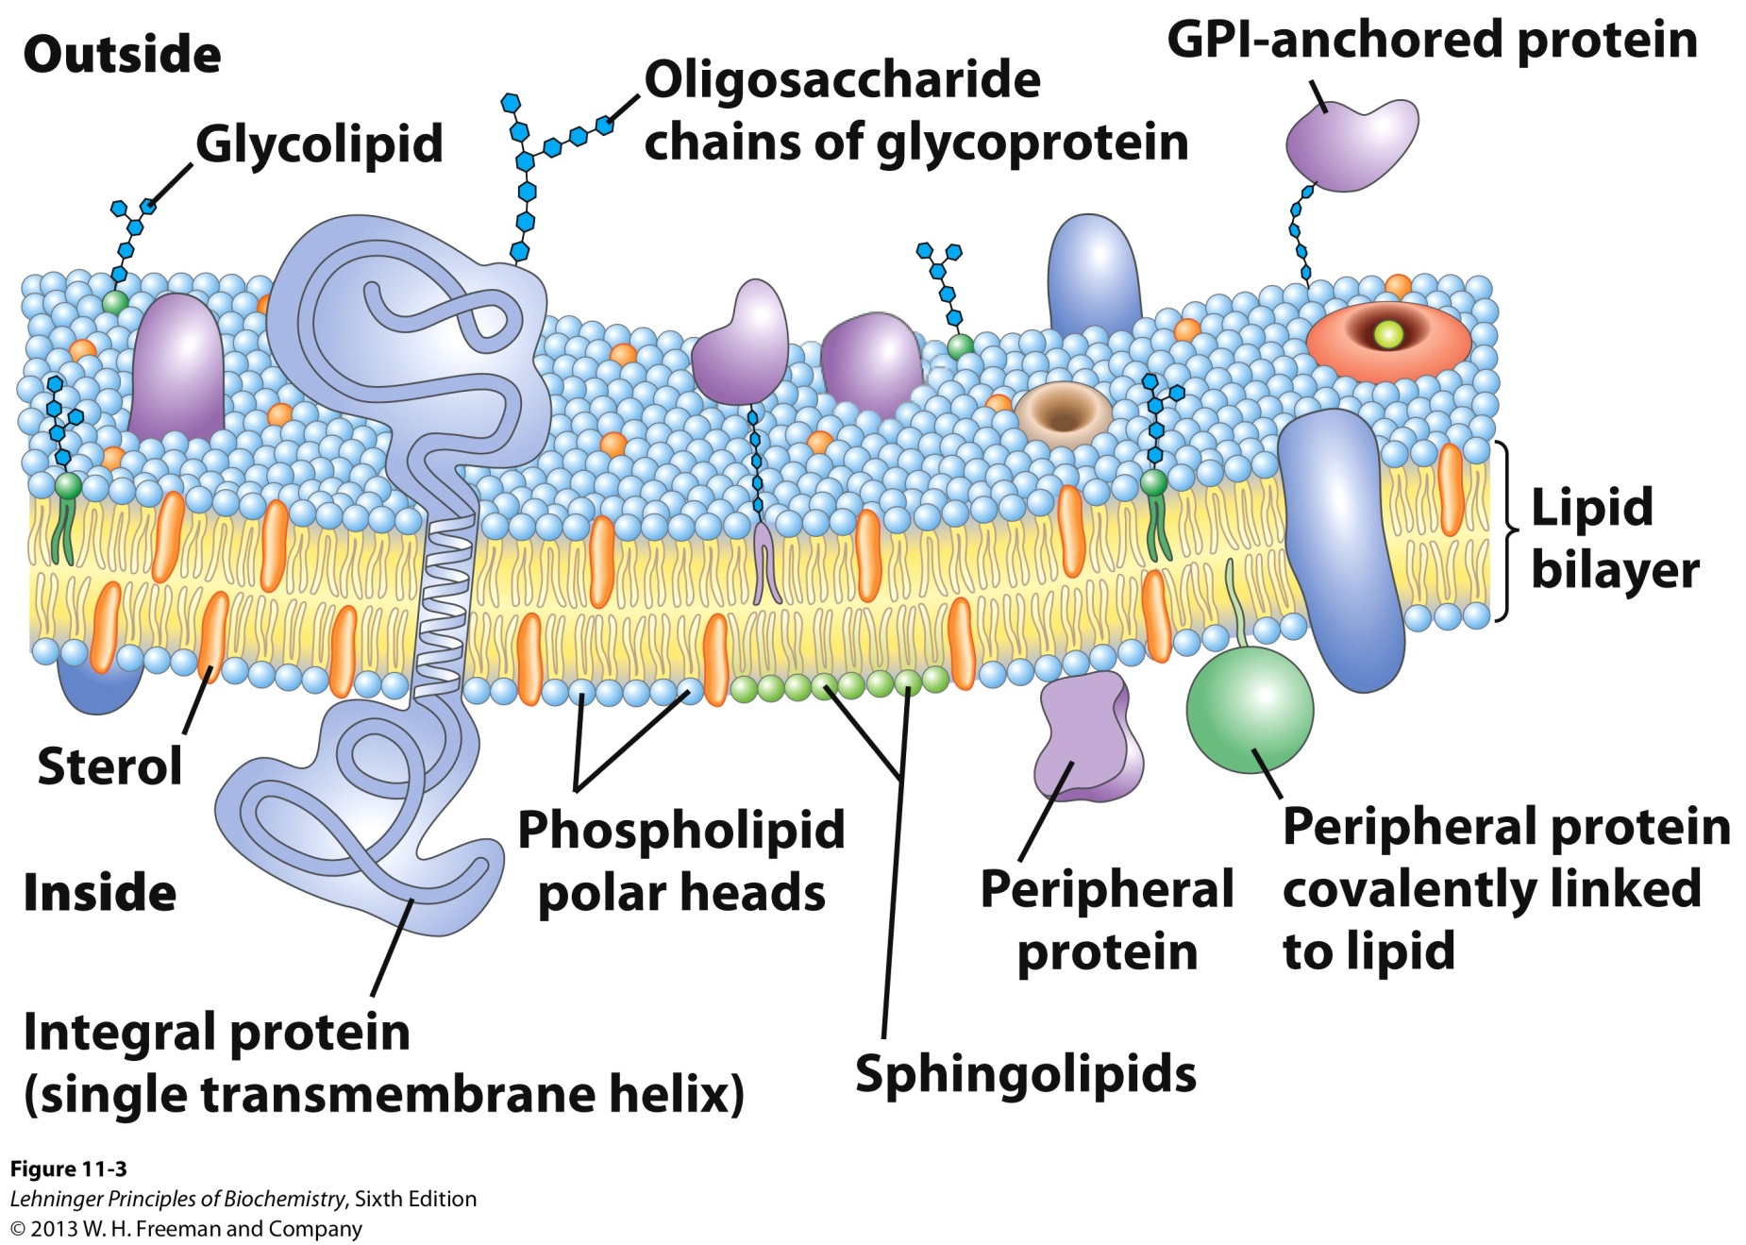
1. Fluid Mosaic Model of Membranes
Membrane mosaic is fluid because the noncovalent interactions enable the molecules to freely move laterally.

Slide 4
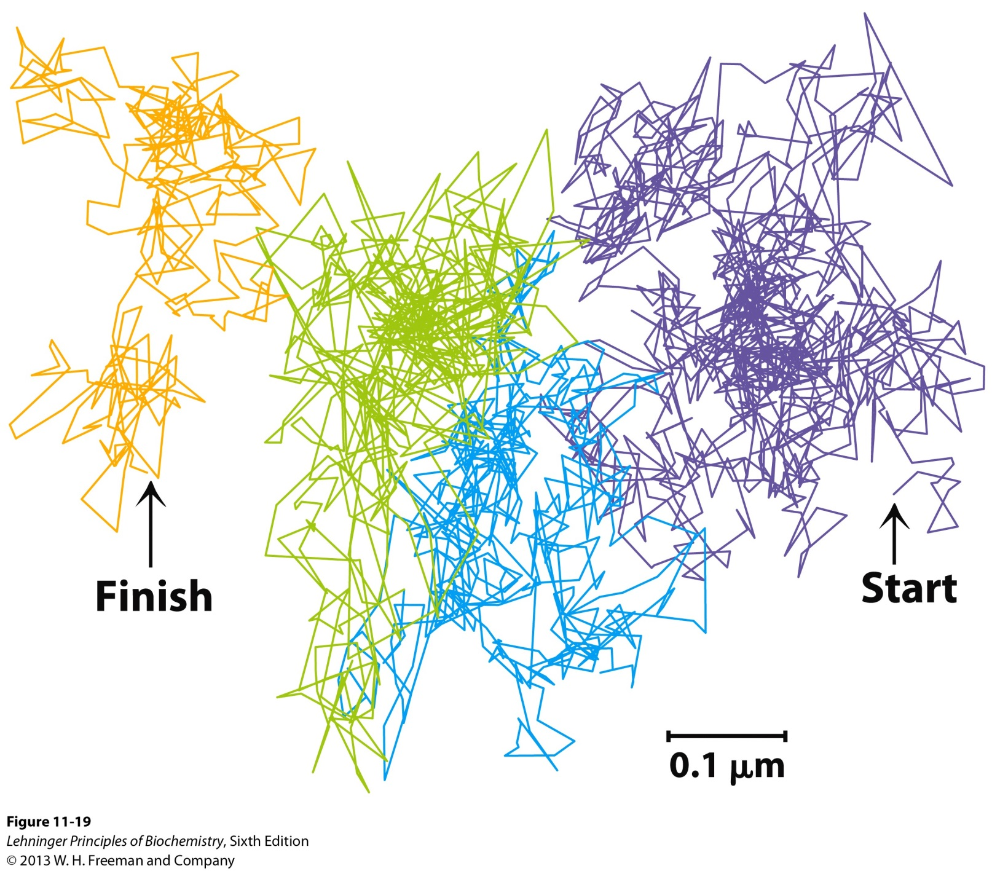
2. Single Particle Tracking of a Lipid by Fluoresence
Movement of a single lipid in 56 ms.
Notes:
 helices and β barrels

Slide 5
2. Single Particle Tracking of a Lipid by Fluoresence
The pattern of movement indicates rapid diffusion within confined regions.
There are occasional hops into an adjoining regions which suggest that lipids are corralled by “molecular fences.”
What are these “molecular fences”?
Notes:
 helices and β barrels

Slide 6
3. Membrane Protein Motion
FRAP studies show that membrane proteins, membrane lipids, are free to diffuse laterally in the plane of the bilayer and are in constant motion.
Some membrane proteins associate to form large aggregates on the surface of a cell or organelle in which individual protein molecules do not move relative to one another.
Acetylcholine receptors on neuron plasma membrane
Notes:
 helices and β barrels

Slide 7
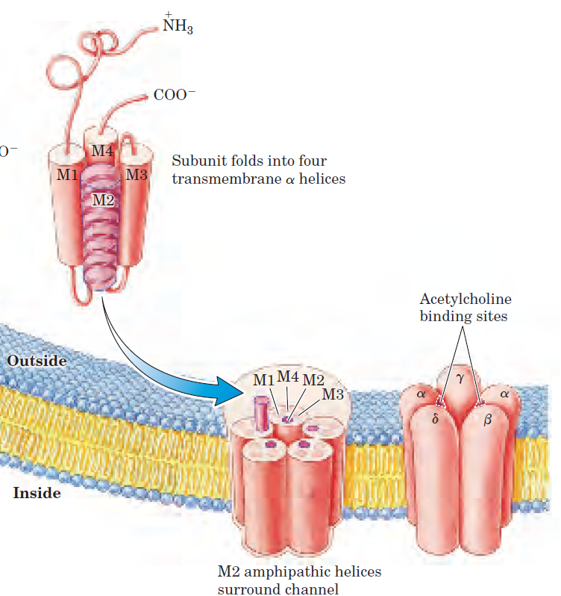
3. Membrane Protein Motion
Acetylcholine receptors on neuron plasma membrane
The receptors consist of five subunits (₂βγδ).
Each subunit has four transmembrane  helices (M1 to M4).
M2 is amphiphatic and the others are hydrophobic. The amphiphaticity is important for subunit arrangement.
Notes:
 helices and β barrels

Slide 8
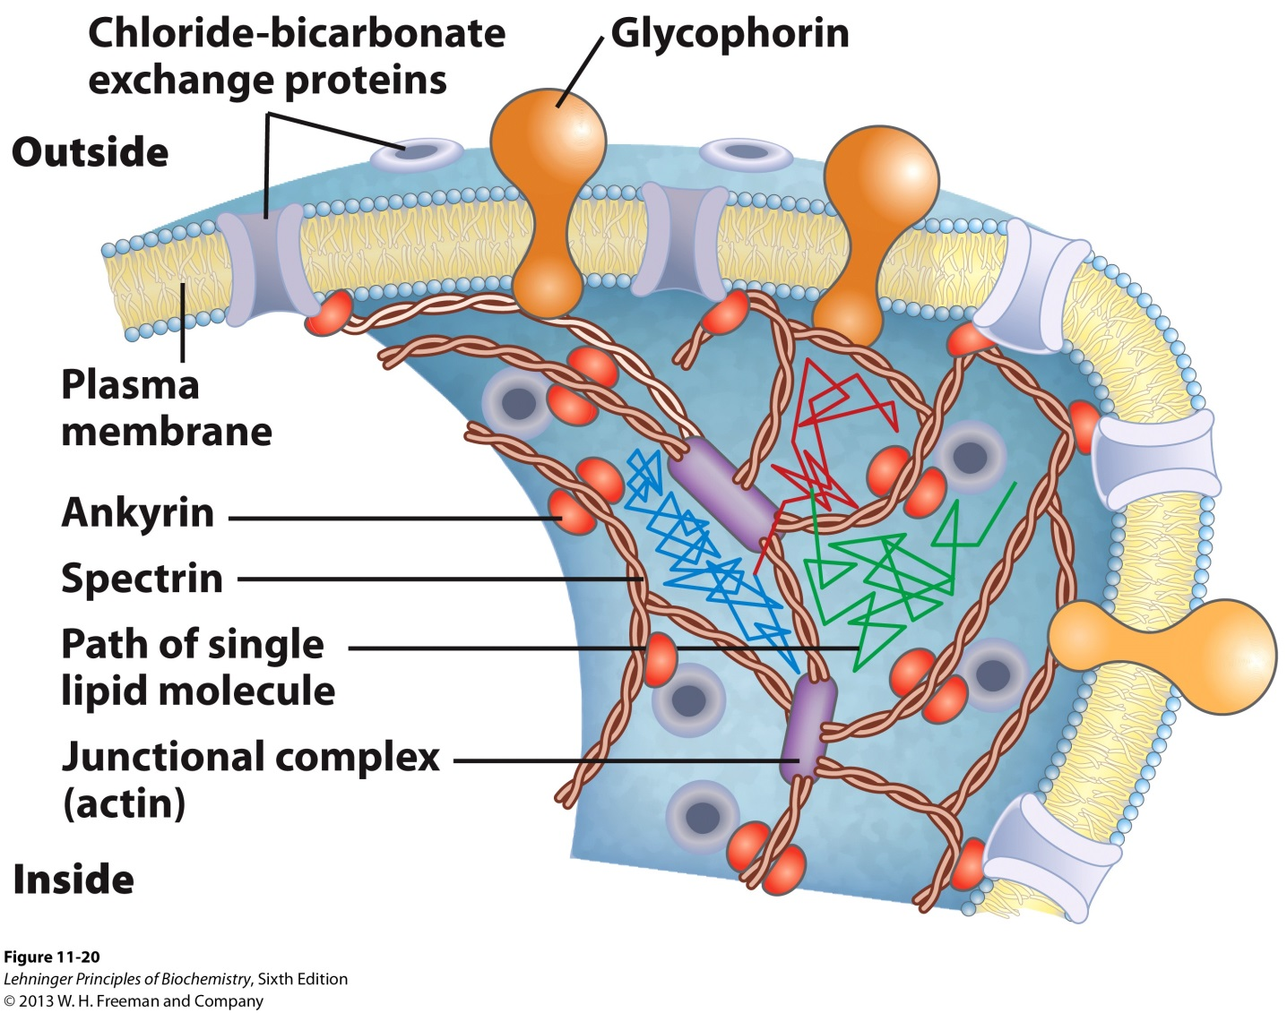
3. Membrane Protein Motion
C. Other membrane proteins are anchored to internal structures that prevent their free diffusion.
Glycophorin and chloride-bicarbonate exchanger are tethered to spectrin, a filamentous cytoskeletal protein.
Notes:
 helices and β barrels

Slide 9
4. Lipid Distribution within a Single Leaflet is NOT Random
Lipids can exist in microdomains.
Glycosphingolipids (cerebrosides and gangliosides; long-chain saturated fatty acids) form transient clusters in the outer leaflet that exclude glycerophospholipids (one unsaturated fatty acyl group and shorter saturated acyl group).
Sphingolipids also form microdomains with cholesterol (outer leaflet of plasma membrane) due to more stable associations with the long ring system of cholesterol.
- These microdomains are slightly thicker and more ordered than those rich in phospholipids.
Notes:
 helices and β barrels

Slide 10
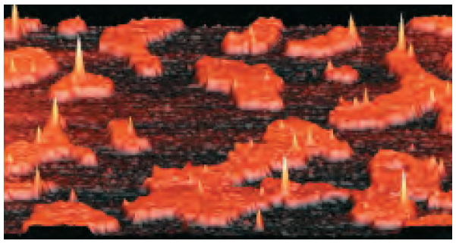
4. Lipid Distribution within a Single Leaflet is NOT Random
Difficult to dissolve with nonionic detergents.
Can be thought of as “liquid-ordered sphingolipid rafts adrift on an ocean of liquid-disordered phospholipids.”
Lipid (Membrane) rafts.
Notes:
 helices and β barrels

Slide 11
5. Membrane Rafts are Enriched in Two Classes of Integral Membrane Proteins
Membrane proteins covalently anchored to the membrane via long-chain saturated fatty acids.
Palmitoyl group (16:0)
Myristoyl group (14:0)
Doubly or triply acylated with the same group or a mixture of both
GPI-anchored proteins.
These anchors may form more stable associations with cholesterol-sphingolipid microdomains than with phospholipids.
Notes:
 helices and β barrels

Slide 12
6. Membrane Rafts can alter Membrane Structure
Caveolin is an integral membrane protein that forms a special class of membrane rafts.
Caveolins have two globular domains each connected to the membrane (cytoplasmic leaflet) by a hairpin-shaped hydrophobic domain.
Also attached via 3 palmitoyl groups of the carboxyl-terminal globular domain.
The proteins bind cholesterol in the membrane.
Notes:
 helices and β barrels

Slide 13
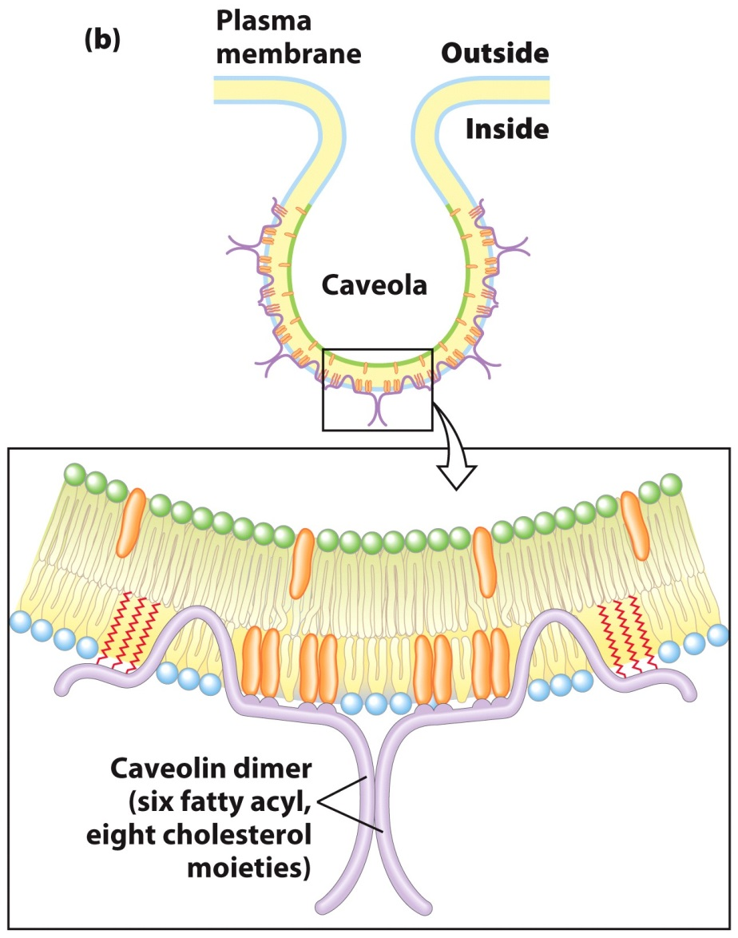
6. Membrane Rafts can alter Membrane Structure
Caveolin forces the associated lipid bilayer to curve inward, forming caveolae (“little caves”) in the surface of the cell.
cholesterol-sphingolipid microdomains on outer leaflet
Notes:
 helices and β barrels

Slide 14
6. Membrane Rafts are Quite Abundant but Transient
Abundance
The cell surface can be occupied with as much as 50% rafts.
Time-scale
Membrane proteins move in and out of rafts on a time-scale of seconds.
Rafts exist on a µs time scale, which is relevant to membrane-mediated biochemical processes.
Important for biological effect
Concentrated/localized interaction between 2 membrane proteins such as a receptor and a signaling protein.
Notes:
 helices and β barrels

Slide 15
Membrane Interactions

Slide 16
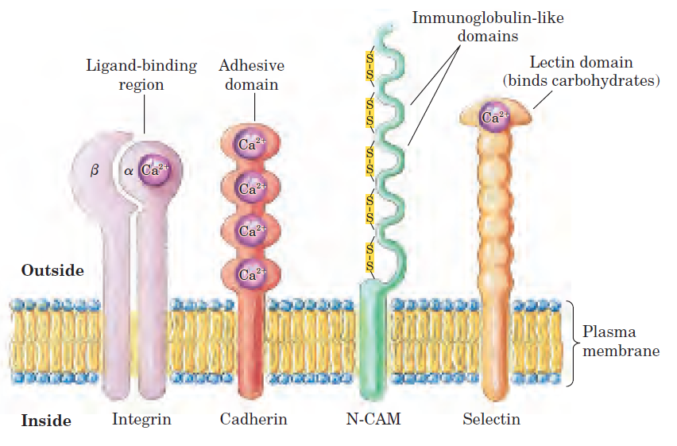
1. Integral Proteins Mediate Cell-Cell Interactions and Adhesion
Several families of integral proteins in the plasma membrane provide specific points of attachment via their extracellular domains between cells, or between a cell and extracellular matrix proteins.
Integrins
Cadherins
Immunoglobulin-like proteins
Selectins
Notes:
 helices and β barrels

Slide 17
1. Integral Proteins Mediate Cell-Cell Interactions and Adhesion
Integrins
Heterodimeric proteins
Made of  and β subunits
Each subunit is anchored to the plasma membrane by a single hydrophobic transmembrane helix
The extracellular domains combine to form a binding site for divalent ions (Ca²⁺), extracellular matrix proteins (collagen and fibronectin), or for specific surface proteins of other cells.
Binding site sequence is Arg-Gly-Asp
Notes:
 helices and β barrels

Slide 18
1. Integral Proteins Mediate Cell-Cell Interactions and Adhesion
Roles played
Adhesives
Receptors
Signal transducers
Regulation of many processes
Tissue repair
Tissue defense
B. Cadherins
Four extracellular Ca²⁺ binding domains
Undergo homophilic (“with same kind”) interactions with identical cadherins in an adjacent cell
- Binding occurs at most distal Ca²⁺ binding domain
Notes:
 helices and β barrels

Slide 19
1. Integral Proteins Mediate Cell-Cell Interactions and Adhesion
C. Immunoglobulin-like proteins
Undergo Ca²⁺ independent interactions
Homophilic interactions
Heterophilic interactions with an integrin
D. Selectins (A type of lectin)
Bind tightly to carbohydrate moieties in neighboring cells in a Ca²⁺ dependent manner
Found in various types of blood cells and endothelial cells lining blood vessels
Participate in blood-clotting

Slide 20
2. Membrane Fusion
Membranes are very stable but are NOT static. They undergo fusion, which is central to many biological processes.
Fusion occurs between two membranes without loss of membrane continuity.
The process can be spontaneous or protein-mediated via integral proteins called fusion proteins.

Slide 21
2I. General Steps for Membrane Fusion
Two membranes recognize one another.
The surfaces become closely apposed resulting in loss of water molecules that interact with the polar head groups of lipids.
The bilayer structures become locally disrupted, resulting in fusion of the outer leaflet of each membrane (hemifusion)
The bilayers fuse to form a single continuous layer
For receptor-mediated endocytosis or regulated secretion::
5. The fusion process is triggered at the appropriate time or in response to a specific signal.

Slide 22
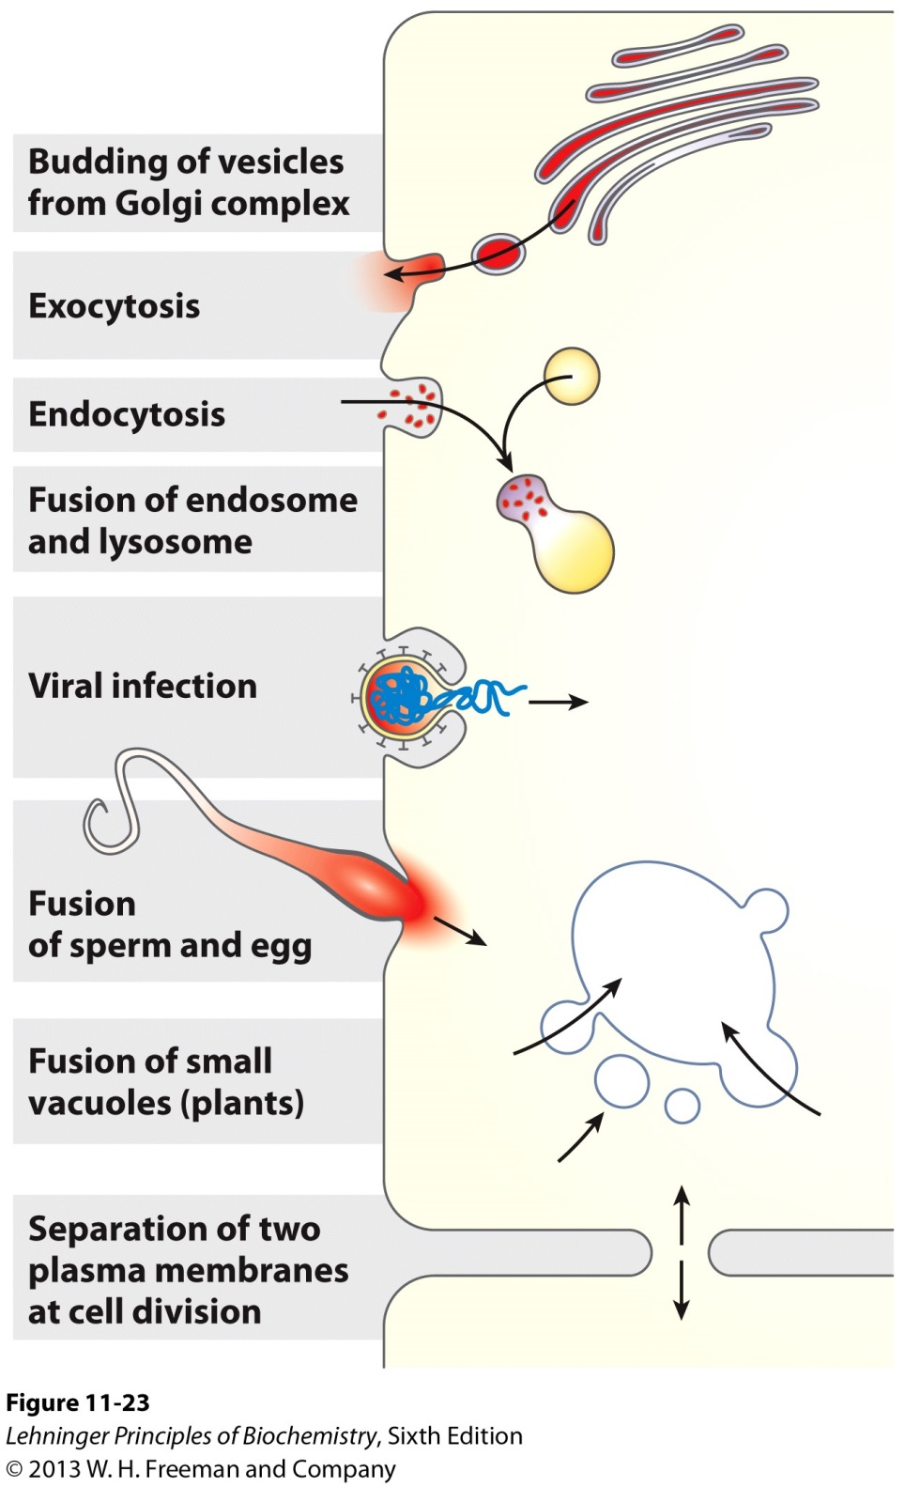
2II. Examples of Membrane Fusion

Slide 23
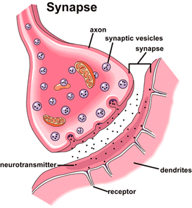
2III. Nerve Cell Communication
Nerve cells communicate with one another via structures called axons and dendrites.
Axons transmit information (neurotransmitter; presynaptic neuron) using exocytosis.
Dendrites receive information (postsynaptic neuron) via receptors.
The apposition of an axon from one nerve cell and a dendrite from another nerve cell creates a structure called the synapse.
http://scienceblogs.com/purepedantry/2007/03/06/neuron-to-glia-synapse-on-axon/

Slide 24
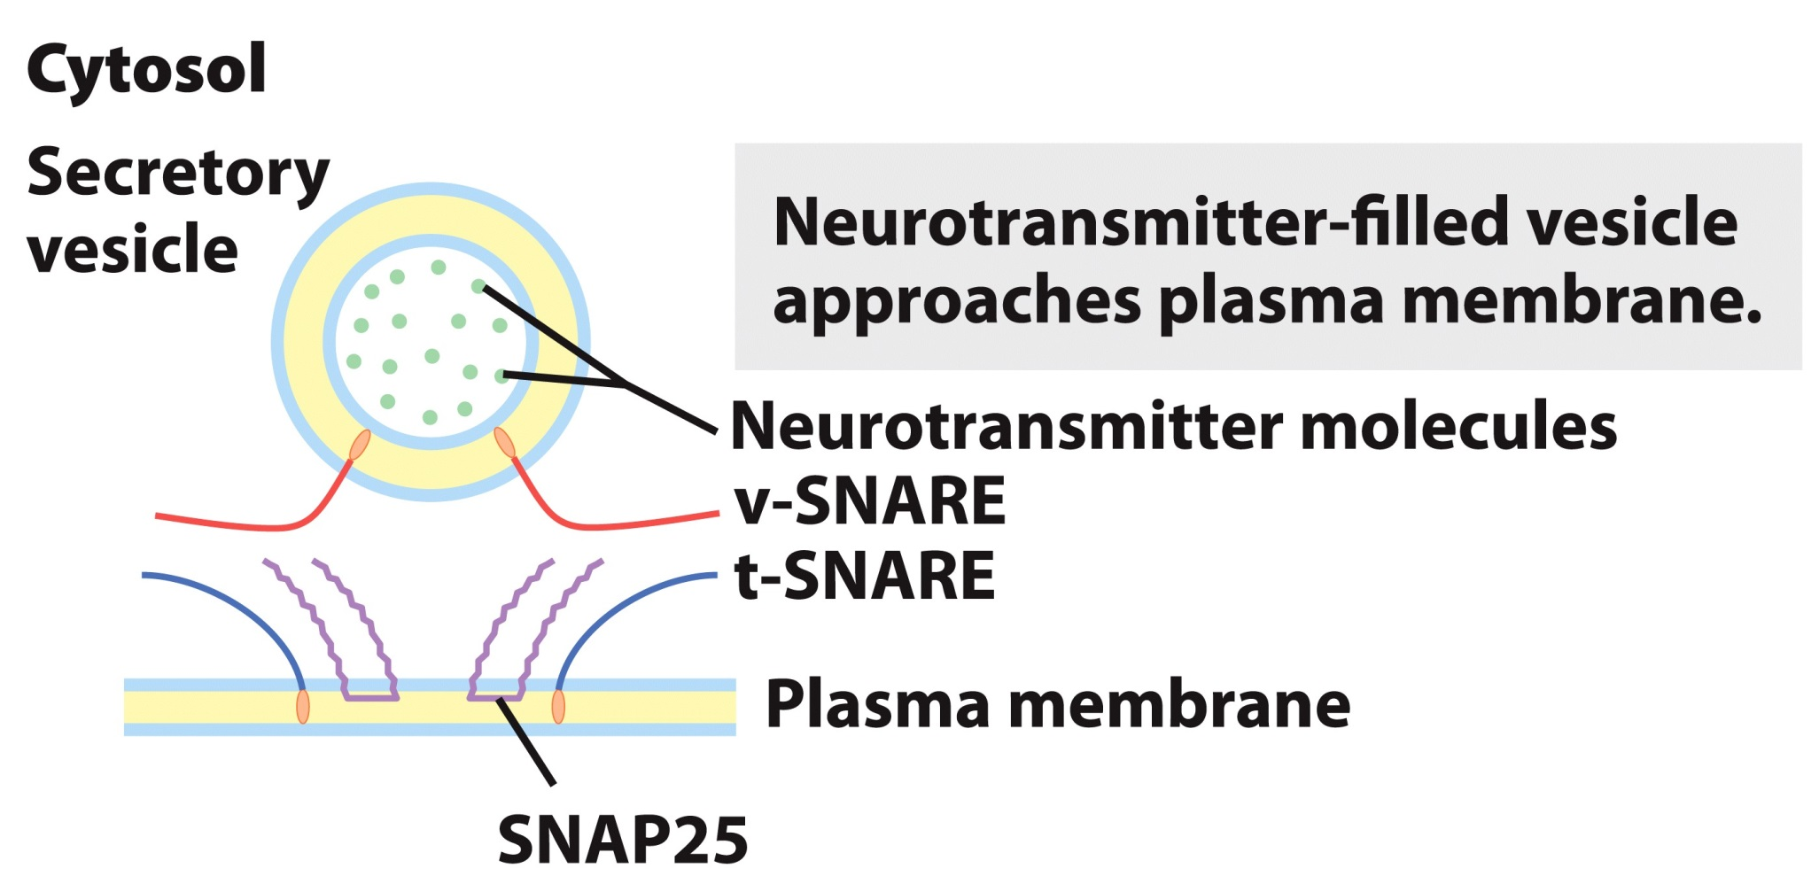
2III. Neurotransmitter Release aided by Fusion Proteins: Step 1
The secretory vesicle membrane contains the v-SNARE synaptobrevin (red).
The target (plasma) membrane contains the t-SNAREs syntaxin (blue) and SNAP25 (violet).

Slide 25
2III. Neurotransmitter Release aided by Fusion Proteins: Step 2
When a local increase in [Ca²⁺] signals release of neurotransmitter, the v-SNARE, SNAP25, and t-SNARE interact, forming a coiled bundle of four α helices.

Slide 26
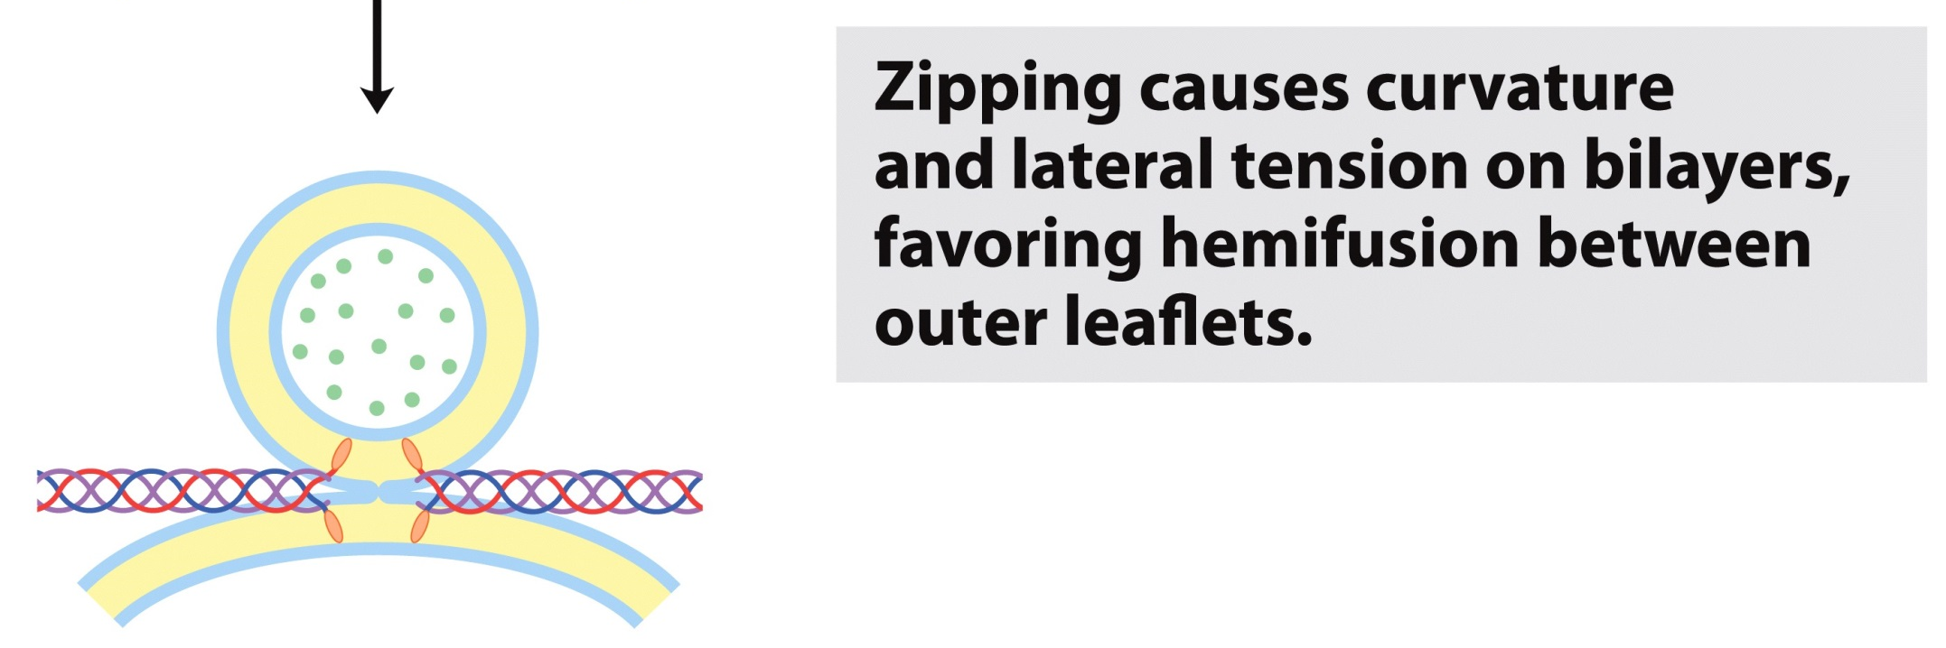
2III. Neurotransmitter Release aided by Fusion Proteins: Step 3 and 4
The bilayers are locally disrupted.

Slide 27
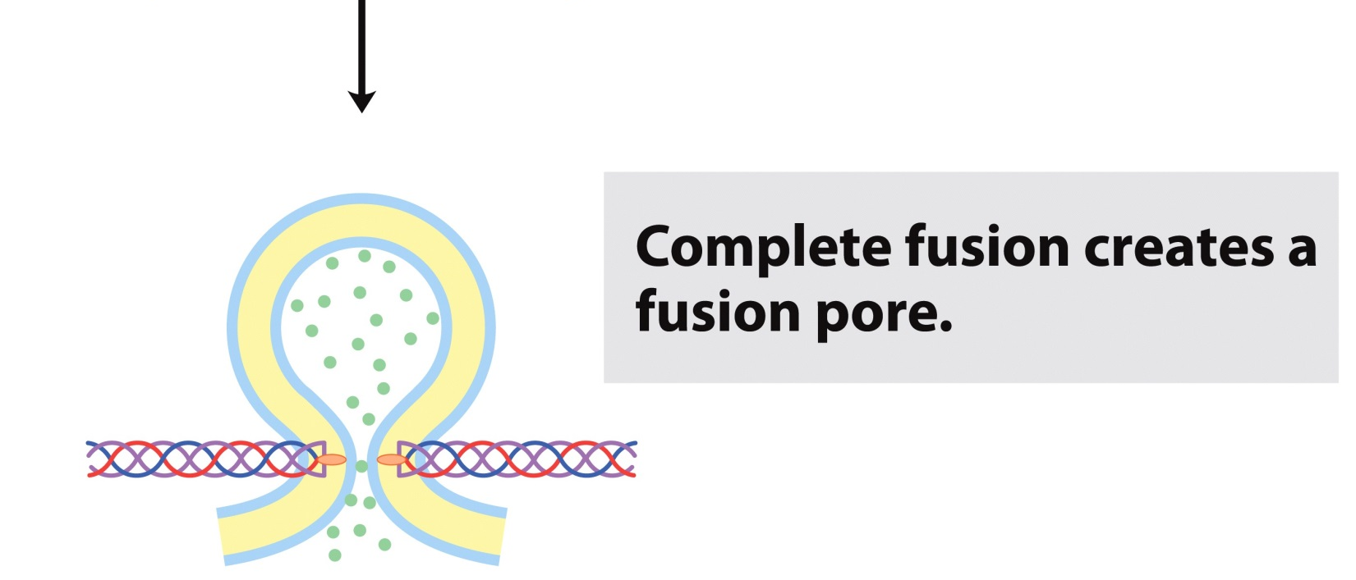
2III. Neurotransmitter Release aided by Fusion Proteins: Step 5 and 6

Slide 28
Membrane Transport

Slide 29
1. The Cell is Selectively Permeable
All living cells interact with their surroundings by transporting solutes in and out as needed for biosynthesis and metabolism. The transport process is restricted by the physical and chemical properties of the solutes.
Four main factors govern cell permeability:
Size
Hydrophobicity
Charge
Concentration

Slide 30
2. General Table for Solute Permeability
Solute | MW (g/mol) | Examples | Permeable
Nonpolar Molecules | * | CO₂ | Yes
Small, uncharged polar molecules | < 100 | Urea, water, ethanol | Yes
Large, uncharged polar molecules | >100 | Glucose | No
Charged polar molecules |  | ATP | No
Ions |  | K⁺, HCO₃⁻ | No
* Size limitations for nonpolar molecules can vary but generally: ↑ MW, ↓ Permeability
In drug design, people aim to synthesize cell-permeable compounds that are ≤ 500 g/mol.
Leeson P.D. & Springthorpe, B. The influence of drug-like concepts on decision-making in medicinal chemistry. Nat. Rev. Drug Discov. 6 : 881–90, 2007.
Notes:
The permeability of membranes can be increased with chemical agents or if a cell is cancerous.

Slide 31
3. Two General Routes for Membrane Transport
Passive Transport
Simple diffusion (In direction of chemical gradient)
Applicable to nonpolar molecules and small polar molecules
Diffusion in direction of electrochemical gradient
Applicable to polar molecules and ions
Membrane protein facilitated
Active Transport
Diffusion against the electrochemical gradient
Membrane protein facilitated

Slide 32
3A. Passive Transport
In accordance with the 2nd Law of Thermodynamics, molecules tend to spontaneously assume the distribution of greatest randomness and lowest energy.

Slide 33
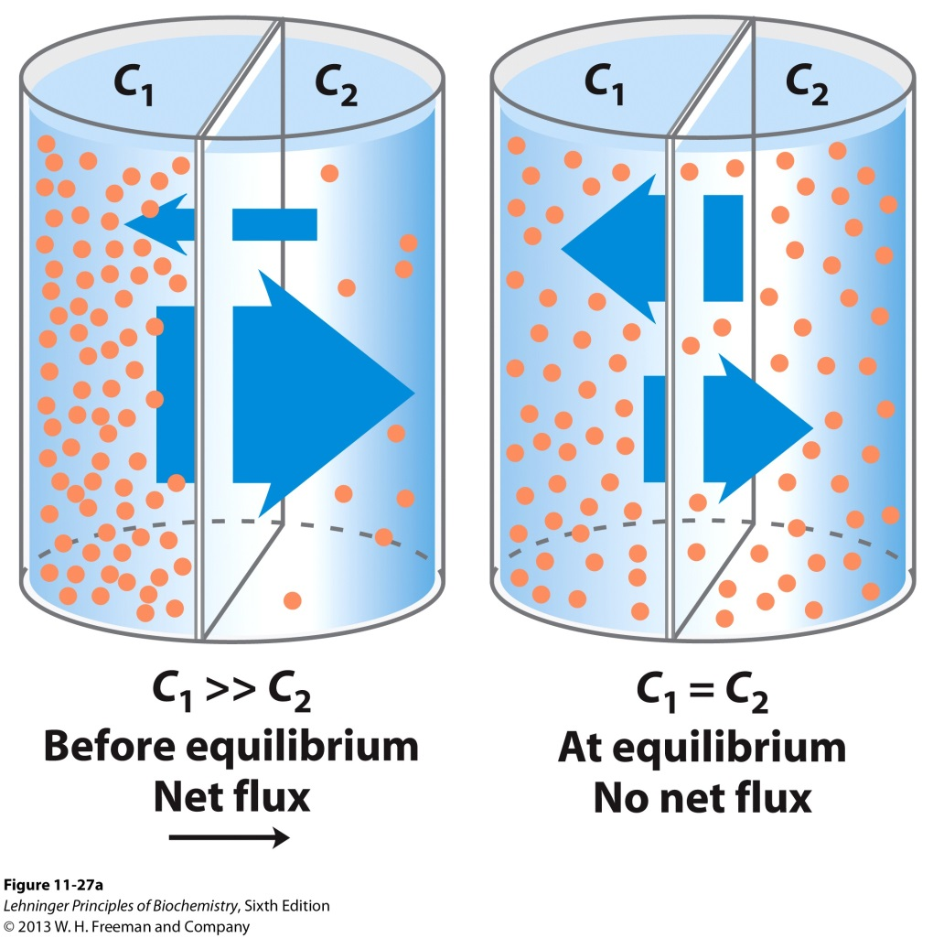
3A. Passive Transport
Simple Diffusion- Net movement of electrically neutral solutes across a plasma membrane toward the side of lower solute concentration until equilibrium is achieved. This is movement in the direction of the chemical gradient.

Slide 34
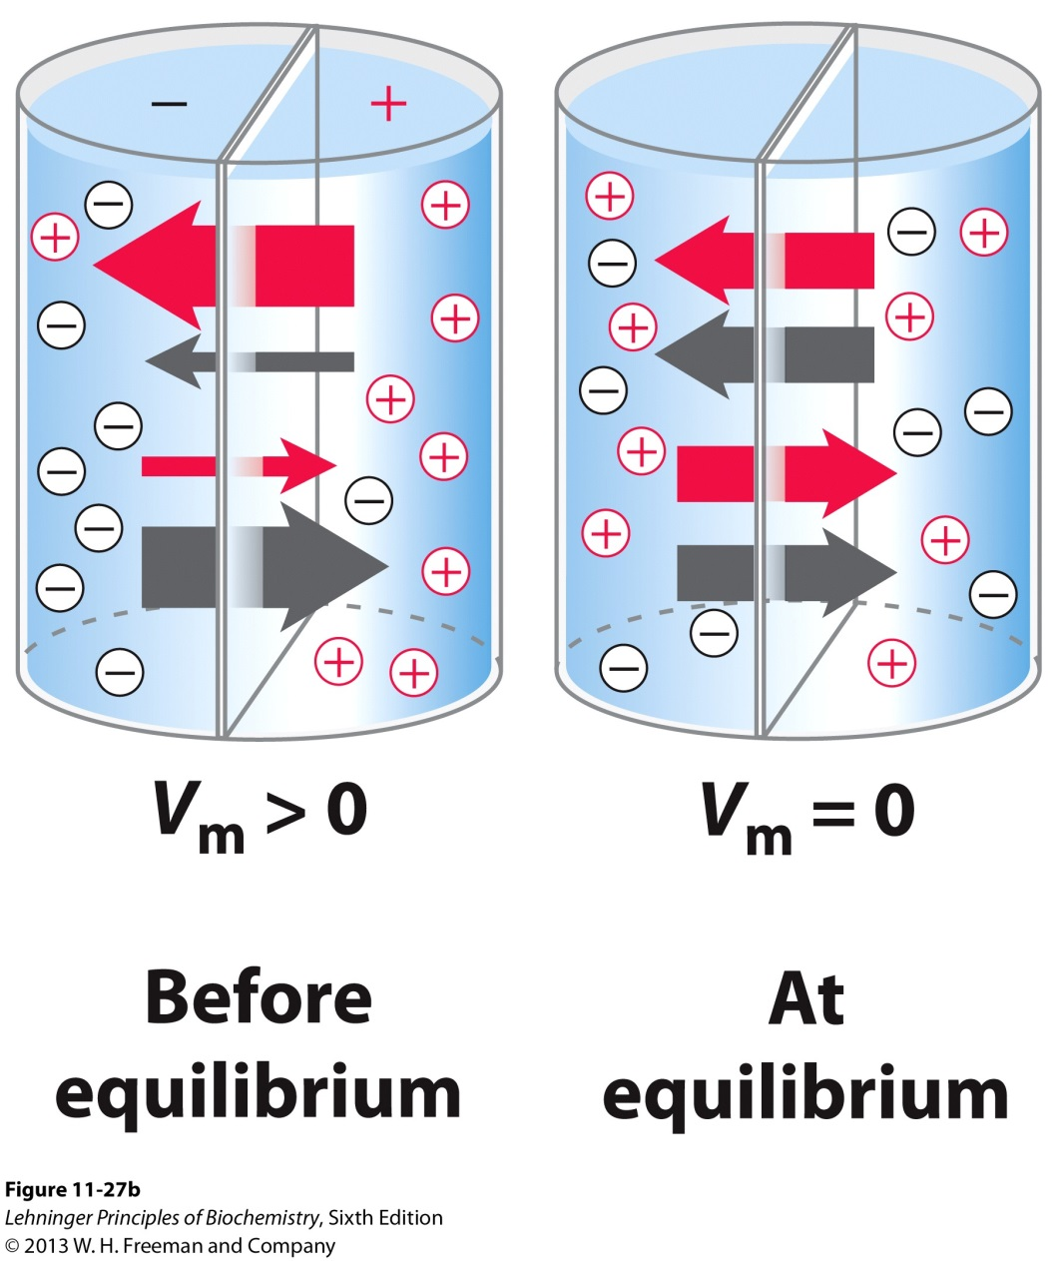
3A. Passive Transport
Electrochemical Gradient Directed Diffusion- Net movement of electrically charged solutes is dictated by a combination of the electrical potential (V_{m}) and the chemical concentration difference across the membrane.
Electrochemical potential reaches zero at equilibrium.

Slide 35
3B. Passive Transport in Contrast to Active Transport
In passive transport, the transported species always moves down its electrochemical gradient and is not accumulated above the equilibrium concentration.
In active transport, the transported species always moves against its electrochemical gradient and is accumulated above the equilibrium concentration.
Active transport is thermodynamically unfavorable (endergonic ΔG > 0) and takes place only when coupled (directly or indirectly) to an exergonic process such as
Breakdown of ATP
The concomitant flow of some other chemical species down its electrochemical gradient.

Slide 36
3C. Transport of a Polar or Charged Solute
To pass through a lipid bilayer, a polar or charged solute must:
1st- Give up its interactions with the water molecules in its hydration shell.
2nd- Diffuse 3 to 10 nm through a nonpolar solvent in which it is poorly soluble.
High Energy Intermediate State

Slide 37
3C. Transport of a Polar or Charged Solute
There are membrane proteins that facilitate this diffusion called transporters or permeases (enzymes but not in the traditional sense) in the direction of or against the electrochemical gradient.
Provide a polar/charged environment with a lower energy intermediate state.
Lower Energy Intermediate State

Slide 38
3C. Transport of a Polar or Charged Solute

Slide 39
3C. Transport of a Polar or Charged Solute
ΔG╪_{transport} < ΔG╪_{simple diffusion}
Because the ΔG_{binding} for polar/charged solute binding to transporter is negative as a result of cumulative weak interactions and compensates partly for the positive ΔG_{dehydration .}
ΔG’° = 0

Slide 40
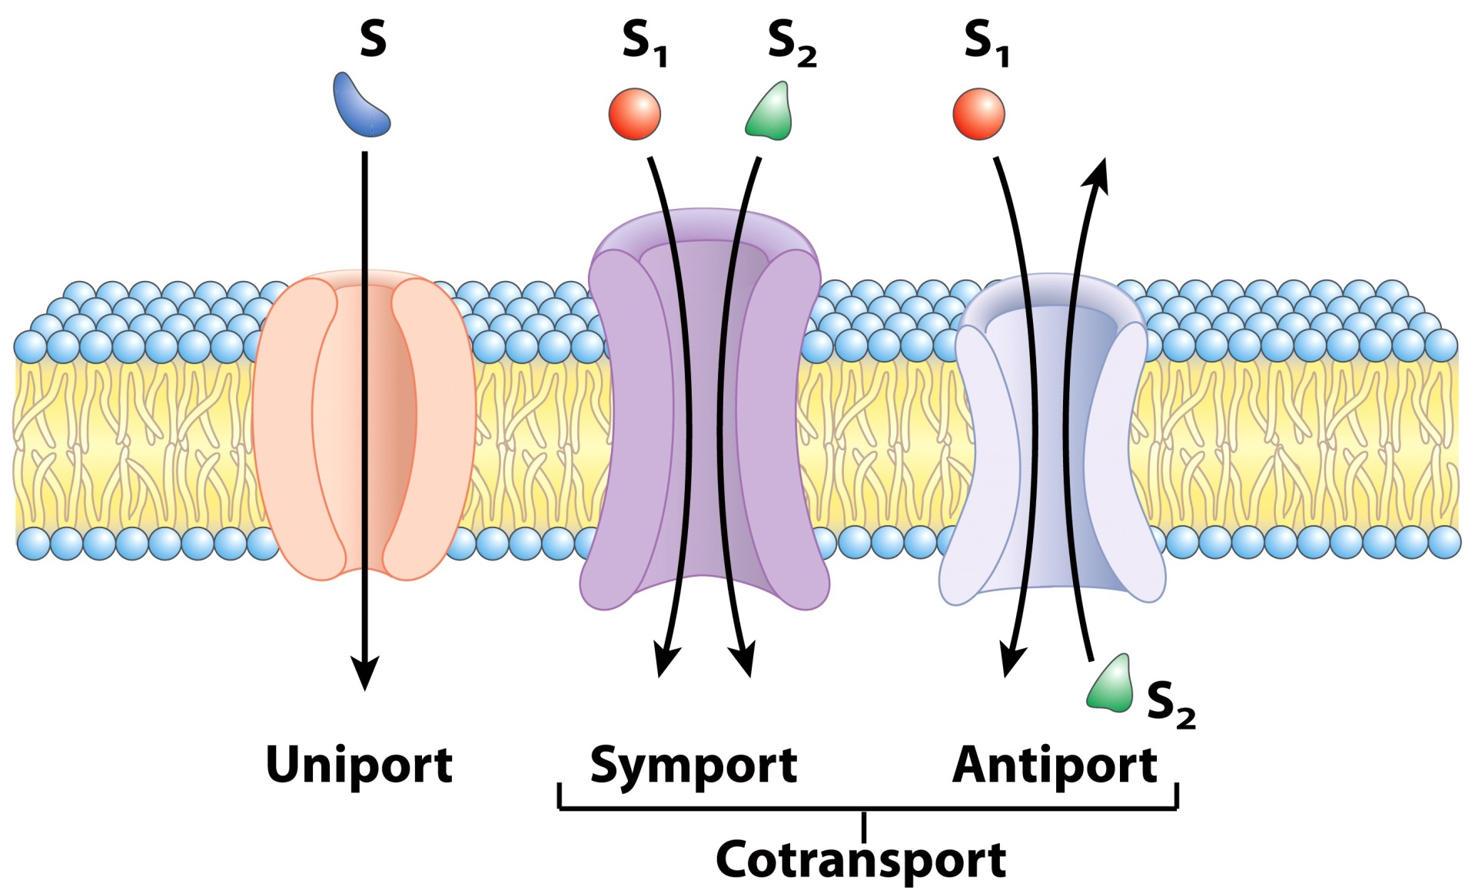
3D. Transporters Classified by Solutes (Substrates) and Directionality
The directionality can be with or against the electrochemical gradient and so transporters can facilitate both passive and active transport.

Slide 41
3E. Active Transport
In primary active transport, the energy released by ATP hydrolysis (for example) drives solute movement against an electrochemical gradient, which is an endergonic process.

Slide 42
3E. Active Transport
In secondary active transport, a gradient of ion X has been established by primary active transport. Movement of X down its electrochemical gradient now provides the energy to drive cotransport of a second solute (S) against its electrochemical gradient.

Slide 43
3F. Free-energy Change for transport (ΔG_{t})
The amount of energy needed for the transport of a solute against a gradient can be calculated from the initial concentration gradient. The general equation for the free-energy change in the chemical process that converts S to P is
ΔG = ΔG’° + RT ln [P]/[S]
where R = 8.315 J/mol· K and T is in K.
Because S is not actually converted into a product P,
ΔG’° = 0; ΔG_{t} = RT ln C₂/C₁
C₁ is the concentration from starting region C₂ is the concentration at the final region.

Slide 44
3F. Free-energy Change for transport (ΔG_{t})
ΔG’° = 0; ΔG_{t} = RT ln C₂/C₁
If C₁ = C₂/10,
ΔG_{t} = RT ln (10 x C₁)/C₁
ΔG_{t} = 5.7 kJ/mol
ΔG_{t} is positive; Flow against electrochemical gradient
ΔG_{t} is negative; Flow down electrochemical gradient

Slide 45
3F. Free-energy Change for transport (ΔG_{t})
If solute is an ion,
Where = Charge x Faraday Constant x Transmembrane
electrical potential (in Volts)
Faraday constant: 96,480 J/V· mol
Eukaryotic cells have electrical potentials across their plasma membranes of about 0.05 to 0.1 V (with the inside negative relative to the outside)

Slide 46
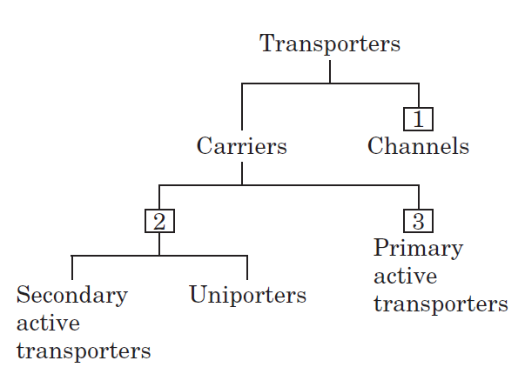
3G. General Classification of Transporters
Carriers
Substrates with high stereospecificity
Catalyze transport at rates below free diffusion limits
Saturable like enzymes
Channels
Not high stereospecificity
Catalyze transfers at rates several orders of magnitude greater than carriers, approaching diffusion limits
Not saturable

Slide 47
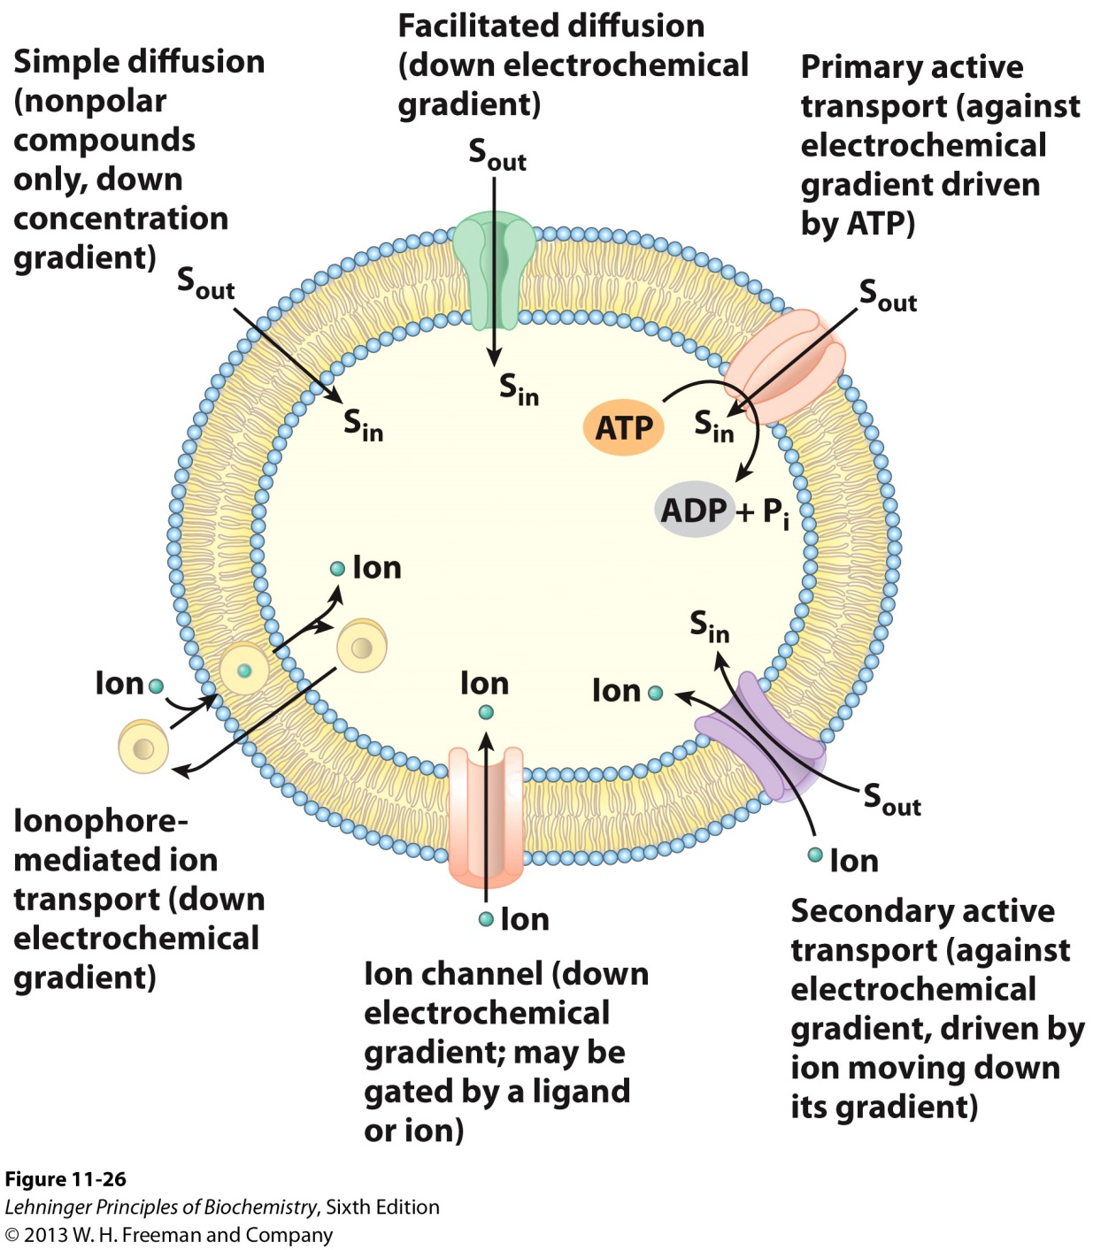
4. Types of Transports

