Slide 1
Biological Membranes
Chapter 11 (Page 369-383)

Slide 2
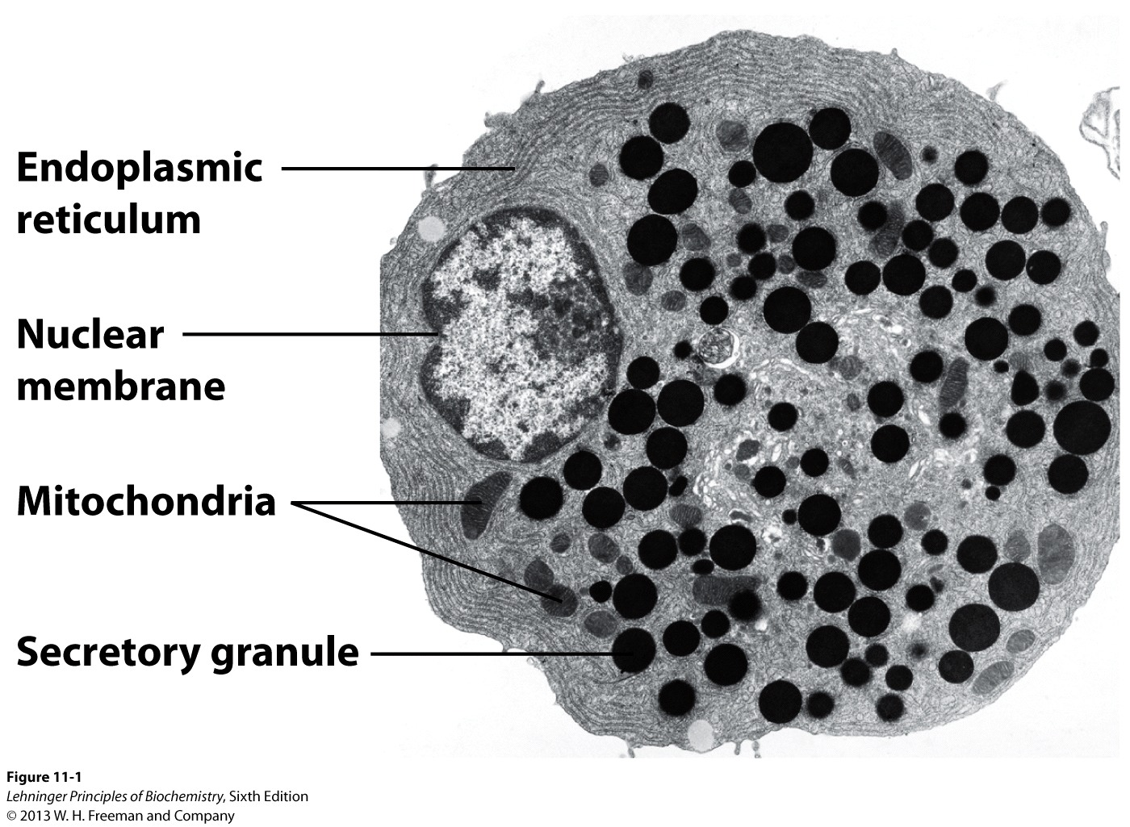
Electron Micrograph of Biological Membranes

Slide 3
1. Biological Membranes
In eukaryotic cells, membranes play many important functions.
Define the external boundaries of cells and regulate the molecular traffic across that boundary.
Divide the internal space into discrete compartments to segregate processes and components.
Aid in cell-to-cell communication and in signaling.
Organize complex reaction sequences and cellular processes.
Energy transduction
Biomolecule synthesis

Slide 4
2. General Physical Properties of Membranes that enable their Biological Activities
Very thin (3 to 10 nm)
Flexible
Self-sealing
Selectively permeable to polar solutes

Slide 5
Lipid-Water Interactions lead to
Cell Formation

Slide 6
1. Lipids Aggregate into Structures in Water
Lipids are typically amphiphatic molecules that are water insoluble. When mixed with water they:
Aggregate in a phase separate from their aqueous surroundings.
The hydrophobic (nonpolar) moieties cluster together to reduce exposure to water.
The hydrophilic (polar) groups interact with the surrounding water.
Greater entropy for these water molecules than at the water-nonpolar moiety interphase.

Slide 7
1. Lipids Aggregate into Structures in Water
Thermodynamically driven by hydrophobic interactions, three types of structure can form that depend on:
Type of lipid
Concentration
Micelle
Bilayer
Liposome

Slide 8
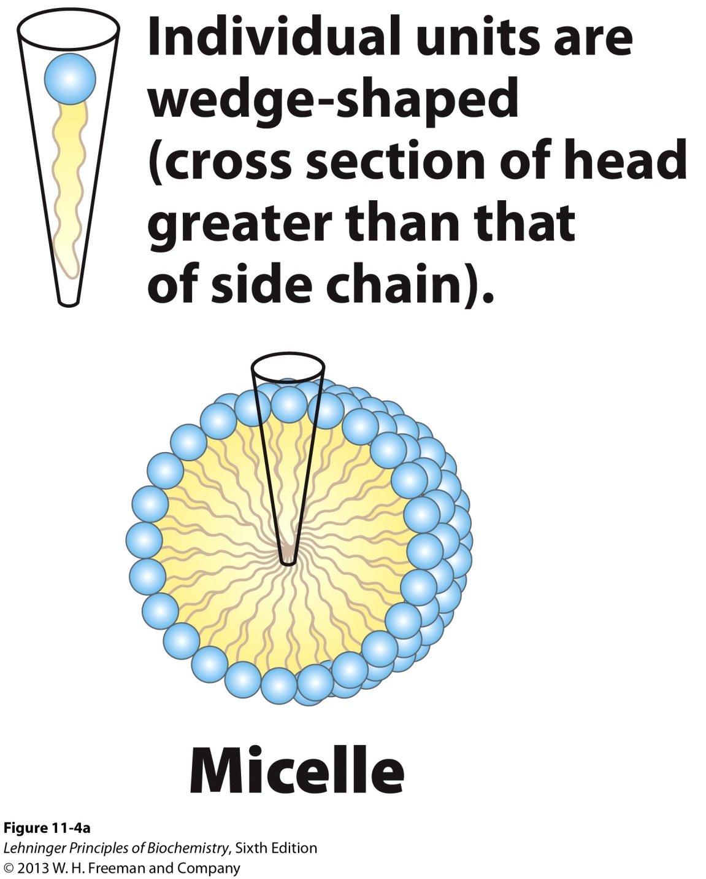
2. Micelle Formation
Hydrophilic exterior interacts with water
Hydrophobic interior; water excluded

Slide 9
2. Micelle Formation
A micelle forms in the solution of amphipathic molecules that have larger polar head than nonpolar tail
Fatty acids
Sodium dodecyl sulfate
Aggregation occurs when the concentration of molecules is higher than a certain threshold
Each micelle has from a few dozen to a few thousand lipid molecules

Slide 10
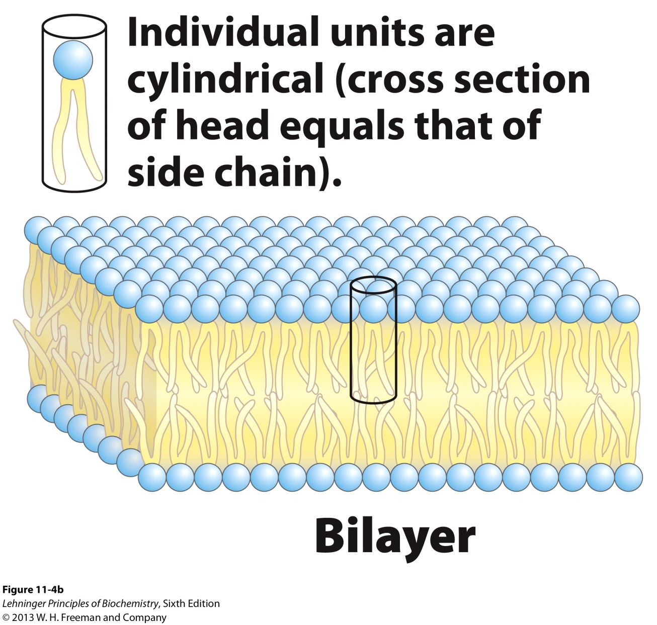
3. Bilayer Formation
Hydrophilic exterior interacts with water
Hydrophobic side transiently interacts with water
Hydrophobic interior; water excluded

Slide 11
3. Bilayer Formation
A bilayer forms when the cross-sectional areas of the head group and nonpolar tail are similar
Glycerophospholipids
Sphingolipids
Because the hydrophobic regions at the edges are transiently in contact with water, the bilayer sheet is unstable

Slide 12
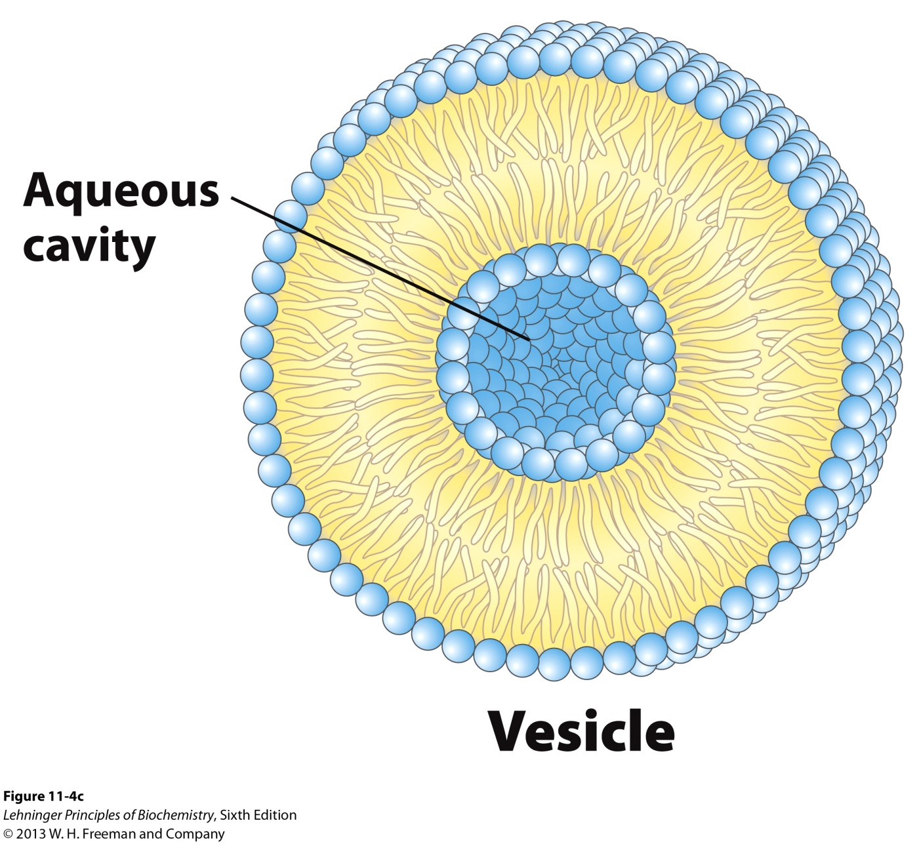
4. Liposome Formation

Slide 13
4. Liposome Formation
A liposome forms by a bilayer spontaneously folding back on itself to form a hollow sphere (a vesicle)
By forming liposomes, bilayers lose their hydrophobic edge regions and achieve maximal stability in their aqueous environment.
A separate aqueous compartment is formed.
Liposomes can be seen as precursors to the 1st living cells.

Slide 14
The Composition of Eukaryotic
Biological Membranes

Slide 15
1. What are Membranes?
Complex lipid-based pliable structures composed of a variety of lipids and proteins.
Some membrane lipids and proteins are glycosylated.
All cells have a cell membrane, which separates the cell from its surrounding.
Eukaryotic cells have various internal membranes (organelles) that divide the internal space into compartments.
- NOTE: Mammalian red blood cells (erythrocytes) do not have organelles.
Why????
Perhaps to make room for hemoglobin.

Slide 16
2. Common Features of Eukaryotic Membranes
A. The membrane of eukaryotic cells consists of two leaflets of lipid-based monolayers:
One leaflet faces the cytoplasm
One leaflet faces the extracellular space or the inside of membrane-enclosed organelle

Slide 17
2. Common Features of Eukaryotic Membranes
B. Sheet-like flexible structure, 3–10 nm thick
C. Structures within the membrane bilayer are stabilized by noncovalent forces, especially hydrophobic ones
D. Membrane bilayers are largely composed of phospholipids.
The polar heads are on the exterior forming a hydrophilic surface.
The fatty acyl chains are in the interior forming a fluid, hydrophobic region.
Other lipids are nestled in between.

Slide 18
2. Common Features of Eukaryotic Membranes
E. Protein molecules span the lipid bilayer
F. Asymmetry
Some lipids are found preferably “inside”
Some lipids are found preferably “outside”
Carbohydrate moieties are always outside the cell
Electrically polarized (inside negative ~ –60mV)
G. Impermeable to polar solutes
Specific transporters allow transport

Slide 19
3. Fluid Mosaic Model of Membranes
The combination of electron microscopy and chemical composition studies, and physical studies of permeability and the motion of individual protein and lipid molecules within the membranes led to the development of the fluid mosaic model (Singer and Nicholson, 1972).
Lipids form a viscous, two-dimensional solvent into which proteins are inserted asymmetrically.
-Membrane sidedness
Integral proteins are firmly associated with the membrane via nonpolar sidegroups, often spanning the bilayer.
- Some have multiple transmembrane domains
Peripheral proteins are weakly associated (noncovalently) and can be removed.

Slide 20
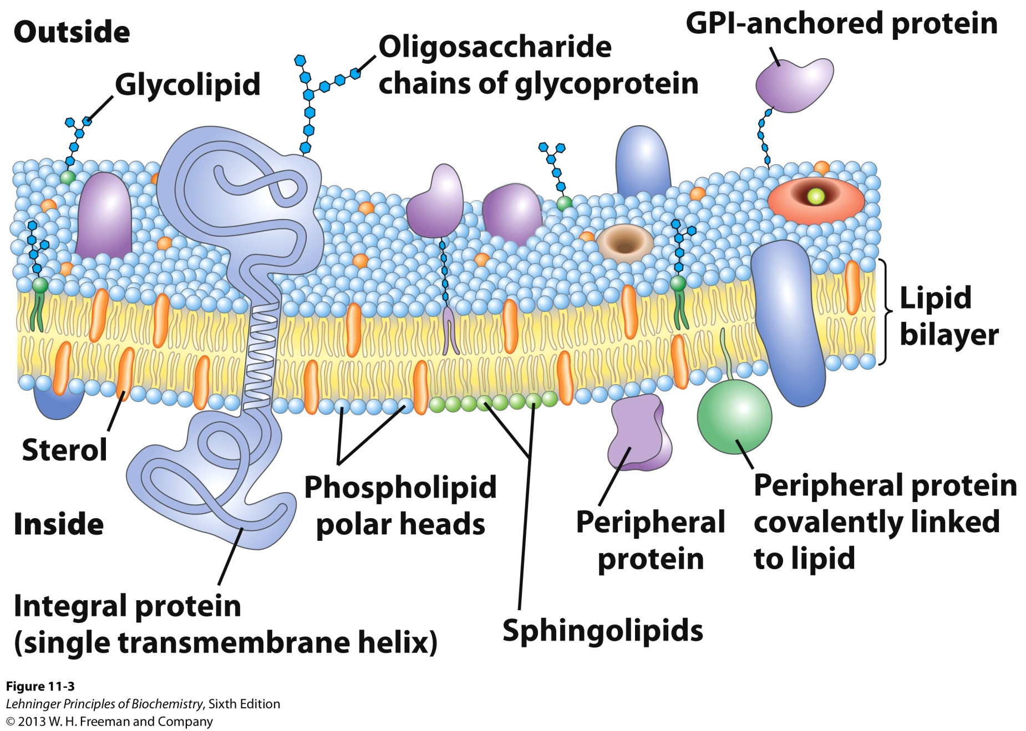
3. Fluid Mosaic Model of Membranes
Membrane mosaic is fluid because the noncovalent interactions enable the molecules to freely move laterally.

Slide 21
4. Composition of Membranes
The composition of membranes is different in:
different organisms, tissues, and organelles
Ratio of lipid to protein varies
Type of lipid varies
Phospholipid and sterol types vary
Galactolipids abundant in plant chloroplasts but almost absent in animals
Type of protein varies
Some membranes have a predominance of only one protein; specialized function

Slide 22
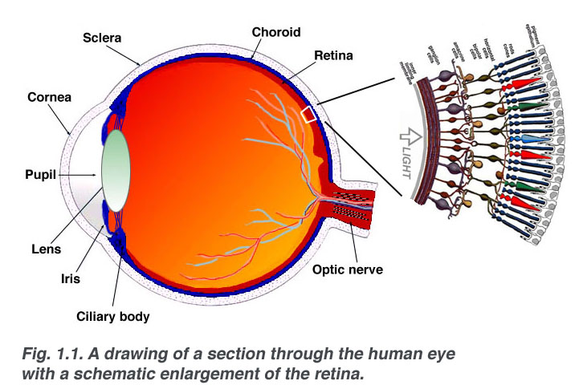
4. Composition of Membranes
More than 90% of the rod cell plasma membrane of the retina is made of the light-absorbing glycoprotein rhodopsin.
Webvision.umh.es/websvision/sretina.html

Slide 23
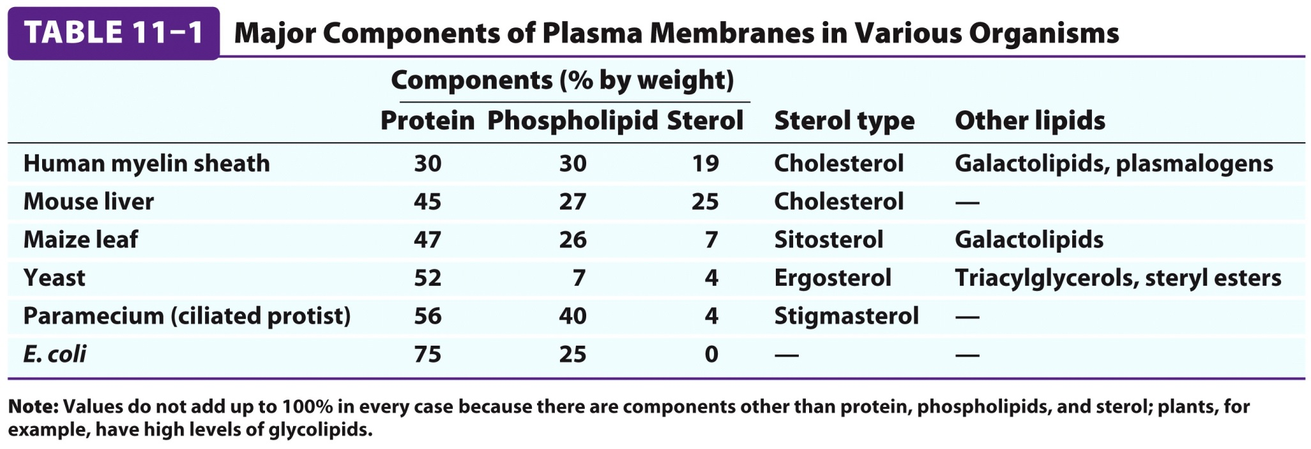
4A. Membrane Composition is Highly Variable in Different Organisms

Slide 24
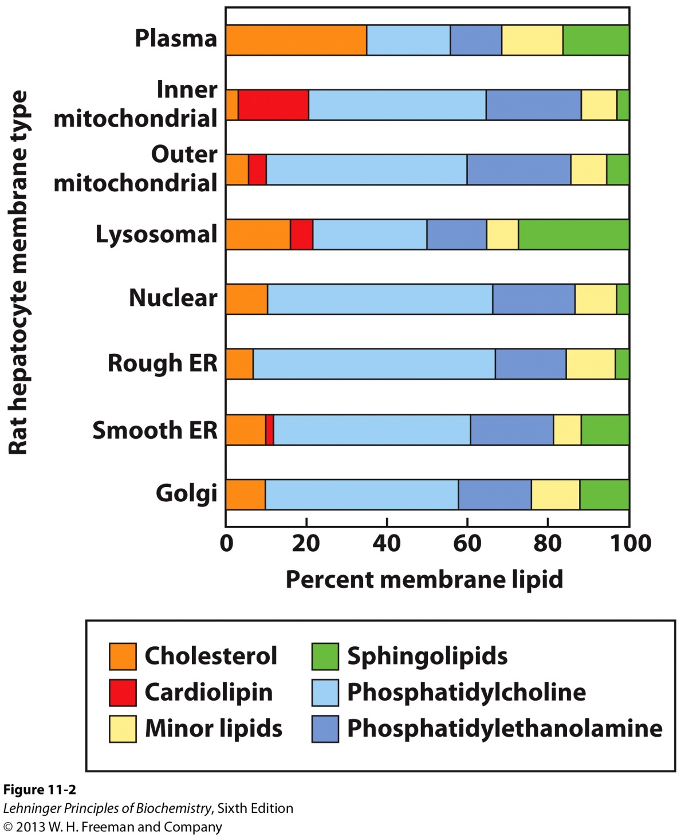
4B. Membrane Composition is Highly Variable in Different Organelles
Phospholipids are abundant in all membranes.
Cholesterol is abundant in the plasma membrane.

Slide 25
5. Membrane bilayers are Asymmetric.
Every component of the membrane exhibits asymmetry
Lipids
Outer and inner leaflets have different lipid compositions
Proteins
Individual peripheral membrane proteins are only associated with one side of the membrane
Integral membrane proteins have different domains on different sides of the membrane.
Specific lipid modification of proteins targets the protein to a specific leaflet
Carbohydrates
Only on the outside of cells

Slide 26
5A. Membrane bilayers are Asymmetric in Lipid Composition
The two leaflets of membranes have different lipid compositions:
Positioning of a lipid on either leaflet can serve a functional role
Phosphatidylserine (typically positioned in the inner leaflet) on the outer leaflet of the plasma membrane serves to
Activate blood clotting (platelets)
Mark the cell for destruction (other cells)

Slide 27
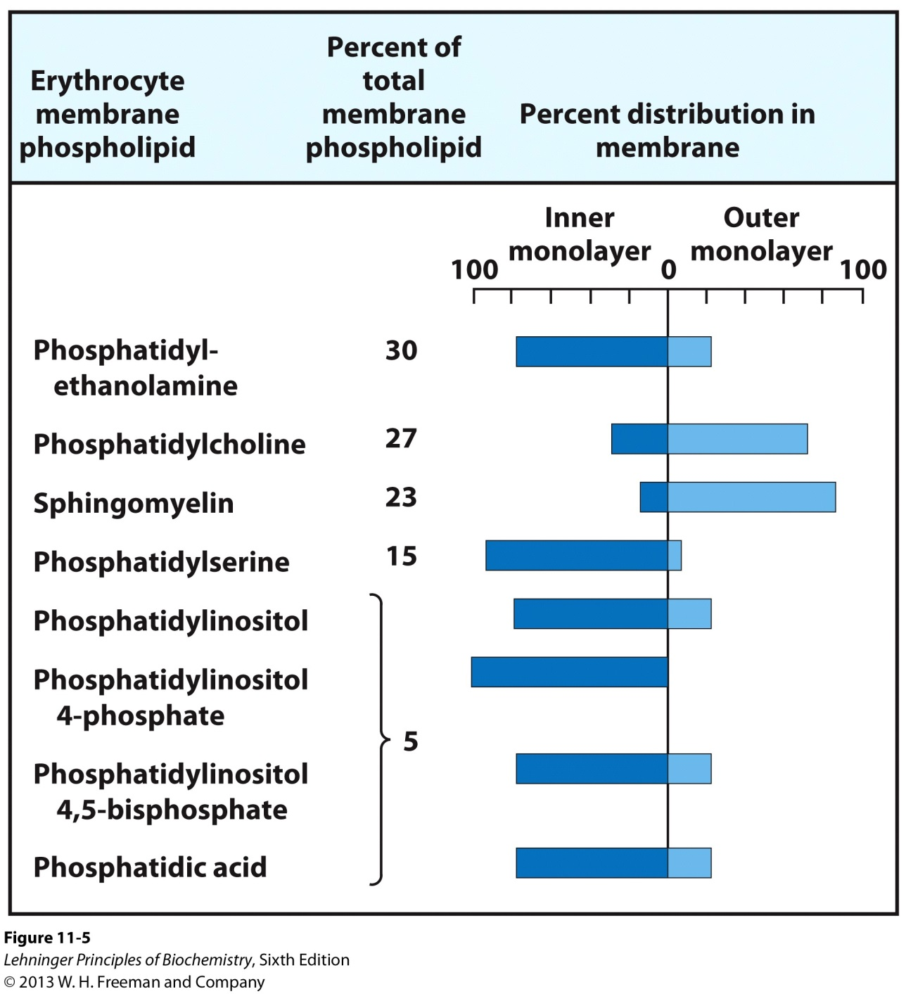
5AI. Asymmetry in Erythrocytes
Choline-containing lipids are typically found in the extracellular leaflet.

Slide 28
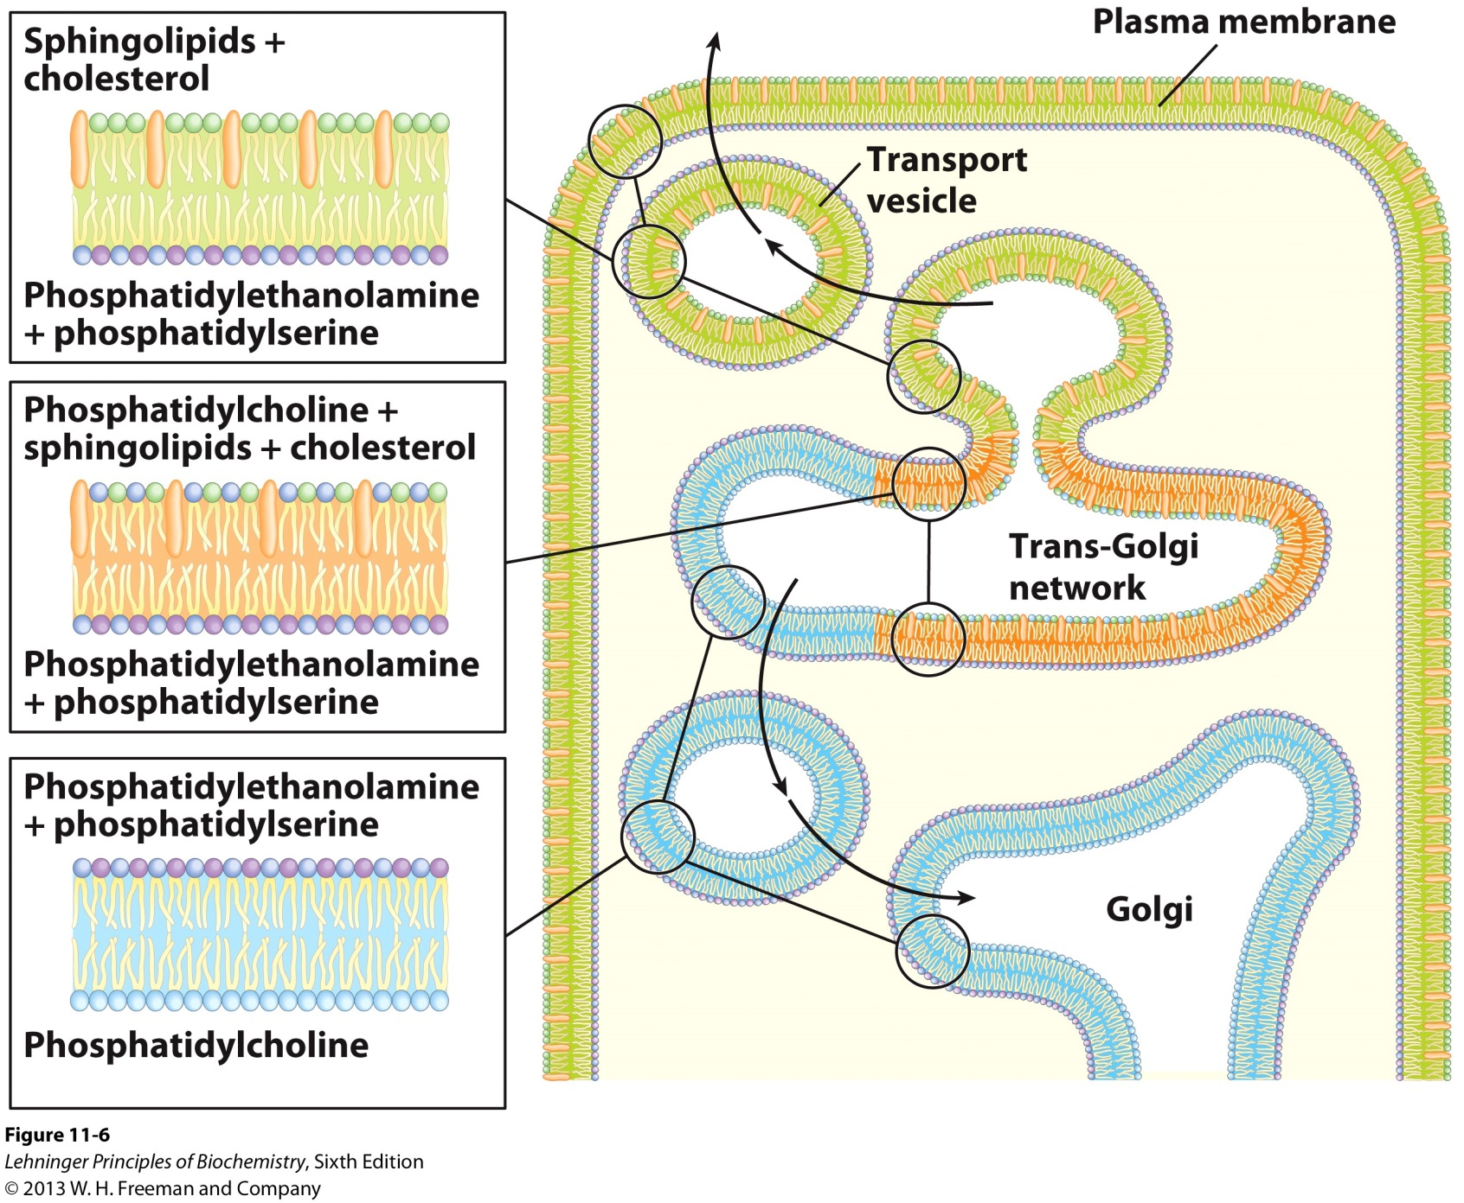
5AII. Asymmetry in Membranes of Other Cells

Slide 29
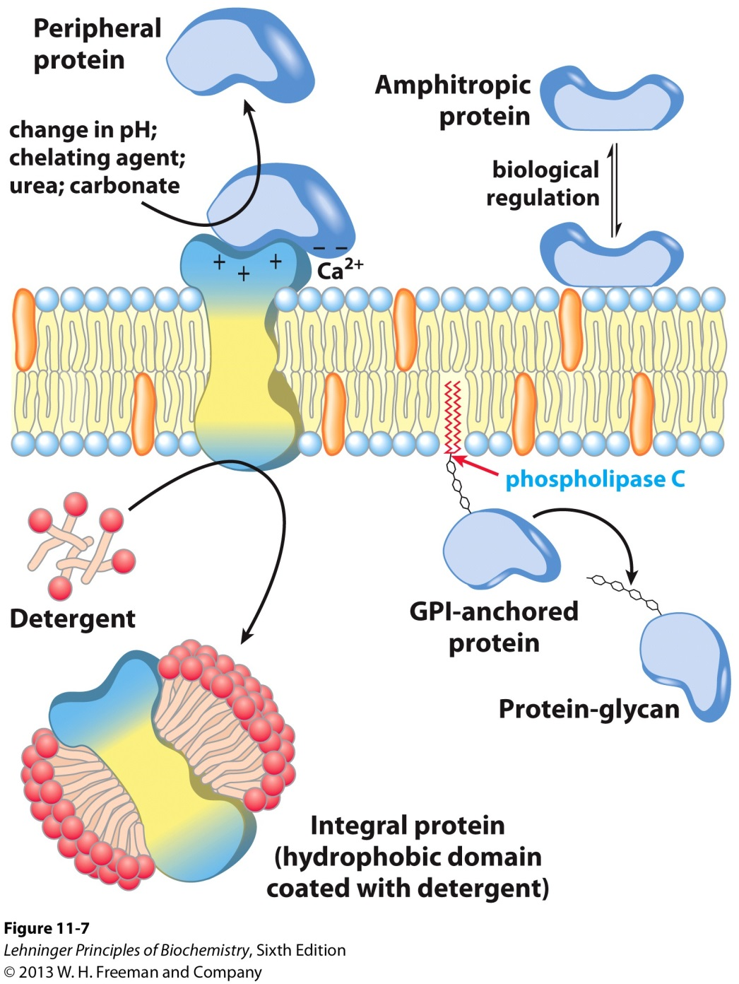
6. Two Main Types of Membrane Proteins
Peripheral proteins
Integral proteins

Slide 30
6A. Peripheral Membrane Proteins
Linkages with the membrane:
Associate with the polar head groups of membranes
Relatively loosely associated with membrane
Through ionic interactions with the lipids or aqueous domains of integral membrane proteins
B. Removed by disrupting ionic interactions or hydrogen bonds either with high salt or change in pH.

Slide 31
6A. Peripheral Membrane Proteins
C. May serve as regulators of membrane-bound enzymes.
D. May limit mobility of integral proteins by tethering them to intracellular structures.
E. Purified peripheral membrane proteins are no longer associated with any lipids.

Slide 32
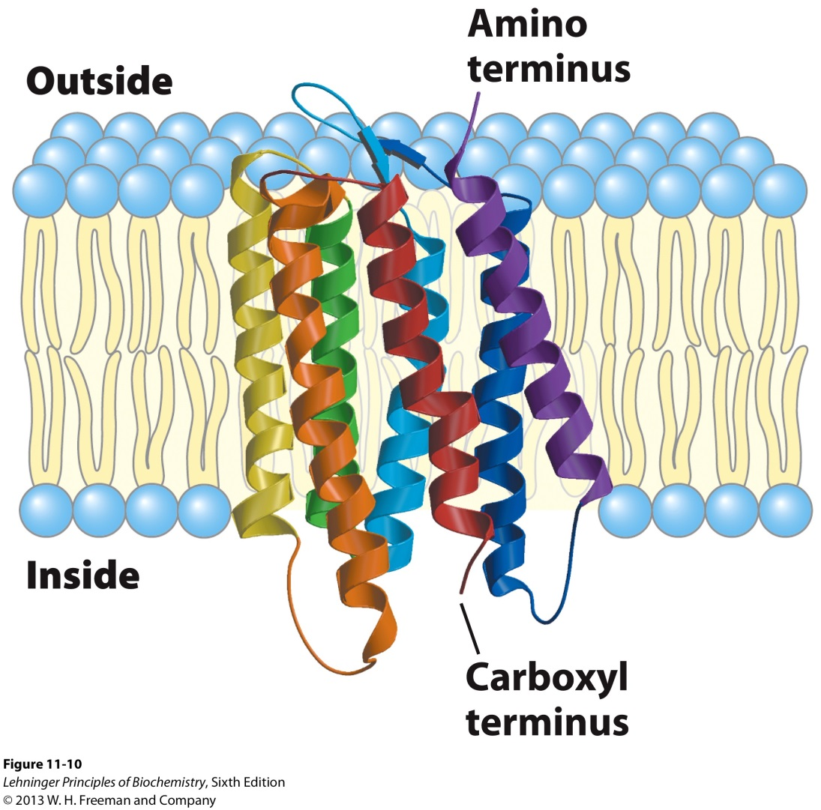
6B. Integral Membrane Proteins
A. Span the entire membrane
B. Localized asymmetrically
Different domains in different compartments
Molecules of an ion pump have the same orientation and therefore pump in the same direction.

Slide 33
6B. Integral Membrane Proteins
C. Tightly associated with membrane
Hydrophobic stretches in the protein interact with the hydrophobic regions of the membrane
D. Removed by detergents that disrupt the membrane
E. Purified integral membrane proteins still have phospholipids associated with them

Slide 34
6C. Function of Integral Membrane Proteins
A. Receptors: Detecting signals from outside
Light (opsin)
Hormones (insulin receptor)
Neurotransmitters (acetylcholine receptor)
Pheromones (taste and smell receptors)
B. Channels, gates, pumps for transport
Nutrients (maltoporin)
Ions (K-channel)
Neurotransmitters (serotonin reuptake protein)
C. Enzymes
Lipid biosynthesis (some acyltransferases)
ATP synthesis (F₀F₁ ATPase/ATP synthase)

Slide 35
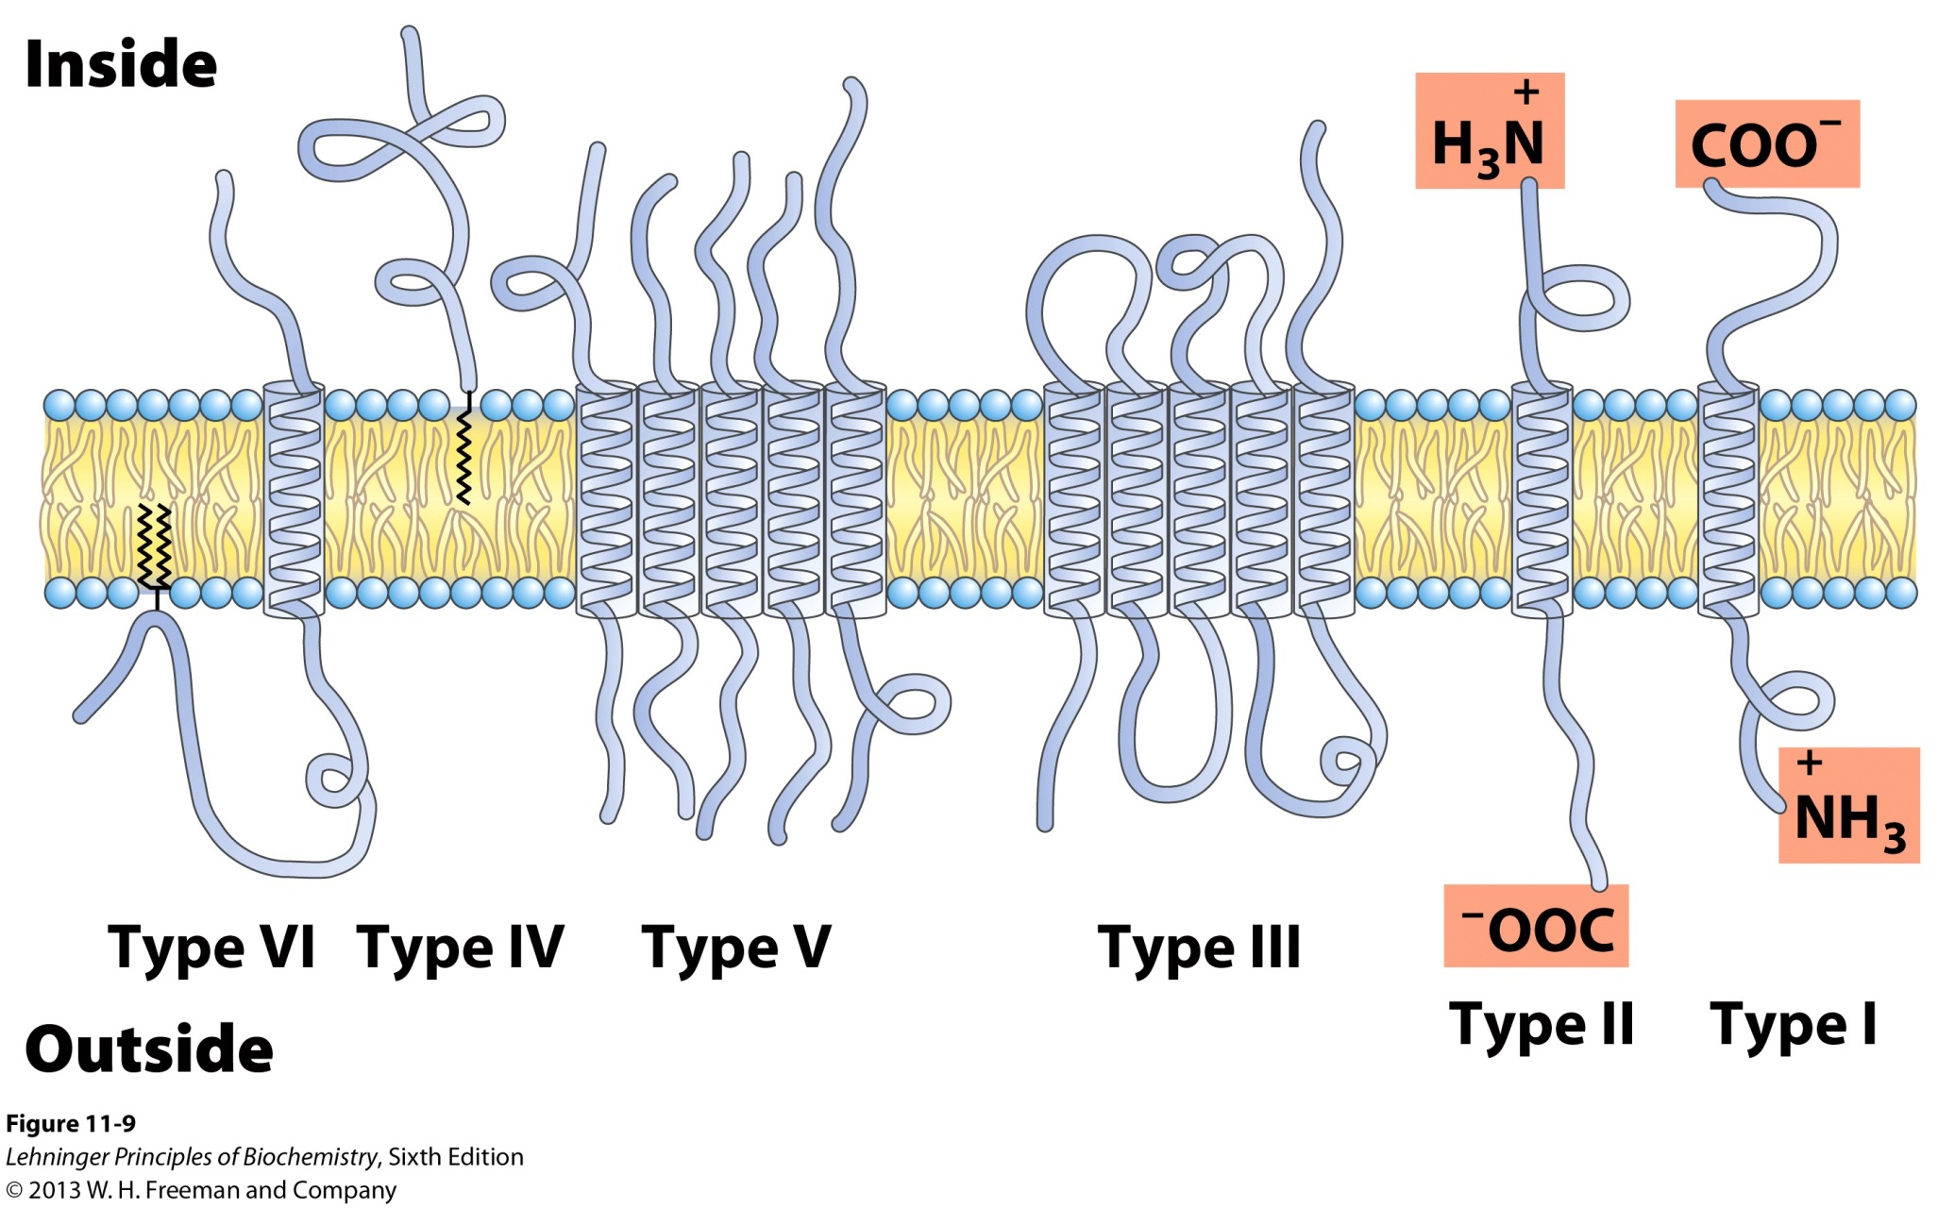
6D. Six Types of Integral Membrane Proteins
IV

Slide 36
6D. Six Types of Integral Membrane Proteins
Type I and II: Have only one transmembrane helix; the amino- terminal domain is outside the cell in type I and inside in type II.
Type III: Have multiple transmembrane helices in a single polypeptide.
Type IV: Transmembrane domains of several different polypeptides assemble to form a channel through the membrane.
Type V: Proteins are held to the bilayer primarily by covalently linked lipids.
Type VI: Proteins have both transmembrane helices and lipid (GPI) anchors.

Slide 37
6E. Determining Membrane Protein Topology
Membrane protein topology refers to determining the 3-D structure of a membrane protein and also the location of domains with respect to the lipid bilayer.
X-ray crystallography
Once a daunting task for membrane proteins is becoming more commonplace with sophisticated new approaches.
B. Reactions with reagents to identify extracellular domains
Membrane-impermeant reagents such as trypsin.
C. Hydropathy index measurements to identify transmembrane domains.
These approaches require sequencing these proteins using standard tecniques.

Slide 38
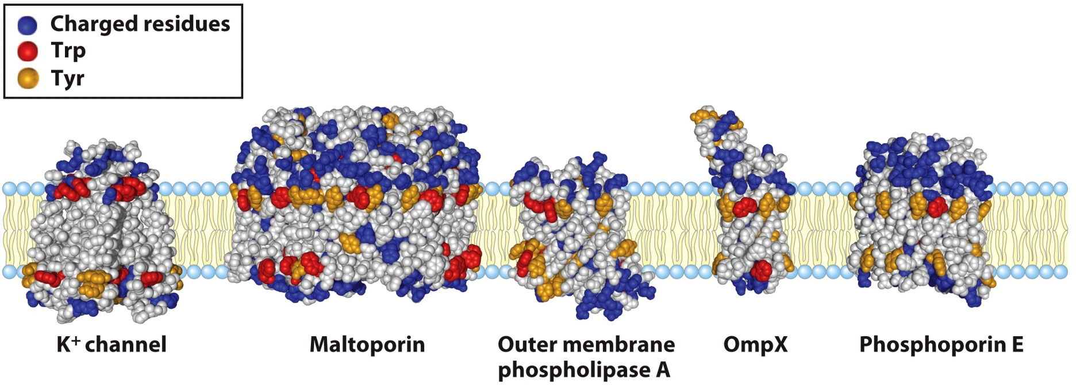
6EI. Amino Acids in Membrane Proteins Cluster in Distinct Regions
Transmembrane segments are predominantly hydrophobic
Tyr and Trp cluster at nonpolar/polar interface
Charged amino acids are only found in aqueous domains

Slide 39
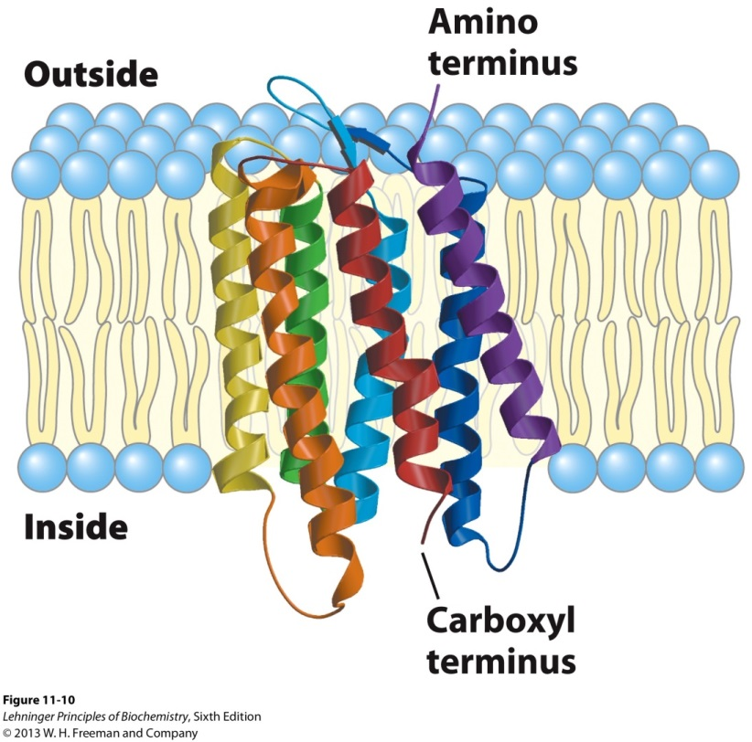
6EII. Structural Motifs of Transmembrane Segments
 Helices
β Barrels
An  helical sequence that spans the membrane contains 20 to 25 residues.
7 to 9 residues of the β conformation span the membrane.
How are these motifs different than their corresponding structures in soluble proteins?

Slide 40
6EII. Structural Motifs of Transmembrane Segments
In soluble proteins, the side groups of the amino acids that participate in  helices and β barrels tend to be polar.
- Interact via hydrogen bonds with water.
In membrane proteins, there is a higher nonpolar content in the side groups of transmembrane domains.
- In the absence of water the domains form  helices and β barrels to maximize intrachain H-bonds.
Notes:
 helices and β barrels

Slide 41
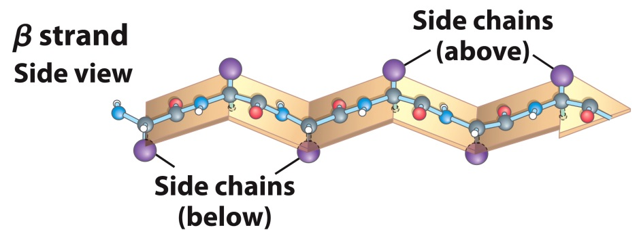
6EII. Structural Motifs of Transmembrane Segments
The side groups in  helices are largely nonpolar.
Due to alternating side chains projecting above and below β sheets, every second residue in β barrels is hydrophobic and interacts with the lipid bilayer and the other residues may or may not be hydrophilic.
Notes:
 helices and β barrels

Slide 42
6EIII. The Hydropathy Index can Predict the Topology of Membrane Proteins
The hydropathy index is a calculation used to determine sequences of hydrophobicity and hydrophilicity in membrane proteins.
The hydropathy index (Table 3.1) is a measure of the relative polarity of each amino acid.
Positive values: Hydrophobic
Negative values: Hydrophilic
The hydropathy index for a sequence is calculated by averaging the hydropathy index for all amino acids within a set window of amino acids.
Notes:
 helices and β barrels

Slide 43
6EIII. The Hydropathy Index can Predict the Topology of Membrane Proteins
A window size of 5-7 amino acids is good for finding hydrophilic regions that are likely exposed on the surface.
A window size of 19-21 AA is good for finding hydrophobic, membrane-spanning domains.
This method works well for -helical transmembranes but not for β barrels.
Let’s focus on applying this method for finding hydrophobic domains.
Notes:
 helices and β barrels

Slide 44
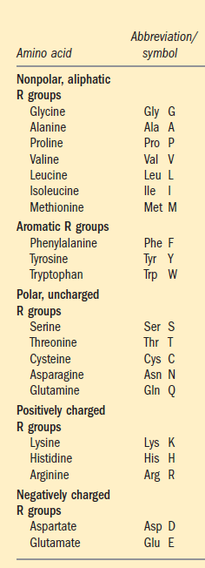
6EIIIa. Hydropathy Plot Determination
Kyle-Doolittle Scale
Notes:
 helices and β barrels

Slide 45
6EIIIa. Hydropathy Plot Determination
For a given window size, say 20 AA and a protein of 160 AA residues:
Calculate HI(1-20) by averaging the HI for AA1 through AA20 then plot for middle residue (AA10).
Calculate HI(2-21) by averaging the HI for AA1 through AA20 then plot for middle residue (AA11).
Continue until you reach sequence 141-160 and plot for residue AA150.
Any region that exceeds +1.6 is likely a transmembrane segment.
Notes:
 helices and β barrels

Slide 46
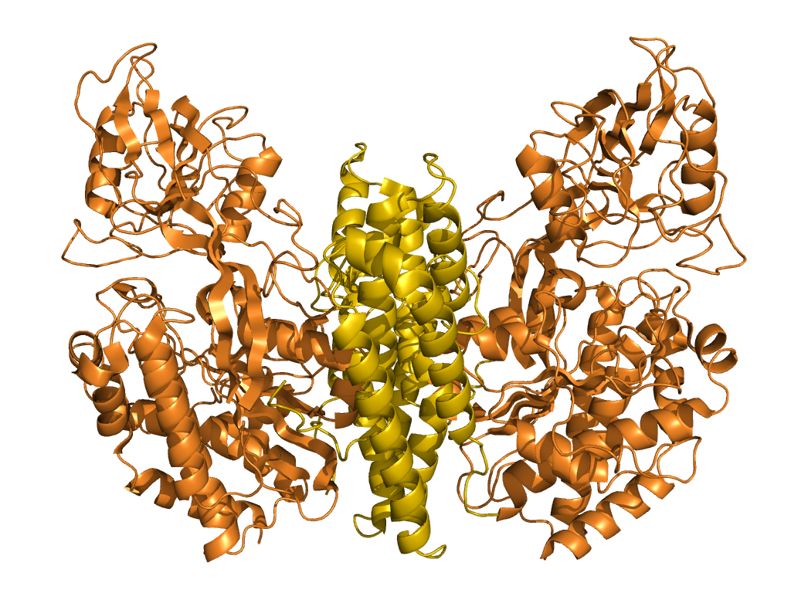
Hydropathy Plot Determination for Transferrin Receptor 1 (TfR1)
dimer
axes
Type II Plasma Membrane
Ectodomain
(AA 89 – 760))
Transmembrane region
(AA68 - 88)
Cytoplasmic region
(AA1 - 67)
Notes:
 helices and β barrels

Slide 47
Hydropathy Plot Determination for Transferrin Receptor 1 (TfR1)
Obtain protein sequence from http://www.uniprot.org website.
Search in: Protein Knowledge (UnitProtKB)
Query: Transferrin Receptor 1
Click on Homo Sapiens Entry (Q9UP52)
Sequence: Copy the sequence
1 MMDQARSAFSNLFGGEPLSYTRFSLARQVDGDNSHVEMKLAVDEEENADNNTKANVTKPK
61 RCSGSICYGTIAVIVFFLIGFMIGYLGYCKGVEPKTECERLAGTESPVREEPGEDFPAAR
121 RLYWDDLKRKLSEKLDSTDFTGTIKLLNENSYVPREAGSQKDENLALYVENQFREFKLSK
181 VWRDQHFVKIQVKDSAQNSVIIVDKNGRLVYLVENPGGYVAYSKAATVTGKLVHANFGTK
241 KDFEDLYTPVNGSIVIVRAGKITFAEKVANAESLNAIGVLIYMDQTKFPIVNAELSFFGH
301 AHLGTGDPYTPGFPSFNHTQFPPSRSSGLPNIPVQTISRAAAEKLFGNMEGDCPSDWKTD
361 STCRMVTSESKNVKLTVSNVLKEIKILNIFGVIKGFVEPDHYVVVGAQRDAWGPGAAKSG
421 VGTALLLKLAQMFSDMVLKDGFQPSRSIIFASWSAGDFGSVGATEWLEGYLSSLHLKAFT
481 YINLDKAVLGTSNFKVSASPLLYTLIEKTMQNVKHPVTGQFLYQDSNWASKVEKLTLDNA
541 AFPFLAYSGIPAVSFCFCEDTDYPYLGTTMDTYKELIERIPELNKVARAAAEVAGQFVIK
601 LTHDVELNLDYERYNSQLLSFVRDLNQYRADIKEMGLSLQWLYSARGDFFRATSRLTTDF
661 GNAEKTDRFVMKKLNDRVMRVEYHFLSPYVSPKESPFRHVFWGSGSHTLPALLENLKLRK
721 QNNGAFNETLFRNQLALATWTIQGAANALSGDVWDIDNEF
Notes:
 helices and β barrels

Slide 48
Hydropathy Plot Determination for Transferrin Receptor 1 (TfR1)
Go to http://www.vivo.colostate.edu/molkit/hydropathy/
Insert the sequence into the window
Specify window size
Specify Kitt-Doolittle scale
One transmembrane region correctly
predicted at the N- terminus
Notes:
 helices and β barrels

Slide 49
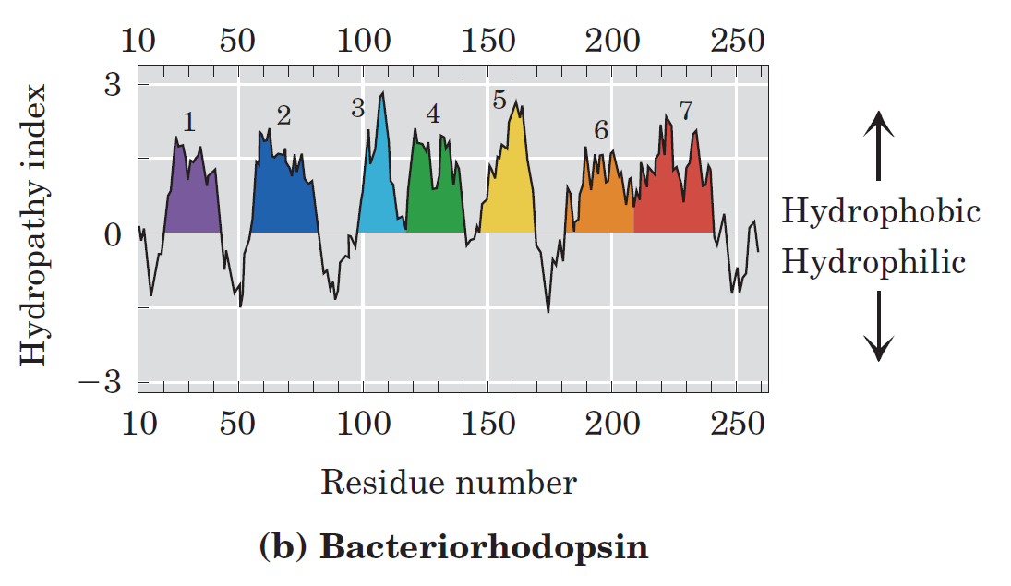
Hydropathy Plot Correctly Predicts 7 Transmembranes for Bacteriorhodopsin
Notes:
 helices and β barrels

Slide 50
6F. Lipid Anchors
Some membrane proteins are lipoproteins.
They contain a covalently linked lipid molecule
Long-chain fatty acids
Isoprenoids
Sterols
Glycosylated phosphatidylinositol (GPI)
The lipid part can become part of the membrane
The anchoring process is reversible.
May be more than one attached lipid moiety
Other interactions, such as ionic attractions between positively charged Lys residues in the protein and negatively charged head groups contribute stability.
Notes:
 helices and β barrels

Slide 51
6F. Lipid Anchors
There is asymmetry in lipid anchoring.
GPI anchors are found only on the outer leaflet of the plasma membrane.
Lipid component displays a targeting function
Directs proteins to correct membrane location
Notes:
 helices and β barrels

Slide 52
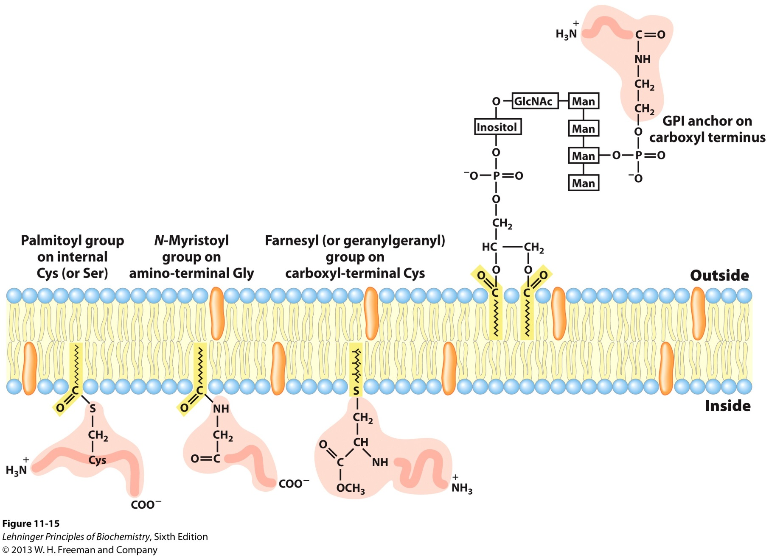
6F. Lipid Anchors
Notes:
 helices and β barrels

