Slide 1
The Physical Properties of
Biological Membranes

Slide 2
1. Physical Properties of Membranes
Dynamic and flexible structures
Can exist in various phases and undergo phase transitions
Permeability can vary
Nonpolar and small polar compounds are permeable
Large polar compounds and ions are not permeable
Chemical treatment can increase permeability
-Important for when targeting a specific organelle
Notes:
 helices and β barrels

Slide 3
2. Membrane Phases
Depending on their composition and the temperature, lipid bilayer can be in gel or fluid phase.
Gel phase: individual molecules do not move around
Fluid phase: individual molecules can move around
Heating causes phase transition from gel to fluid
Under physiological conditions, membranes are more fluid-like than gel-like
- Must be fluid for proper function
Notes:
 helices and β barrels

Slide 4
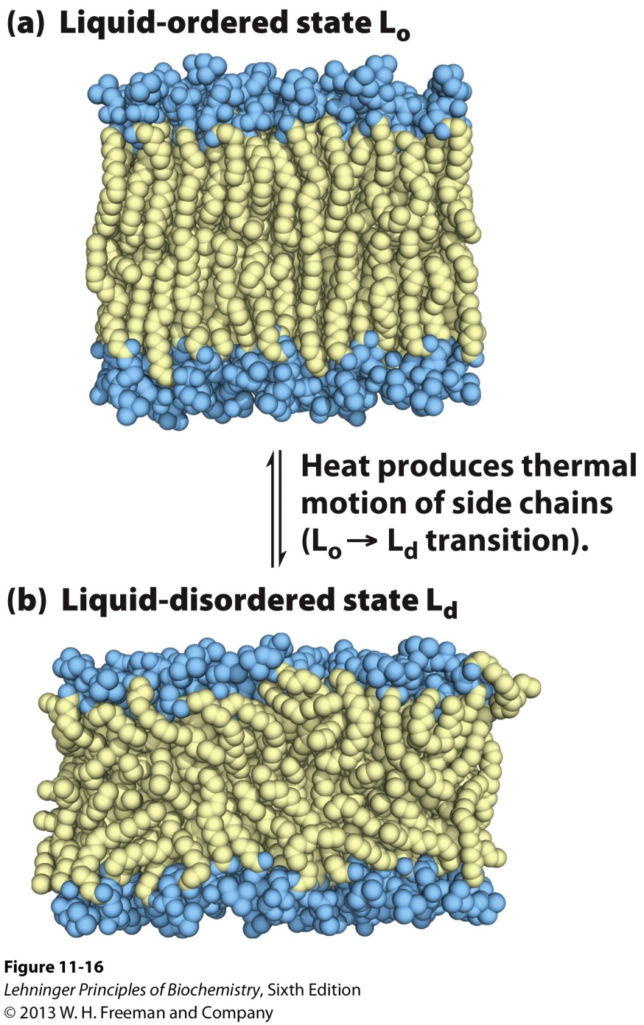
2. Membrane Phases
Liquid-ordered state:
Polar head groups are uniformly arrayed at the surface.
The acyl chains are nearly motionless and packed with regular geometry.
Liquid-disordered state:
The acyl chains undergo much thermal motion and have no regular organization.

Slide 5
3. Organisms can Adjust the Membrane Composition
Membrane fluidity is determined mainly by the fatty acid composition:
More fluid membranes require shorter and more unsaturated fatty acids
Remember differences in T_{M}
At higher temperatures cells need more saturated fatty acids
To maintain integrity
At lower temperatures cells need more unsaturated fatty acids
To maintain fluidity
Notes:
 helices and β barrels

Slide 6
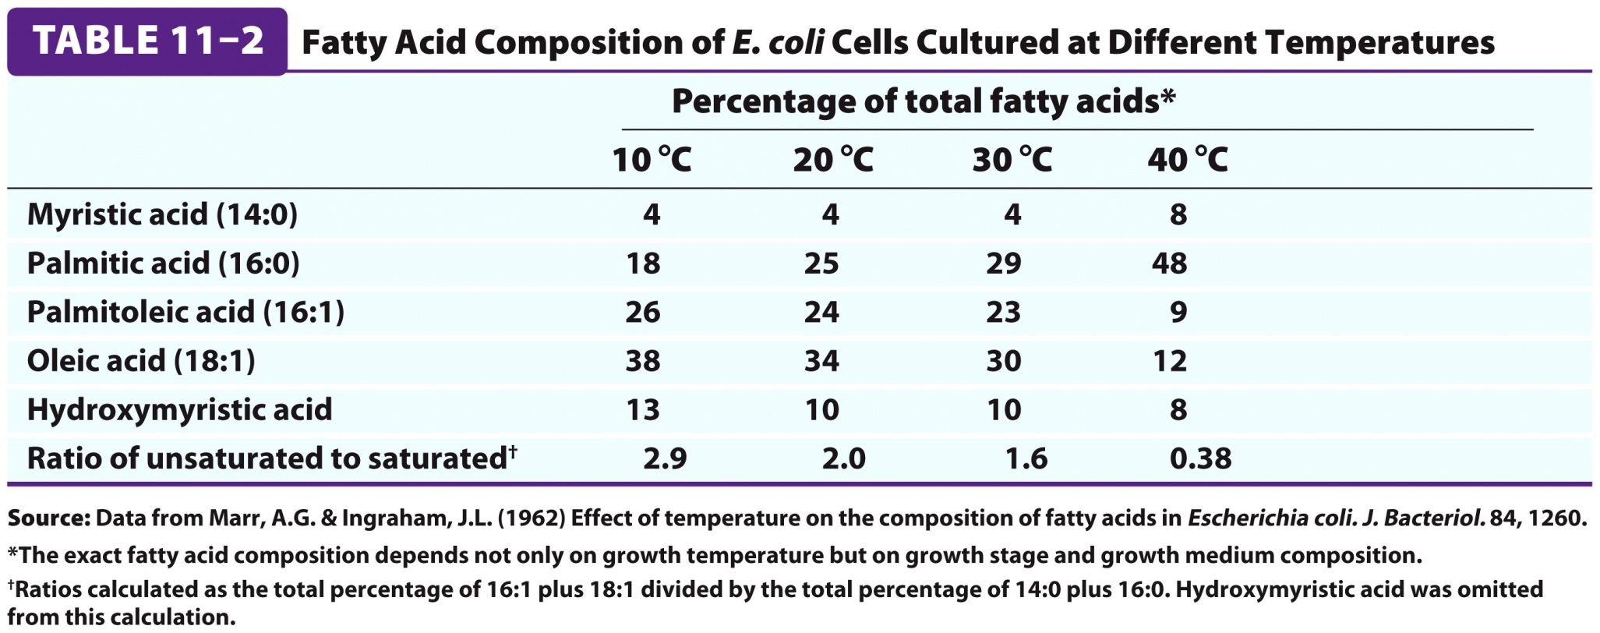
3. Organisms can Adjust the Membrane Composition
Notes:
 helices and β barrels

Slide 7
3. Sterols increase Membrane Rigidity
Cell membranes of many eukaryotes contain sterols
i.e. Cholesterol
Steroid nucleus inserts between fatty acyl chains reducing their freedom of motion.
cholesterol
ergosterol
Notes:
 helices and β barrels

Slide 8
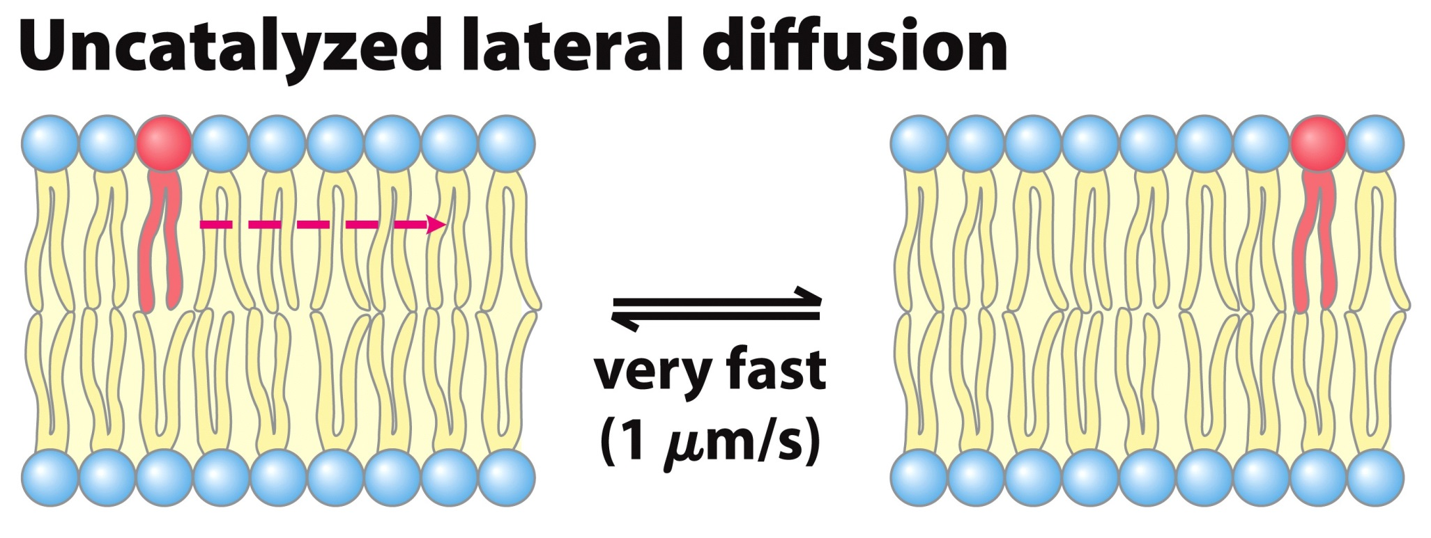
4A. Membrane Dynamics: Lateral Diffusion
Individual lipids undergo fast lateral diffusion within the leaflet.
Notes:
 helices and β barrels

Slide 9
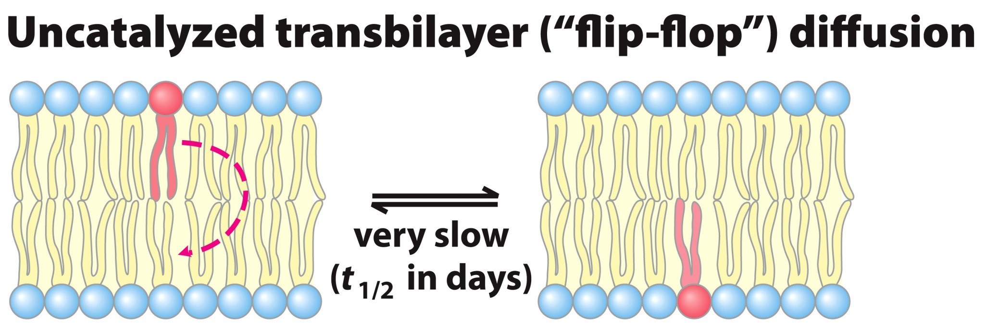
4B. Membrane Dynamics: Transverse Diffusion
Spontaneous flips from one leaflet to another are rare because the charged head group must transverse the hydrophobic tail region of the membrane.
Notes:
 helices and β barrels

Slide 10
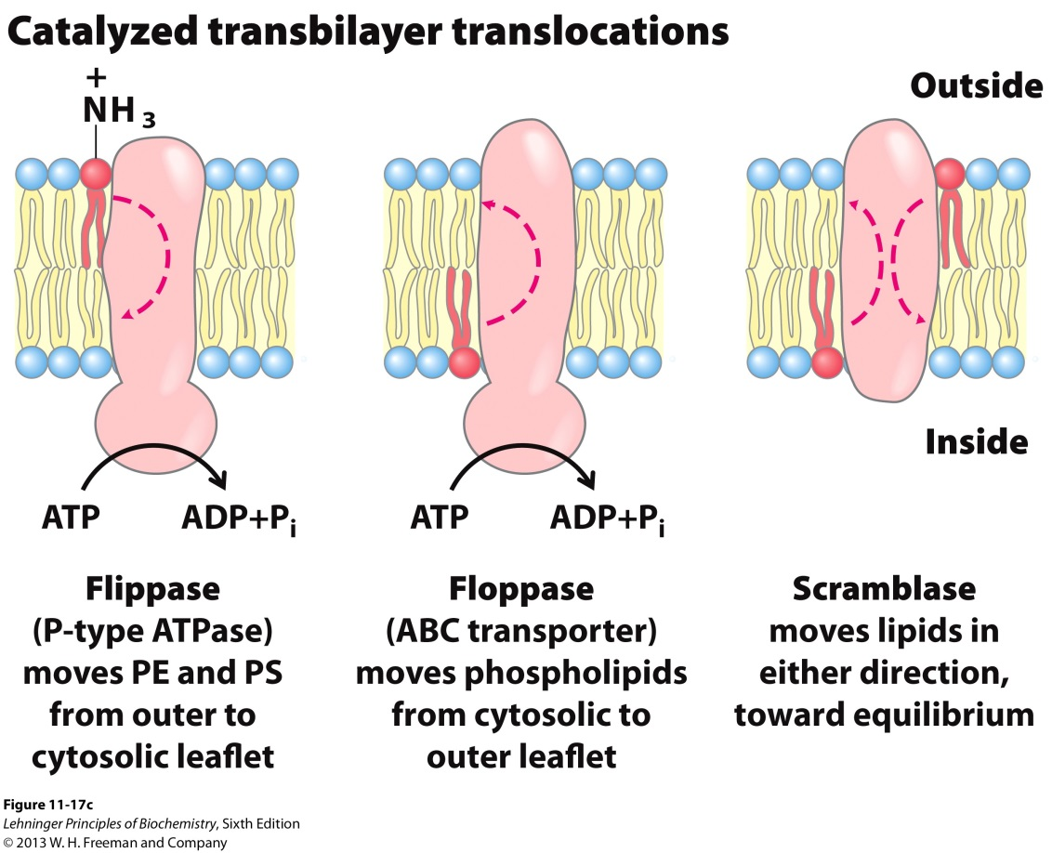
4BI. Membrane Diffusion: Flippases
Special enzymes, flippases, catalyze transverse diffusion.
Some flippases use energy of ATP to move lipids against the concentration gradient.
Notes:
 helices and β barrels

Slide 11
5. Study of Membrane Dynamics: FRAP
Fluorescence Recovery After Photobleaching (FRAP) allows us to monitor lateral lipid diffusion by monitoring the rate of fluorescence return.
From the rate of return of lipids, the diffusion coefficient of a lipid in the leaflet can be determined
Rates of lateral diffusion are high (up to 1 μm/sec):
- A lipid can circumnavigate E.coli cell in one second
Notes:
 helices and β barrels

Slide 12
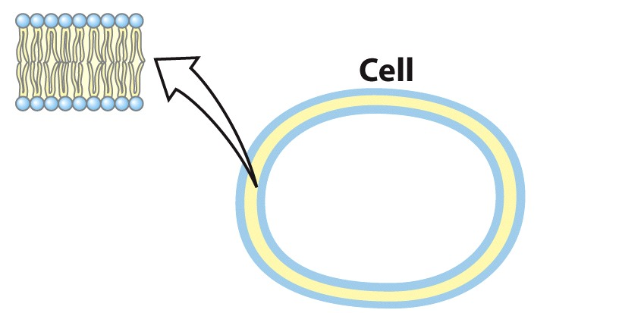
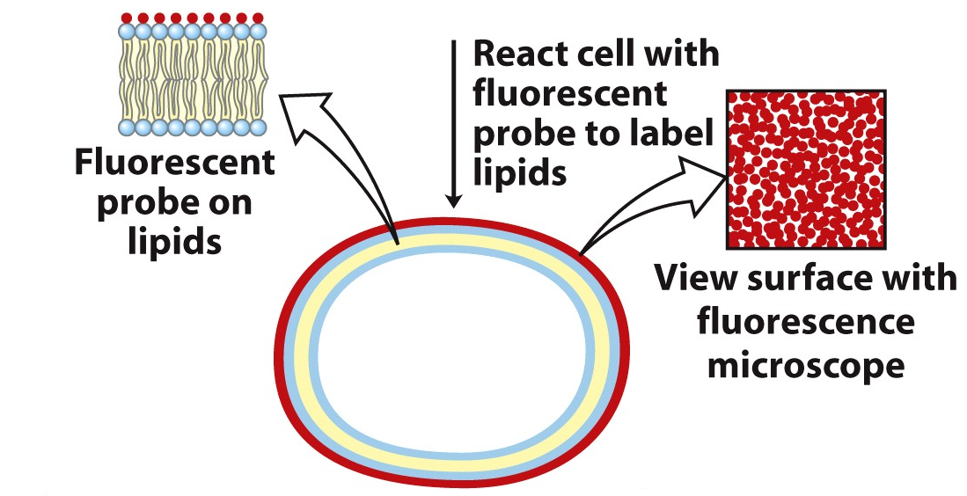
FRAP Step 1: Label Outside of Cell
Notes:
 helices and β barrels

Slide 13
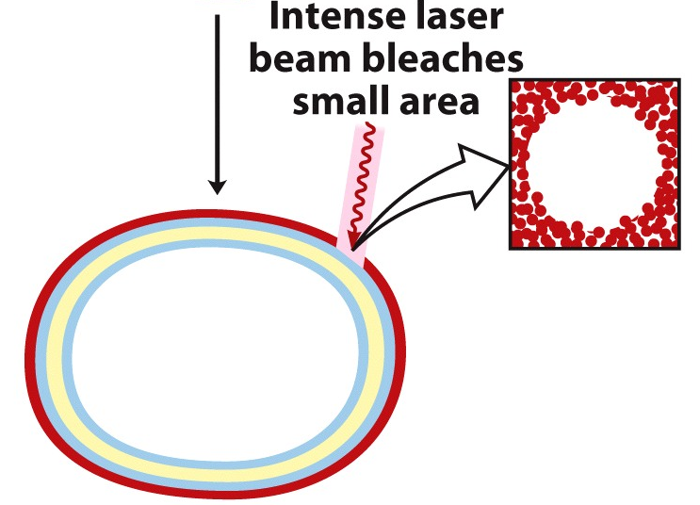
FRAP Step 2: Photobleaching
Loss of fluorescence signal in localized area.
Notes:
 helices and β barrels

Slide 14
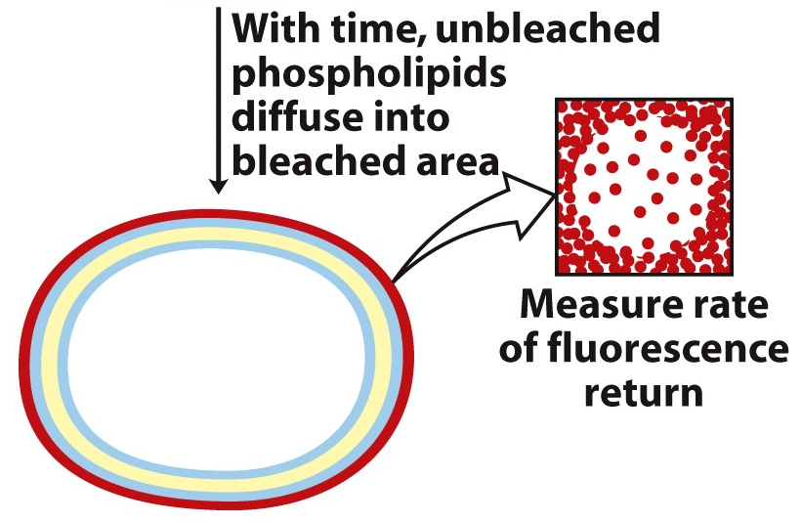
FRAP Step 3: Measure Recovery
Notes:
 helices and β barrels

Slide 15
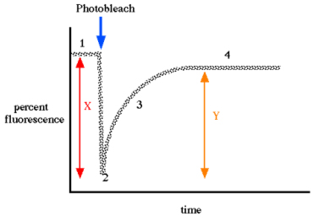
FRAP Step 3: Measure Recovery
Measure diffusion coefficient
- A rate constant
Notes:
 helices and β barrels

Slide 16
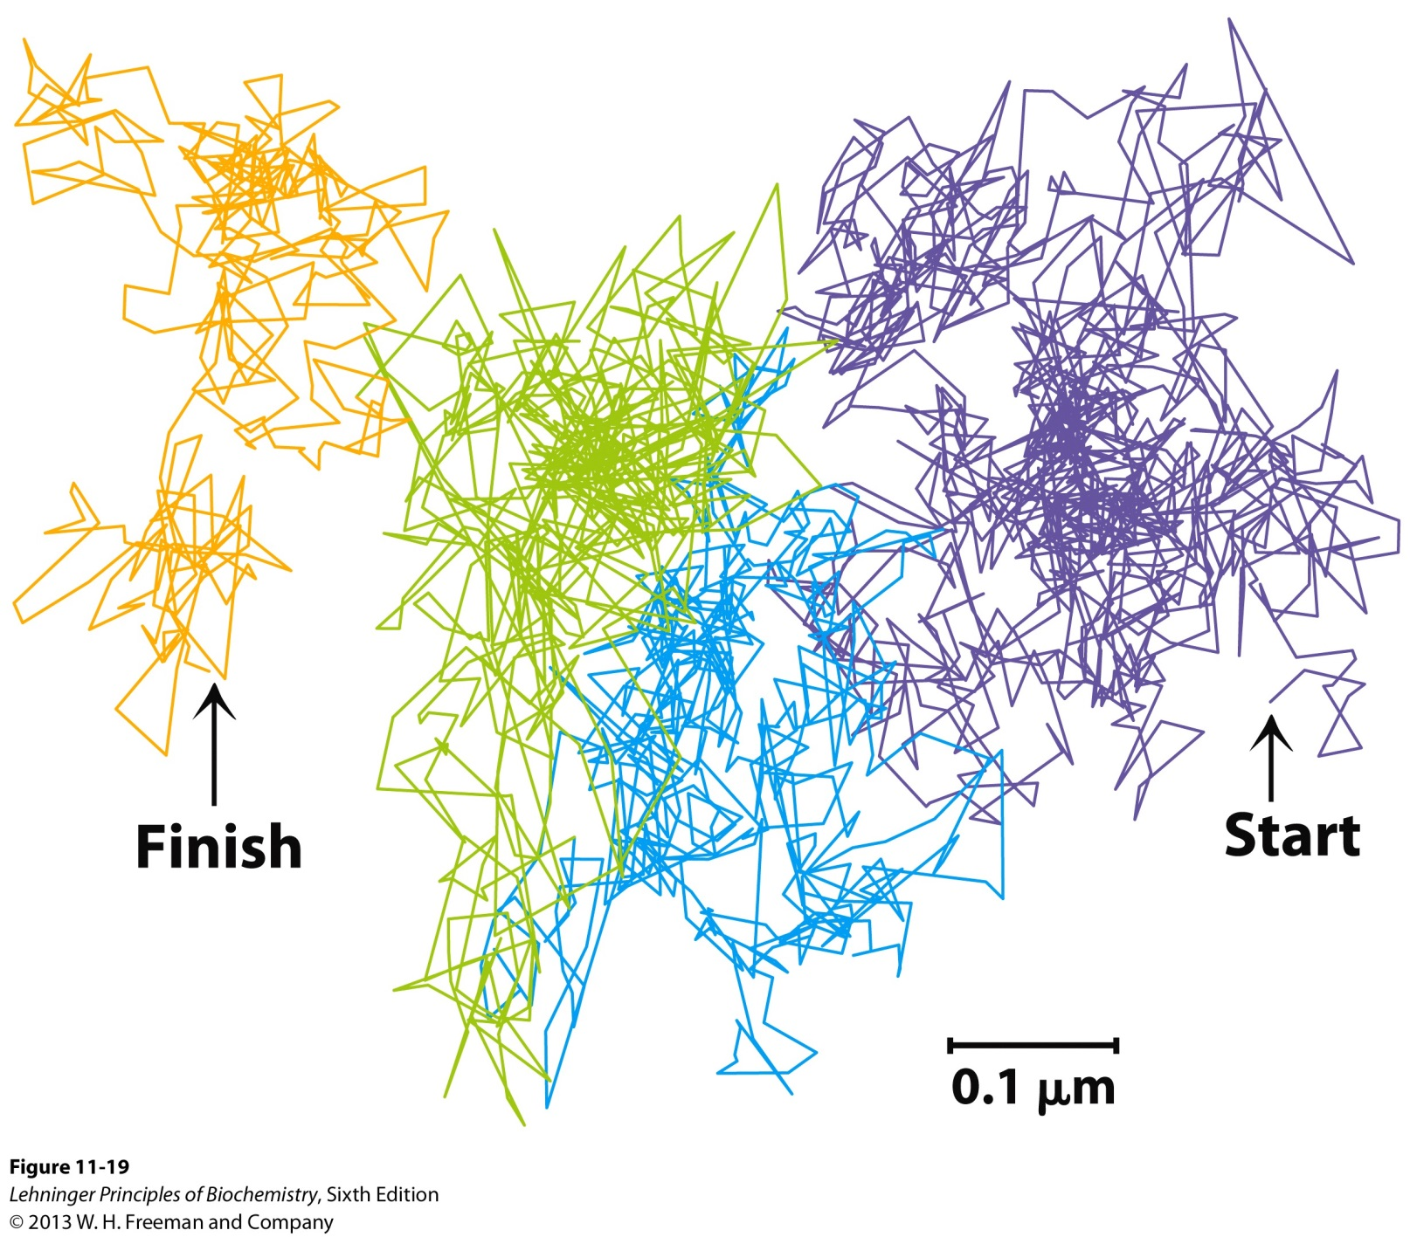
Movement of a Single Lipid in 56 ms
Why is there a jump?
Notes:
 helices and β barrels

