Slide 1
Protein Extraction, Fractionation, and Identification
Chapter 3 (Page 88-104)

Slide 2
General Peptide and Protein Properties

Slide 3
1. The Range of Sizes of Peptides and Polypeptides
As little as 2 Amino Acids (AA) to thousands; share physical/chemical properties of the AA
Bioactivity transcends size; small peptides are important
Proteins can consist of a single polypeptide chain or two or more noncovalently associated chains called multisubunit proteins
If consists of two or more noncovalently associated chains then called oligomeric proteins

Slide 4
2. General Composition of Proteins
Some proteins are only made of amino acids
Others are conjugated proteins
Have conjugated non AA group called a prosthetic group
The arrangement of the AA leads to 4 levels of protein structure

Slide 5
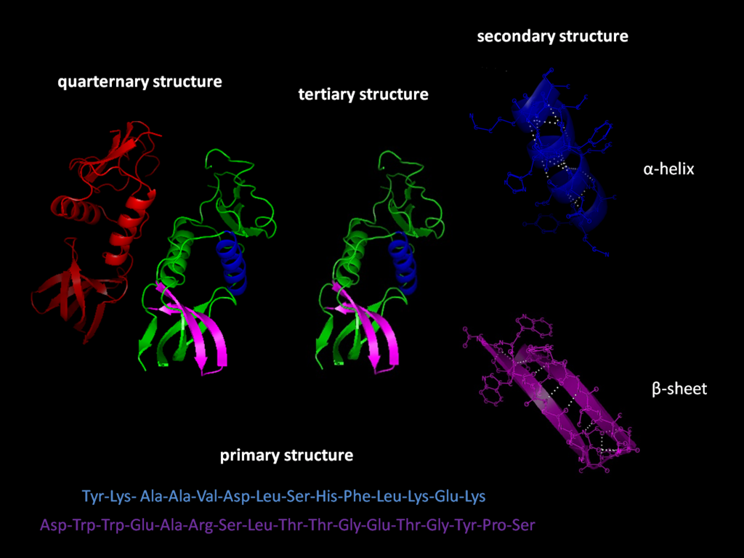
Levels of Protein Structure

Slide 6
Developing a Protein Extraction, Fractionation, and Identification Workflow

Slide 7
Standard Protein Workflow

Slide 8
1. Protein Extraction
Isolate proteins (including protein of interest) from cell plate, in which recombinant expression is occurring, or from tissue of an organism
Requires cells that contain the protein to be lysed (or broken open)
Yields crude extract

Slide 9
2. Fractionation
Use a biochemical property to purify the protein of interest
Usually requires more than one property for high purification

Slide 10
3. Analysis
Perform a treatment of the protein, which either maintains the protein intact or cleaved into amino acid or peptide pieces, in order to identify it or determine its AA sequence
For unknown proteins, use sequence information to characterize them

Slide 11
Fractionation Protocols

Slide 12
1. Dialysis
Technique based on protein size
Involves the use of a semipermeable membrane with a particular pore size (based on molecular weight)
Molecular weight measured in Daltons (Da); 1 Da = 1 g/mol
Used to separate larger proteins from smaller proteins and salts or small molecules
Used to equilibrate proteins in a desired buffer for subsequent biochemical steps

Slide 13
Dialysis

Slide 14
2. Ammonium Sulfate Precipitation
Technique based on solubility
(NH₄)₂SO₄, a salt, is highly water soluble
Proteins lose solubility as you increase salt concentration
(NH₄)₂SO₄ can be used a different concentrations
(%weight/volume) to “salt out” or precipitate proteins
E. Precipitated proteins isolated by centrifugation and are not denatured

Slide 15
Ammonium Sulfate Precipitation
25% w/v (NH₄)₂SO₄
Centrifugation

Slide 16
3. Column Chromatography
Technique that takes advantage of differences in protein charge, size, binding affinity, and other properties. Consists of:
Stationary phase: Porous solid matrix with appropriate chemical properties
Mobile phase: A buffered solution percolates through the stationary phase
The protein-containing solution is layered on top of the column and the mobile phase causes the proteins to migrate faster or slower depending on their properties.

Slide 17
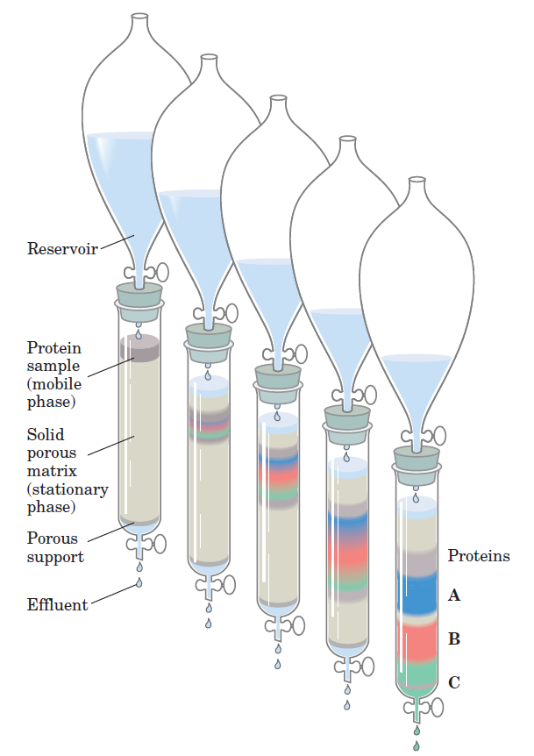
Column Chromatography

Slide 18
3I. Ion Exchange Chromatography
Technique based on charge of protein (either cation or anion exchange)
Stationary phase has charged groups
Cation exchange: Charged groups are negative
Anion exchange: Charged groups are positive
Mobile phase is at first the buffer and then includes a concentration gradient of charged ions opposite in charge to the stationary phase
Cation exchange: K⁺
Anion exchange: Cl⁻

Slide 19
Cation Exchange Chromatography
Order of Elution
Protein charge based on their isoelectric point (PI):
pH > pI; Negatively Charged
pH < pI; Positively Charged
At pH 7.4, most proteins are negatively charged.

Slide 20
3I. Size Exclusion Chromatography
Technique based on the size of a protein
Stationary phase has pores of a particular size
Mobile phase is just buffer
Proteins at the same size of the pores or smaller enter the pores
Larger proteins do not enter and elute first
Remaining proteins elute in order of larger to smaller

Slide 21
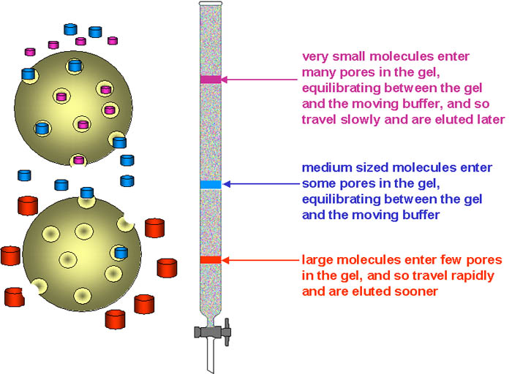
Size Exclusion Chromatography

Slide 22
3II. Affinity Chromatography
Technique based on the binding affinity of the protein
Stationary phase contains a covalently attached chemical group
Mobile phase is buffer at first then includes a concentration gradient of an agent with affinity for the chemical group or free ligand
Proteins with affinity for the chemical group will bind to it then elute as the concentration of the agent or free ligand in the mobile phase increases

Slide 23
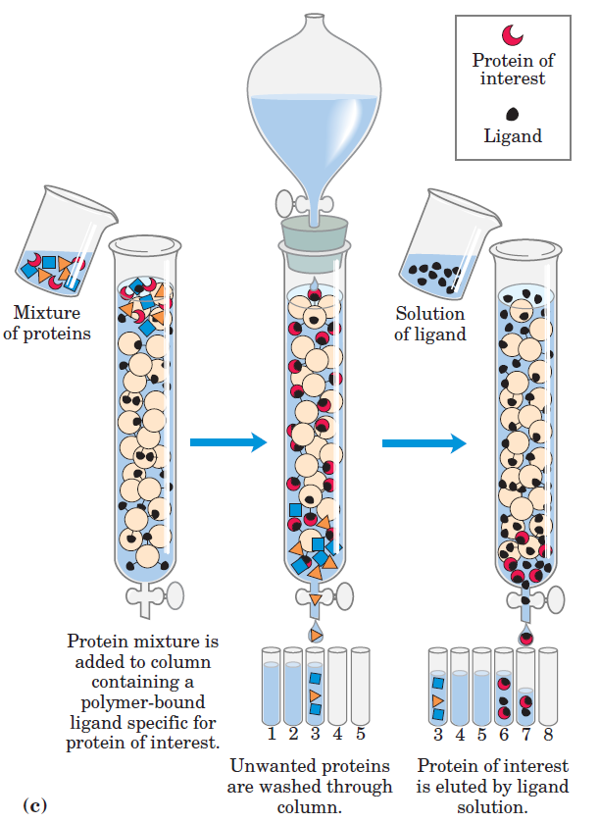
Affinity Chromatography

Slide 24
Checking the Success of Fractionation

Slide 25
1. Electrophoresis
Technique that involves fractionation but on a small scale.
Based on the migration of charged proteins in an electric field
Usually done after isolating the crude extract
Repeated after a fractionation step

Slide 26
1I. Sodium Dodecyl Sulfate Polyacrylamide Gel Electrophoresis (SDS PAGE)
SDS is a detergent that denatures proteins and gives them a similar shape
SDS binds to proteins @ ratio of 1 SDS : 2 AA residues
Contributes large net negative charge making protein charge insignificant
Each protein has similar charge to mass (m/z)

Slide 27
1I. Sodium Dodecyl Sulfate Polyacrylamide Gel Electrophoresis (SDS PAGE)
C. SDS bound proteins travel through a gel made up of the cross- linked polymer polyacrylamide
D. After applying electric field, proteins migrate to positively charged electrode according to their size and not charge:
$µ= \frac{V}{E}$  $\frac{1}{MW}$
$µ$ = Electrophoretic mobility
V = Velocity
E = Electric Potential
MW= Molecular weight
$µ$, MW

Slide 28
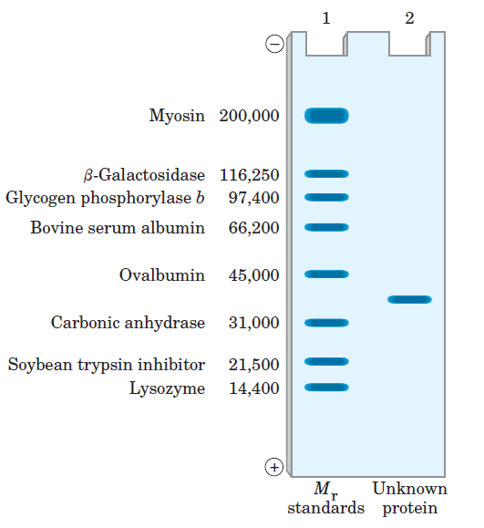
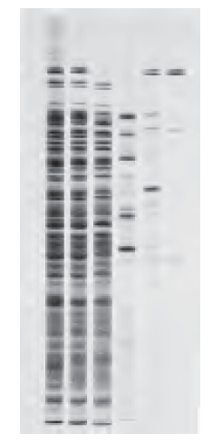
SDS PAGE
Can be used to gauge MW and purity using dye staining.
Crude
Purification

Slide 29
1II. Isoelectric Focusing
Procedure used to determine the pI of a protein
pH gradient is established by allowing a mixture of low MW organic acids and bases (ampholytes) to distribute themselves in an electric field
When a protein mixture is applied, the proteins will migrate in the electric field (positive or negative end) until it reaches the pH that matches the pI (no charge)
Dye stain the gel to track the proteins

Slide 30
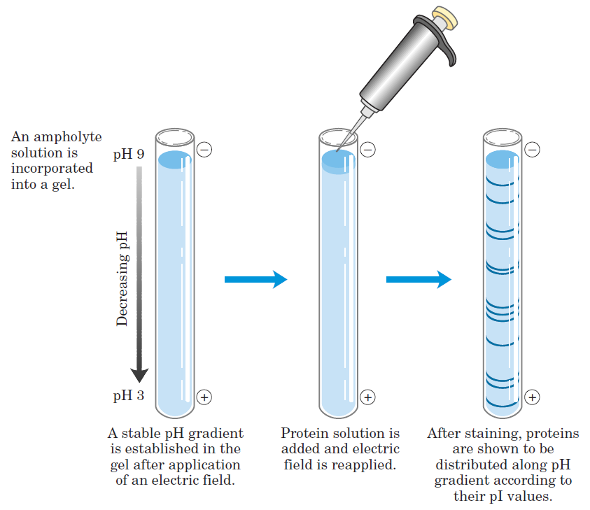
Isoelectric Focusing

Slide 31
2. Measuring Enzyme Activity
If purifying a protein that is an enzyme then can measure the improvement in enzyme activity. Need to know:
A specific assay for the enzyme
Optimal conditions- pH, cofactors, temperature
Compare specific activity before and after purification
$$Specific activity= \frac{\# of enzyme units}{mg of total protein}$$
1.0 unit of enzyme activity = Enzyme amount to transform
1.0 µmol substrate/min. @ 25°C

Slide 32
3. Measuring Nonenzyme Activity
If purifying a protein that is a not an enzyme then have to use a particular property of the protein to track.
As an example, for a transport protein-
Identify ligand that it transports
Identify suitable ligand binding assay

Slide 33
Protein Identification

Slide 34
1. Protein Identification Today
The world of protein identification has greatly evolved due to the success of the Genome Project
The genome (the set of all genes) has been sequenced for many organisms
Many genes (segment of DNA) encode for proteins
By sequencing the genome, the large majority of the proteome (the set of proteins) has been sequenced
People now use genome databases for protein identification

Slide 35
2. Identifying a Protein from Organism of Sequenced Genome
Requires the use of Tandem Mass Spectrometry (MS)
2 dimensional MS (MS-MS)
Protein digestion to yield peptides
Use a protease, an enzyme that cleaves a protein at a specific AA residue
i.e. Trypsin- Cleaves at the carboxyl end of a lysine or arginine residue
XXXXKXXXRXXX
(XXXXKXXXR + XXX) + (XXXXK + XXXRXXX) + (XXXR + XXX)
Trypsin

Slide 36
2. Identifying a Protein from Organism of Sequenced Genome
B. Peptides are fractionated based on their hydrophobic character
C. Peptides are ionized
Electrospray ionization
D. The mass of the peptide is measured (First Dimension of MS)
E. The peptides are then cleaved via collision

Slide 37
2. Identifying a Protein from Organism of Sequenced Genome
F. Mass of the peptide fragments is measured (Second Dimension MS)
G. The Second Dimension MS data is submitted to a genome database (Sequest)
H. Theoretical and experimental b and y ion fragmentation patterns are compared for protein identification
I. peptide identification, protein identification confidence
b fragments
y fragments

Slide 38
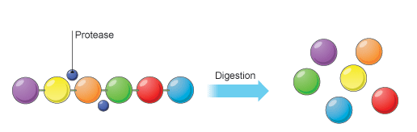
Tandem Mass Spectrometry
Digestion
Fractionation
Protein
Peptide

Slide 39
3. 1 Dimensional Protein MS
No need to perform a trypsin digest
Directly measure the mass of the intact protein by electrospray ionization
No sequence information can be obtained
Mass may be higher due to a post translational modification or lower due to hydrolysis
Will only measure the mass of individual subunits for multisubunit proteins

Slide 40
4. Traditional Method for Identifying Proteins
Involves the use of a labeling method such as Edman Degradation
A chemical method to sequence a polypeptide
Label and cleave the amino terminal AA residue one at a time
H₂N-X_{n}XX + L L-NH-X_{n}XX L-NH-XX
L-NH-X_{n}
C. AA identified one at a time
+ L

Slide 41
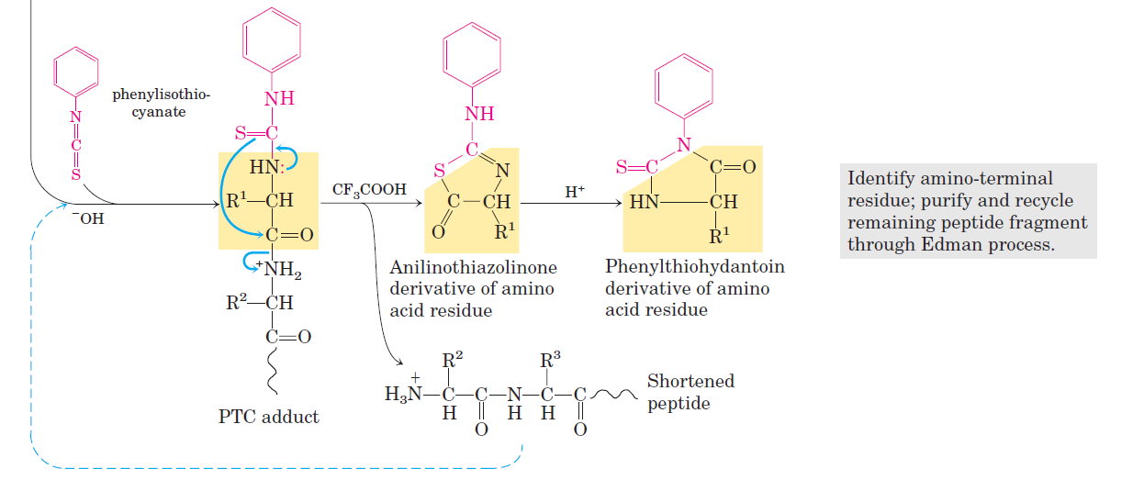
Edman Degradation

Slide 42
4. Traditional Method for Identifying Proteins
D. Method good for 50 AA polypeptide or less
E. For >50 AA, need to use a protease to cleave into smaller peptides
F. The order of the AA sequence is determined by the use of additional proteases and sorting through the fragments like pieces of a puzzle

Slide 43
5. Identifying Proteins with Disulfide Bonds
Proteins with at least 2 Cys residues may form disulfide bonds (covalent modification).
For proper sequencing of proteins with disulfide bonds (cystine bonds) it is necessary to perform a reduction alkylation to break the disulfide bond.
Digest the protein and sequence it

Slide 44
Disulfide Bond Reduction Alkylation

Slide 45
5. Identifying Proteins with Disulfide Bonds
C. Repeat the digestion without reduction alkylation
D. For each disulfide bond, two of the original peptides will be missing and a new, larger peptide will appear

