Slide 1
Introduction to Proteins and
their Building Blocks
Chapter 3 (Page 75-88)

Slide 2
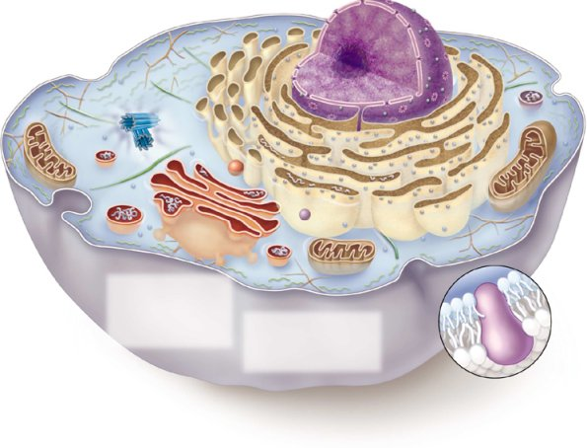
Fundamental Biology of Life
Nucleus:
Site of transcription
Ribosomes on endoplasmic reticulum:
Site of translation
Transcription
Translation
DNA RNA Protein
Replication

Slide 3
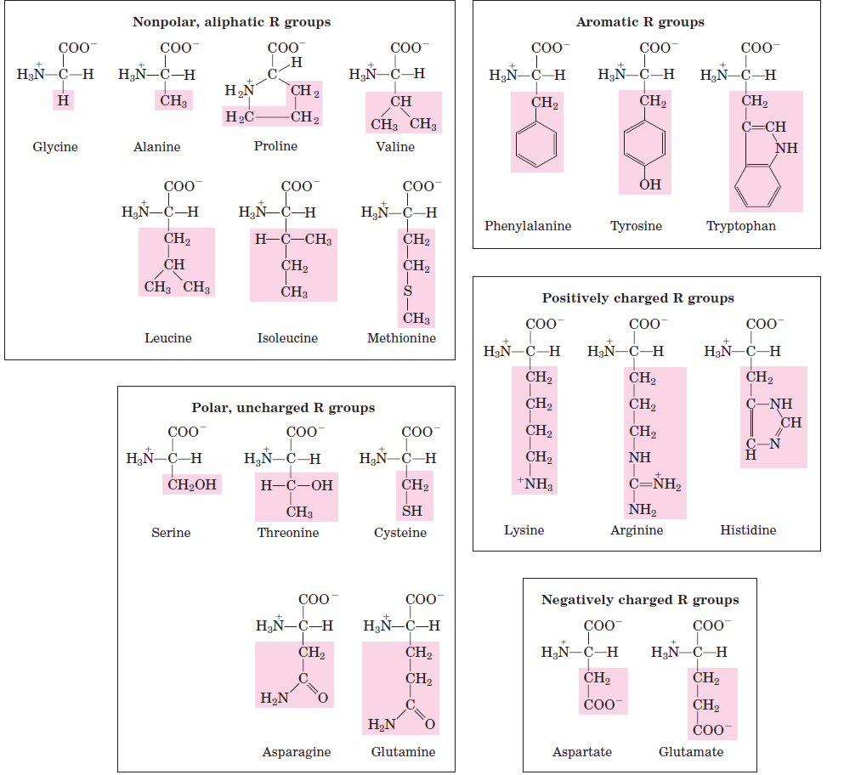
20 Standard Amino Acids

Slide 4
Nonpolar, Aliphatic R groups
Amino Acid | Symbol | Letter | R
Alanine | Ala | A
Valine | Val | V
Leucine | Leu | L
Isoleucine | Ile | I

Slide 5
Nonpolar, Aliphatic R groups
Amino Acid | Symbol | Letter | R
Glycine | Gly | G
Methionine | Met | M
Proline | Pro | P
Notes:
CH2CH2SCH3

Slide 6
Aromatic R groups
Amino Acid | Symbol | Letter | R
Phenylalanine | Phe | F
Tyrosine | Tyr | Y
Tryptophan | Trp | W

Slide 7
Polar, Uncharged R groups
Amino Acid | Symbol | Letter | R
Serine | Ser | S
Threonine | Thr | T
Asparagine | Asn | N
Glutamine | Gln | Q
Cysteine | Cys | C

Slide 8
Positively Charged (Basic) R groups
Amino Acid | Symbol | Letter | R
Lysine (pKa =10.53) | Lys | K
Arginine (pKa = 12.48) | Arg | R
Histidine (pKa = 6.00) | His | H
Notes:
CH2CH2SCH3

Slide 9
Negatively Charged (Acidic) R groups
Amino Acid | Symbol | Letter | R
Aspartate (pKa 3.65) | Asp | D
Glutamate (pKa 4.25) | Glu | E

Slide 10
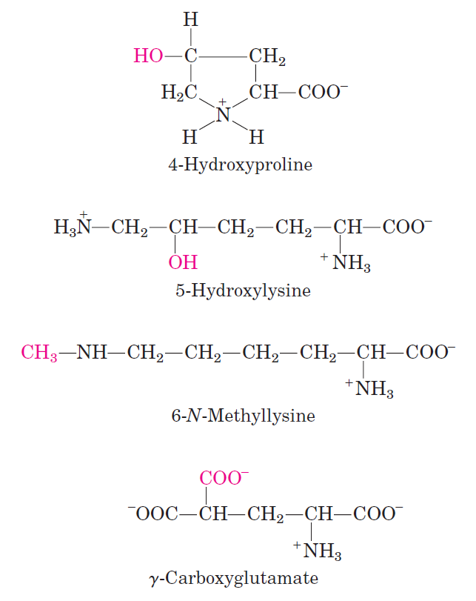
Some Uncommon Amino Acids

Slide 11
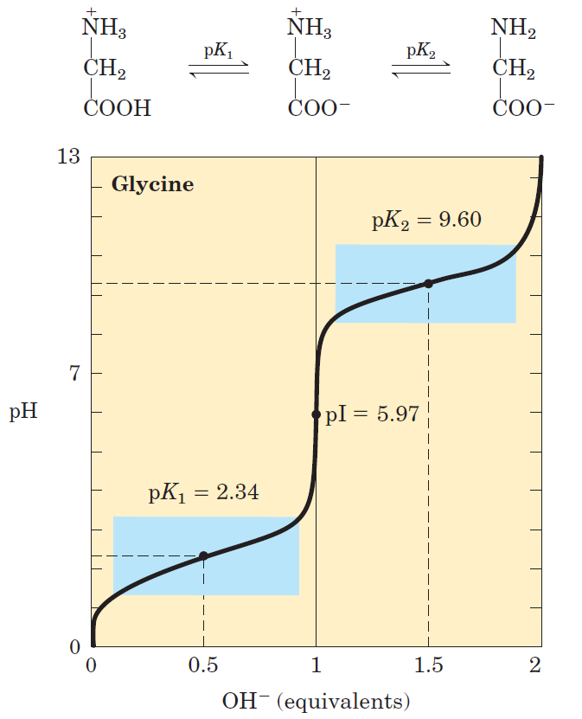
Titration Curve for a Simple Amino Acid

Slide 12
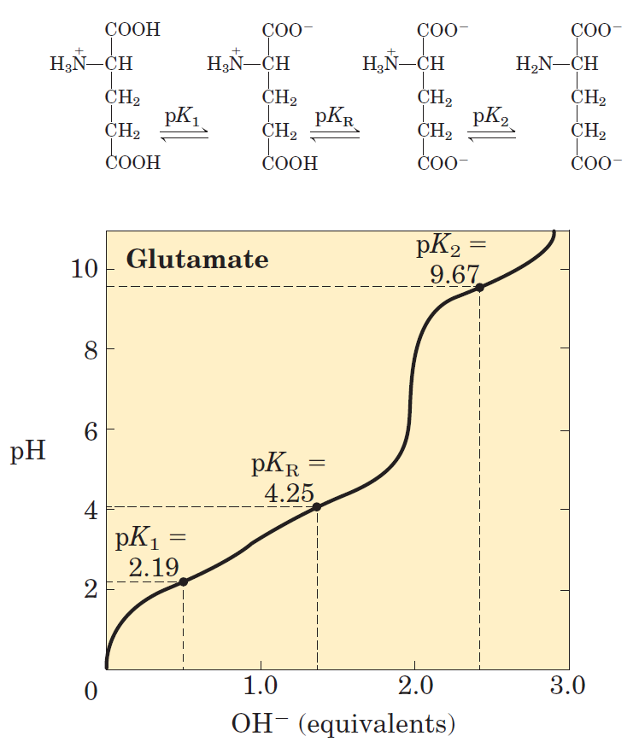
Titration Curve for Amino Acid with Ionizable R group

Slide 13
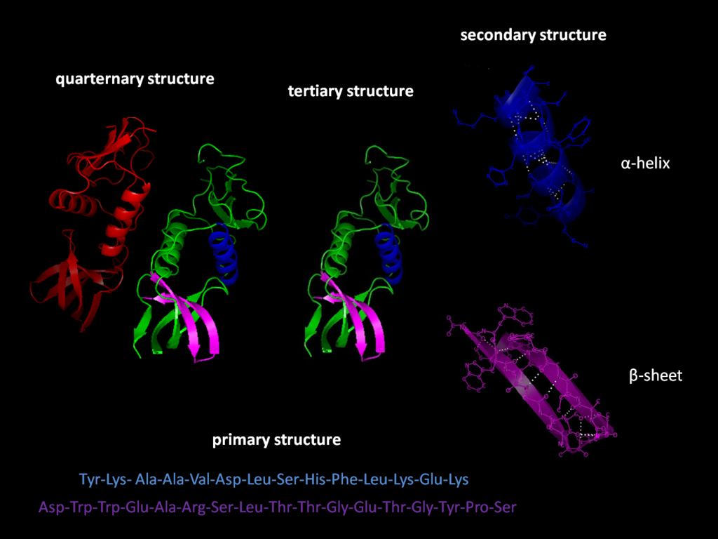
Levels of Protein Structure

