Slide 1
Protein Structure
-Primary and Secondary Structure-
Chapter 3 (Page 96-97; 106-107)
Chapter 4 (Page 116-125)

Slide 2
1. Protein Structure
Provides deep insight into:
Protein function and stability
The evolutionary relatedness of all proteins, and more fundamentally of all organisms
Disease
Though it can be quite complex and diverse, protein structure can be broken down to four levels of structure.

Slide 3
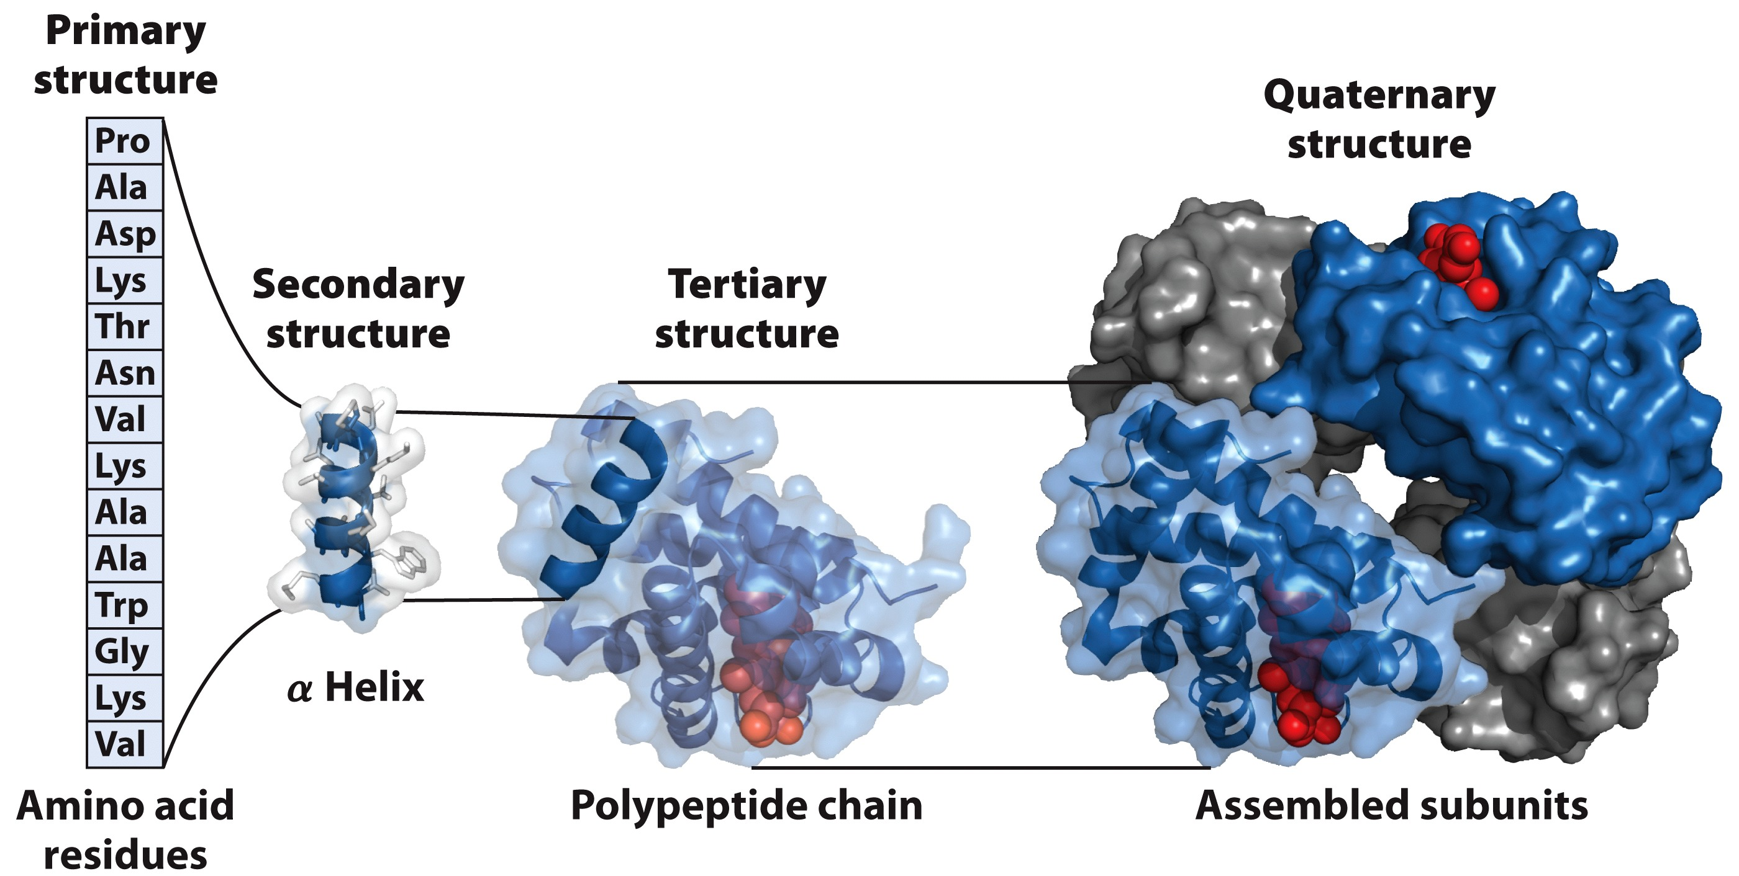
The 4 Levels of Protein Structure

Slide 4
2. Primary Structure
In our discussions of amino acids, amide and disulfide bond formation, and protein sequencing we have essentially alluded to the primary structure of proteins.
The sequence of amino acid residues (i.e. HAYP…)
A description of all COVALENT bonds linking amino acids
Bond strength ~200 to 460 kJ/mol for covalent bonds in proteins

Slide 5
2. Primary Structure
C. Proteins can be polymorphic
20-30% of proteins in humans have amino acid sequence variants
The variations can have little or no effect on protein function especially if conservative variations such as Asp substituting for a Glu

Slide 6
2 I. Protein Homology dictates Evolutionary Ties
Protein homology refers to the degree to which the AA sequences of proteins is the same
Typically measured in % homology
% homology, evolutionary relatedness
B. AA sequence can vary considerably yet as long as crucial regions are conserved, proteins may exhibit similar function
Crucial regions such as AA that are important for ligand (or substrate) binding
The conserved primary structure of these regions will not result in comparable activity if other levels of structure are widely different

Slide 7
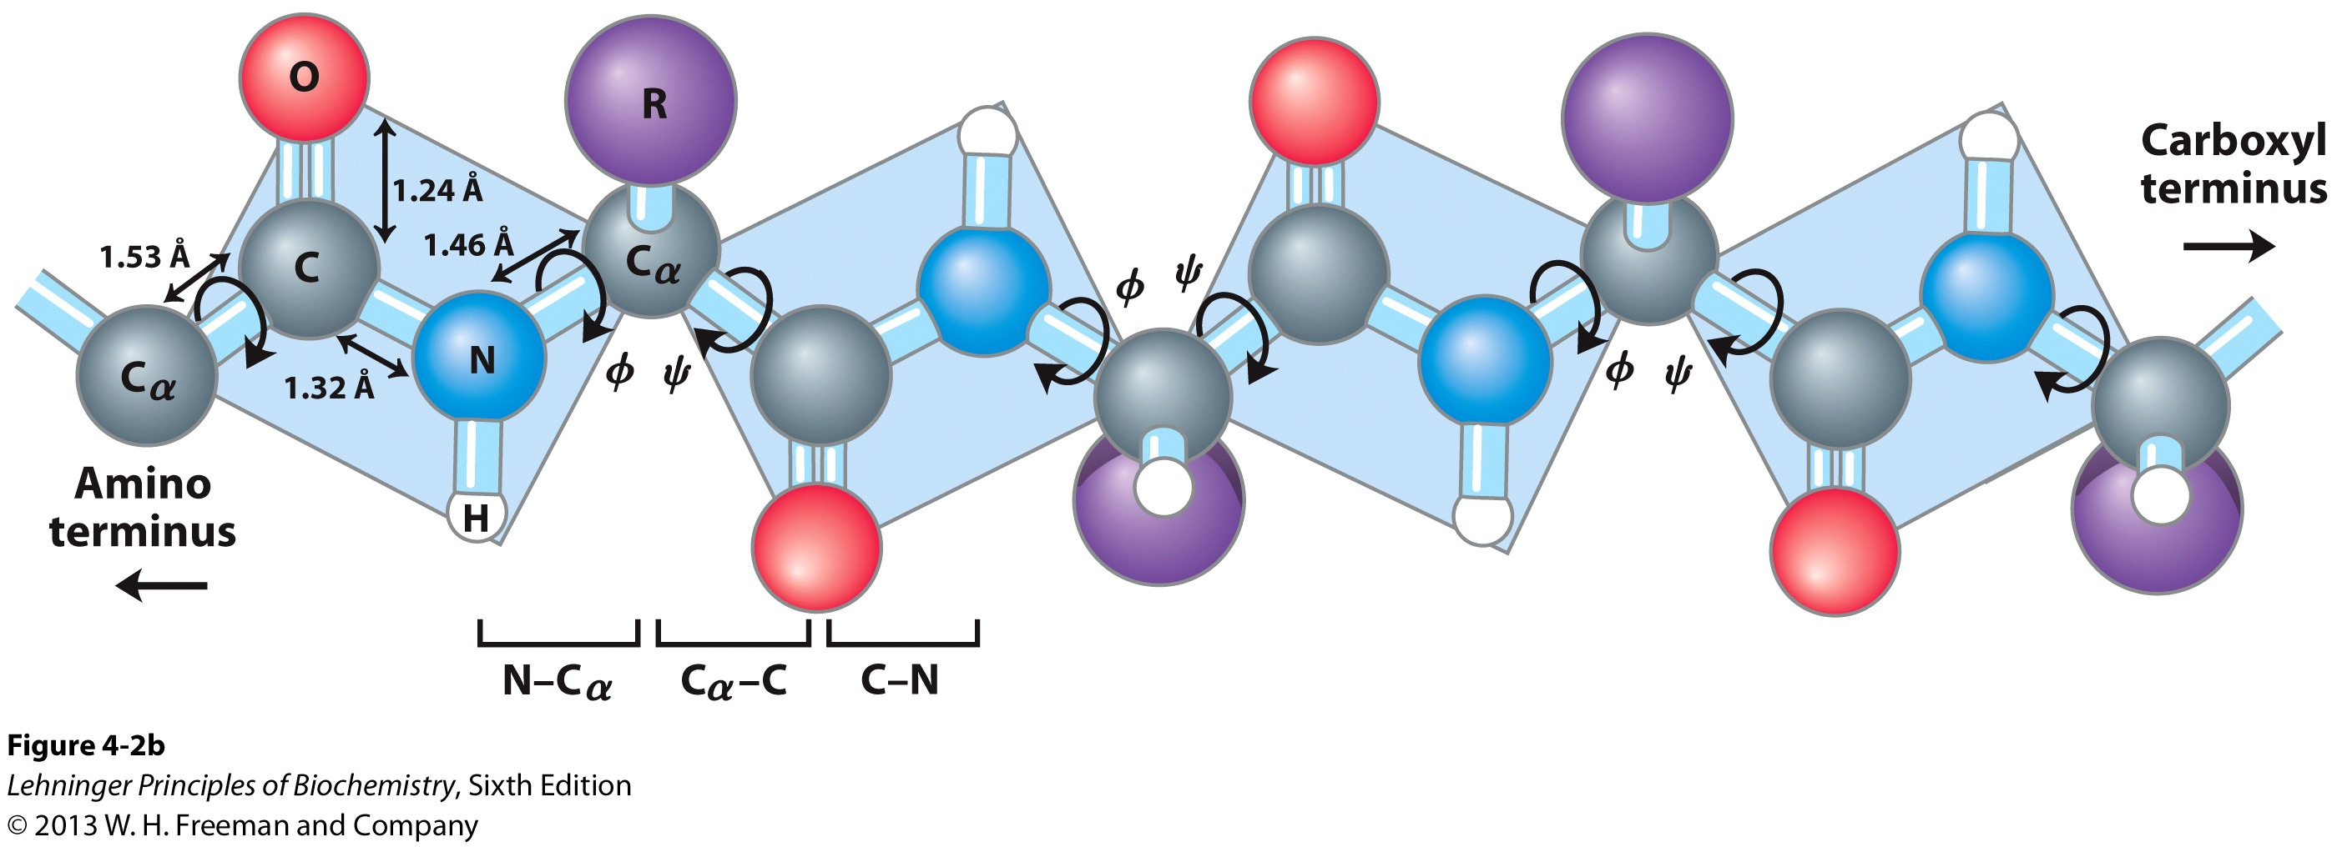
2II. Arrangements of the Atoms in Primary Structure
Covalent bonds place important constraints on the conformation of a polypeptide.
3 D Structure

Slide 8
2II. Arrangements of the Atoms in Primary Structure
B. Peptide C-N bond is shorter than normal C-N bonds
C. Six atoms of the peptide group lie in a single plane

Slide 9
2II. Arrangements of the Atoms in Primary Structure
D. There are two bond angles resulting from rotation at Cα
ϕ (phi) for N-Cα
Ψ (psi) for Cα-C bond
When ϕ = Ψ = 180°; fully extended
conformation
Many angles prohibited due to steric interference between atoms in polypeptide backbone and amino acid side chains
ϕ = Ψ = 0 PROHIBITED

Slide 10
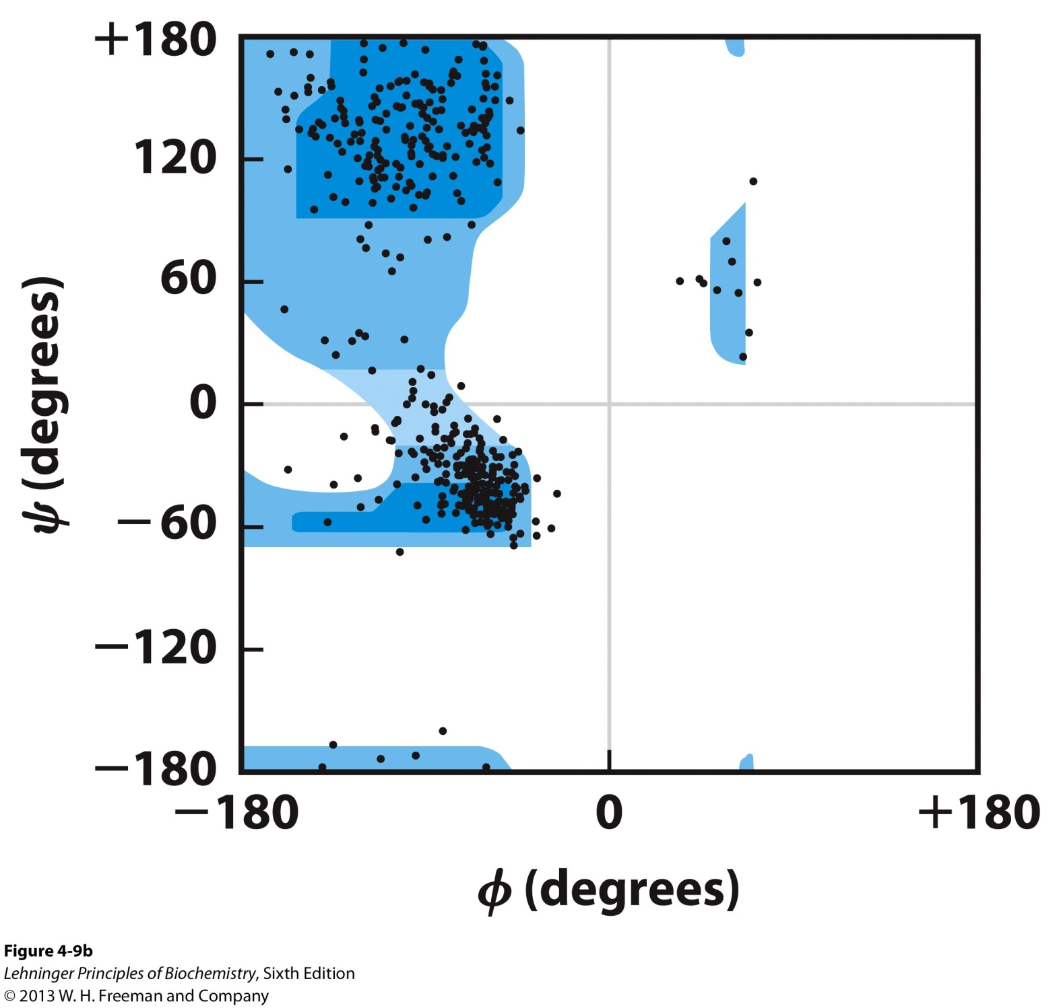
The Ramachandran Plot
This plot depicts the allowed values for ϕ and Ψ for sequences of a particular AA. All plots are similar except for glycine.

Slide 11
3. Secondary Structure
This level of structure refers to the local conformation of some portion of a protein
Characterized by recurring structural patterns
Linus Pauling and Robert Corey predicted and discovered two of the most prominent secondary structures (1951) even before the first complete protein structure was determined
Demonstrated the importance of NONCOVALENT interactions, particularly hydrogen bonding
Polar C=O and N-H groups of amino acids can engage in H Bonds
C=O H-N
…

Slide 12
3I. The Alpha (α) Helix
The simplest arrangement the polypeptide chain could assume with its rigid peptide bonds is a helical structure
Stabilized by H bonds between nearby residues
Backbone is tightly wound around an imaginary axis

Slide 13
3I. The Alpha (α) Helix
D. The R groups of the AA residues protrude outward from the helix backbone
E. Repeating unit
A single turn of the helix, 5.4 Å along the long axis
Includes 3.6 AA residues
F. Helical twist is right-handed

Slide 14
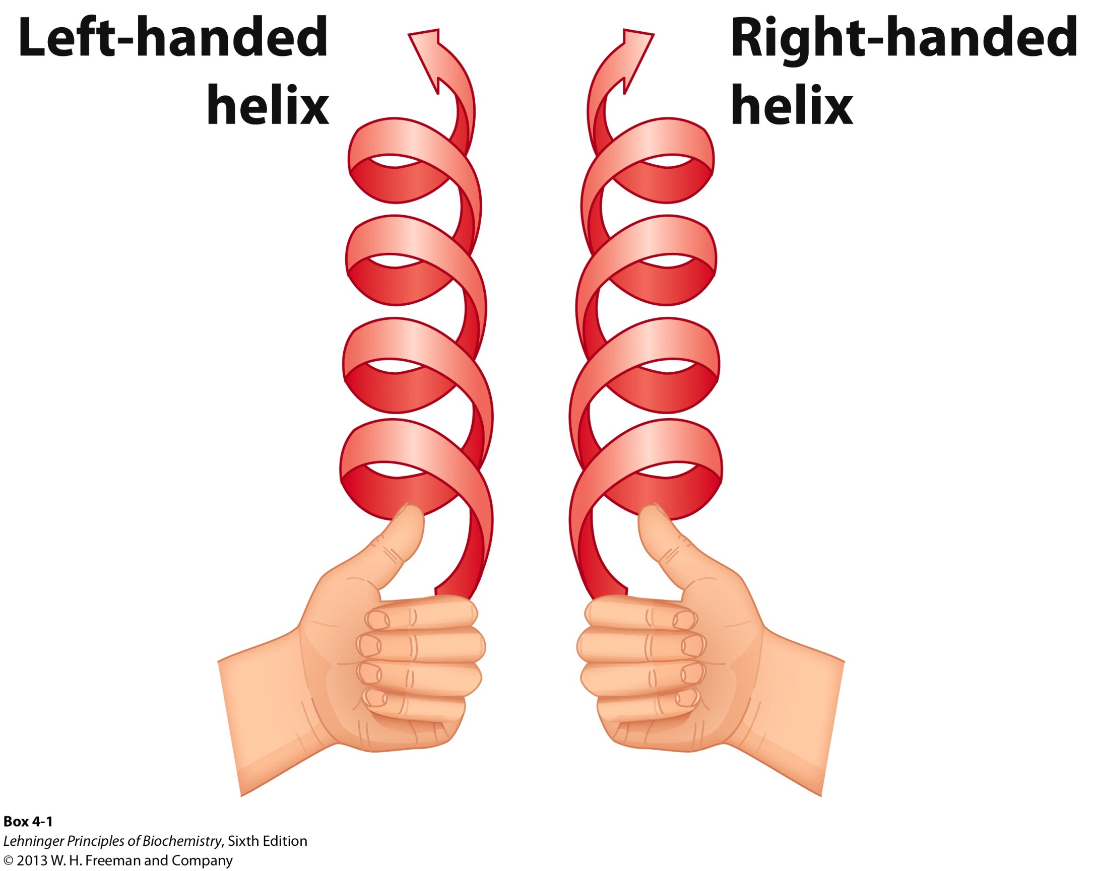
Right-handed Helical Twist

Slide 15
3I. The Alpha (α) Helix
G. The helix makes optimal use of internal H bonds
3 to 4 H bonds for each turn
Every peptide bond (except @ N and C-terminus ends) engages in H Bond between H of N atom in amide bond and the O atom of the 4th AA on the amino terminal side
H. Predominant secondary structure
Excellent stability
Atoms in close contact
Space Filling view

Slide 16
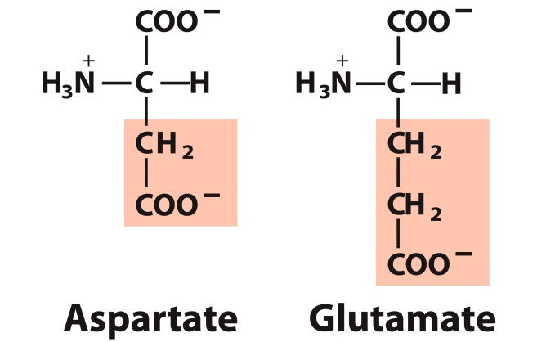
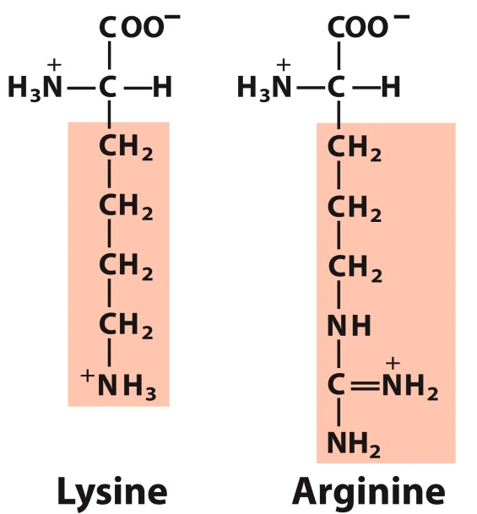
3Ib. Some Amino Acids resist α Helix Structure
Long block of Glu and/or Asp residues (negatively R groups) due to electrostatic repulsion
B. Long block of Lys and/or Arg residues (positively charged R groups) also due to electrostatic repulsion

Slide 17
3Ib. Some Amino Acids resist α Helix Structure
C. Gly has more conformational flexibility and adopts a coiled structure different from α Helix
D. Pro introduces a destabilizing kink due to its rigid ring structure
No N-Cα rotation

Slide 18
3Ic. Stabilizing Interactions in α Helices
Two AA will interact 3 AA units away through:
A. Ion pairing between positively charged and negatively charged AA
B. Hydrophobic interactions between aromatic AA
Ion pairing
or
Hydrophobic Interactions

Slide 19
3Id. α Helix Net Dipole
The polypeptide of an α Helix tends to have a net dipole that is extended through the H bonds.
Amino terminus has partial positive charge
Negatively charged AA at this end
Carboxy terminus has partial negative charge
Positively charged AA at this end

Slide 20
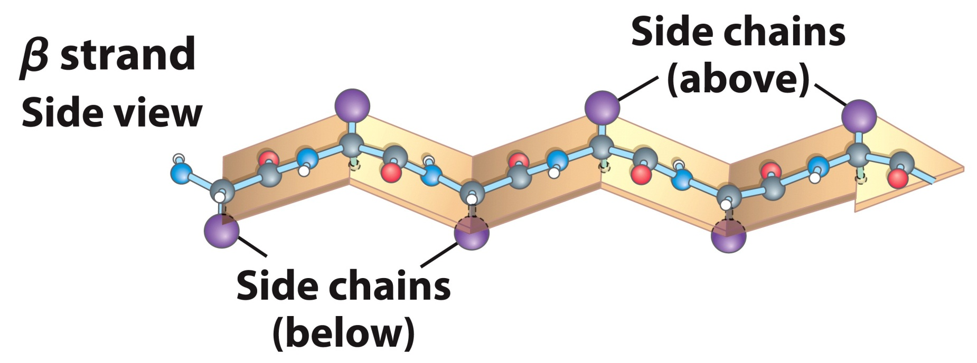
3II. The Beta (β) Sheet
More extended conformation of polypeptide chains
The planarity of the peptide bond and tetrahedral geometry of the α-carbon create a pleated sheet-like structure
Side chains protrude from the sheet alternating in up and down direction

Slide 21
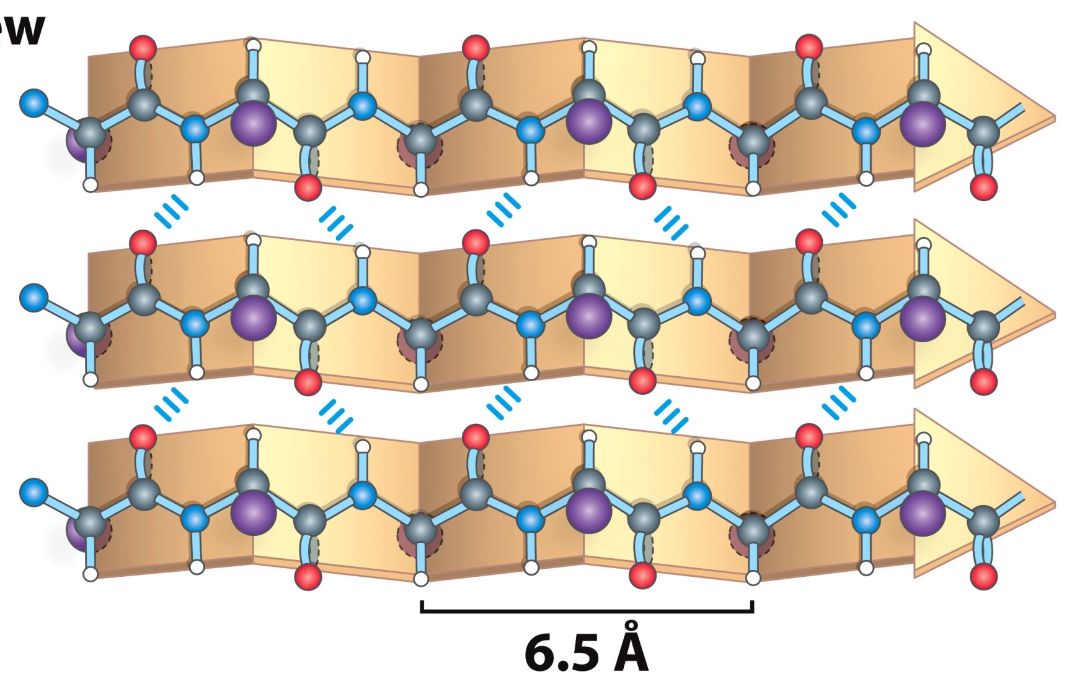
3II. The Beta (β) Sheet
D. Sheet-like arrangement of backbone is held together by hydrogen bonds between the backbone amides in different strands
Parallel Orientation
Strands have same amino-to-carboxyl orientations
Bent H-bonds
6.5 Å repeat units

Slide 22
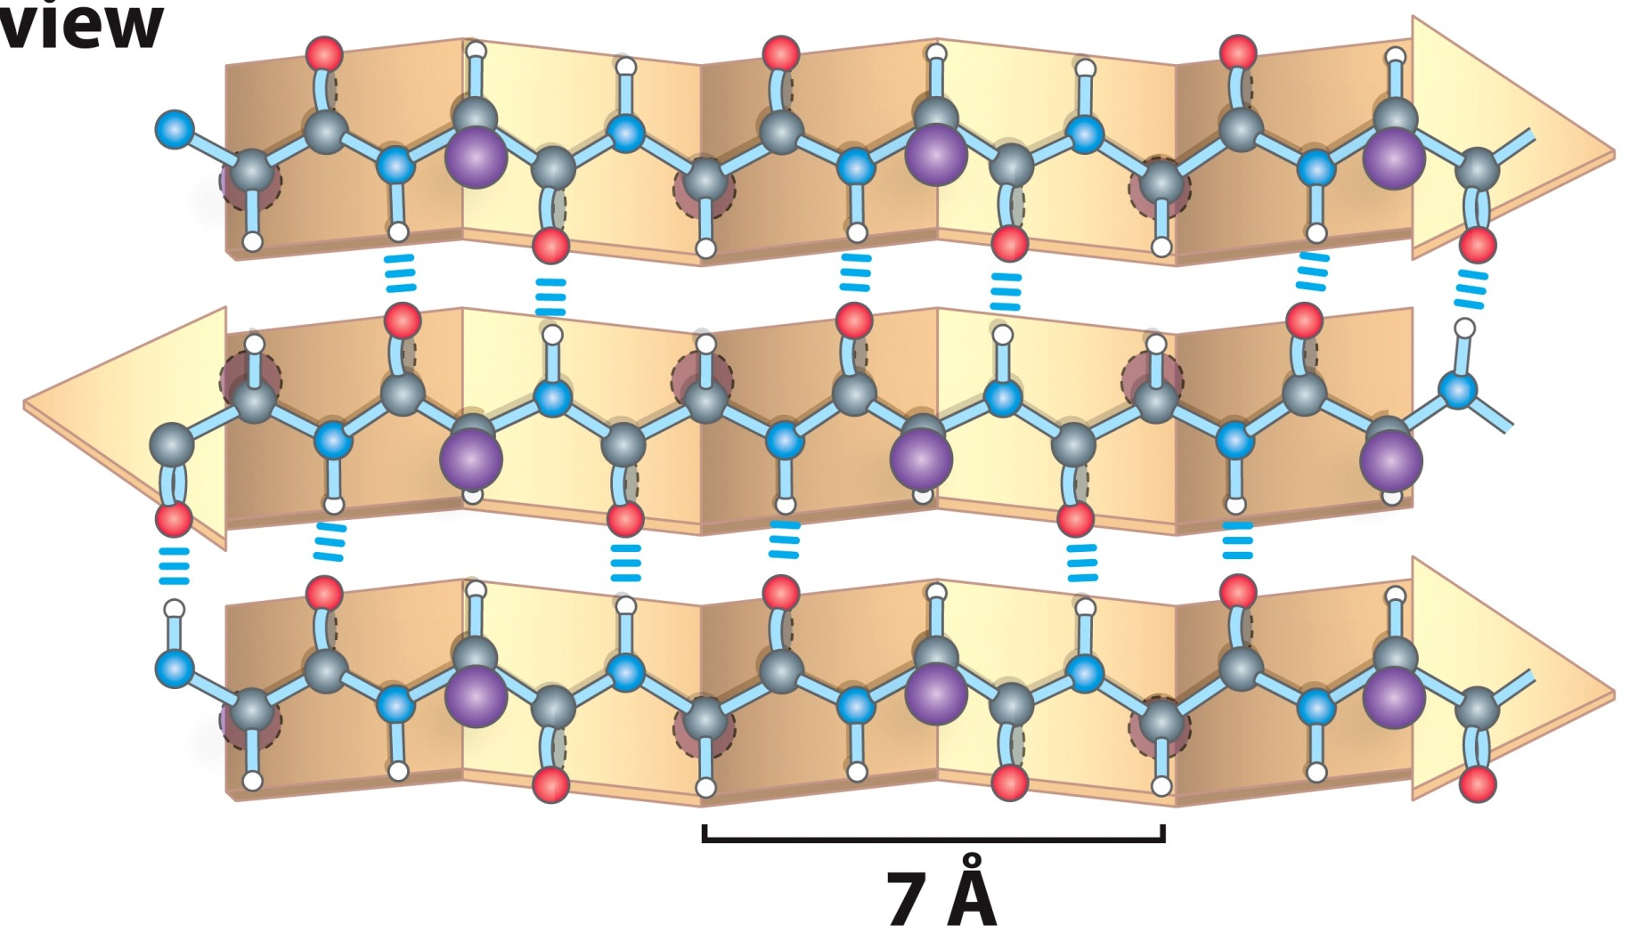
3II. The Beta (β) Sheet
Antiparallel Orientation
Strands have opposite amino-to-carboxyl orientations
Straight H-bonds (Stronger)
7.0 Å repeat units

Slide 23
3II. The Beta (β) Sheet
E. When two or more chains are layered together, the R groups of the AA must be relatively small
Proteins like β-Keratins have very high Gly and Ala content
F. The individual chains can be nearby or far in the protein

Slide 24
3III. The Beta Turns
β turns occur frequently whenever strands in β sheets change the direction
The 180° turn is accomplished over four amino acids
The turn is stabilized by a hydrogen bond from a carbonyl oxygen to amide proton three residues down the sequence
Proline in position 2 or glycine in position 3 are common in β turns

Slide 25
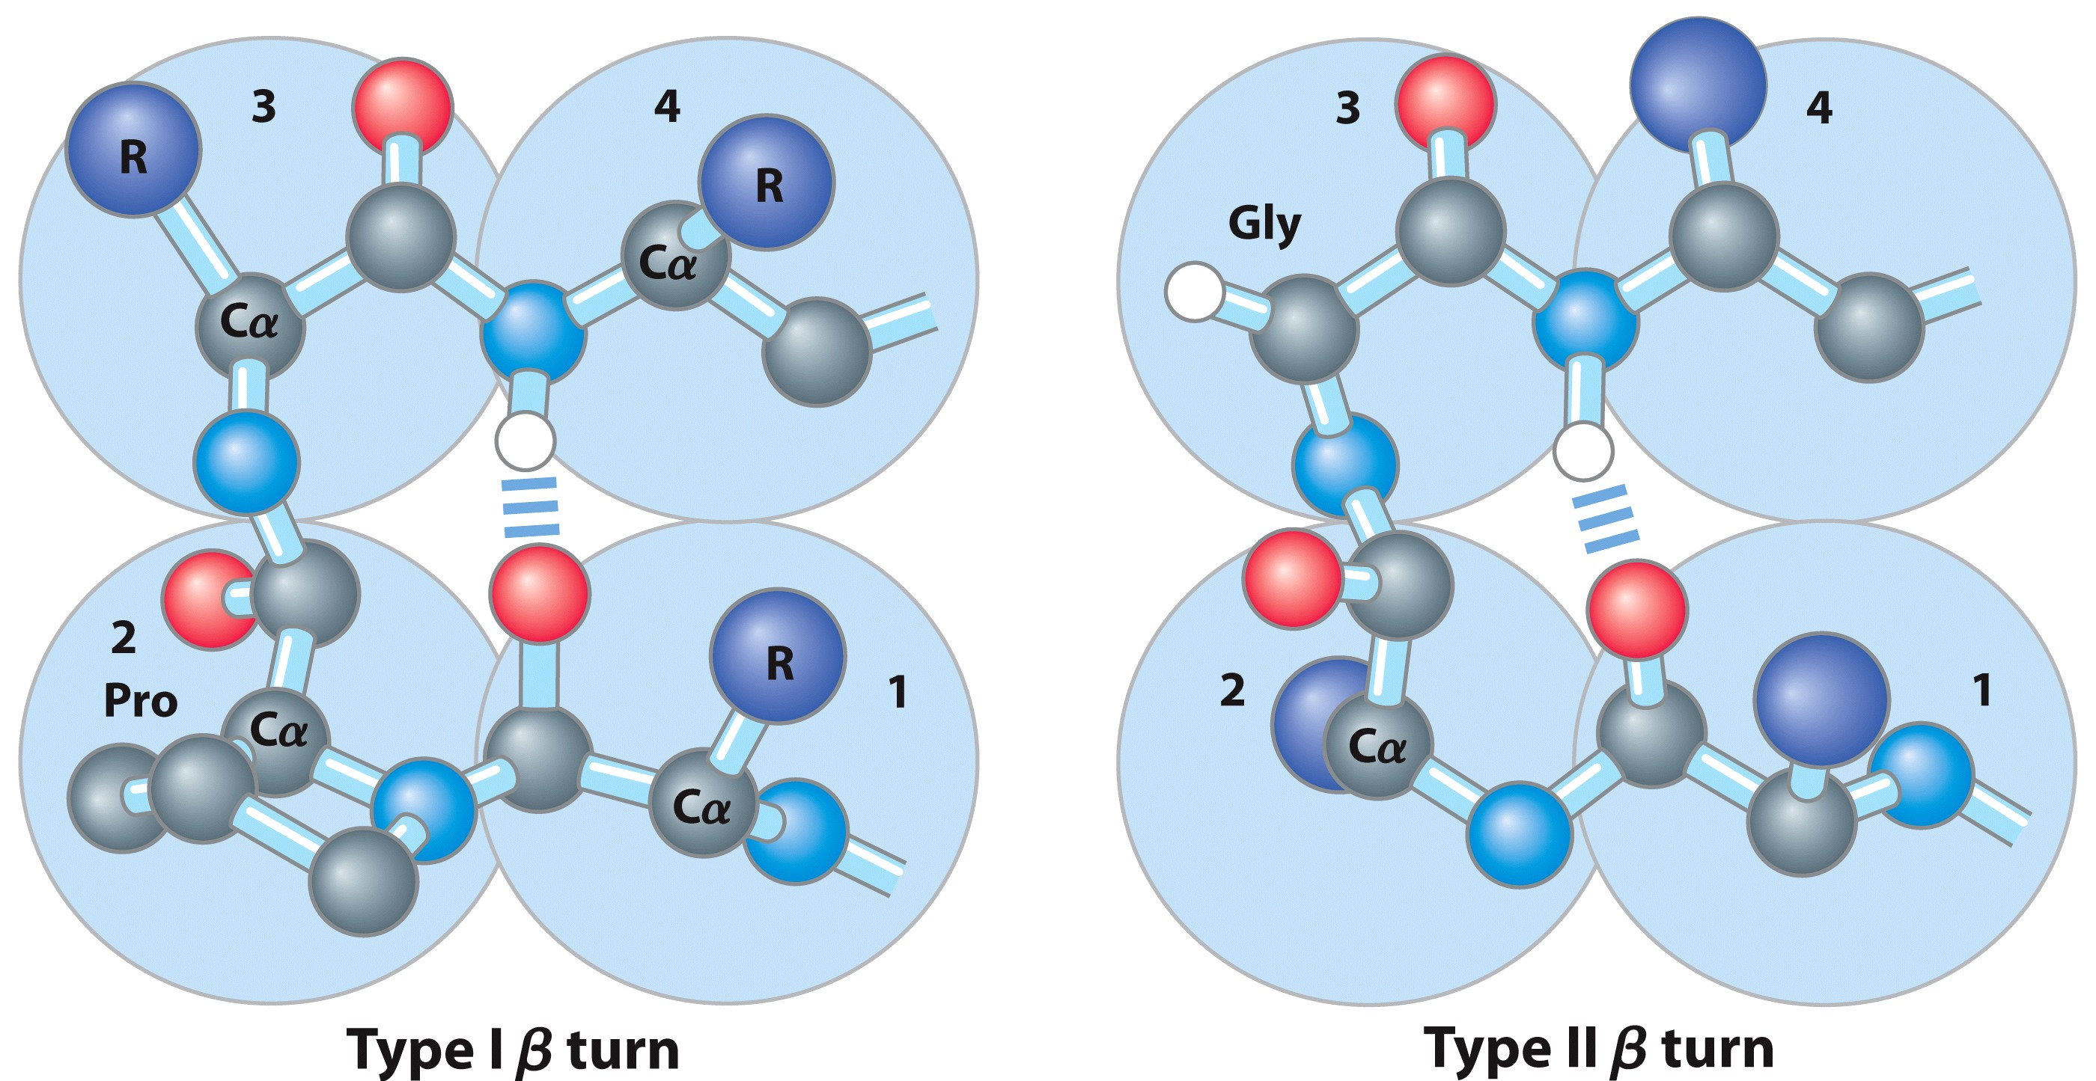
3IIIb. Two types of Beta Turns

Slide 26
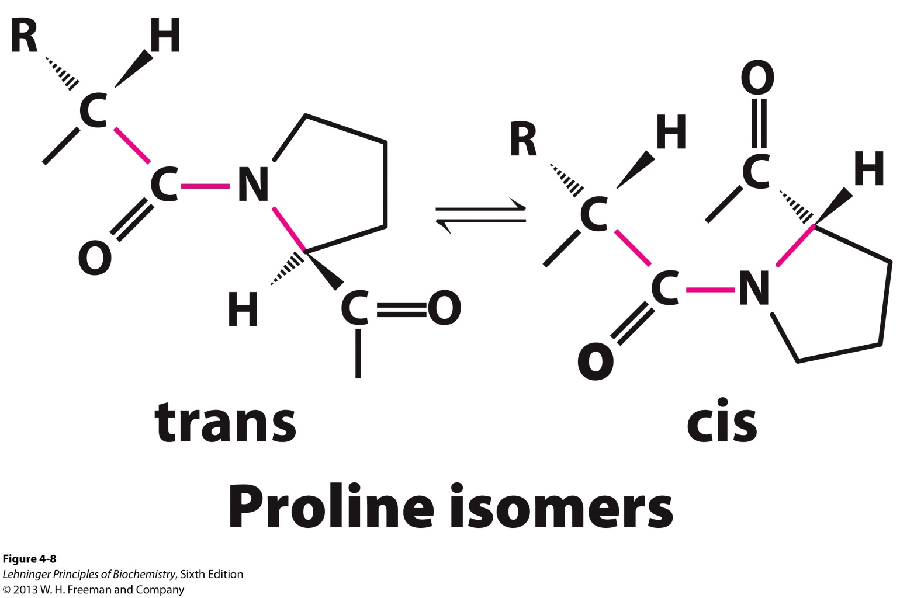
3IIIb. Two types of Beta Turns
Type 1 occurs twice as much as Type 2
Proline occurs at residue 2 because it can assume the cis configuration (6% frequency)
B. Type 2 always has a Gly as the 3rd residue

Slide 27
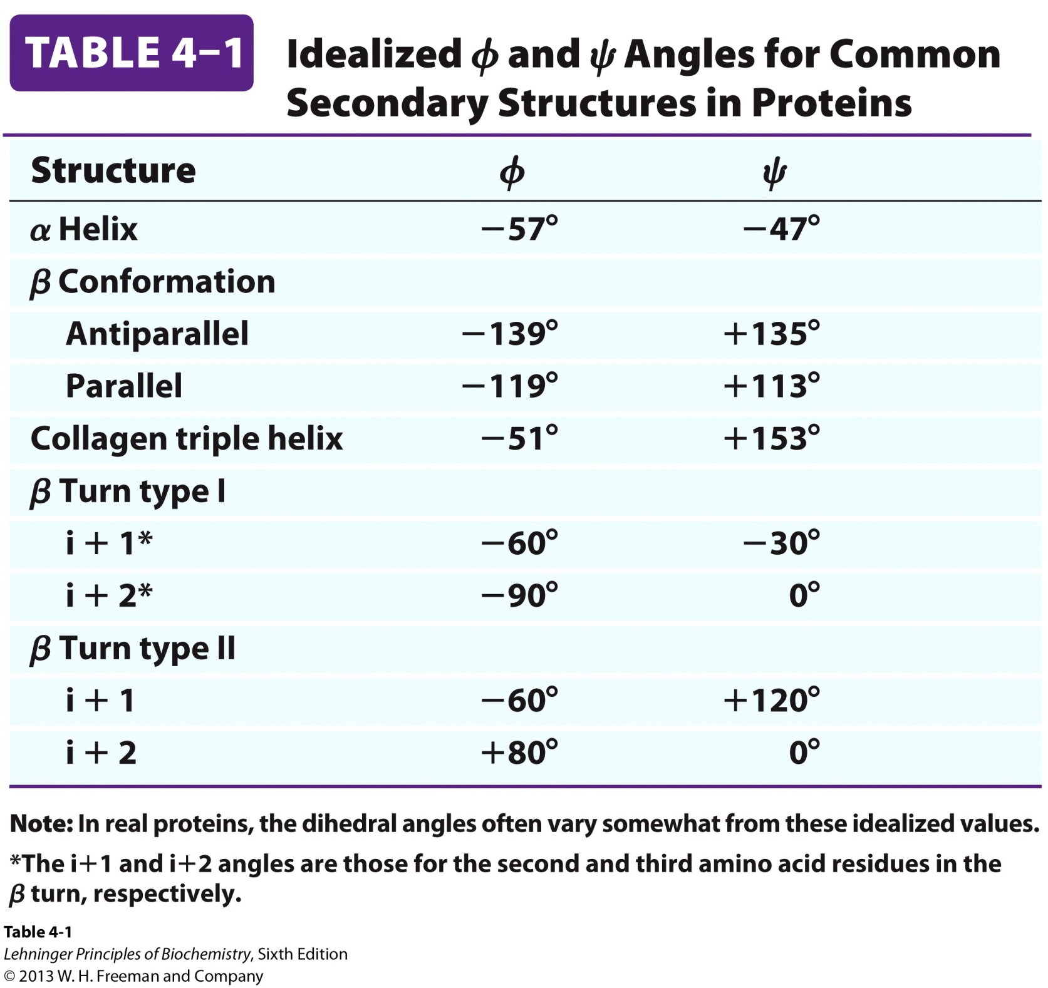
3IIIc. Secondary Structures have Characteristic Bond Angles

Slide 28
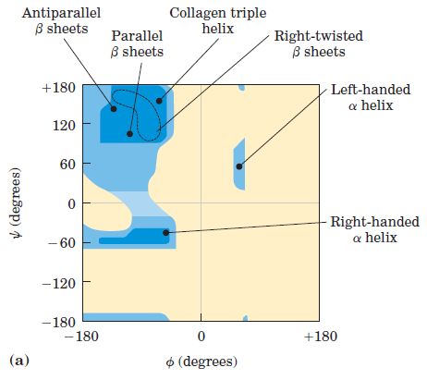
Ramachandran Plot for Secondary Structures

Slide 29
4. Spectroscopic Detection of Secondary Structure
Because proteins are made of amino acids, which are optically active, they exhibit circular dichroism (CD) spectroscopy
CD measures the molar absorption difference Δε of left- and right-circularly polarized light: Δε = ε_{L} – ε_{R}
Characteristic signals are produced based on the environment of the chiral molecule
CD signals from peptide bonds depend on the chain conformation

Slide 30
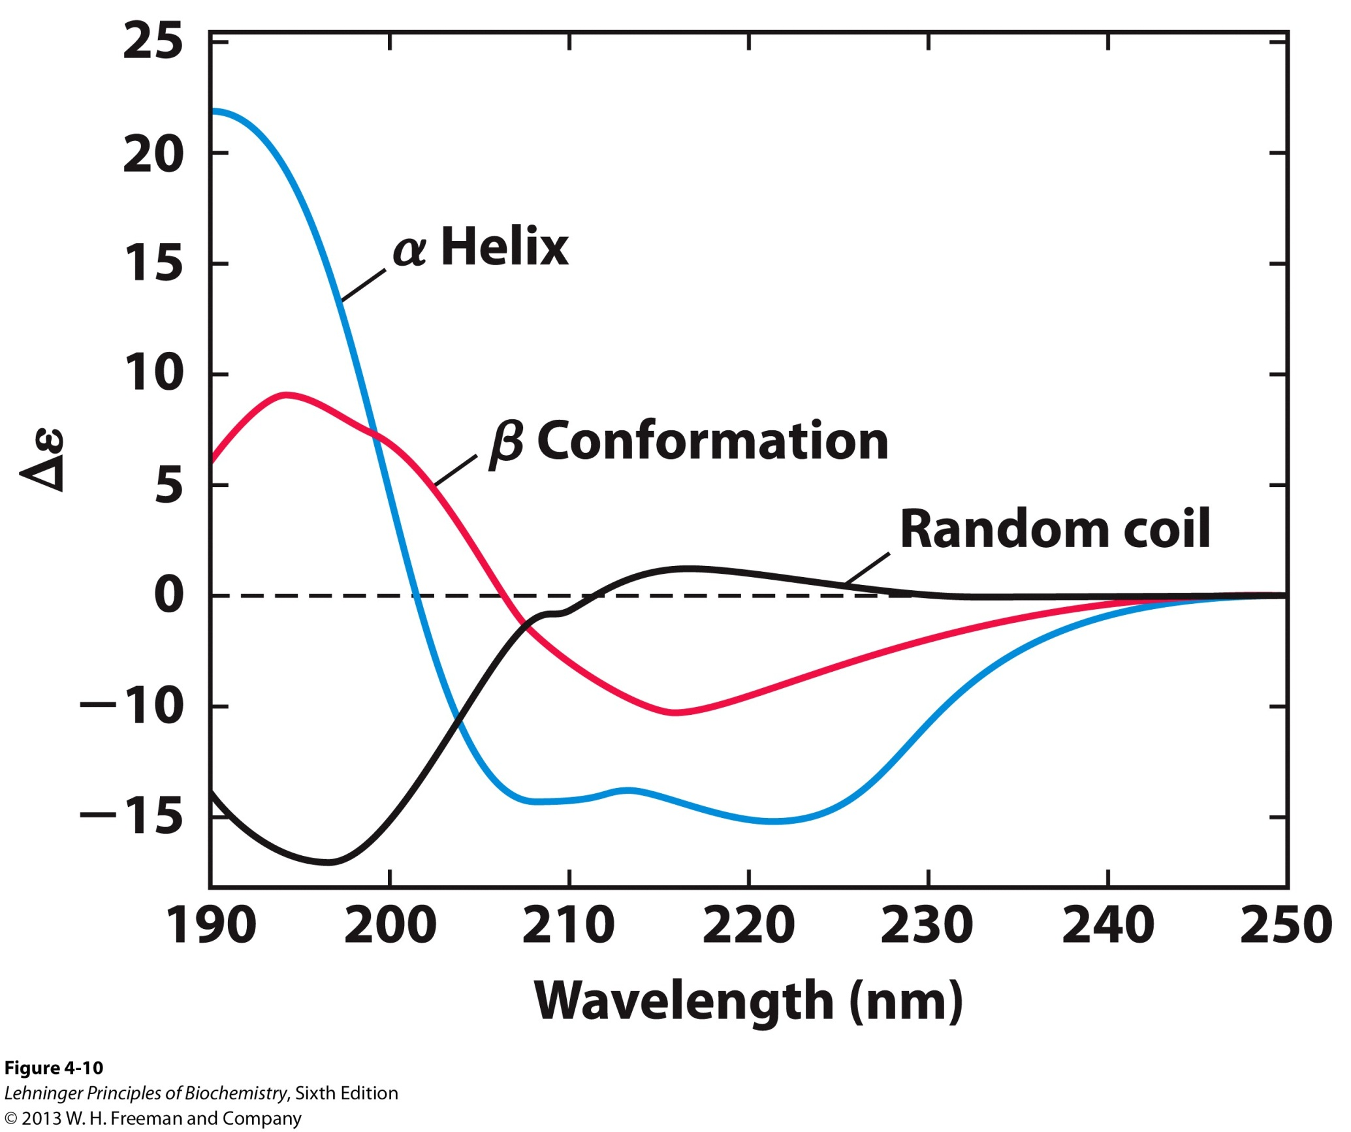
Characteristic Secondary Structure Signal

Slide 31
4. Spectroscopic Detection of Secondary Structure
D. CD in the ultraviolet region (UV), 190 to 250 nm, is used to investigate the secondary structure of proteins
E. % of α Helix and β Sheet can be determined from the CD spectrum
α Helix, CD spectrum will appear more α Helix in form
F. Change in CD spectrum indicates a structural change
Typically from one structure to a random coil

