Slide 1
Protein Structure
-Tertiary and Quaternary Structures-
Chapter 4 (Page 125-153)

Slide 2
1. Tertiary Structure
3-D arrangement of all atoms in a protein usually referred to as protein folding.
Includes longer-range aspects of AA sequence
Interactions of AA between far apart chains
Interactions of AA between chains of different secondary structures
For monomeric proteins, tertiary structure is the highest level of structure
Two main types of proteins

Slide 3
1. Tertiary Structure
E. Stable, folded conformation dictates the native state of the protein.
Stability defined relative to unfolded state
Native state may NOT be the most stable form of the protein. Often, ligand binding further stabilizes a protein.

Slide 4
1b. Native Proteins are only Marginally Stable
ΔΔG between folded and unfolded = 20 to 65 kJ/mol
Unfolded state is entropically favorable but weak noncovalent interactions within the protein and with water molecules counterbalance this
Water molecules can cause hydrophobic residues to interact in an orderly form
The water molecules adopt a highly structured shell called a solvation layer

Slide 5
2. Fibrous Proteins
Have polypeptide chains arranged in long strands or sheets; not compact
Consist of a single type of secondary structure
Serve the function of providing support, shape, and external protection
The strength of fibrous proteins is enhanced by covalent cross-links between polypeptide chains, such as disulfide bonds

Slide 6
2I. α-Keratin
Displays strength and structural function
Found in hair, nails, skin
Part of a broader family of proteins called intermediate filament (IF) proteins.

Slide 7
2I. α-Keratin
D. All IF proteins share structural features exhibited by α-Keratin
Consist of right-handed α-helices in a left-handed coiled coil (see structure in hair)
Parallel orientation of the strands
~5.2 Å per turn

Slide 8
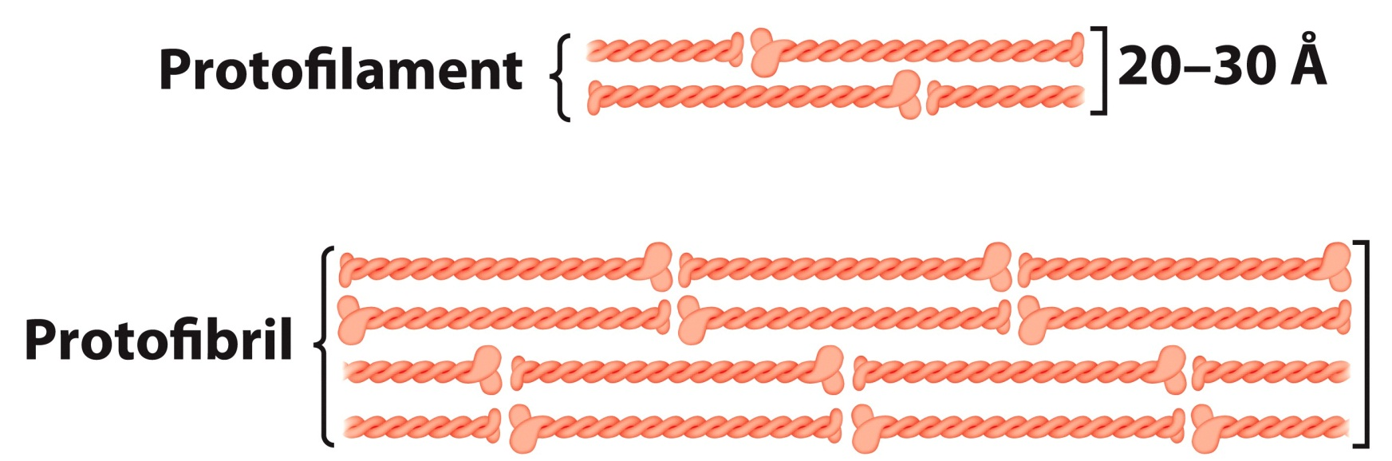
2I. α-Keratin
The surfaces where the two α-helices touch are made up of hydrophobic AA residues (Namely Ala, Val, Leu, Ile, Met, and Phe)
The two-chain coiled coils combine in higher-order structures called protofilaments and protofibrils stabilized by disulfide bonds

Slide 9
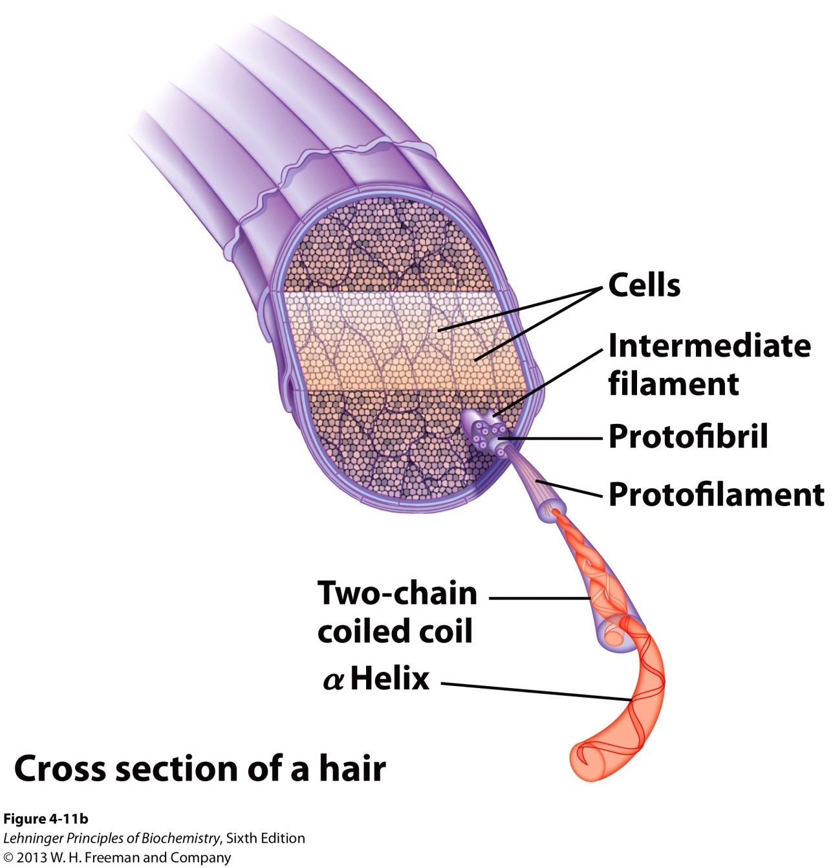
2I. α-Keratin

Slide 10
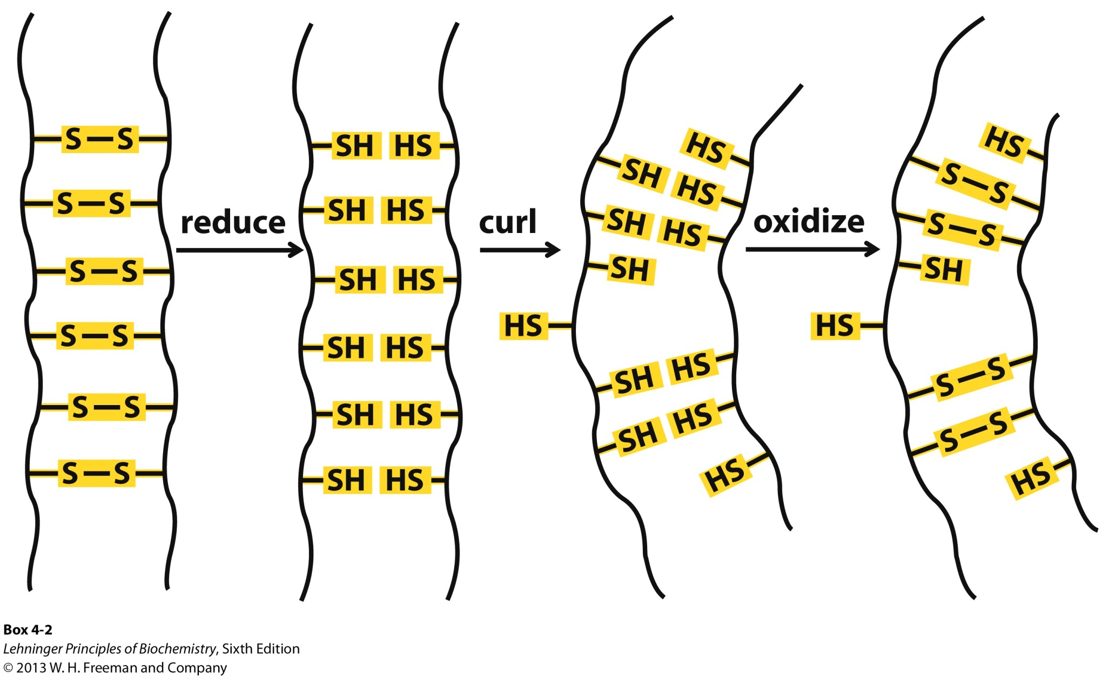
2Ib. Chemistry of Permanent Waving

Slide 11
2II. Collagen
Provides strength
Found in connective tissue such as tendons, cartilage, bones
Helical (α-chain) but unlike α-helix
Left-handed
3 AA per turn
High Gly content
D. Three α-chains are supertwisted in a right-handed manner
E. The triple helix has higher tensile strength than a steel wire of equal cross section

Slide 12
2II. Collagen

Slide 13
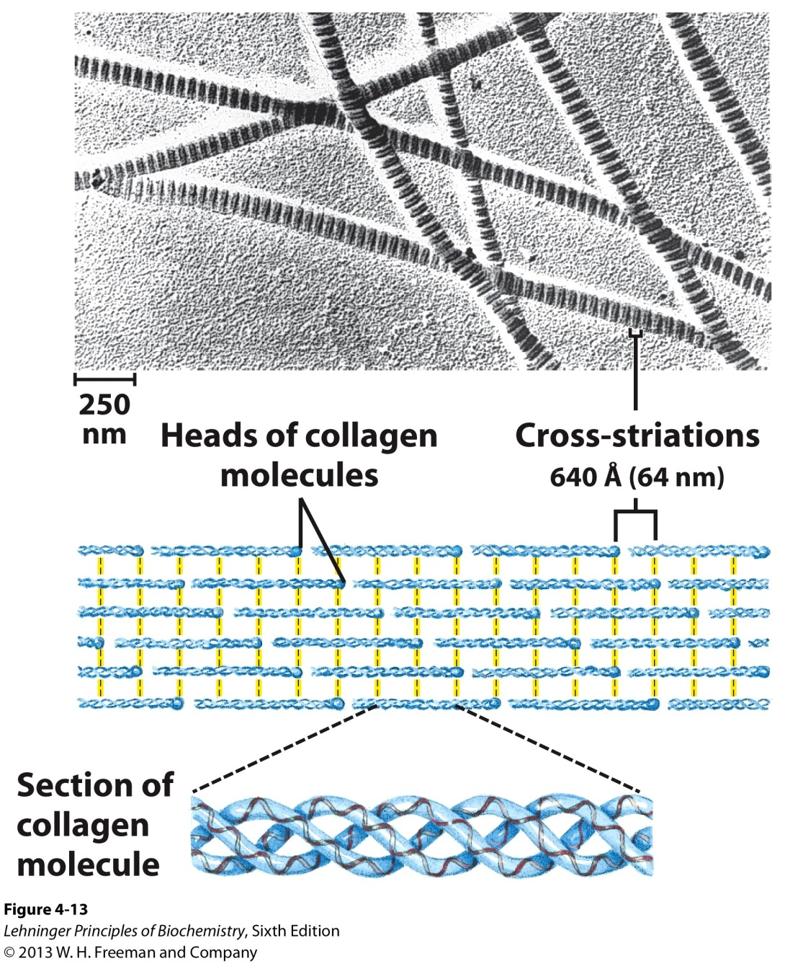
2II. Collagen
F. Many triple-helices assemble into a collagen fibril
Collagen molecules alligned
in a staggered fashion
Cross-linked by unusual
type of covalent bonds
involving Lys, His, or the
uncommon AA
5-hydroxylysine

Slide 14
3. Globular Proteins
Consist of different segments of a polypeptide chain that fold into a compact structure
i.e. Human Serum Albumin (64.5 kDa; 585 AA)
Native Globular form: 100 x 60 Å
β conformation: 2000 x 5 Å
α Helix: 900 x 11 Å
B. Include enzymes, transport proteins, motor proteins, regulatory proteins, immunoglobulins

Slide 15
3I. Myoglobin
3D structure determined from the x-ray diffraction studies of John Kendrew et al (1950s)
Relatively small; 16.7 kDa; 153 AA
Oxygen-binding protein of muscle cells
Distributes and stores O₂ in muscle
D. Consist of 8 α helices and 8 β turns
E. Fe(II) bound heme prosthetic group, responsible for binding O₂

Slide 16
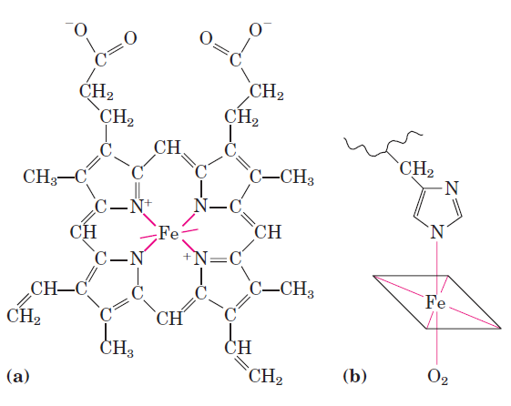
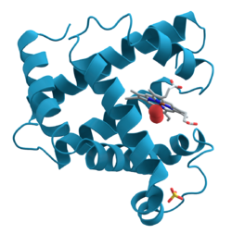
3I. Myoglobin
Heme:
Porphyrin Ligand
Covalent bond with
His residue
Reversible binding of O₂ to Fe(II) is important for breathing.
Fe(II) oxidation to Fe(III) results in dissociation of O₂ because Fe(III) has a poor affinity for O₂.

Slide 17
3I. Myoglobin
F. Much of the protein’s stability is derived from hydrophobic interactions.
The hydrophobic R groups are in the interior
Only 4 H₂O molecules in the interior
The dense hydrophobic core is typical of globular proteins
G. Polar R groups are mostly on the surface surrounded by water
Red: Hydrophilic AA
Blue: Hydrophobic AA
Green: Heme

Slide 18
3II. Protein Folding
Protein folding can be quite complex and therefore it is easiest to discuss it in terms of common structural patterns.
Supersecondary structures (i.e. motifs or folds) are particularly stable arrangements of several elements of secondary structure and the connections between them.
Will discuss them in the context of protein folding rules.

Slide 19
3II. Protein Folding
Hydrophobic interactions are extremely important to protein structure stability. The burial of hydrophobic AA (to exclude water) requires at least two layers of secondary structure.
B. α helices and β sheets are generally in different structural layers due to inefficient hydrogen
bonding

Slide 20
3II. Protein Folding
C. Polypeptide segments adjacent to each other in the primary sequence are usually stacked adjacent to each other in the folded structure
D. Connections between elements of secondary structure can not cross or form knots

Slide 21
3II. Protein Folding
E. The β conformation is most stable when the individual segments are twisted slightly in a right-handed sense.
Twisting leads to twisted segments
Twisted β Sheet
β Barrel

Slide 22
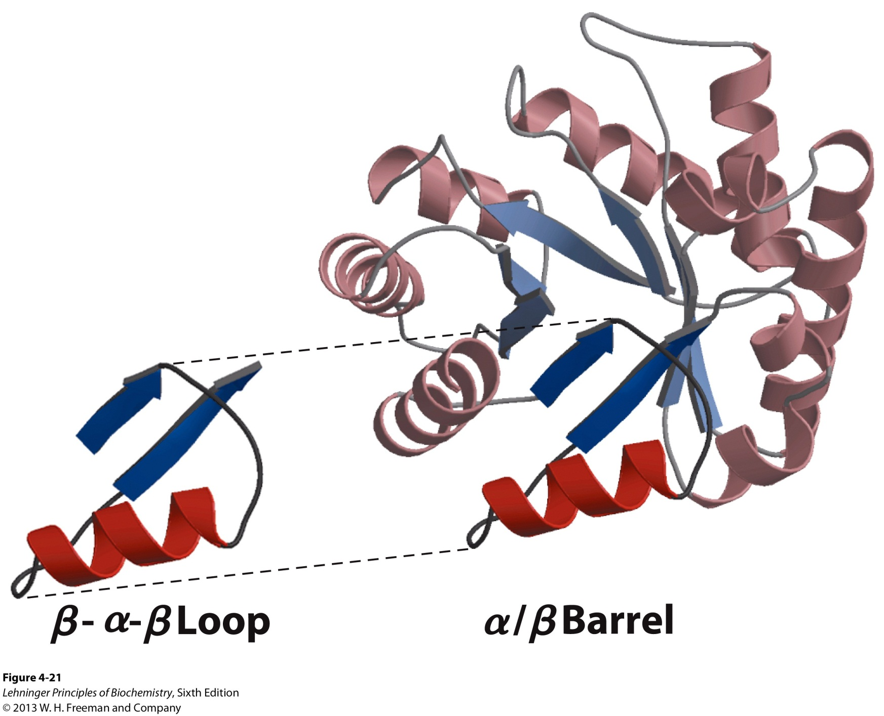
3IIb. Complex Motifs can be built up from simpler ones

Slide 23
3IIc. Organization of Proteins based on Motifs
All α
All β
Serum Albumin
Bacterioferritin
α-Amylase
inhibitor tendamist
UDP N-acetylglucosamine
acyltransferase

Slide 24
3IIc. Organization of Proteins based on Motifs
C. α/β (The α and β segments
are interspersed)
D. α + β (The α and β segments are segregated)
Alcohol Dehydrogenase
Pilin

Slide 25
3III. Tertiary Structure and Evolutionary Ties
Protein tertiary structure is often more reliably conserved than primary sequence.
Protein structure can give great insight into evolution
Proteins with significant primary sequence similarity and/or significantly similar function are grouped into the same Protein Family
Two or more families with little primary sequence similarity but same major structural motifs and similar functions are grouped as Super Families

Slide 26
4. Quaternary Structure
When a protein has two or more polypeptide subunits held together by hydrophobic interactions, hydrogen bonds, disulfide bonds
Is the highest level of structure for this type of protein
Multisubunit proteins tend to play regulatory roles
Binding of small molecules may affect the interaction between subunits
Separate subunits may play different but related functions

Slide 27
4I. Nomenclature
A multisubunit protein is called a multimer and can be named by the number of subunits
If 4 subunits, tetramer
Multimer with just a few subunits (≤ 4) is called an oligomer
A repeating structural unit, whether a single subunit or a group of subunits, is called a protomer

Slide 28
Hemoglobin is a Tetramer
α Subunits
β Subunits
4 polypeptide chains
4 Fe(II)-heme groups for O₂ binding
2 α, 2 β segments
Also known as (AKA) Dimer of αβ protomers

Slide 29
4Ib. Geometry
A multimer may be composed of several nonidentical subunits resulting in complex, asymmetric structure
Typically though, multimers are arranged in one or a limited set of symmetric patterns
Rotational symmetry- Individual subunits can be superimposed on others by rotation about one or more rotational axes
Helical symmetry- The units are related by a screw axis (a translation and rotation operation)

Slide 30
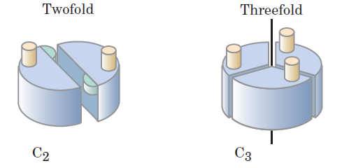
4Ic. Rotational Symmetry
Cyclic Symmetry- Rotation about a single axis.
The protein has a symmetry defined by convention as C_{n}
C: Cyclic
n: # of subunits related by the axis

Slide 31
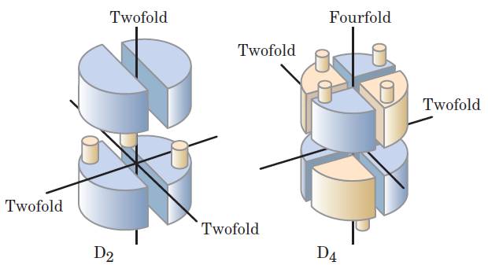
4Ic. Rotational Symmetry
B. Dihedral Symmetry- A twofold rotational axis intersects a n-fold axis at right angles
D_{n}: Protein has 2n protomers
i.e. D₂ protein has 4 protomers

Slide 32
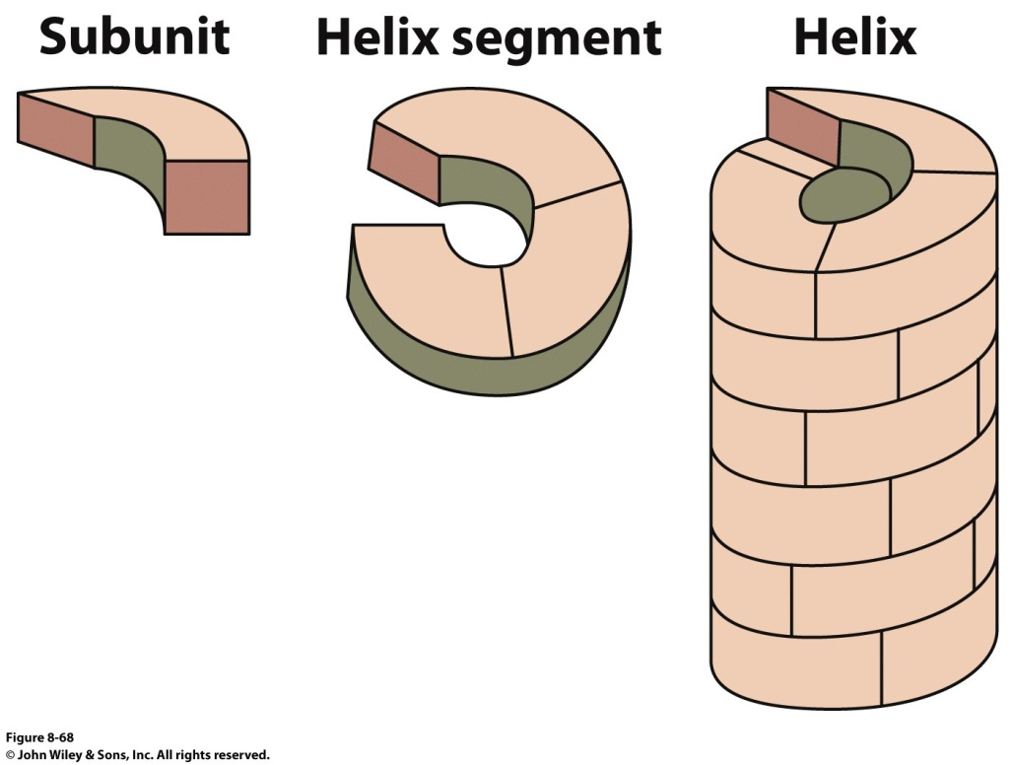
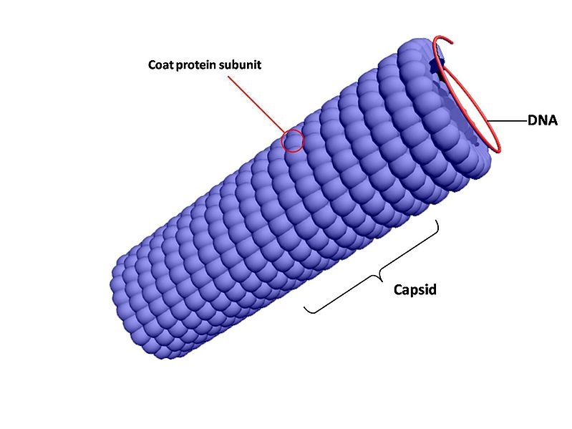
4Ic. Helical Symmetry
Proteins with helical symmetry form structures that are open-ended and spiral
i.e. Capsid: Protein shell of a virus
Capsid
Helical Symmetry

Slide 33
5. Protein Stability
Protein Size
Proteins subunits are typically < 100 kDa
Size of proteins is limited by the error frequency during protein biosynthesis
Error frequency: 1 mistake in 10,000 AA
Though low, the mistake has high probability for production of damaged, unstable protein
Protein can’t fold
Important residue for binding is missing or a conservative substitution did not occur

Slide 34
5. Protein Stability
B. Protein Cleavage and Folding
Protein subunits (>100 AA) often fold into two or more stable, globular units called domains.
A domain will often retain 3D structure even when separated from large protein via cleavage
C. Protein Denaturation and Folding
Denaturation is a loss of 3D structure, which results in the loss of function
Complete unfolding does not occur nor complete randomization of conformation

Slide 35
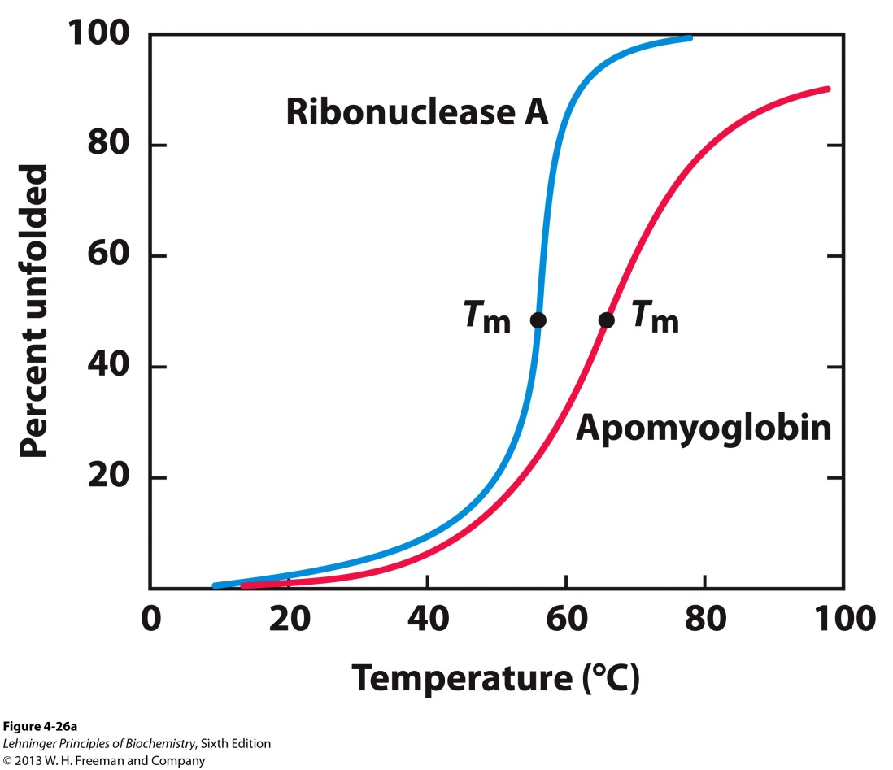
5I. Sources of Denaturation
Heat: Thermal denaturation can be gauged by a number of techniques, such as fluorescence. Changes in environment of aromatic AA, changes protein fluorescence.
Unfolding exposes Trp residues and increases fluorescence.
Unfolding, Fluorescence

Slide 36
5I. Sources of Denaturation
Heat affects the weak interactions in a protein in a complex manner
If increase Temp. slowly, a protein’s conformation remains intact until an abrupt loss of structure occurs over a narrow temp. range.
The midpoint of this range is T_{m} (Melting temp.)
Abruptness indicates there is cooperativity in the unfolding process. Loss of structure in one part leads to instability in another.
If not cooperative, protein unfolding would occur just by raising the Temp. Would be a linear dependence.

Slide 37
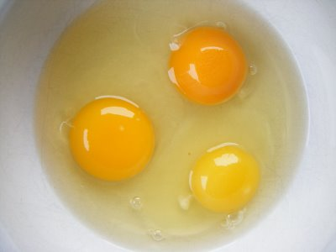
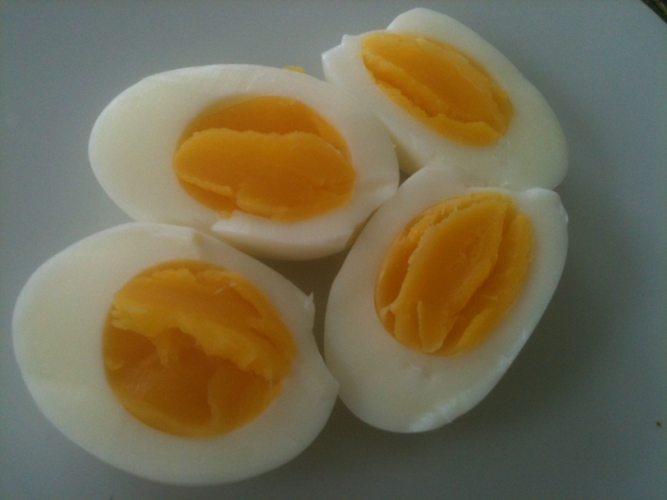
5I. Sources of Denaturation
Heat denaturation can be reversible, semi reversible, or irreversible
Classic irreversible example
Albumin

Slide 38
5I. Sources of Denaturation
B. Extreme pH alters net protein charge
Changing protonation states can disrupt hydrogen bonds
C. Organic solvents
D. Solutes such as urea and guanidine hydrochloride (Gu·HCl)
E. Detergents
Note: C, D, E disturb hydrophobic interactions
F. Reducing agents
Break up disulfide bonds

Slide 39
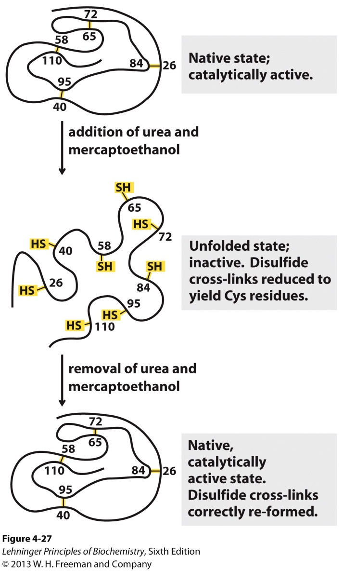
5II. Protein Renaturation
Certain proteins will regain their native structure and their biological activity if returned to conditions in which the native conformation is stable

Slide 40
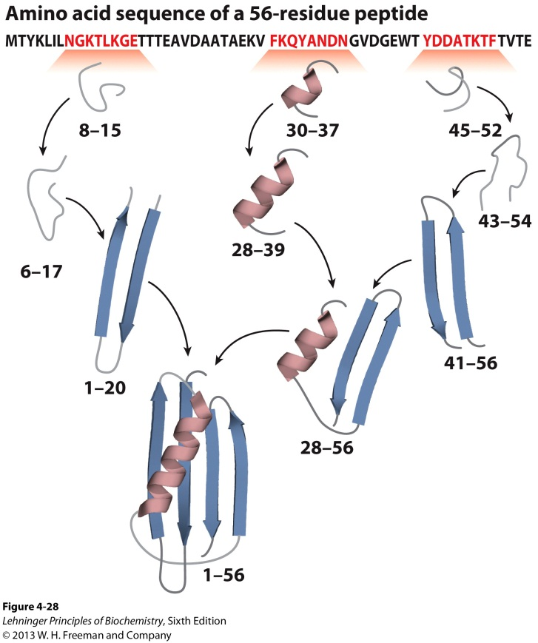
5III. Models for Protein Folding
The “correct” AA primary sequence is necessary for proper tertiary structure folding. (Christian Anfinsen, 1950s).
Protein folding is NOT RANDOM.
Hierarchical Fold
Local secondary structure first
Longer range supersecondary structures next
Tertiary then quaternary structure

Slide 41
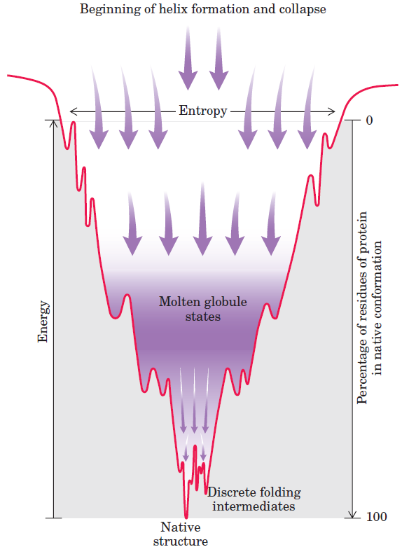
5III. Models for Protein Folding
B. Collapsed State Model (Molten globule)
Folding is initiated by a spontaneous collapse of the polypeptide into a compact state mediated by hydrophobic interactions

Slide 42
5IV. Folding facilitated by specialized proteins
Folding for many proteins is facilitated by the action of specialized proteins.
Molecular chaperones are proteins that interact with partially folded or improperly folded polypeptides
Hsp70 (MW 70 kDa) family of proteins
Chaperonins
Two enzymes catalyze isomerization reactions
Protein disulfide isomerization (PDI)
Peptide prolyl cis-trans isomerase (PPI)

Slide 43
6. Techniques to Study Protein Fold
X-ray Crystallography
Steps needed
Purify the protein
Crystallize the protein
Collect diffraction data
Calculate electron density
Fit residues into density
Pros
No size limits
Well-established
Cons
Difficult for membrane proteins
Cannot see hydrogens

Slide 44
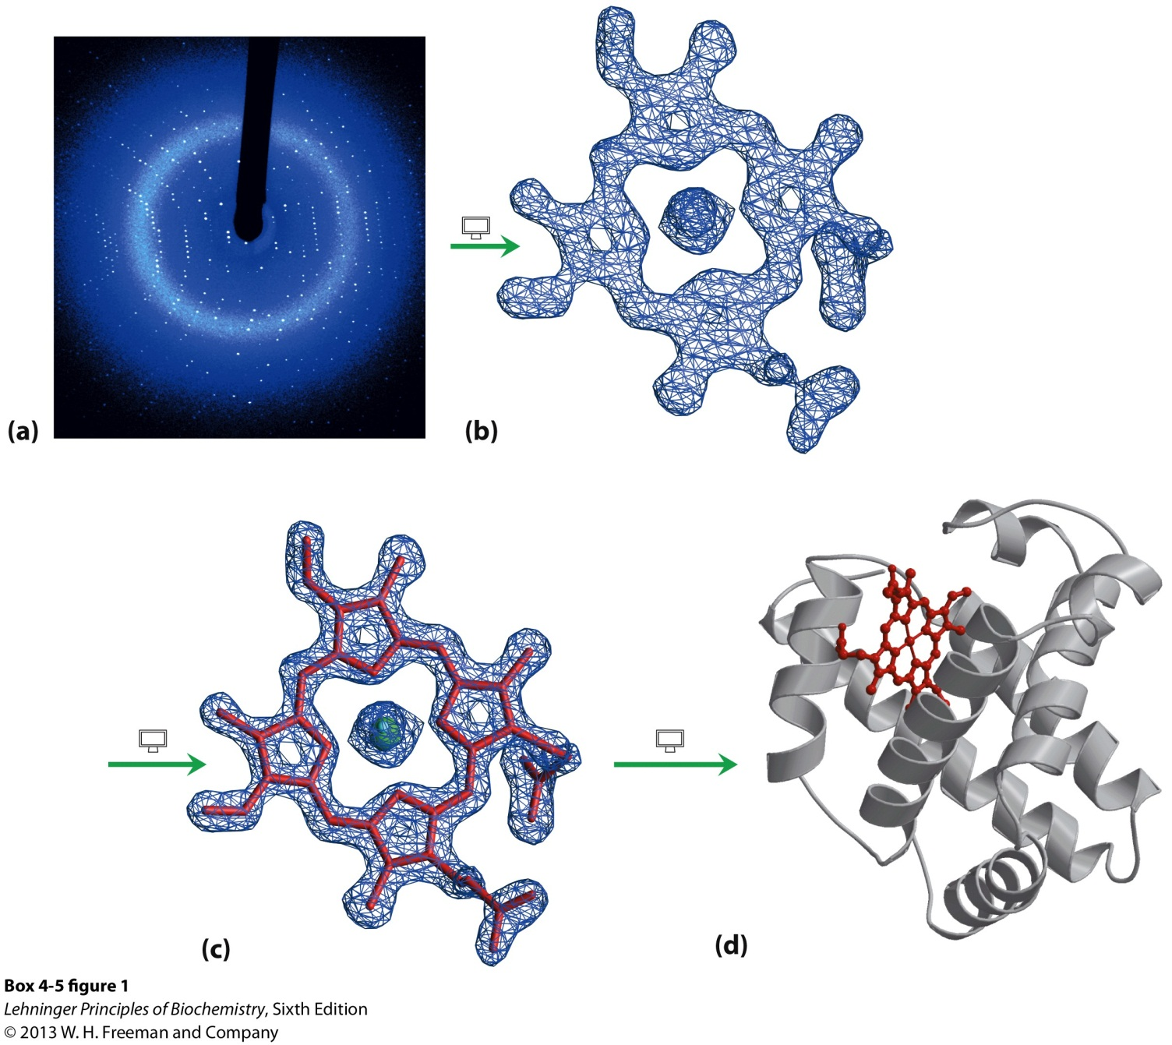
X-ray Crystallography

Slide 45
6. Techniques to Study Protein Fold
B. Nuclear Magnetic Resonance (NMR)
Steps needed
Purify the protein
Dissolve the protein
Collect NMR data (Typically 2D ¹H NMR)
Assign NMR signals
Calculate the structure
Pros
No need to crystallize the protein
Can see many hydrogens
Can study proteins in motion
Cons
Difficult for insoluble proteins
Works best with small proteins

Slide 46
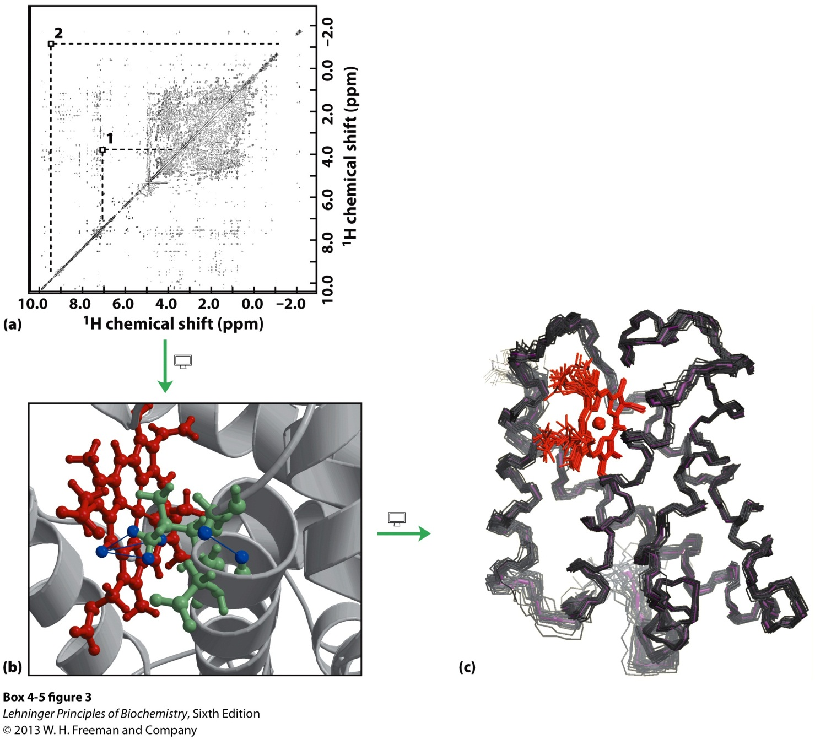
NMR

