Slide 1
Protein Function in the Context of
Protein Ligand Interactions
Chapter 5 (Page 157-170)

Slide 2
1. Protein Function
Proteins are dynamic molecules. Their functions largely depend on interactions with other molecules and conformational changes associated with these interactions.
The function of fibrous proteins as structural elements depends on stable, long term quaternary interactions between identical polypeptide chains
The function of globular proteins involve interactions with a variety of different molecules

Slide 3
2. Globular Protein Functions
Storage of ions and molecules
Myoglobin, Ferritin
B. Transport of ions and molecules
Hemoglobin, Serotonin transporter
C. Defense against pathogens
Antibodies, Cytokines
D. Muscle contraction
Actin, Myosin
E. Biological catalysis
Chymotrypsin, Lysozyme

Slide 4
3. Interaction with Other Molecules
Reversible, transient, specific process of chemical equilibrium:
A + B → AB
B. A molecule that binds to a protein is called a ligand
Typically a small molecule
Can be any type of species, even other proteins
C. A region in the protein where the ligand binds is called the binding site
Complementary in size, shape, charge, hydrophobic or hydrophilic character
←

Slide 5
3. Interaction with Other Molecules
D. The binding site is specific
Discriminates among thousands of different molecules to selectively bind only one or few ligands
E. Ligands bind via same noncovalent forces that dictate protein structure
Allows the interactions to be transient
F. Ligands also bind via covalent interactions that can be reversed (moderate affinity)

Slide 6
4. Ligand Binding: Quantitative Description
Consider a process in which a ligand (L) binds reversibly to a site in a protein (P)
The kinetics of such a process is described by:
The association rate constant k_{a} or the dissociation rate constant k_{d}
$\frac{d[PL]}{dt}= k_{a}\left[P\right]\left[L\right];$ - $\frac{d[PL]}{dt}= k_{d}\left[PL\right]$
k_{a}
+
L
P
k_{d}
PL

Slide 7
4. Ligand Binding: Quantitative Description
The process will reach equilibrium where the association and dissociation rates are equal.
$$k_{a}\left[P\right]\left[L\right] = k_{d}\left[PL\right]$$
Equilibrium is characterized by the equilibrium constant K_{a}, AKA the association constant (M⁻¹)
$$K_{a} = \frac{[PL]}{\left[P\right][L]}= \frac{k_{a}}{k_{d}}$$
It is more common to consider the dissociation constant K_{d} (M)
$$K_{a} = \frac{1}{K_{d}}$$

Slide 8
4. Ligand Binding: Quantitative Description
$$θ = {\frac{Binding Sites Occupied}{Total binding sites} }_{ }$$
In practice, we can often determine the fraction of occupied binding site (θ)
Substituting [PL] with K_{a}[L][P], we’ll eliminate [PL]
Eliminating [P] and rearranging gives the result in terms of equilibrium association constant and ultimately equilibrium dissociation constant
$$θ = {\frac{[PL]}{\left[PL\right]+[P]} }_{ }$$
$$θ = {\frac{K_{a}\left[P\right][L]}{K_{a}\left[P\right][L]+[P]} }_{ }$$
$$θ = {\frac{[L]}{[L]+\frac{1}{K_{a}}} }_{ }$$
$$θ = {\frac{[L]}{\left[L\right]+K_{d}} }_{ }$$

Slide 9
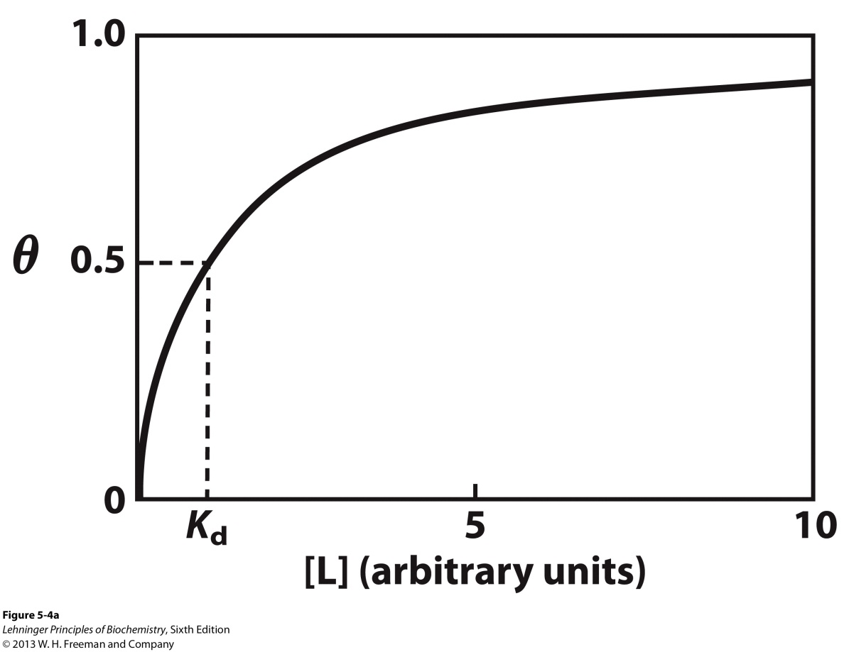
4I. Ligand Binding: Graphical Analysis
θ is a hyperbolic function of [L]
Experimentally
[L] is known
K_{d} can be determined graphically or via least-squares regression
When [L] = K_{d,} θ = 0.5.
[L] < K_{d}, progressively less of the protein has ligand bound.
θ = 0.9, [L] = 9 x K_{d}

Slide 10
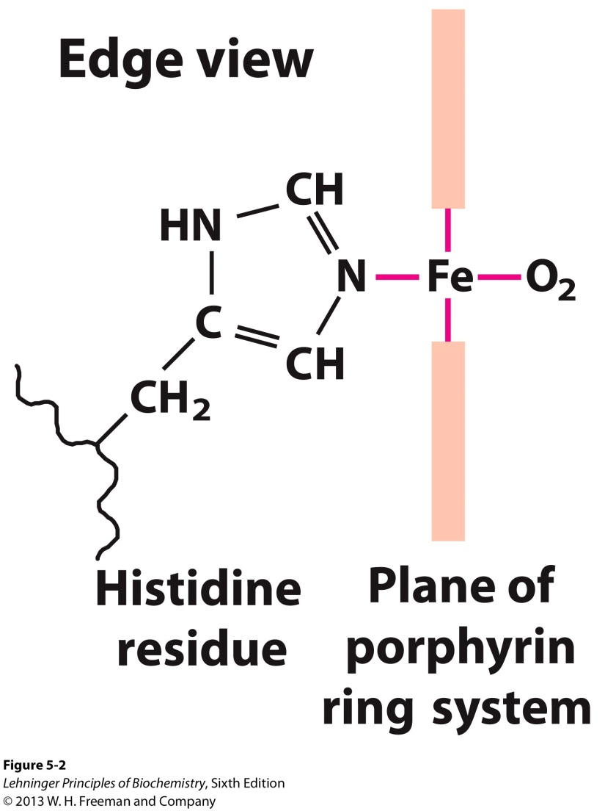
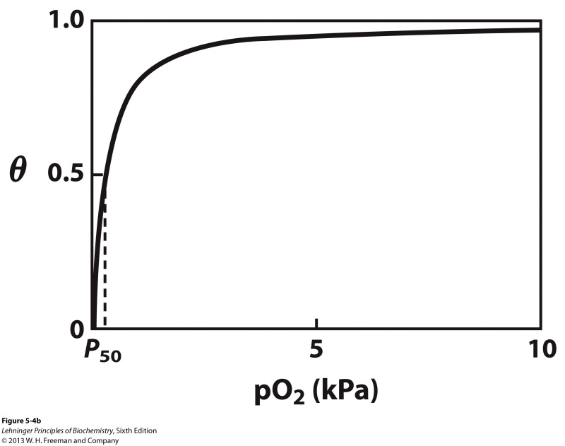
4Ib. Binding of O₂ to Myoglobin is Hyperbolic
O₂ binds to the Fe(II) heme prosthetic group of myoglobin. Because O₂ is a gas, it is necessary to adjust the ligand binding equation.
Henry’s Law:
p_{O2} = k_{H} x C_{O2}
Partial Pressure (p_{O2})  [O₂]
$$θ = {\frac{p_{O2}}{p_{O2}+P_{50}} }_{ }$$

Slide 11
4Ic. Binding Strengths
Magnitudes
Strong binding: K_{d} < 10 nM
Weak binding: K_{d} > 10 μM
*Note that a reported dissociation constant is valid only for the particular solution conditions under which it was measured.

Slide 12
5. Binding Specificity Models
Proteins typically have high specificity: Only certain ligands bind.
Lock-and-Key Model
High specificity can be explained by the complementary of the binding site and the ligand
Complementary in size, shape, charge, or hydrophobic/hydrophilic character
“Lock and key” model by Emil Fisher (1894) assumes that complementary surfaces are preformed
+

Slide 13
5. Binding Specificity
B. Induced Fit Model
Conformational changes may occur upon ligand binding (Daniel Koshland, 1958)
Induced fit allows for tighter binding of the ligand
Induced fit allows for high binding for different ligands
Both the ligand and the protein can change their conformations in thermodynamically favorable way
+

Slide 14
6. The Complexity of Ligand Binding
The binding of a ligand to a protein is not as simple as the binding equations suggest. The interaction is greatly affected by protein structure and is accompanied by conformational changes. We will examine the complexity of ligand binding by discussing O₂ binding to a porphyrin core.
In the absence of protein residues
Within myoglobin
Within hemoglobin

Slide 15
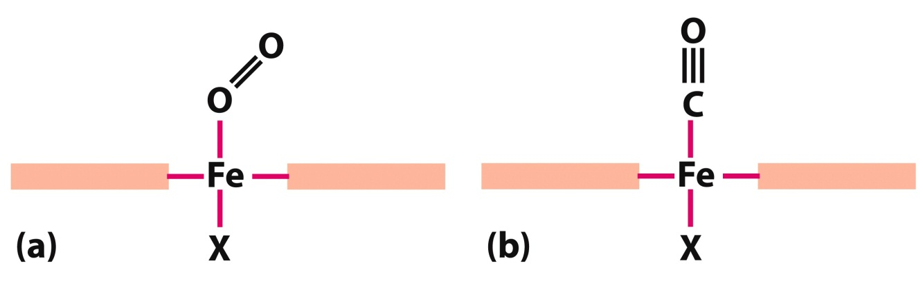
6I. O₂ binding to the Protoporphyrin IX core
O₂ has similar size and shape to CO
CO binds over 20,000 times better than O₂ because of the negative charge on CO, which enables it to have a stronger attraction to Fe(II)
Side on binding of O₂ also results in weaker affinity

Slide 16
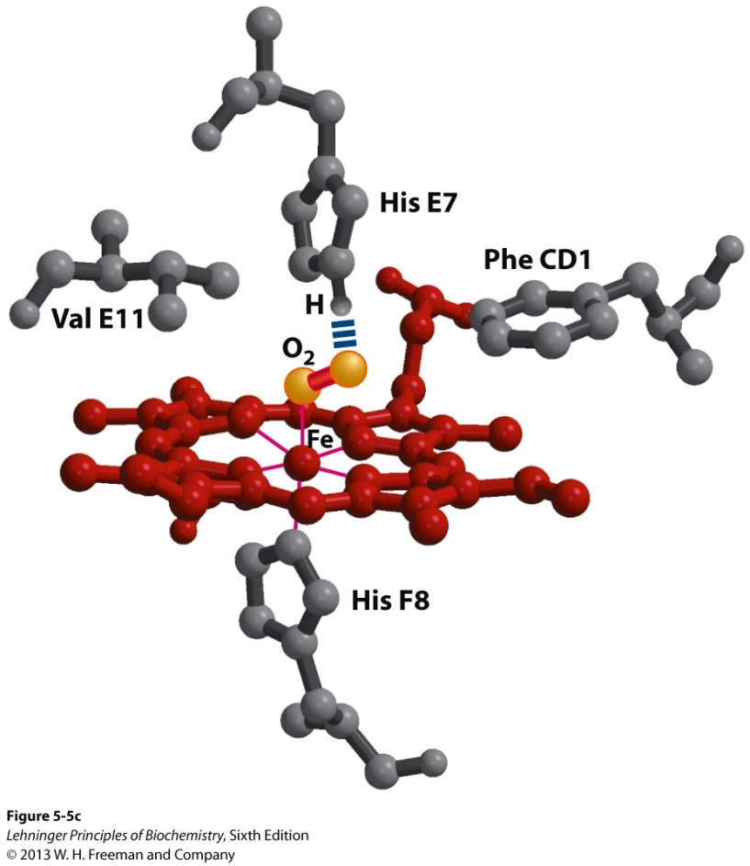
6II. O₂ binding in Myoglobin
CO binds only 200 times better when the heme is bound in myoglobin
The side-on binding of O₂ is favorably accomodated by hydrogen binding to the His E7 residue.
The linear binding of CO results in some steric hindrance.
Reduction in CO binding is physiologically important.

Slide 17
6III. O₂ binding in Hemoglobin
O₂ is transported in blood by hemoglobin via erythrocytes (red blood cells)
Erythrocytes principally function as vehicles for hemoglobin, present at a high concentration (~34% w/v)
In arterial blood passing from the lungs through the heart to the peripheral tissues, hemoglobin is ~96% saturated with O₂
In the venous blood returning to the heart, hemoglobin is ~64% saturated

Slide 18
6IIIb. Hemoglobin Structure
α Subunits
β Subunits
A. Roughly spherical, tetrameric protein (64.5 kDa)
B. 4 polypeptide chains: 2 α Subunits, 2 β Subunits
with high 3-D structural similarity
C. 4 Fe(II)-heme groups for O₂ binding
D. Strong interactions between αβ subunits
E. Can exist in T and R state conformations

Slide 19
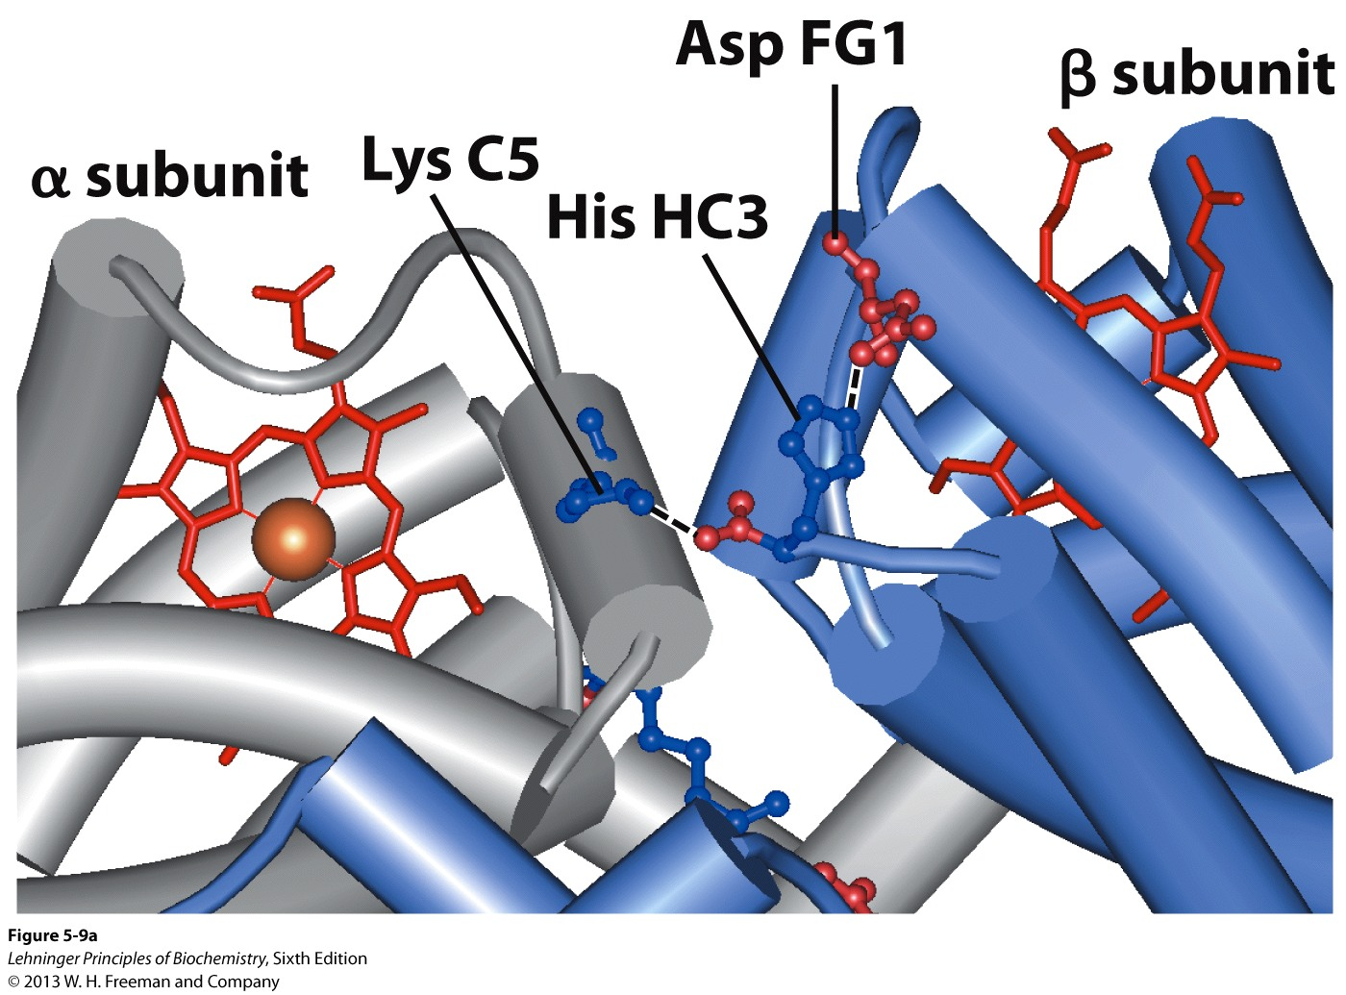
6IIIc. Hemoglobin Tense State (T State) Structure
In the absence of oxygen, hemoglobin is called deoxyhemoglobin
In this form, the protein exists predominantly in the T state conformation

Slide 20
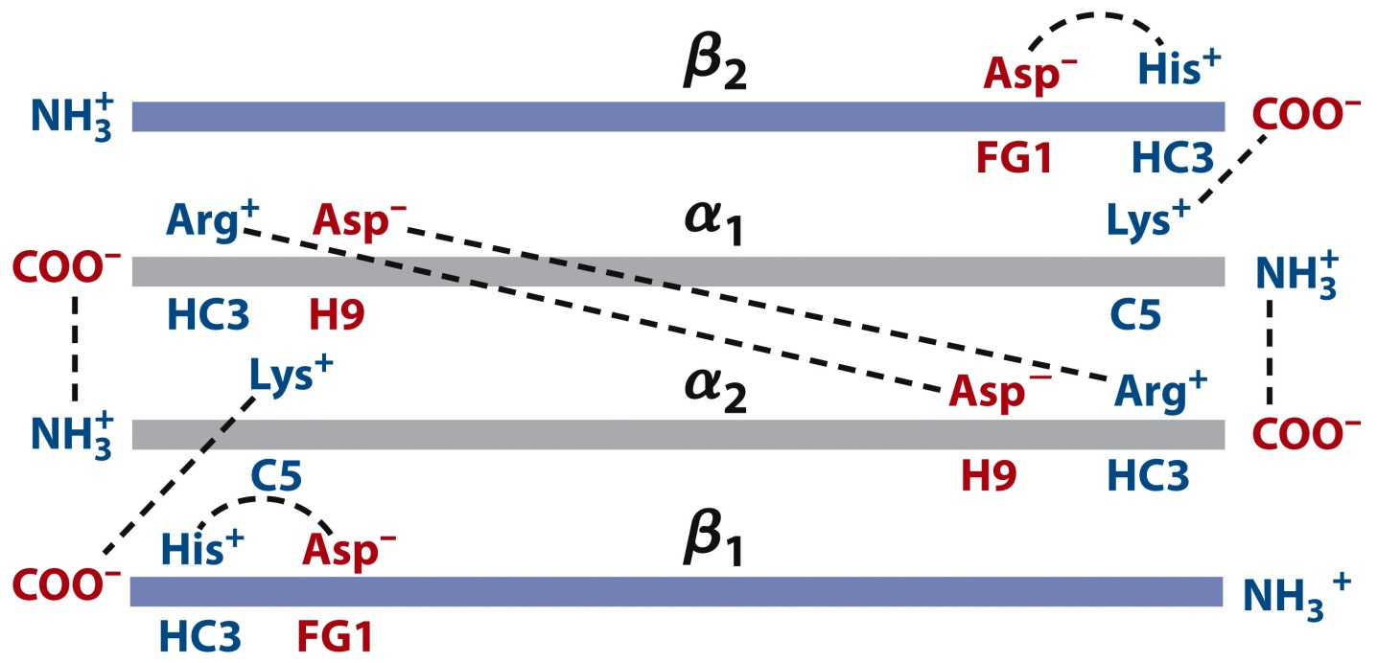
6IIIc. Hemoglobin Tense State (T State) Structure
C. The T state is stabilized by a greater number of ion pairs compared to the Relaxed (R) state, many of which lie at the αβ interfaces
D. This state is more rigid than the R state

Slide 21
6IIId. T State to Relaxed (R) State Transition
O₂ binds to both the T state and the R state
The binding results in a major conformational transition to predominantly the R state, with several ion pairs being broken
The structures of the individual subunits change little
The αβ subunit pairs slide past each other and rotate, narrowing the pocket between the β subunits

Slide 22
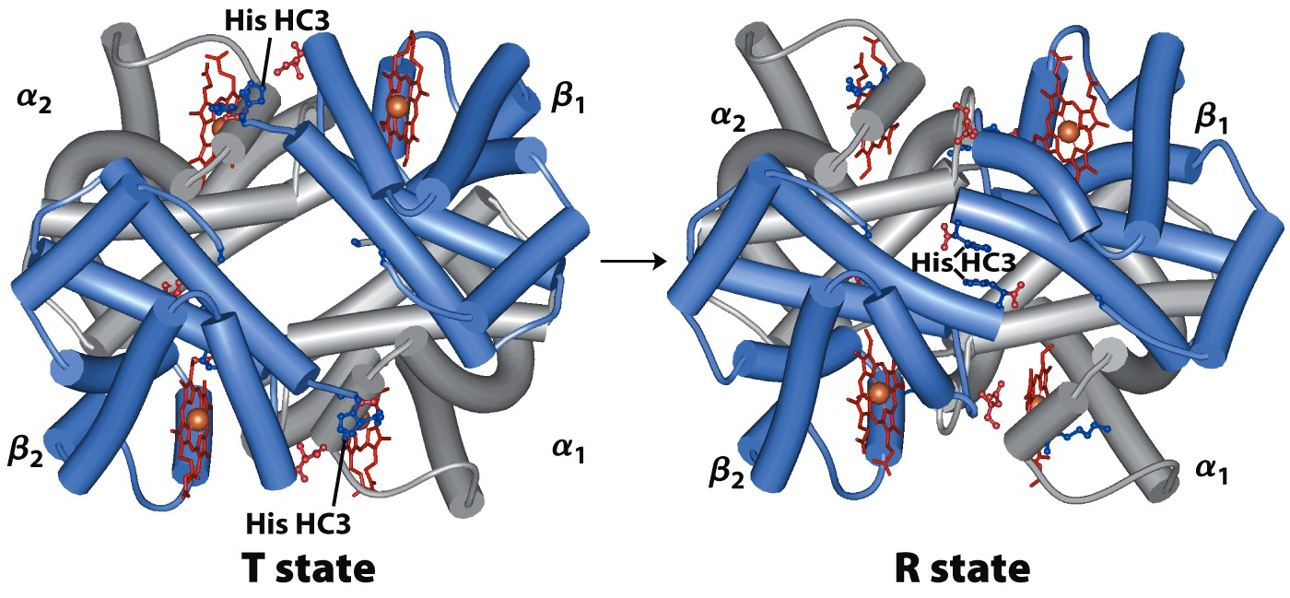
6IIId. T State to Relaxed (R) State Transition

Slide 23
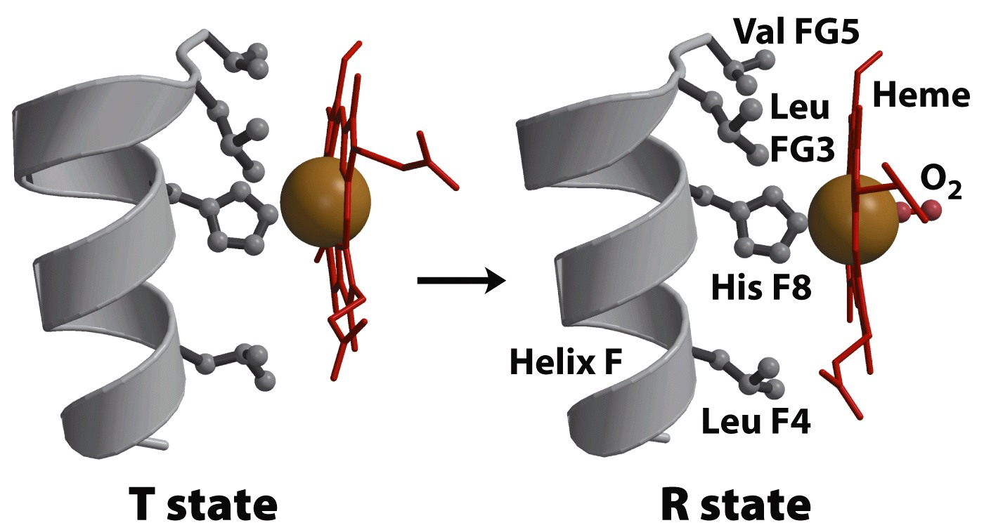
6IIId. T State to Relaxed (R) State Transition
E. The binding of O₂ causes the heme to assume a more planar conformation, shifting the position of the proximal His and the helix to which the His is attached to

Slide 24
6IIIe. The Reversibility and Cooperativity of O₂-Hemoglobin Binding
For hemoglobin to serve as an O₂ transport vehicle
It must bind O₂ efficiently in the lungs, where the pO₂ is about 13.3 kPa
It must release O₂ in the tissues, where the pO₂ is about 4 kPa
It’s binding profile must be distinct from myoglobin’s
Myoglobin serves mostly as an O₂ storage compartment
Certain stresses allow myoglobin to transport O₂

Slide 25
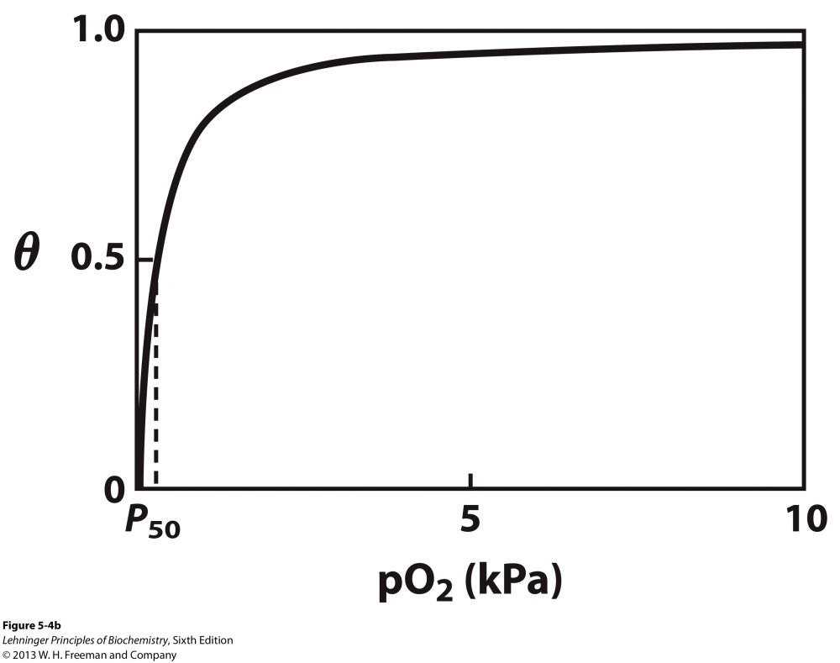
O₂-Myoglobin Binding Profile
P₅₀ = 0.26 kPa
pO₂ (in lungs and tissues) > P_{50 ;} O₂ will be tightly bound and not released in tissues
Breathing would be inefficient

Slide 26
6IIIe. The Reversibility and Cooperativity of O₂-Hemoglobin Binding
D. Hemoglobin overcomes O₂ affinity issues through cooperativity by modulating the affinity at the
different binding sites
Undergoes a transition from a low-affinity state (the T state) to a high-affinity state (the R state) as more O₂ molecules are bound

Slide 27
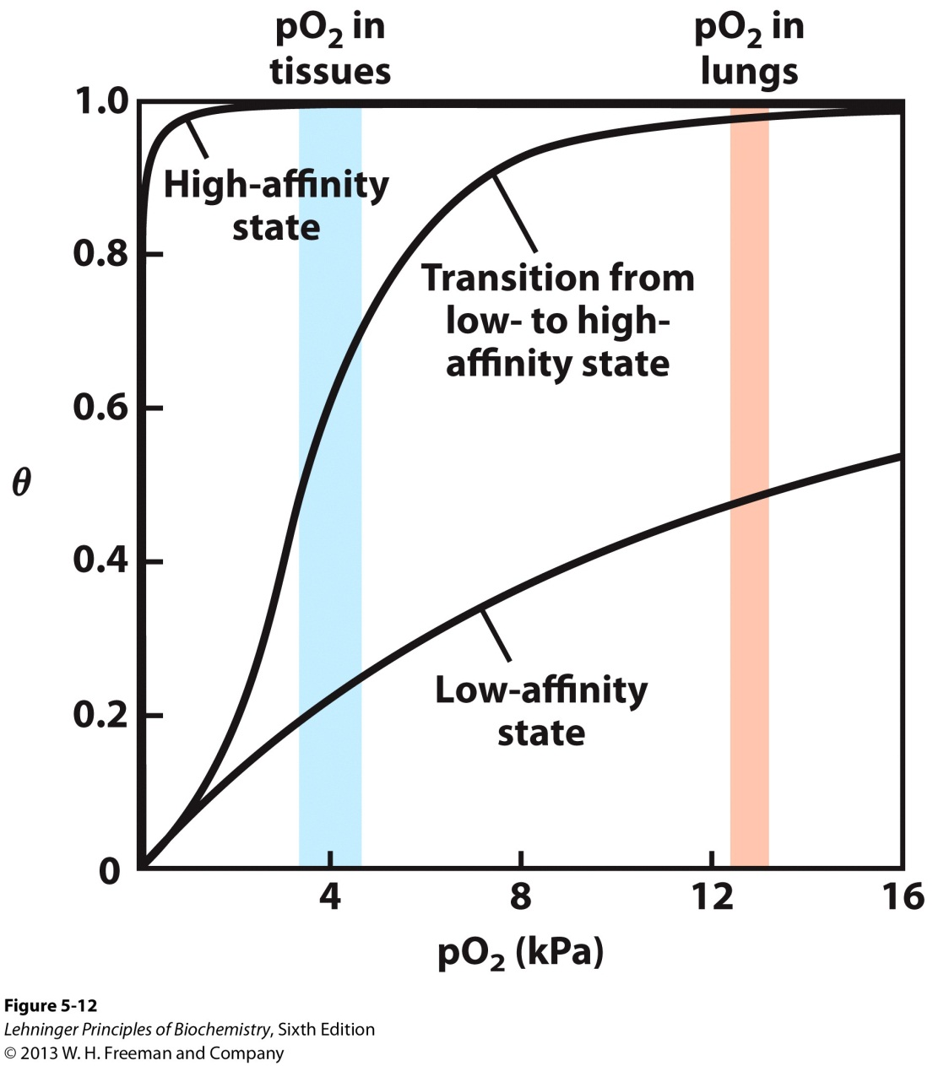
O₂-Hemoglobin Binding Profile
Sigmoidal curve shape is diagnostic of cooperative binding. Much more sensitive response to [ligand].

Slide 28
6IIIe. The Reversibility and Cooperativity of O₂-Hemoglobin Binding
Hemoglobin is an allosteric protein. O₂ binding to individual subunits alters the affinity for O₂ in adjacent subunits
The 1st O₂ molecule interacts weakly with deoxyhemoglobin because it binds to a subunit in the T state
A conformational change occurs that is communicated to adjacent subunits, resulting in faster T to R transitions in the second subunit
The last O₂ binds to a subunit already in the R state, and thus binds with higher affinity

Slide 29
7. Modulators for Allosteric Proteins
Modulators interconvert more-active and less-active forms of the protein
Modulators can be activators or inhibitors
When the normal ligand and modulator are identical, the interaction is termed homotropic
When the modulator is a molecule other than the normal ligand the interaction is heterotropic

Slide 30
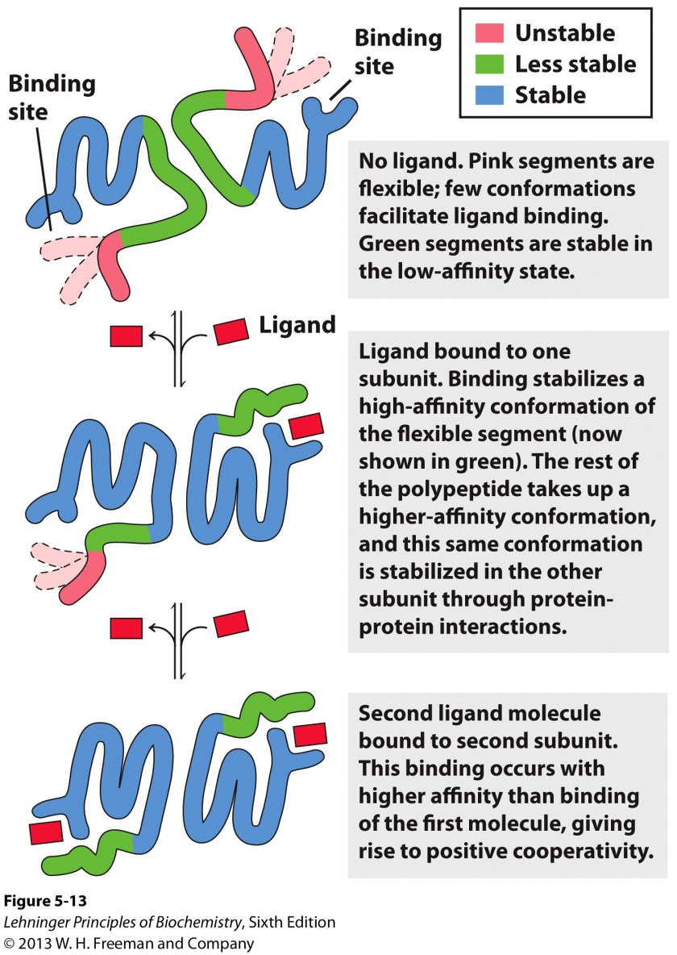
8. Cooperativity and Variations in Structural Stability
Cooperative conformational changes depend on variations in the structural stability of different parts of the protein, particularly in the vicinity of the binding site.

Slide 31
9. Cooperative Ligand Binding: Quantitative Description
For a protein with n binding sites,
the expression for association constant is
$$K_{a} = \frac{[PLn]}{\left[P\right]\left[L\right]n}$$
The expression for θ is
P + nL PL_{n}
←
←
$$θ = {\frac{\left[L\right]n}{\left[L\right]n+K_{d}} }_{ }$$

Slide 32
9. Cooperative Ligand Binding: Quantitative Description
The Hill Equation:
$$\log\left(\frac{θ}{1−θ}\right)=n\log\left[L\right]−\log{K_{d}}$$
where K_{d} = [L]^{n}_{0.5}, n is the Hill Coefficient
n ≠ # of binding sites but degree of interaction
n = 1, ligand binding is not cooperative (Myoglobin)
n > 1, Positive cooperativity (Hemoglobin)
n < 1, Negative cooperativity

Slide 33
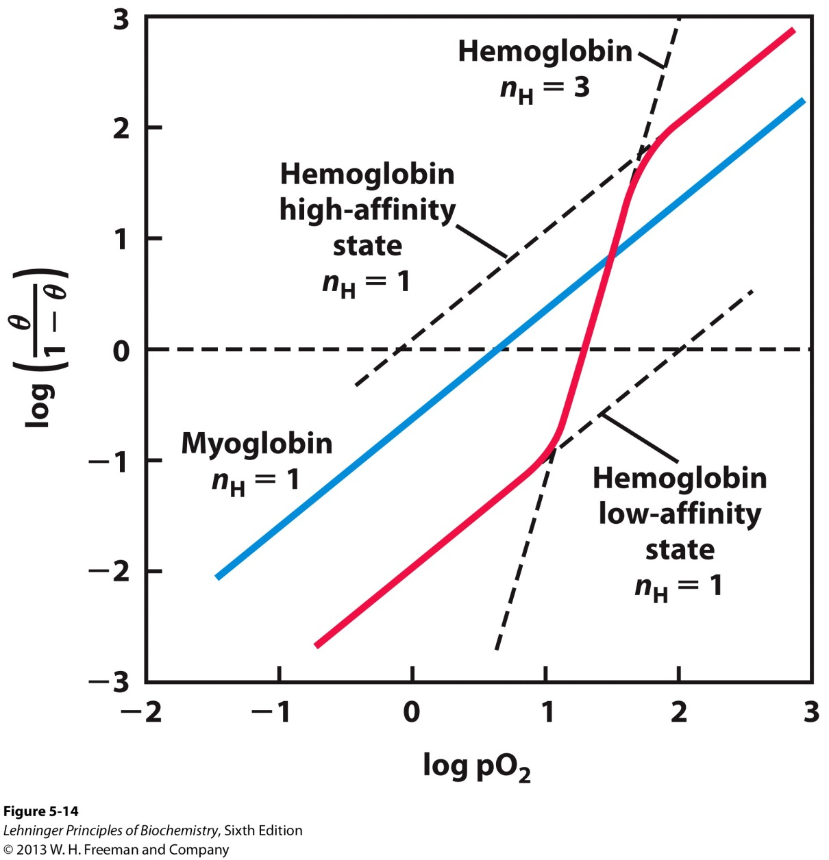
Hill Plot
$$\log\left(\frac{θ}{1−θ}\right)=n\log{pO2−n log{{P }_{n50}}}$$

Slide 34
10. Two Models for Cooperative Binding
The MWC model (concerted model) assumes
The subunits of a cooperatively binding protein are functionally identical
That each subunit can exist in (at least) two conformations
That all subunits undergo the transition from one conformation to the other simultaneously

Slide 35
The Concerted Model

Slide 36
10. Two Models for Cooperative Binding
B. The Sequential model
Ligand binding can induce a change in conformation in an individual subunit
A conformational change in one subunit makes a similar change in an adjacent subunit
Makes the binding of a second ligand molecule more likely

Slide 37
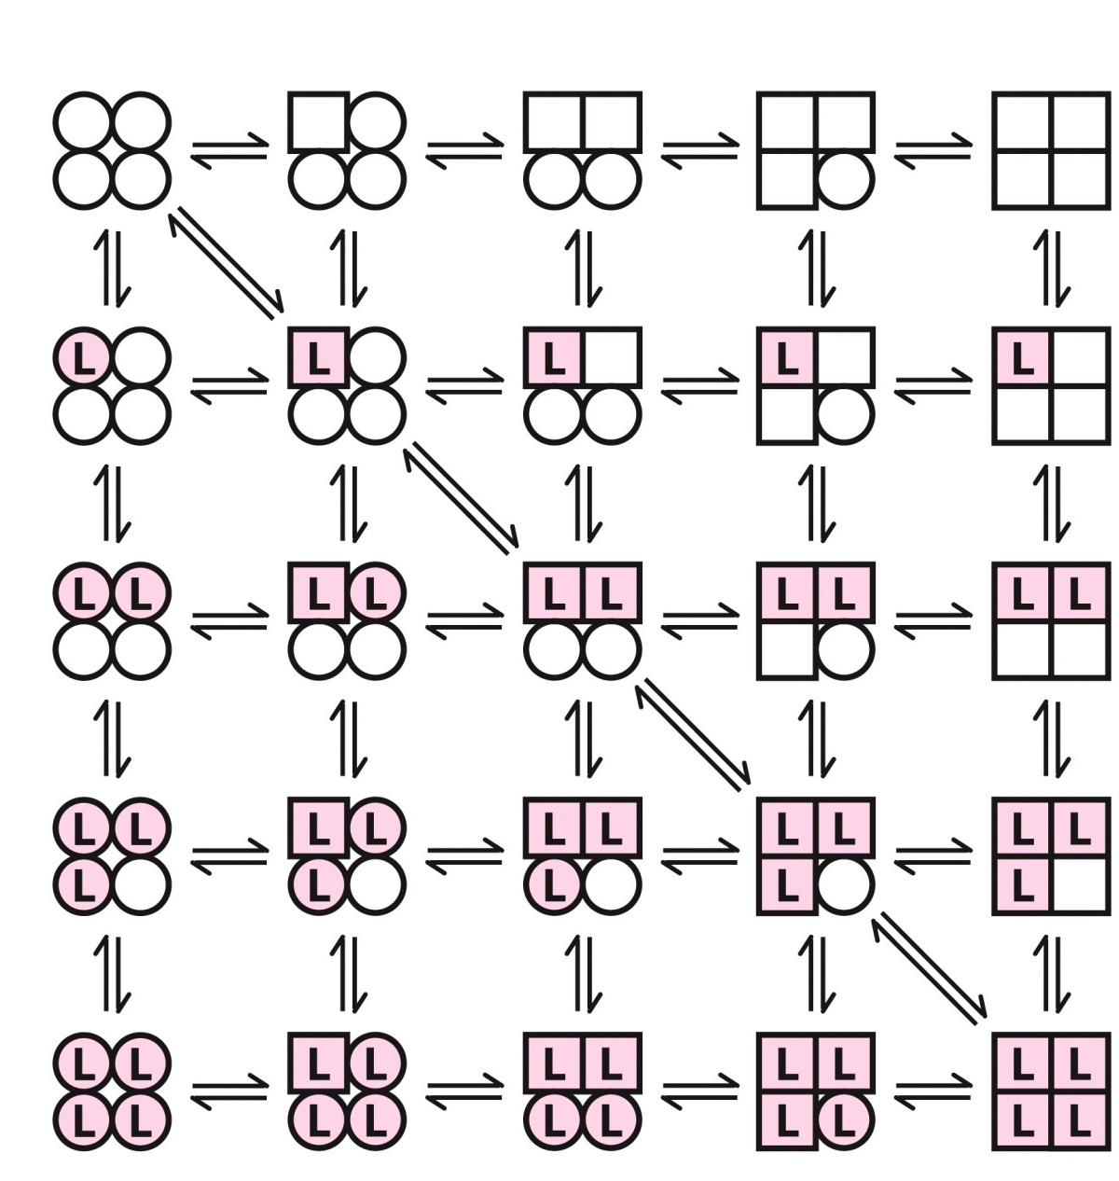
The Sequential Model

