Slide 1
Binding and Structural Factors that Influence Protein Function
And
The Application of Protein Function
Chapter 5 (Page 170-182)

Slide 2
The Complexity of Hemoglobin Binding O₂ Beyond
Subunit Cooperativity

Slide 3
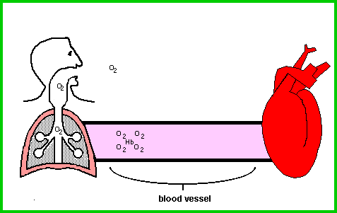
1. Hemoglobin in Cellular Respiration
A. Carries 4 O₂ molecules from the lung to the tissues via erythrocytes.
Courtesy of www.coheadquarters.com

Slide 4
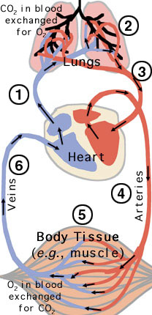
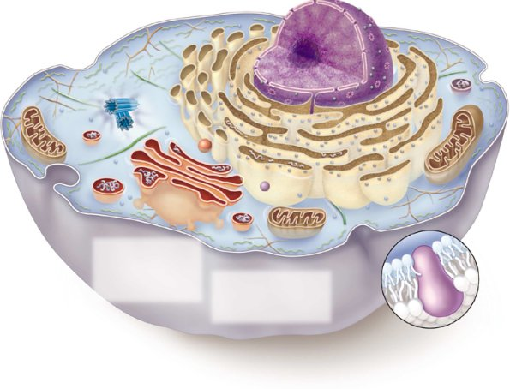
1. Hemoglobin in Cellular Respiration
B. Carries two end products of cellular respiration, CO₂ and H⁺, from the tissues to the lungs and kidneys, where they are excreted.
CO₂
O₂
Mitochondrion:
Site of CO₂
Production

Slide 5
1I. CO₂ in Equilibrium with H⁺
CO₂(g) + H₂O(l) H⁺(aq) + HCO₃⁻(aq)
The hydration of CO₂ to form bicarbonate is catalyzed by carbonic anhydrase.
This process is important in solubilizing CO₂ and also for the bicarbonate buffering system in blood.
The hydration results in an increase in H⁺, decrease in pH in tissues.

Slide 6
1II. The Bohr Effect
The binding of H⁺ and CO₂ to hemoglobin is inversely related to the binding of O₂, a process known as the Bohr Effect.
Hemoglobin transports about 40% of the total H⁺ and 15% to 20% CO₂ formed in tissues
At relatively low pH and high CO₂ concentration of peripheral tissues, the affinity of hemoglobin for O₂ decreases as H⁺ and CO₂ are bound, and O₂ is released
In the capillaries of the lung, as CO₂ is excreted and the blood pH consequently rises, the affinity of hemoglobin for O₂ rises

Slide 7
Le Chatelier’s Principle
CO₂(g) + H₂O(l) H⁺(aq) + HCO₃⁻(aq)
When a system in dynamic equilibrium is disturbed, the system responds so as to minimize the disturbance and return to a state of equilibrium.
If [reactant] or [product] , then
If [reactant] or [product] , then
Product(s) Favored
Reactant(s) Favored

Slide 8
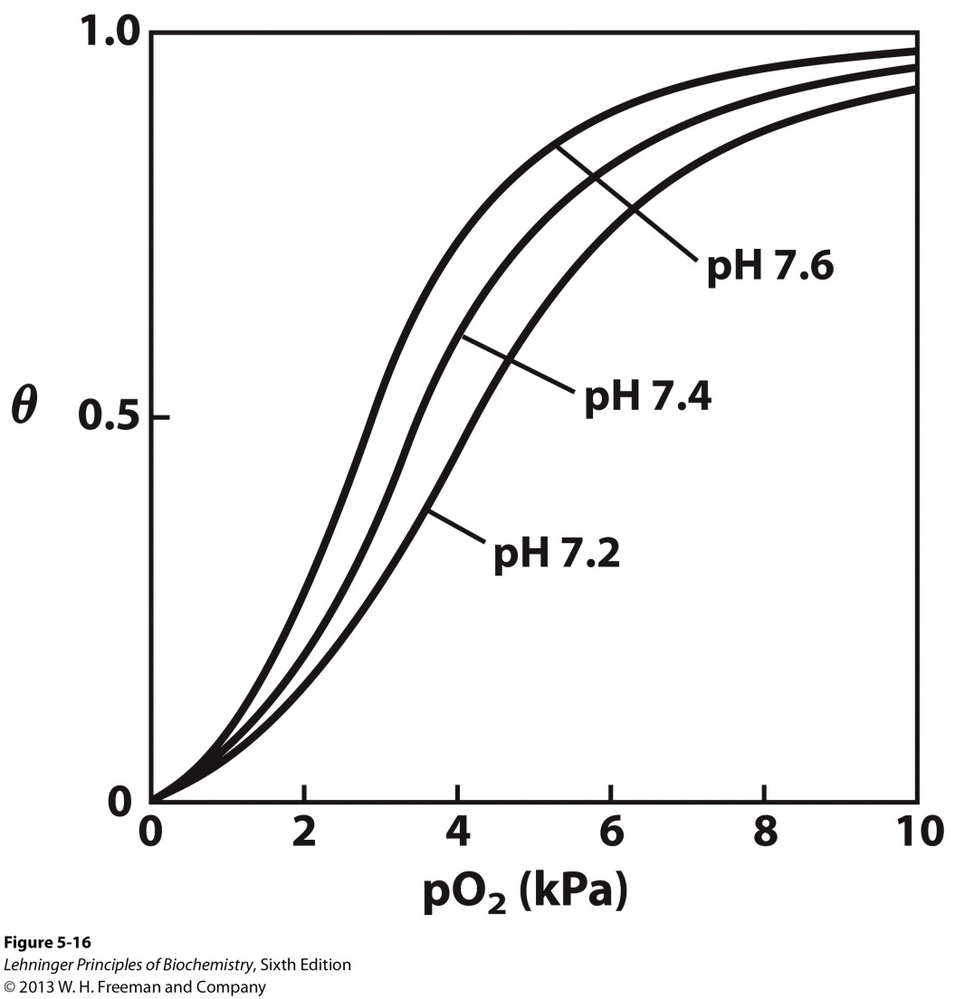
1III. pH Effect on O₂ binding to Hemoglobin
HHb⁺ + O₂ HbO₂ + H⁺
In the lungs, high [O₂] results in binding by hemoglobin and H⁺ release.
In peripheral tissues, low [O₂] results in release from hemoglobin and H⁺ binding.
As [H⁺], O₂ affinity decreases. Actively metabolizing tissues generate H⁺, lowering the pH of blood near tissues.

Slide 9
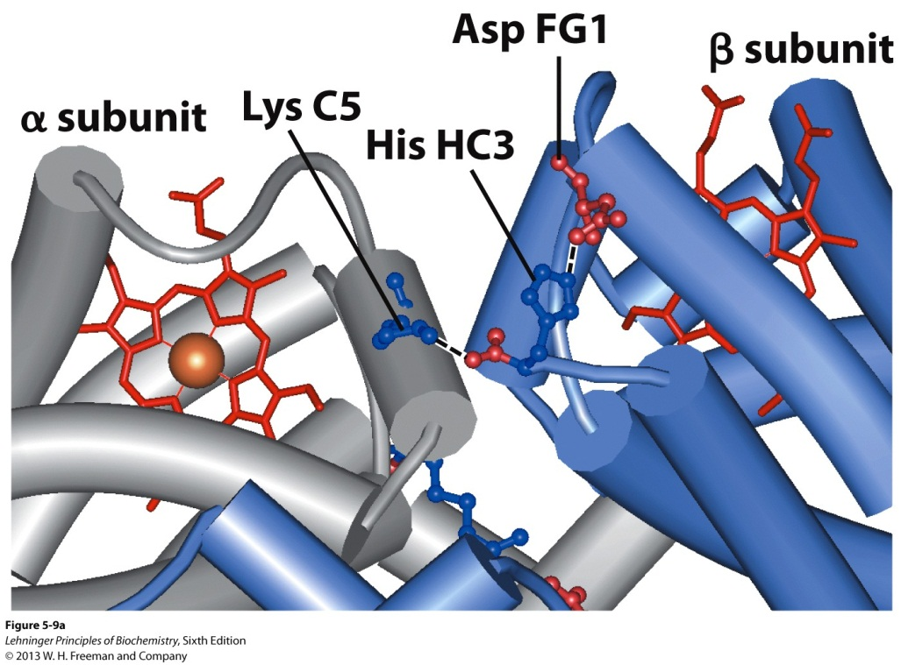
1III. pH Effect on O₂ binding to Hemoglobin
D. H⁺ binds at different sites in hemoglobin than O₂, namely several amino acid residues in the protein.
The H⁺ at His146 (His HC3) engages in an ion pair with Asp94 (Asp FG1), which stabilizes the low O₂ affinity T state.
pKa is 7.6 (T state)
pKa is 6.0 (R state) because of no ion pairing
[H⁺] promotes O₂ release by favoring T state

Slide 10
1IV. CO₂ Effect on O₂ binding to Hemoglobin
CO₂ binds as a carbamate group to the α-amino group at the amino-terminal end of each globin chain, forming carbaminohemoglobin.
This reaction produces H⁺, which contributes to the Bohr effect.
The bound carbamates also form additional salt bridges that stabilize the T state and promote the release of O₂.

Slide 11
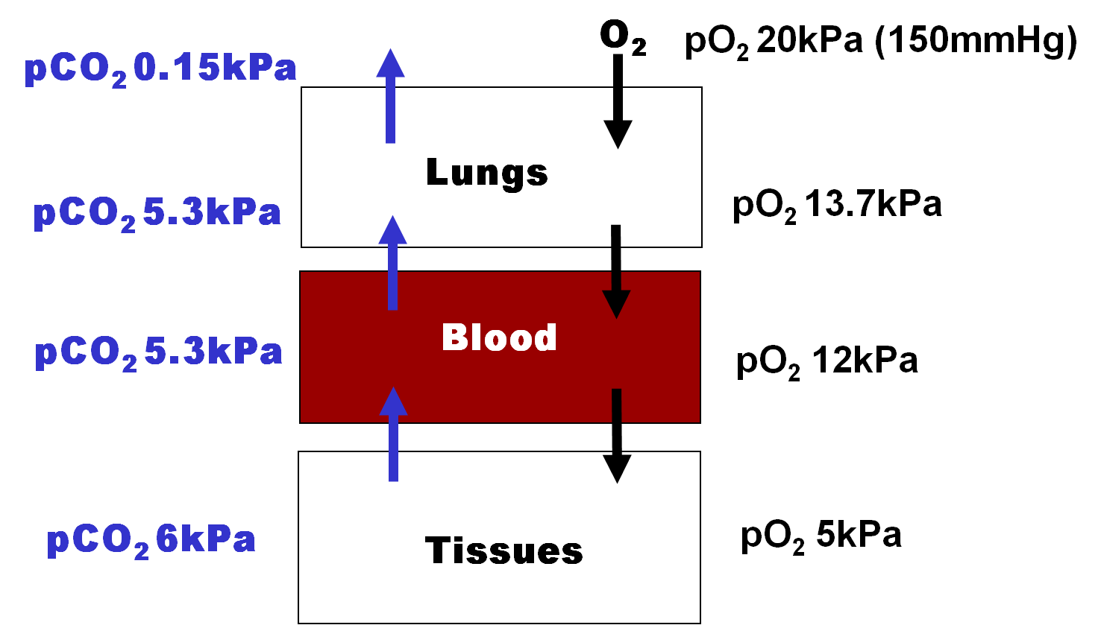
1IV. CO₂ Effect on O₂ binding to Hemoglobin
13.3 kPa
12 kPa
4 kPa

Slide 12
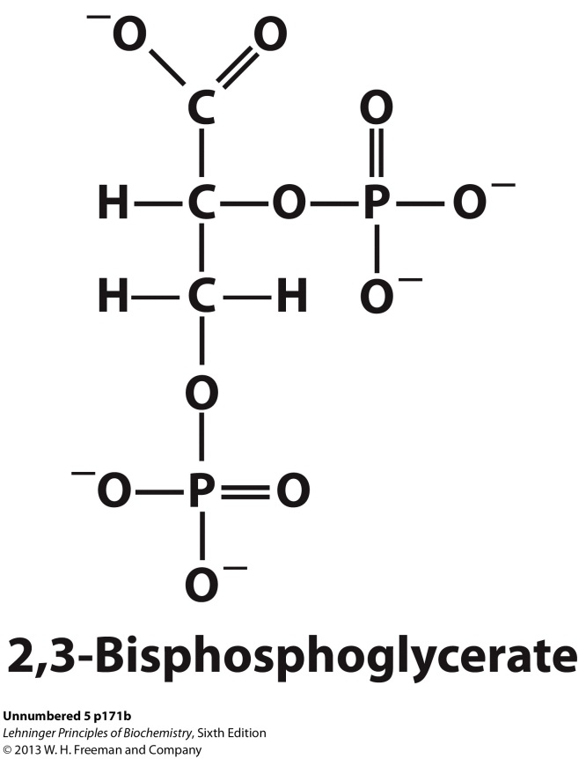
2. Heterotropic Allosteric Modulation of O₂ binding to Hemoglobin
2,3-bisphosphoglycerate (BPG) helps to modulate the release of O₂ to tissues.
High [BPG] in erythrocytes
There is an inverse relationship between the binding of O₂ and the binding of BPG to hemoglobin.
HbBPG + O₂ HbO₂ + BPG

Slide 13
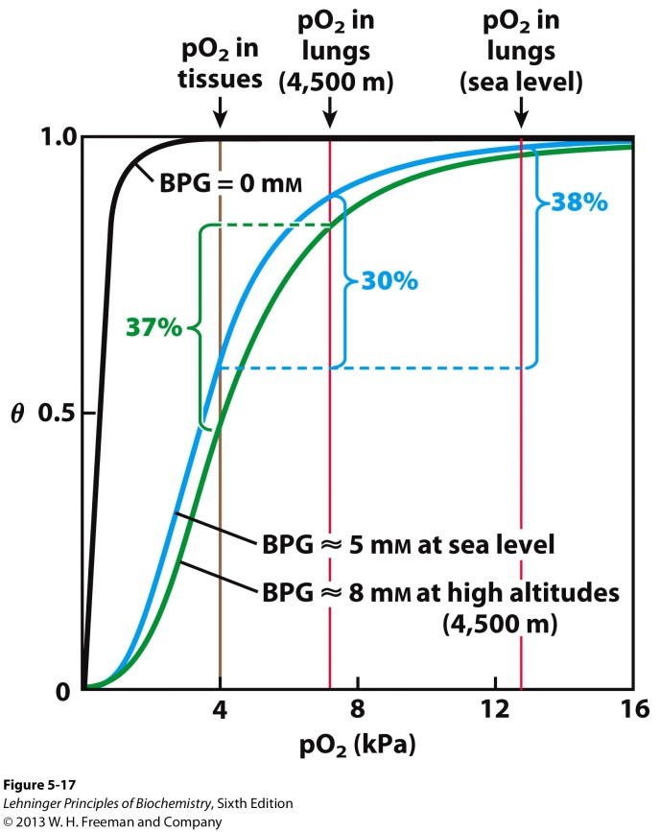
2. Heterotropic Allosteric Modulation of O₂ binding to Hemoglobin
C. BPG plays an important role in the physiological adaptation to the lower pO₂ at high altitudes.
Lower pO₂ results in lower O₂ release in tissues
[BPG] increases to counter this and facilitates O₂ release

Slide 14
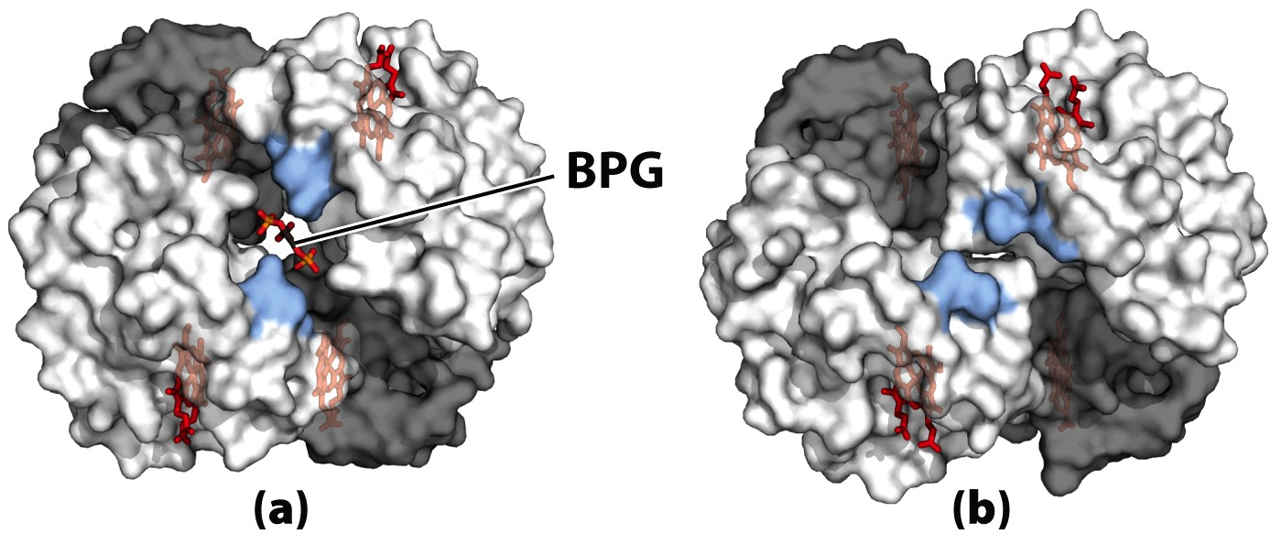
2. Heterotropic Allosteric Modulation of O₂ binding to Hemoglobin
D. One molecule of BPG binds to the central cavity of HB stabilizing the T state conformation. This cavity is lined with positively charged AA, which interact with the negatively charged BPG.
T State
R State

Slide 15
3. Summaryof O₂ binding to Hemoglobin
O₂ binding in lungs
Hb(O₂)₄ + CO₂ + H⁺ + BPG⁻ Hb-CO₂-H-BPG + 4O₂
O₂ release in peripheral tissues

Slide 16
A Single AA Mutation in Hemoglobin Results in Impaired Function
and Disease

Slide 17
1. Sickle Cell Anemia
Sickle-cell anemia is a genetic disease in which an individual has inherited the allele (variant gene) for sickle-cell hemoglobin from both parents.
A Val is substituted for a Glu at position 6 in the two β chains forming hemoglobin S
Two fewer negative charges than normal hemoglobin A
The Val creates a “sticky” hydrophobic contact ,which is on the outer surface of the molecule.
Deoxyhemoglobin S is poorly soluble and the “sticky”spots cause the protein to associate abnormally with each other forming long, fibrous aggregates

Slide 18
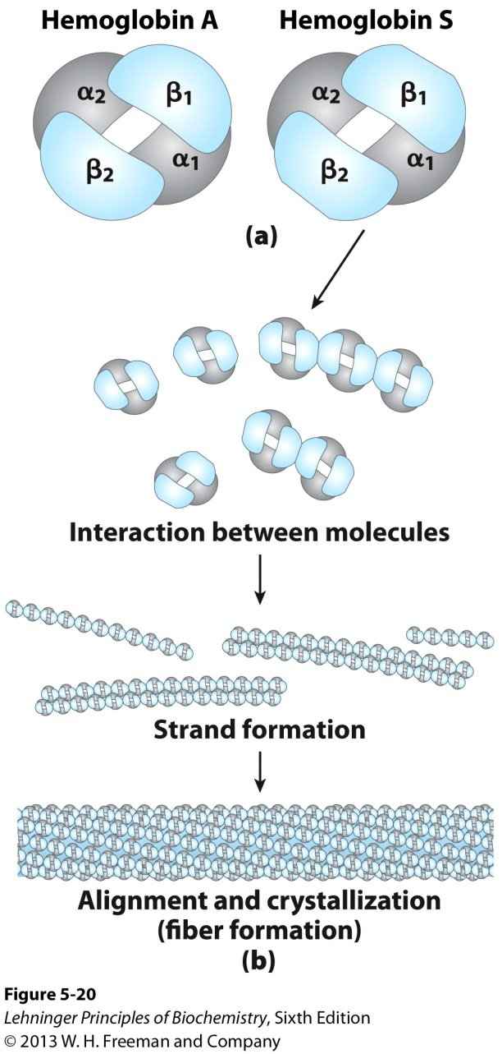
2. Formation of Hb Strands in Sickle-Cell Anemia

Slide 19
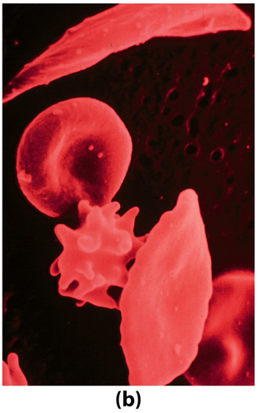
3. Hemoglobin S changes Cell Structure and O₂ Transport
A. The insoluble fibers of deoxygenated hemoglobin S are responsible for the deformed
sickle shape of the erythrocytes.
B. The proportion of sickled cells increases greatly as blood is deoxygenated.
C. Patients have fewer erythrocytes, suffer lots of pain, and have difficulty breathing due to much lower O₂ release.

Slide 20
4. General Stats on Sickle Cell Anemia
A. Untreated homozygous individuals generally die in childhood
B. Treated individuals have a life expectancy in the 50s
C. Sickle-cell anemia is prevalent in areas where malaria is abundant
Heterozygous individuals exhibit a resistance to malaria

Slide 21
Technological Application of
Protein Function from the
Immune System

Slide 22
1. Two Types of Immune Systems
Cellular immune system
Targets own cells that have been infected
Destroys viruses and bacteria
Key players: Macrophages, killer T cells (T_{c}), and inflammatory cells (TH₁), T-cell receptors
B. Humoral “fluid” immune system
Targets extracelllar pathogens
Recognizes foreign proteins
Key players: B-lymphocytes, helper T-cells (TH₂), soluble proteins called antibodies (or immunglobulins)

Slide 23
2. Antibody-Antigen Interactions
Any molecule or pathogen capable of eliciting an immune response and that specifically binds an antibody is called an antigen.
An antigen may be a virus, a bacterial cell wall, a protein, or other macromolecule.
An antibody binds only a particular molecular structure within the antigen, called its antigenic determinant or epitope.

Slide 24
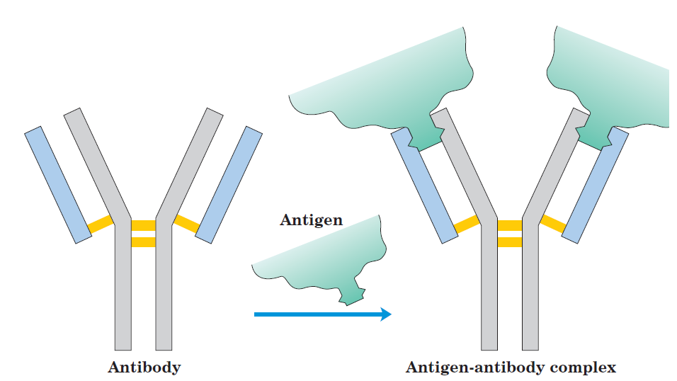
2. Antibody-Antigen Interactions
D. Polyclonal antibodies are those produced by many different B lymphocytes responding to one antigen
and recognize different epitopes.
Monoclonal antibodies are synthesized by a population of identical B cells, are homogenous, and recognize one epitope on the antigen.

Slide 25
3. Using Antibody-Antigen Interactions for Protein Identification
There are several techniques that take advantage of antibody-antigen interactions for purifying and detecting specific proteins.
A. Protein Purification:
- Affinity Chromatography
An antibody is covalently attached to a resin
A protein that binds the antibody will bind to the column

Slide 26
3. Using Antibody-Antigen Interactions for Protein Identification
B. Protein Identification:
I. Radioactively labeled antibody
The label reveals the presence of the protein in solution or its location in a gel.
Can even reveal the location of the protein within a cell.
II. ELISA (enzyme-linked immunoabsorbent assay)
Based on adsorbing proteins to an inert surface.
An inexpensive nonspecific protein (i.e. albumin) is used to block unbound areas of the surface.

Slide 27
3. Using Antibody-Antigen Interactions for Protein Identification
The surface is treated with a solution containing the primary antibody-an antibody against the protein of interest.
Unbound antibody is washed away and the surface is treated with a solution containing antibodies (secondary antibodies) against the primary antibodies.
These antibodies are linked to an enzymatic reaction that catalyzes the formation of a colored product.
The enzyme substrate is added.
Product formation (monitored by color intensity) is proportional to [protein] of interest.

Slide 28
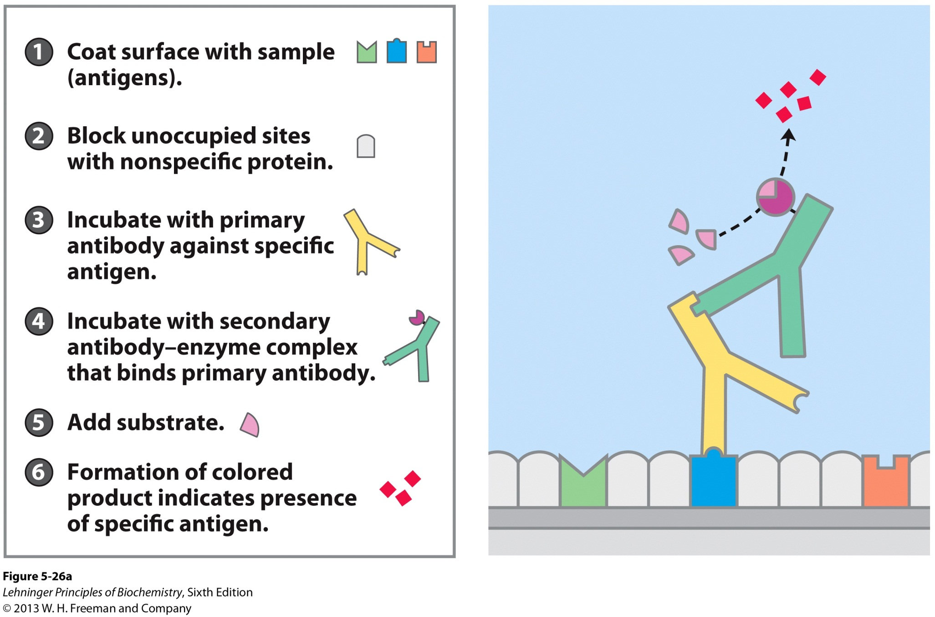
Adsorbent Based Method

Slide 29
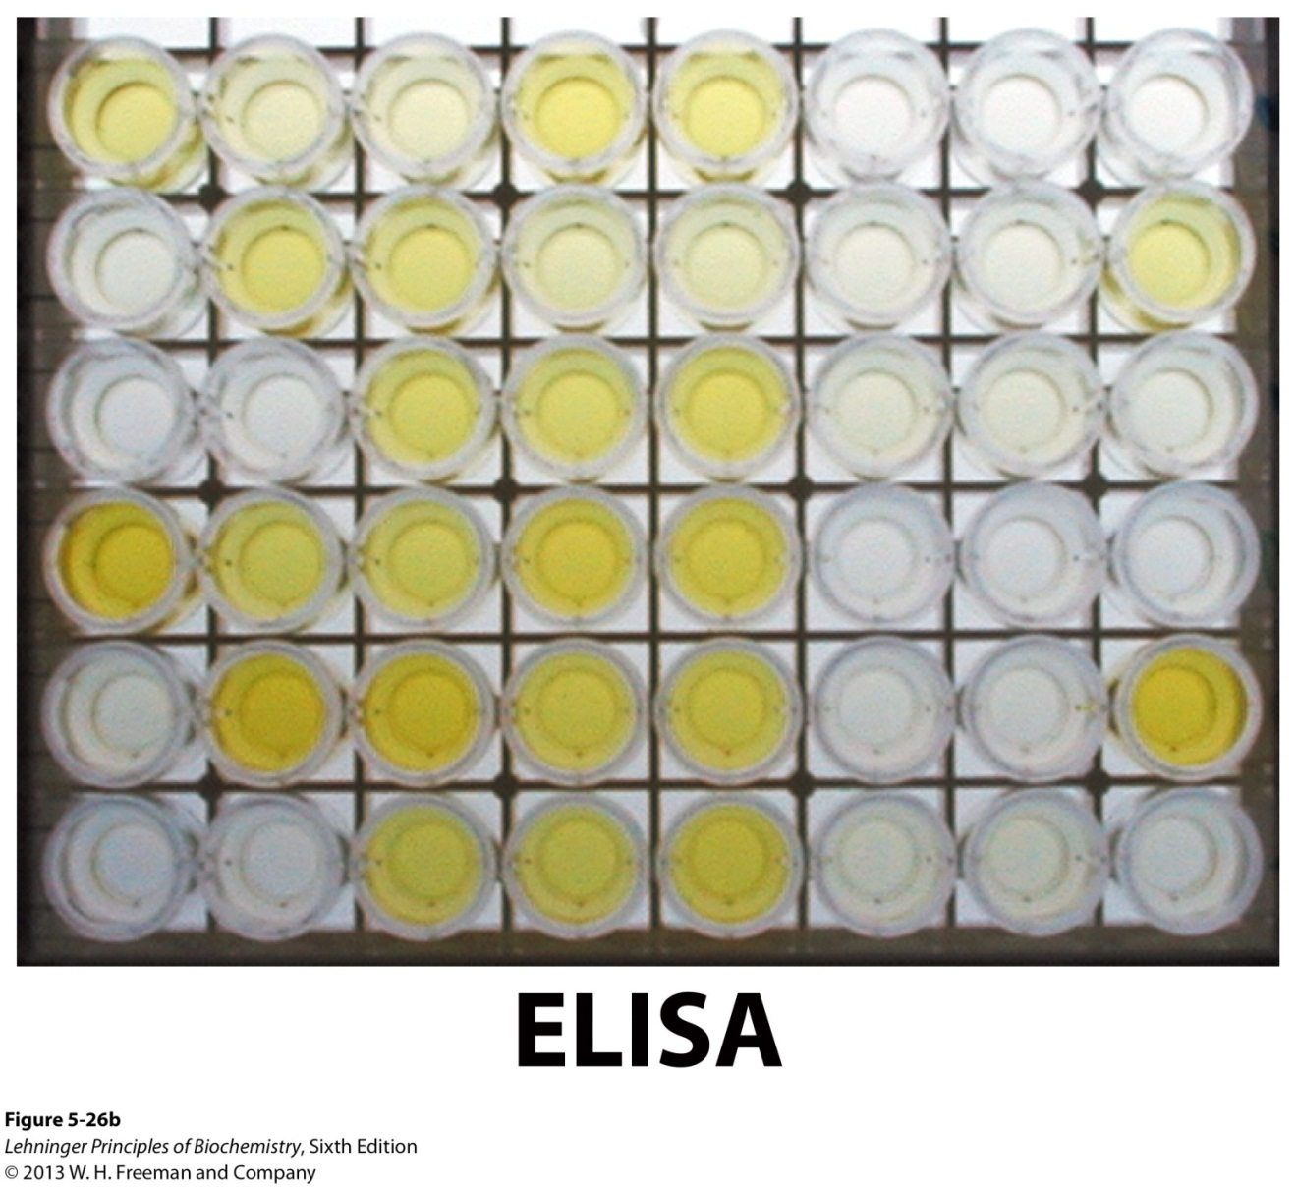
Adsorbent Based Method
Product formation (monitored by color intensity) is proportional to [protein] of interest.

Slide 30
3. Using Antibody-Antigen Interactions for Protein Identification
III. Immunoblot assay (Western Blot)
Proteins that have been seperated by SDS PAGE are transferred electrophoretically to a nitrocellulose membrane.
The membrane is blocked, then treated with primary and then secondary antibody, which is labeled.
The detection of the bound, labeled secondary antibody indicates the presence of the protein of interest.
Provides molecular weight information.
A monoclonal primary antibody is usually more specific than polyclonal antibodies.
Cheaper assay than ELISA but not as quantitative.

Slide 31
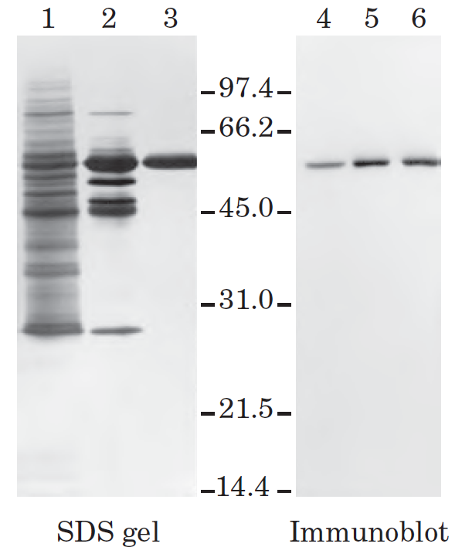
Western Blot
Band intensities tell you about relative amounts of proteins.

