Slide 1
Introduction to Enzymes
Chapter 6 (Page 190-202)

Slide 2
1. Enzymes
Enzymes are the reaction catalysts of biological systems. As catalysts, they do not get consumed during the course of the reaction.
First recognized in the late 1700s in the study of meat digestion by stomach fluids
Name coined by Frederick W. Kühne
Accelerate chemical reactions tremendously and are generally superior to organic/inorganic catalysts

Slide 3
Why Biocatalysts over Synthetic Catalysts?
Greater reaction specificity: avoids side products
Milder reaction conditions: conducive to conditions in cells
(pH ~ 7; 37 °C)
Higher reaction rates: in a biologically useful timeframe
Capacity for regulation: control of biological pathways
Metabolites have many potential pathways of decomposition
Enzymes make the desired one most favorable

Slide 4
1. Enzymes
D. Are central to every biochemical process often involving hundreds of stepwise reactions to
Degrade nutrients
Conserve and transform chemical energy
Make biological macromolecules from simple precursors
E. Are involved in disease due to
A deficiency or total absence of one or more enzymes (i.e. inheritable genetic disorders)
Excessive activity of an enzyme
Working in conjunction with a drug for therapeutic effect

Slide 5
1I. Proteins as Enzymes
The majority of enzymes are proteins
The catalytic activity of enzymes is heavily dependent on the structural integrity of their native protein conformation (primary, secondary, tertiary, and quaternary)
Denatured enzymes or dissociated multimeric enzymes lose all activity
Molecular weights range from 12 to 1000 kDa
Some enzymes are made of only AA

Slide 6
1I. Proteins as Enzymes
E. Some enzymes require additional chemical
components for activity
Cofactor: Typically one or more inorganic ions
- Fe²⁺, Mg²⁺, Mn²⁺, Zn²⁺
Coenzyme: A complex organic or metalloorganic molecule (i.e. Heme)
- Act as transient carriers of specific functional groups
- Most are derived from vitamins (i.e. biocytin derived from biotin)

Slide 7
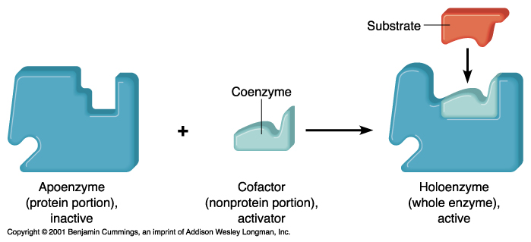
1I. Proteins as Enzymes
A coenzyme or metal ion that is very tightly or covalently bound to the enzyme protein is called a prosthetic group

Slide 8
1I. Proteins as Enzymes
Some enzyme proteins are modified covalently
-By phosphorylation (addition of phosphate)
- Phosphate binding to Ser, Thr, or Tyr
By glycosylation (addition of sugar), which is important in regulatory processes

Slide 9
2. Enzyme Nomenclature
General Categorization-
Enzymes are typically named by adding the suffix “-ase” to the name of their substrate or to a word/phrase describing their activity.
Urease: Catalyzes hydrolysis of urea
Others are named by their discoverers for a broad funciton.
Pepsin: An enzyme known to participate in the digestion of foods

Slide 10
2. Enzyme Nomenclature
International agreement to divide enzymes into six classes-
Enzymes are then divided into subclasses-
Adenosine triphosphate converted to Adenosine diphosphate
Phosphotransferase

Slide 11
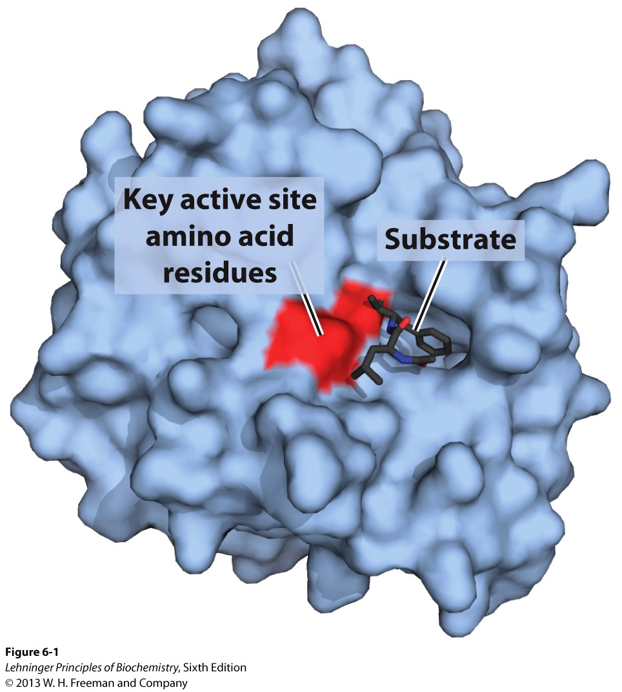
3. The Enzyme-Substrate Complex
The enzyme-catalyzed reaction takes place within the confines of a pocket on the enzyme called the active site.
The molecule bound in the active site and acted upon by the enzyme is called the substrate.
The active site is often found within the protein, where the substrate is sequestered from solvent.
Proposed by Charles-Adolphe Wurtz (1880)

Slide 12
4. Enzymes affect Reaction Rates, Not Equilibria
A. A simple enzymatic reaction is written:
$$E + S ES EP E + P$$
E: Enzyme; S: Substrate; P: Product
ES: Transient Enzyme-Substrate Complex
EP: Transient Enzyme-Product Complex
The function of the enzyme is to increase the rate of the reaction but not affect the reaction equilibria.
$S P$

Slide 13
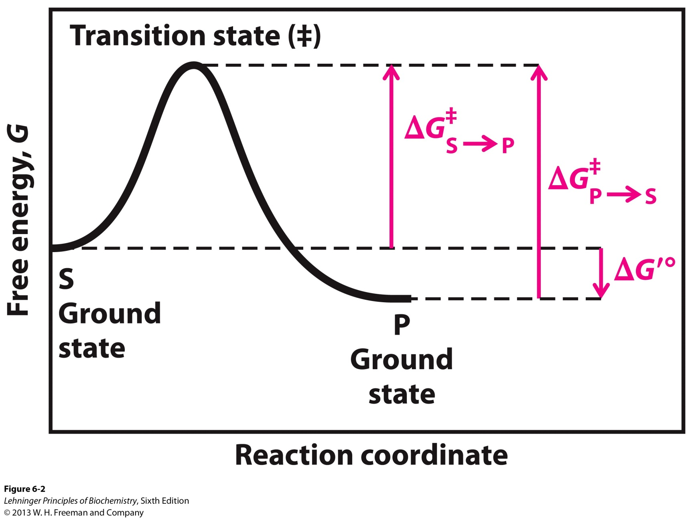
4. Enzymes affect Reaction Rates, Not Equilibria
B. A reaction coordinate diagram for :
$$S P$$

Slide 14
4. Enzymes affect Reaction Rates, Not Equilibria
The free energy of the system (G) is plotted against the progress of the reaction (the reaction coordinate).
The starting point for either the forward or the reverse reaction is called the ground state, the contribution to the free energy of the system by the substrate or product under a given set of conditions.
ΔG’° is defined as the standard free energy change at pH 7.0 and 298 K (biochemical standard).
The equilibrium between S and P reflects the difference in the free energies of their ground states.
The free energy of the ground state of P is lower than that of S, so ΔG’° < 0, and P is favored.

Slide 15
4. Enzymes affect Reaction Rates, Not Equilibria
A favorable equilibrium does not mean that the
S → P conversion will occur at a detectable rate.
The rate is dependent on the energy barrier between S and P, the energy required for alignment of reacting groups, formation of transient unstable charges, bond rearrangements, and other transformations.
The substrate must overcome this barrier and thus be raised to a higher energy level.
At the top of the energy hill is a point, the transition state (‡) , in which decay to either S or P state is equally probable. The transition state is a chemical species that is extremely transient and very unstable.

Slide 16
4. Enzymes affect Reaction Rates, Not Equilibria
The difference between the energy levels of the ground state and the transition state is the activation energy, ΔG‡.
The rate of a reaction reflects this activation energy:
activation energy, rate
Reaction rates can be increased by raising the temperature, thereby increasing the number of molecules with sufficient energy to overcome the energy barrier.

Slide 17
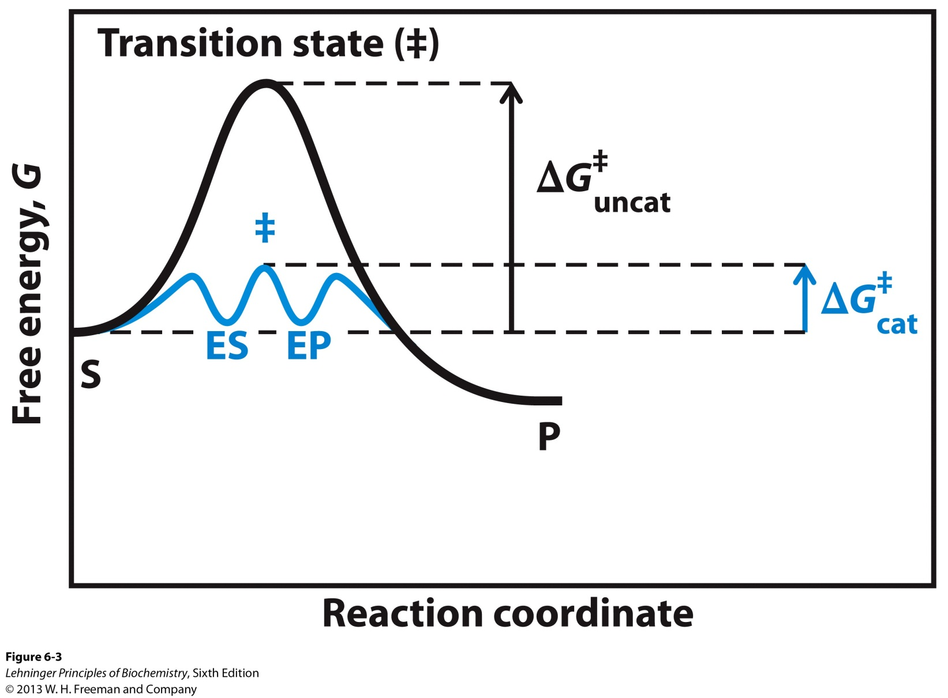
4. Enzymes affect Reaction Rates, Not Equilibria
C. Enzymes enhance rates by lowering activation energies
----------------------------

Slide 18
4. Enzymes affect Reaction Rates, Not Equilibria
In the reaction coordinate involving an enzyme, ES and EP are reaction intermediates. A reaction intermediate is any species on the reaction pathway that has a finite chemical lifetime (longer than a molecular vibration, ~10⁻¹³ seconds).
The interconversion of the ES and EP intermediates constitutes a reaction step, with a much lower activation barrier (ΔG‡_{cat})
When several steps occur in a reaction, the overall rate is determined by the step (or steps) with the highest activation energy called the rate-limiting step.
The ΔG’° is unaffected and remains < 0, and favors P.

Slide 19
4. Enzymes affect Reaction Rates, Not Equilibria
D. Enzymes also help the body use any energy released by a reaction.
The breakdown of sucrose is a thermodynamically favorable reaction but is very slow.
The appropriate enzyme speeds up the reaction on a biologically useful time scale and also organizes the reaction such that the energy released is recovered in other chemical forms and made available to the cell for other tasks.
This breakdown pathway is the primary energy yielding pathway for cells.

Slide 20
5. Thermodynamic Definitions for Reaction Equilibria and Kinetics
A. Equilibria
$$S P$$
$${K′}_{eq}= \frac{[P]}{[S]}$$
$$ΔG^{′}°=−RT\ln{{K′}_{eq}}$$
R (gas constant) = 8.315 J/(mol K) T = 298 K
A large negative value for ΔG’° is a favorable reaction.
K’_{eq}, ΔG’°

Slide 21
5. Thermodynamic Definitions for Reaction Equilibria and Kinetics
B. Kinetics
$$S P$$
$$\frac{d[P]}{dt} = k[S]$$
k = rate constant, for a first-order reaction has unit of s⁻¹
k, Faster the reaction
From transition-state theory,
$$k= \frac{k_{b}T}{h}e^{−Δ\text{G}\text{‡}\text{/}\text{RT}}$$
k_{b} = Boltzman constant, h = Planck’s constant
k, ΔG‡ (lower activation energy)

Slide 22
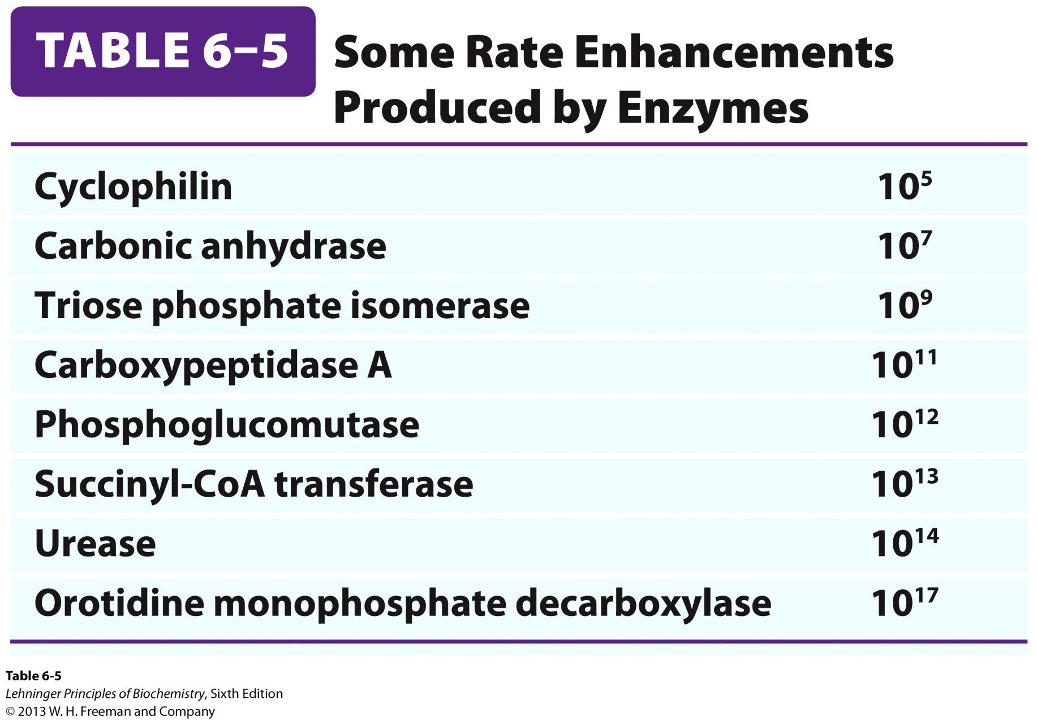
Rate Enhancement by Enzyme

Slide 23
6. Enzyme Specificity via Covalent and Noncovalent Interactions
Enzyme specificity, the ability to discriminate between a substrate and a competing molecule, is facilitated by:
Covalent interactions
Catalytic functional groups on an enzyme may form a transient covalent bond with a substrate and activate it for reaction.
Or a group may be transiently transferred from the substrate to the enzyme.
These interactions lower the activation energy.

Slide 24
6. Enzyme Specificity via Covalent and Noncovalent Interactions
B. Noncovalent interactions
The interaction between substrate and enzyme in the ES complex is mediated by the same forces that stabilize protein structure, including hydrogen bonds and hydrophobic and ionic interactions.
The formation of each weak interaction in the ES complex is accompanied by release of a small amount of energy called the binding energy, ΔG_{B}.
Binding energy helps to lower activation energy.

Slide 25
7. Theories to explain ES Binding Energy
Lock and Key Theory
In 1894, Emil Fischer proposed that enzymes were structurally complementary to their substrates.
Binding energy was the result of the structural complementary nature of the substrate and the binding pocket.
This theory has since been challenged when considering the enzyme free reaction.
Metal stick (substrate) in a magnetic pocket (enzyme active site)

Slide 26
7. Theories to explain ES Binding Energy
B. Enzyme free reaction
Consider the breaking of a magnetized metal stick.
In the transition state, the stick is bent before it becomes broken.

Slide 27
7. Theories to explain ES Binding Energy
In the lock and key theory, the metal stick would be “locked” into place in the “magnetic” pocket of the enzyme and would be unable to obtain the transition state structure (bent structure) necessary to break.
In the reaction coordinate, the ES complex would be highly stabilized causing for an even higher activation energy for the substrate to overcome to become product (ΔG‡_{cat} > ΔG‡_{uncat})

Slide 28
7. Theories to explain ES Binding Energy
C. Modern Enzyme Catalysis Theory
Elaborated by Linus Pauling (1946)
In order to catalyze reactions, an enzyme must be complementary to the reaction transition state. The optimal interactions between substrate and enzyme occur only in the transition state.
The summation of the unfavorable ΔG‡ and the favorable ΔG_{B} results in a lower ativation energy.
ΔG‡_{cat} < ΔG‡_{uncat}

Slide 29
8. How to Lower ΔG‡ via Noncovalent Interactions
There are physical and thermodynamic factors contributing to ΔG‡:
Entropy reduction of the substrate
The substrate becomes constrained which is not thermodynamically favorable.
Binding energy holds the substrate in the proper orientation via many weak interactions with strategically located groups on the enzyme.
This is similar to entropy reduction in small molecules resulting in major rate enhancements.

Slide 30
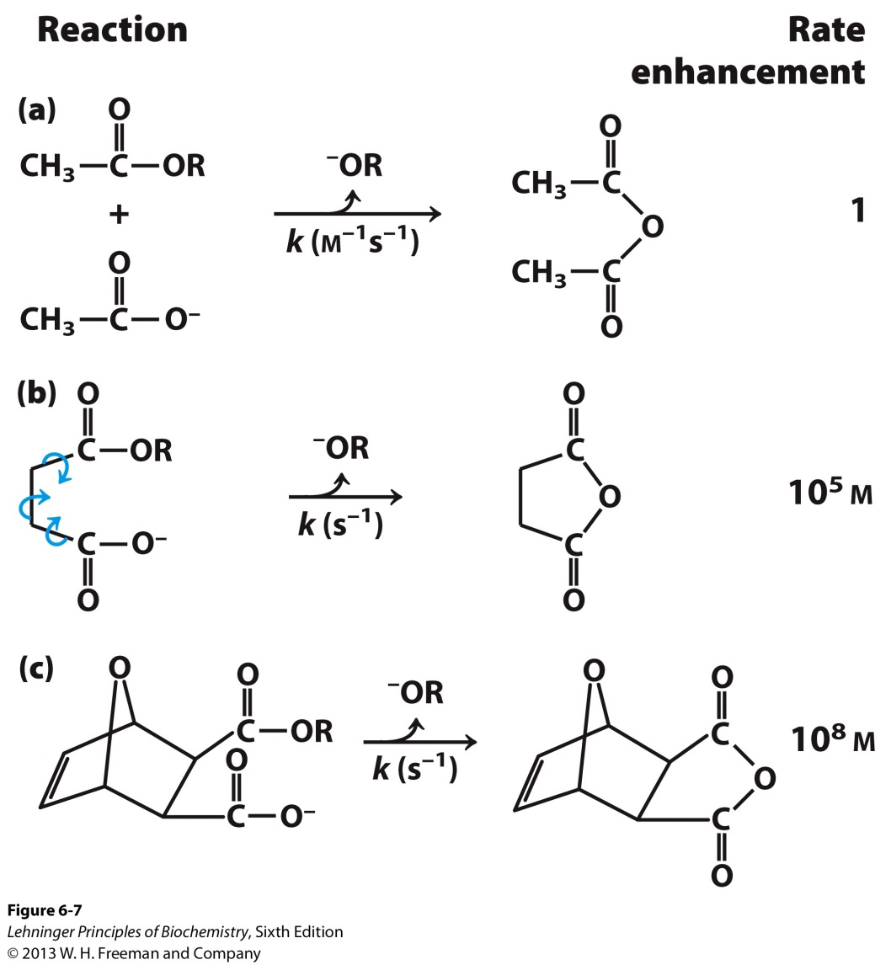
Support of the Proximity Model
The rate of anhydride formation from esters and carboxylates shows a strong dependence on proximity of two reactive groups (work by Thomas C. Bruice’s group).

Slide 31
8. How to Lower ΔG‡ via Noncovalent Interactions
B. Desolvation of the substrate
Solvation shell of water typically stabilizes biomolecules.
Loss of hydrogen bonding between the substrate and water is overcome by the many weak interactions found only in the transition state.
C. Distortion of the substrate
The substrate may undergo electron distribution

Slide 32
8. How to Lower ΔG‡ via Noncovalent Interactions
D. Enzyme conformational change
The enzyme usually undergoes a conformational change when the substrate binds.
An induced fit (Daniel Koshlan, 1958) occurs resulting in specific functional groups on the enzyme being repositioned to favor catalysis of the reaction. This conformational change facilitates additional weak bonding interactions in the transition state.

Slide 33
9. Enzyme Catalytic Mechanisms based on Covalent Interactions
After a substrate is bound to an enzyme, properly positioned catalytic functional groups aid in the cleavage and formation of bonds by a variety of mechanisms involving transient covalent interactions including:
Acid-base catalysis
Give and take protons
Covalent catalysis
Change reaction paths
Metal ion catalysis
Use redox cofactors, pKa shifters

Slide 34
9I. General Acid-base Catalysis
A. Many biochemical reactions involve the formation of unstable charged intermediates that tend to break down rapidly reforming their constituent reactant species, thus impeding the reaction.
Hydrolysis of an amide bond
Unstable (charged) intermediate

Slide 35
9I. General Acid-base Catalysis
B. Charged intermediates can be stabilized by the transfer of protons to or from the substrate or intermediate to form a species that breaks more readily to products.
Specific acid-base catalysis:
Proton transfers involving H⁺ (H₃O⁺) and OH⁻ ions from water. This takes place when proton transfer between intermediate and water is faster than intermediate breakdown.
General acid-base catalysis:
Proton transfers mediated by other classes of
molecules. Takes place when proton transfer with water is slower than intermediate breakdown.

Slide 36
9I. General Acid-base Catalysis
Specific Acid-Base:
This takes place when proton transfer between intermediate and water is faster than intermediate breakdown.
General Acid-Base:
This takes place when proton transfer between intermediate and water is slower than intermediate breakdown.

Slide 37
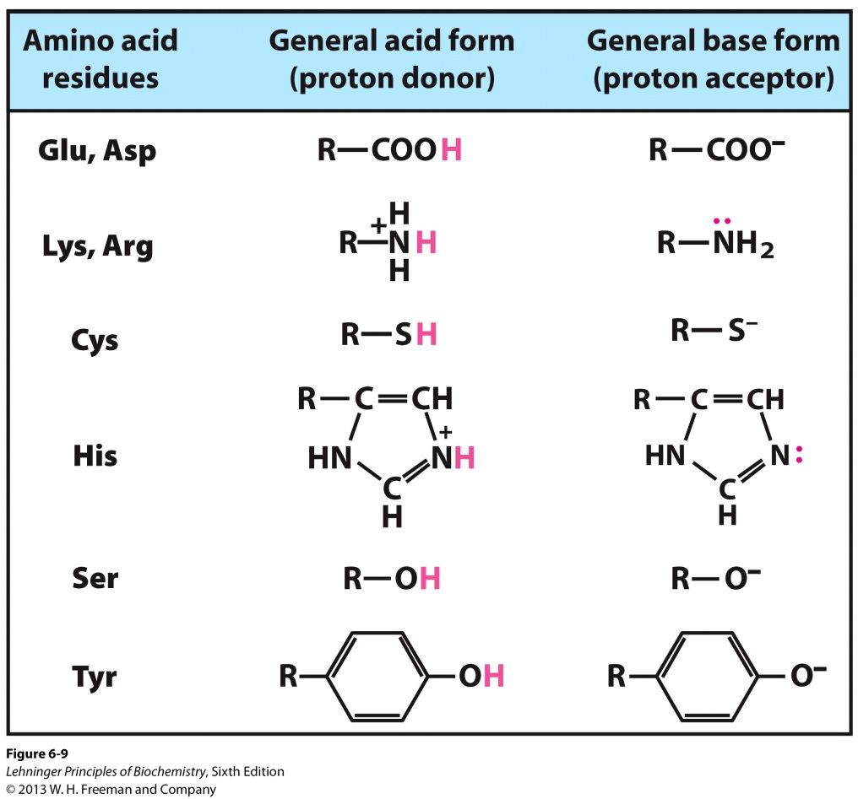
9I. General Acid-base Catalysis
C. In the active site of an enzyme, a number of amino acid side chains can act as general proton donors and acceptors.
AA groups can enhance rates on the order of 10² to 10⁵.

Slide 38
9II. Covalent Catalysis
In covalent catalysis, a transient covalent bond is formed between the enzyme and the substrate.
Consider the following hydrolysis:
In the presence of a covalent catalyst (an enzyme with a nucleophile group X: ) the reaction becomes

Slide 39
9II. Covalent Catalysis
B. The pathway of the reaction is altered and catalysis occurs only when the new pathway has a lower activation energy than the uncatalyzed pathway. Both of the new steps depicted must be faster than the uncatalyzed reaction.
C. Requires a nucleophile on the enzyme
Reactive serine, thiolate, amine, or carboxylate (conjugate base of ionizable AA R groups)

Slide 40
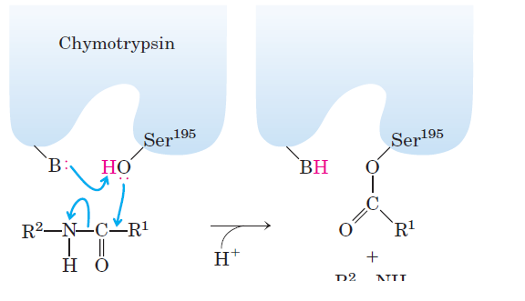
9II. Covalent Catalysis
Chymotrypsin uses an AA nucleophile to cleave peptides.
D. These covalent complexes always undergo further reaction to regenerate the free enzyme
R²-NH₂

Slide 41
9III. Metal Ion Catalysis
Involves a metal ion bound to the enzyme.
Ionic interactions between an enzyme-bound metal and a substrate can help orient the substrate for reaction or stabilize charged reaction transition states.
Metals can also mediate oxidation-reduction reactions by reversible changes in the metal ion’s oxidation state.

