Slide 1
Enzyme Kinetics provides Insight into
Enzyme Mechanism
Chapter 6 (Page 202-212)

Slide 2
1. Understanding Enzyme Function
Understanding what role an enzyme plays and how it executes this role requires
Knowledge of the three-dimensional structure of the protein
Sequence homology can be very telling of the class of enzyme a protein belongs to.
The structure of the protein in complex with its substrate can highlight important AA for catalysis.
Determining the rate of the enzyme catalyzed reaction through enzyme kinetics
Investigate how the rate is effected by experimental parameters.

Slide 3
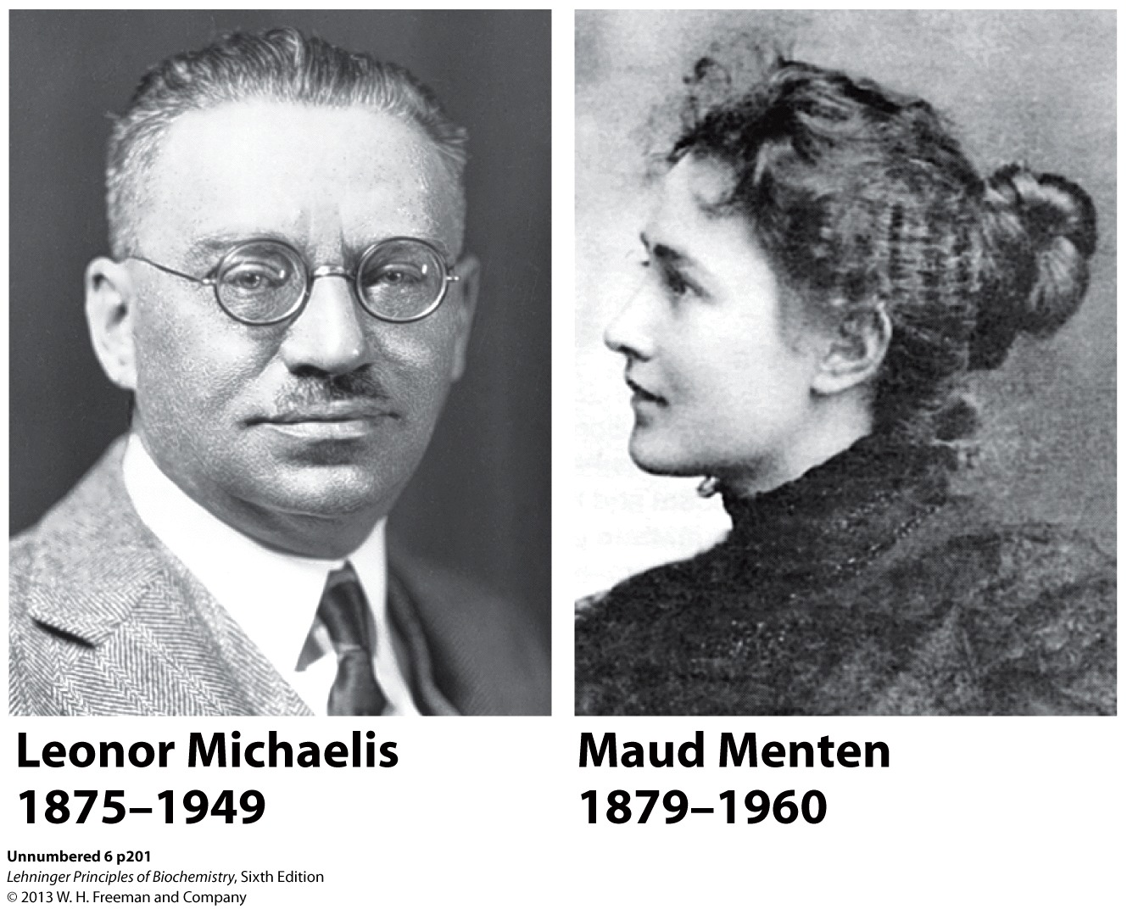
2. Key Players in the Development of Enzyme Kinetics
Michaelis-Menten Enzyme Kinetics

Slide 4
3. What is Enzyme Kinetics?
Kinetics is the study of the rate at which compounds react.
The rate of enzymatic reactions is affected by:
Enzyme
Substrate
Effectors
Temperature

Slide 5
4. Why Study Enzyme Kinetics?
Quantitative description of biocatalysis
Determine the order of binding of substrates
Understand catalytic mechanism
Find effective inhibitors
Understand regulation of activity

Slide 6
5. How to do Kinetic Measurements?
Experiment:
Mix enzyme and substrate (S).
Record rate of substrate disappearance/product (P) formation as a function of time (the velocity of the reaction).
[S], [P]
Need a distinct spectroscopic signal to detect the substrate and/or the product (i.e. UV-Vis)
S → P

Slide 7
5. How to do Kinetic Measurements?
You can monitor the concentration of substrate or product if they absorb light in the UV-Vis range.
S → P
Beer’s Law:
A = εbc
[S]
[P]
Absorbance
Wavelength (nm)
Isosbestic point- Represents a clear division between the UV-vis signal of two molecules.

Slide 8
5. How to do Kinetic Measurements?
Determine the rate dependence on [S].
Studying the effects of substrate concentration is complicated by the fact that [S] changes during the course of a reaction as substrate is converted to product.
In enzyme kinetics this issue has been simplified by measuring the initial rate (or initial velocity; V₀) when [S] is much greater than the concentration of enzyme.
The enzyme may be present at nM (10⁻⁹) quantities and the substrate at at least 5 orders of magnitude higher.
The reaction is monitored for typically the 1st minute during which [S] changes insignificantly.

Slide 9
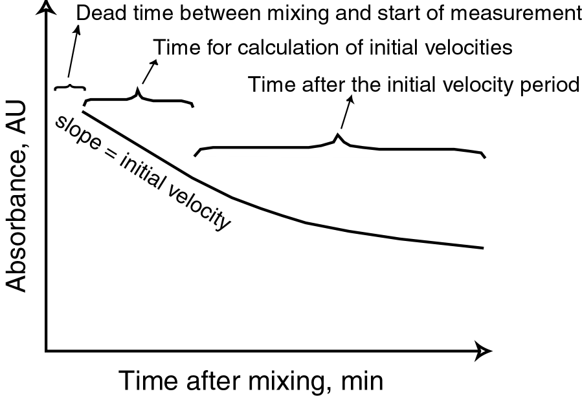
5. How to do Kinetic Measurements?
An example of real data for a decrease in the absorbance of substrate at a fixed wavelength.
(Linear region)

Slide 10
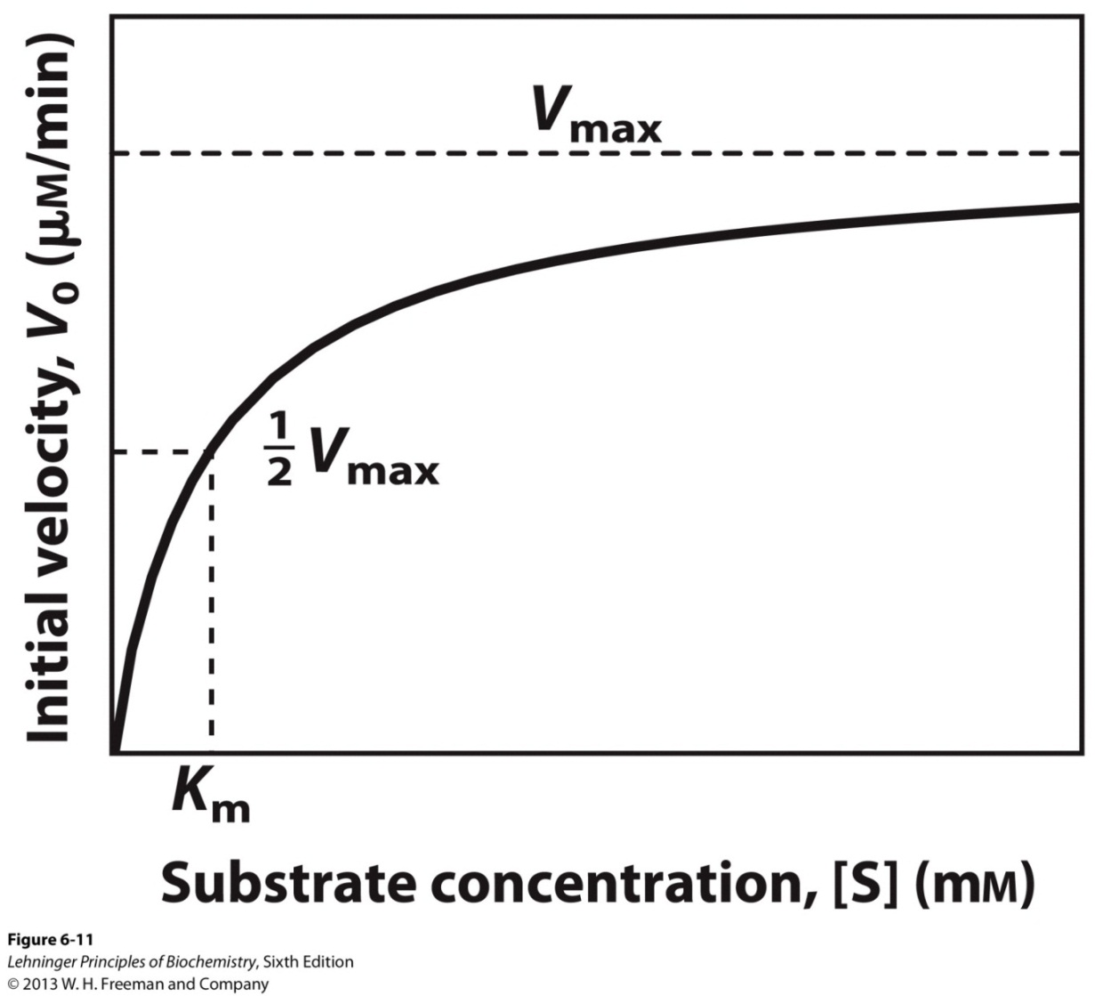
5. How to do Kinetic Measurements?
The initial velocity depends on [S] in a hyperbolic manner. The plateau of the curve represents the maximum velocity, V_{max}. Demonstrates saturation kinetics.

Slide 11
6. Deriving the Michaelis-Menten Equation.
A. Michaelis-Menten proposed that the enzyme first combines reversibly with its substrate to form an enzyme-complex in a relatively fast reversible step:
$$E+S ES$$
B. The ES complex then breaks down in a slower second step to yield the free enzyme and the reaction product (P):
$$ES E + P$$
The rate limiting step is dependent on [ES].
V_{max} is observed when virtually all of the enzyme is present as the ES complex, when the enzyme is “saturated” with substrate.
k₁
k-₁
k₂
k-₂

Slide 12
6. Deriving the Michaelis-Menten Equation.
Early in the reaction, the concentration of the product is negligible, and the assumption is made that the reverse reaction (P→S) can be ignored.
The formation of product (d[P]/dt or V₀) is determined by the rate of ES breakdown to form product.
$V_{0} = k_{2}$[ES]
[ES] is not easily measurable.
Easier to think of [E_{t}] representing the total enzyme concentration.
Unbound enzyme = [E_{t}] - [ES].
[S] essentially remains constant.
k₁
k₂
$$E+S ES E + P$$
k-₁

Slide 13
6. Deriving the Michaelis-Menten Equation.
E. The rates of ES formation and breakdown are defined as
Rate of ES formation = k₁([E_{t}] – [ES])[S]
Rate of ES breakdown = k-₁[ES] + k₂[ES]
Steady-state assumption: The rate of ES formation is equal to the rate of its breakdown. There is negligible build up of ES.
k₁([E_{t}] – [ES])[S] = k-₁[ES] + k₂[ES]
Steady-State Kinetics
k₁
k₂
$$E+S ES E + P$$
k-₁
[E]

Slide 14
6. Deriving the Michaelis-Menten Equation.
k₁([E_{t}] – [ES])[S] = k-₁[ES] + k₂[ES]
Algebraic steps:
k₁[E_{t}][S] – k₁[ES][S] = (k-₁ + k₂)[ES]
Add k₁[ES][S] to both sides:
k₁[E_{t}][S] = (k₁[S] + k-₁ + k₂)[ES]
Solve the equation for [ES] (the term that is hard to measure):
$\left[ES\right] = \frac{\text{k}\text{1}\text{[}\text{Et}\text{][}\text{S}\text{]}}{\text{k}\text{1}\text{[}\text{S}\text{] + }\text{k}\text{−1} \text{+ }\text{k}\text{2}}$
Combine the rate constants into one term.

Slide 15
6. Deriving the Michaelis-Menten Equation.
$\left[ES\right] = \frac{\text{[}\text{Et}\text{][}\text{S}\text{]}}{\text{[}\text{S}\text{] + }\frac{k_{2} + k_{−1}}{k_{1}}}$
The term $\frac{k_{2} + k_{−1}}{k_{1}}$is defined as the Michaelis constant, K_{m}.
$$\left[ES\right] = \frac{\text{[}\text{Et}\text{][}\text{S}\text{]}}{K_{m} \text{+ }[S]}$$
Recall that $V_{0} = k_{2}$[ES]
$$V_{0}= \frac{k_{2}\text{[}\text{Et}\text{][}\text{S}\text{]}}{K_{m} \text{+ }[S]}$$
Maximum velocity occurs when the enzyme is saturated,
[ES] = [E_{t}]

Slide 16
6. Deriving the Michaelis-Menten Equation.
V_{max} = k₂[E_{t}];
$$V_{0}= \frac{V_{max} \text{[}\text{S}\text{]}}{K_{m} \text{+ }[S]}$$
Michaelis-Menten equation for a one-substrate enzyme-catalyzed reaction.
K_{m} has units of M
V_{max} has units of Ms⁻¹

Slide 17
6I. V₀ = V_{max}/2
$$\frac{V_{max}}{2} = \frac{V_{max} \text{[}\text{S}\text{]}}{K_{m} \text{+ }[S]}$$
$$\frac{1}{2} = \frac{ \text{[}\text{S}\text{]}}{K_{m} \text{+ }[S]}$$
Solve for K_{m.}
K_{m} + [S] = 2[S]
K_{m} = [S]
K_{m} equals the substrate concentration at which V₀ is half the maximal velocity.

Slide 18
6II. Understanding the kinetic parameters K_{m} and V_{max}.
Although derived for a simple two-step (one substrate) reaction mechanism, the Michaelis-Menten equation can be applied to enzymes that catalyze reactions with several steps.
The real meaning of K_{m} and V_{max} can differ for different enzymes.

Slide 19
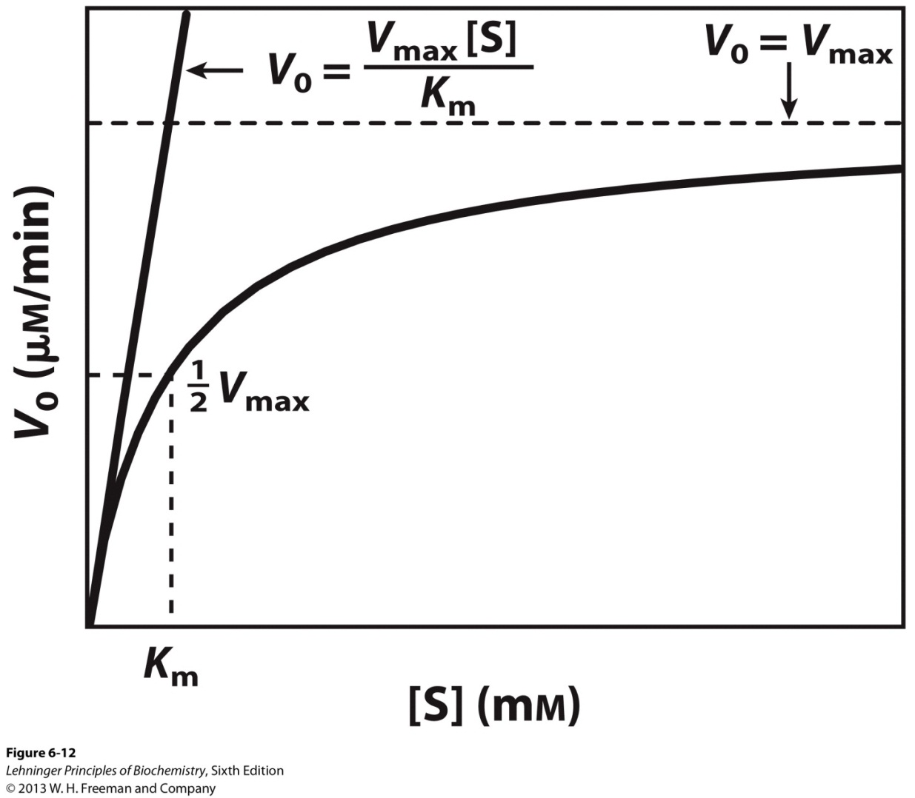
6II. Understanding the kinetic parameters K_{m} and V_{max}.
A. Nonlinear Michaelis-Menten plot should be used to calculate parameters K_{m} and V_{max}.

Slide 20
6II. Understanding the kinetic parameters K_{m} and V_{max}.
B. Linearized double-reciprocal plot is good for analysis of two-substrate data or inhibition.
Lineweaver-Burk Equation
$$\frac{1}{V_{0}} = \frac{K_{m}}{V_{max}[S]} + \frac{1}{V_{max}}$$

Slide 21
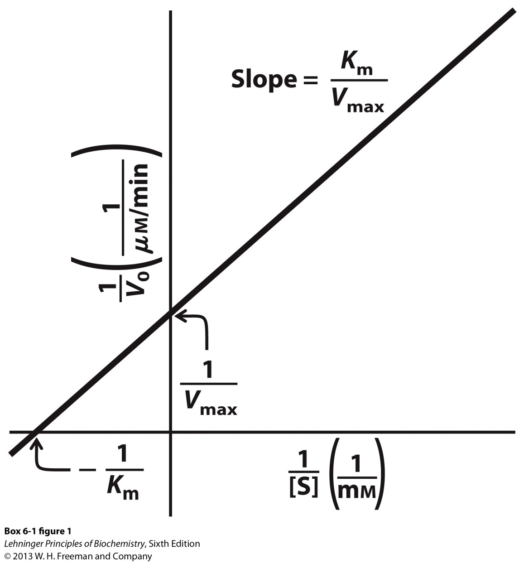
6II. Understanding the kinetic parameters K_{m} and V_{max}.
X-intercept

Slide 22
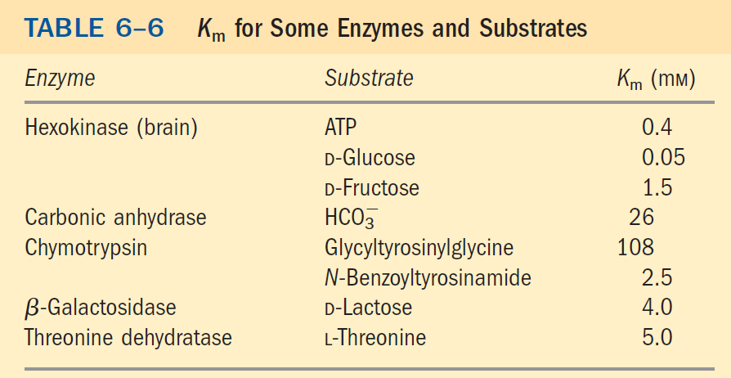
6II. Understanding the kinetic parameters K_{m} and V_{max}.
C. K_{m} can vary from enzyme to enzyme.

Slide 23
6II. Understanding the kinetic parameters K_{m} and V_{max}.
For reactions with two steps (one substrate):
$$K_{m} = \frac{k_{2} + k_{−1}}{k_{1}}$$
When k₂ is rate limiting, k₂ << k₋₁, K_{m} = k₋₁/k₁;
K_{m} then represents a dissociation constant
But this condition is not true for most enzymes
k₂ > k₋₁
k₂ ~ k₋₁

Slide 24
6II. Understanding the kinetic parameters K_{m} and V_{max}.
D. V_{max} can vary from enzyme to enzyme.
For a two-step reaction (one substrate),
V_{max} = k₂[E_{t}] where k₂ is rate limiting
The number of reaction steps and the identity of the rate-limiting step(s) can vary from enzyme to enzyme.
It is useful to define a general rate constant, k_{cat}, to describe the limiting rate of any enzyme- catalyzed reaction at saturation.
k₁
k₂
k₃
$$E+S ES E P E + P$$
k-₁
k-₂

Slide 25
6II. Understanding the kinetic parameters K_{m} and V_{max}.
V_{max} = k_{cat}[E_{t}]
$$V_{0}= \frac{k_{cat}{[E}_{t}] \text{[}\text{S}\text{]}}{K_{m} \text{+ }[S]}$$
k_{cat} is a first-order rate constant
It is called the turnover number: the number of substrate molecules converted to product in a given unit of time on a single enzyme molecule when the enzyme is saturated with substrate.
k_{cat}, substrate to product conversion

Slide 26
6II. Understanding the kinetic parameters K_{m} and V_{max}.
E. The best way to compare the catalytic efficiencies of different enzymes or the turnover of different substrates by the same enzyme is to compare the ratio k_{cat}/K_{m} (the specificity constant)
When [S] << K_{m}
$$V_{0}= \frac{k_{cat}{[E}_{t}] \text{[}\text{S}\text{]}}{K_{m} }$$
k_{cat}/K_{m} is a second order rate constant.
There is an upper limit to k_{cat}/K_{m} imposed by the rate at which E and S can diffuse together in an aqueous solution. The diffusion-controlled limit is
10⁸ to 10⁹ M⁻¹s⁻¹.
E + S → ES (diffusion-controlled)

Slide 27
6II. Understanding the kinetic parameters K_{m} and V_{max}.

Slide 28
7. Two Substrate Reactions.
For a two substrate reaction, the enzyme kinetic mechanism is made more complicated by the order of binding of substrates and release of products.
When two or more reactants are involved, enzyme kinetics analysis helps to distinguish between different kinetic mechanisms.
Sequential mechanism
Ping-Pong mechanism

Slide 29
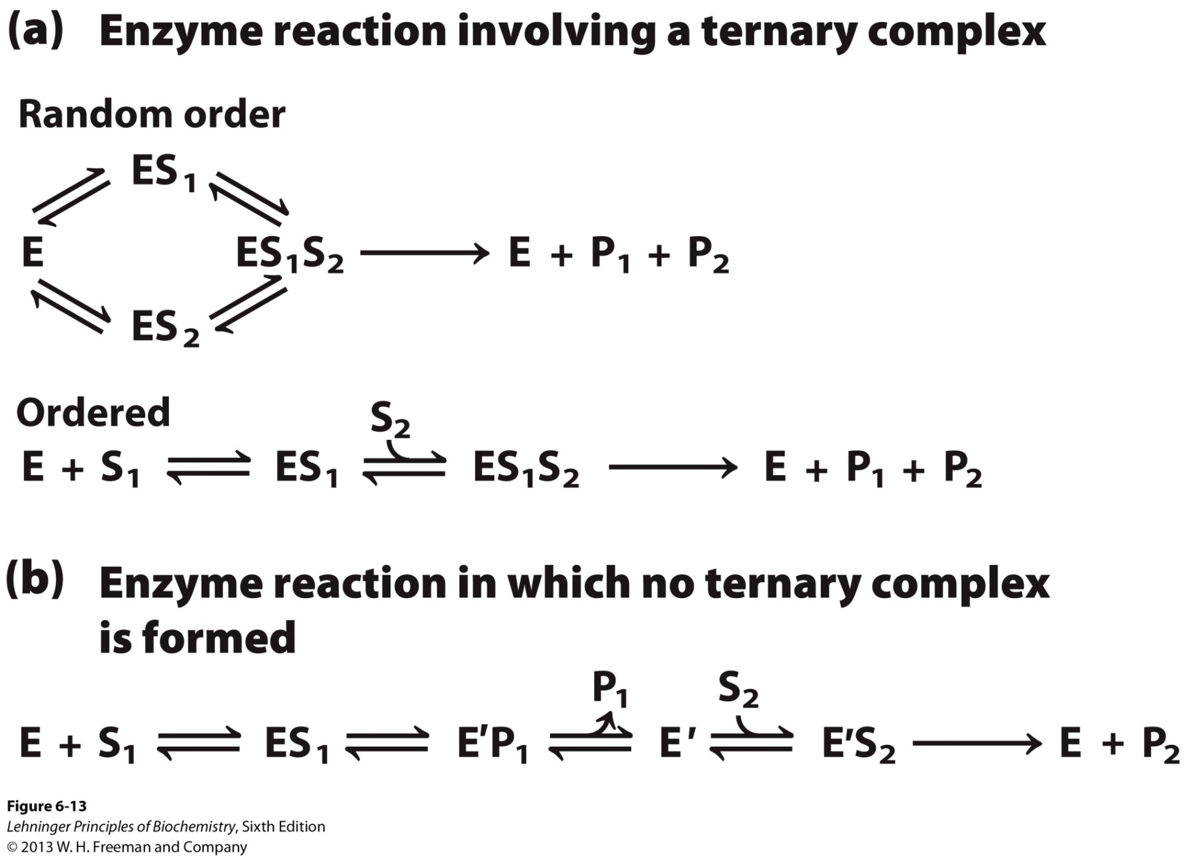
7. Two Substrate Reactions.
Sequential binding
Ping-pong binding

Slide 30
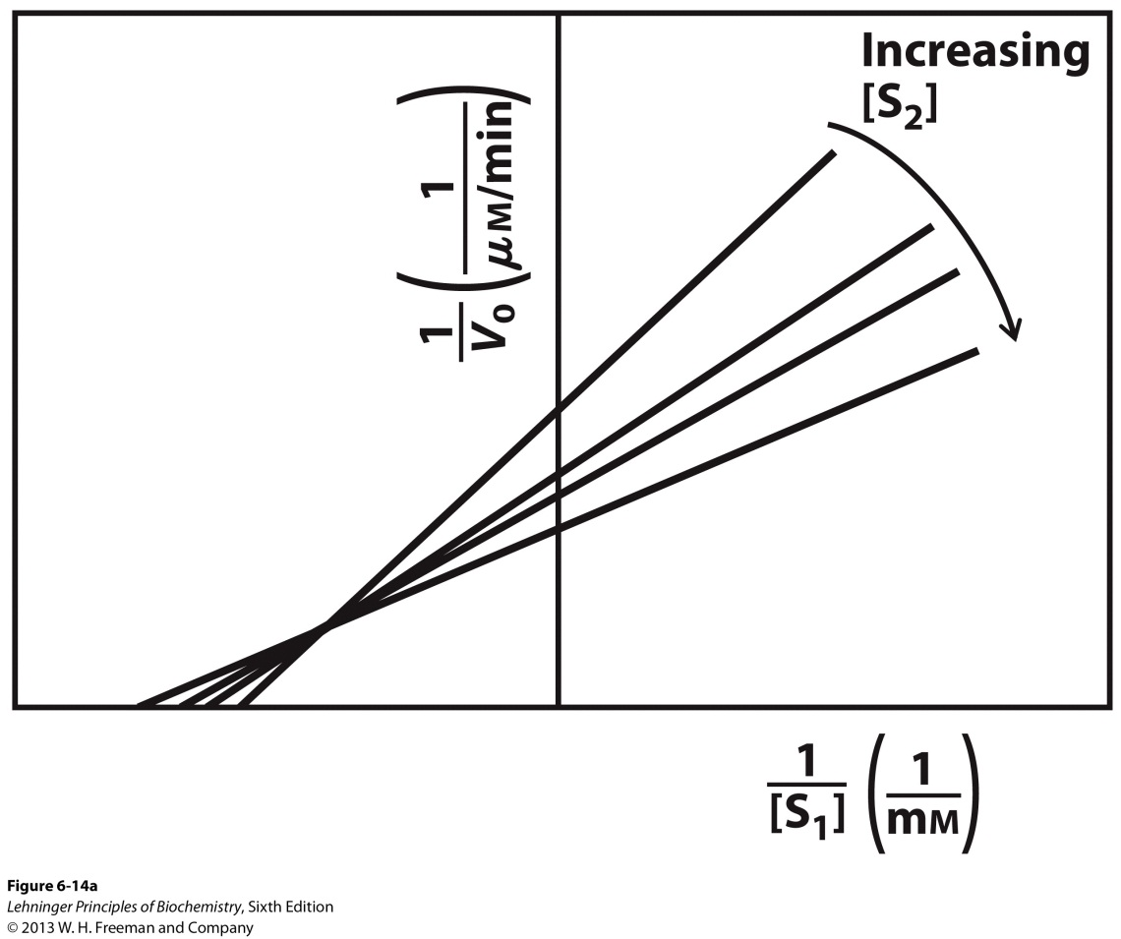
7I. Ternary Complex Formation.
We cannot easily distinguish random from ordered mechanism for ternary complex formation.
Lineweaver-Burk plots obtained at different [S₂] show intersecting lines, which suggest a ternary complex

Slide 31
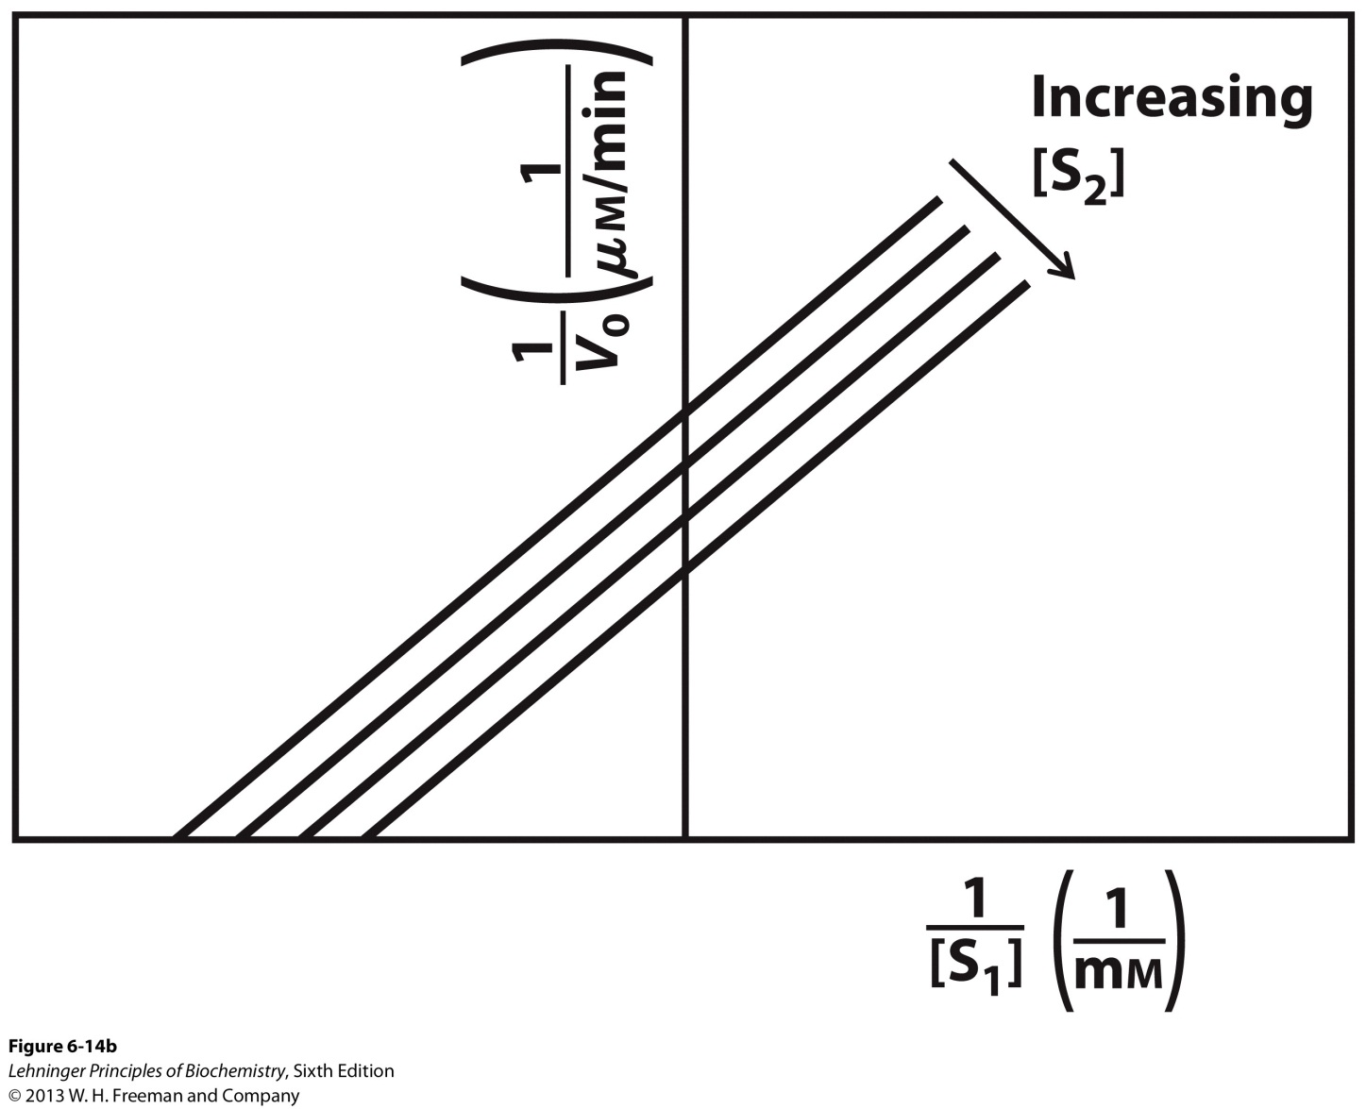
7II. Ping-pong mechanism.
For a ping-pong mechanism, lines obtained by the Lineweaver-Burk plots at different [S₂] are parallel.

Slide 32
8. Enzyme Inhibition.
Inhibitors are compounds that decrease enzyme’s activity.
Cause deviations in the ideal rate equation:
$$V_{0}= \frac{V_{max} \text{[}\text{S}\text{]}}{K_{m}\text{+ }[S]}$$

Slide 33
8I. Reversible Inhibitors.
Reversible inhibitors bind to and can dissociate from the enzyme.
They are often structural analogs of substrates or products.
They are often used as drugs to slow down a specific enzyme.
They bind to the free enzyme and prevent the binding of the substrate.
Or they bind to the enzyme-substrate complex and prevent the reaction.

Slide 34
8Ia. Competitive Inhibitors.
Competitive inhibitors compete with substrate for binding.
These inhibitors bind to the active site.
Do not affect catalysis.
They do not change V_{max} but increase K_{m}.
The Lineweaver-Burk plots show lines intersecting at the y-axis.

Slide 35
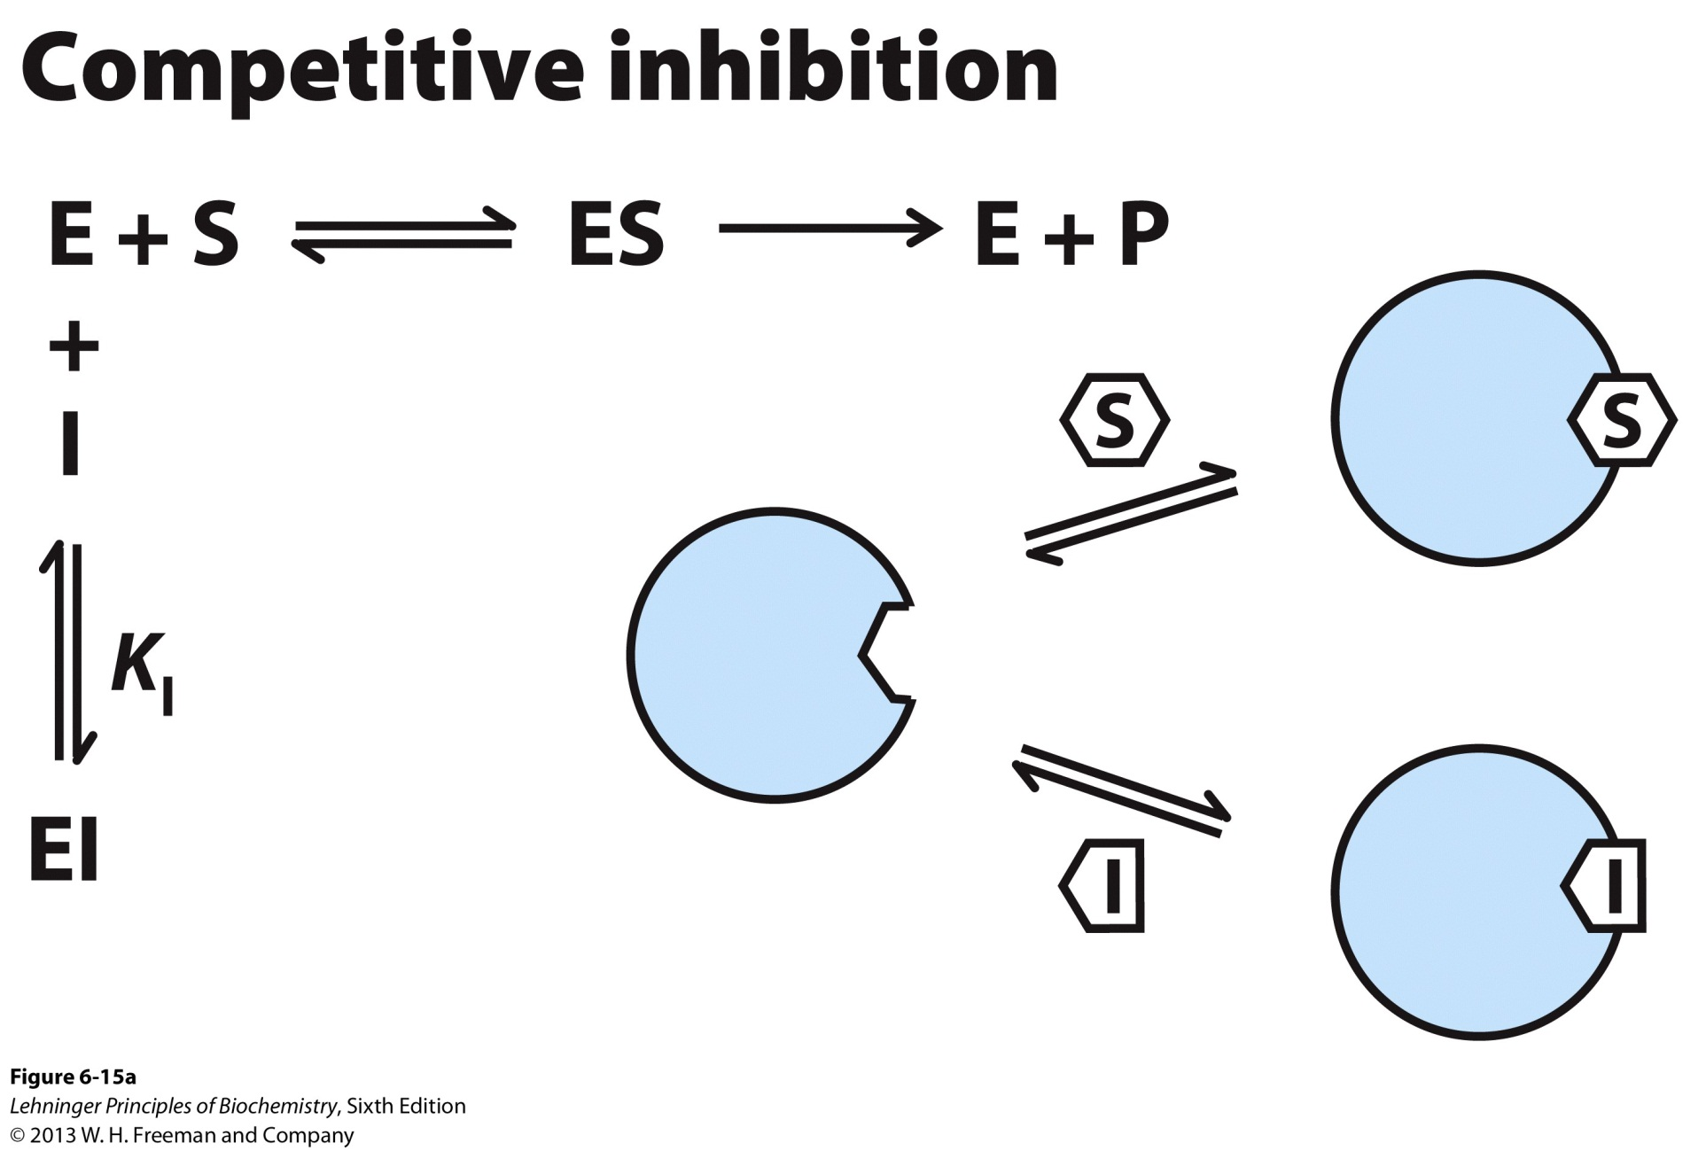
8Ia. Competitive Inhibitors.

Slide 36
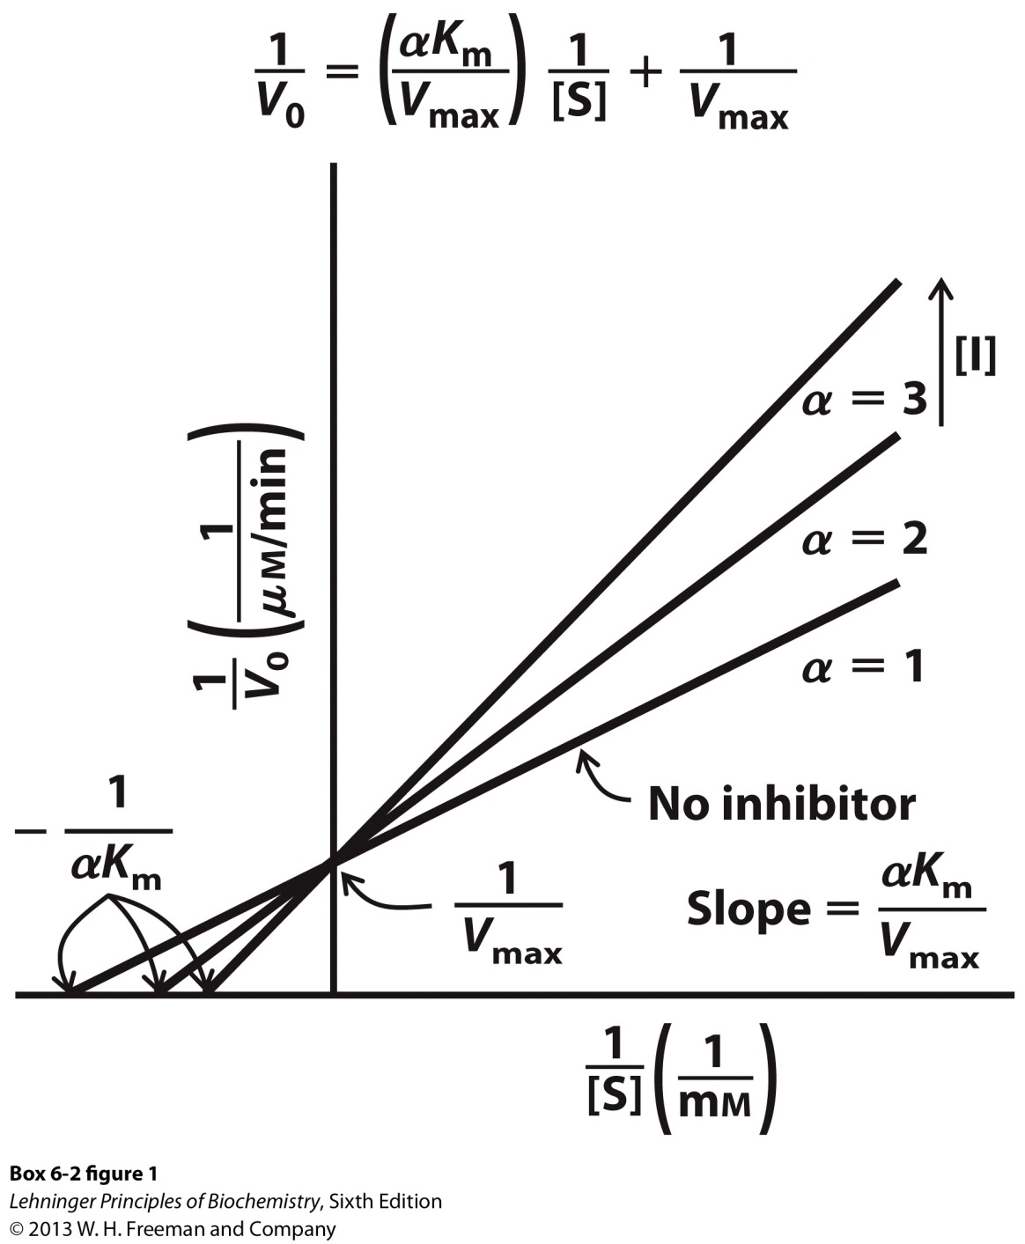
8Ia. Competitive Inhibitors.
α $= 1+ \frac{[I]}{K_{I}}$
$$K_{I} = \frac{\left[E\right][I]}{[EI]}$$

Slide 37
8Ib. Uncompetitive Inhibitors.
Uncompetitive inhibitors only bind to ES complex.
Do not affect substrate binding.
Do inhibit catalytic function.
They decrease V_{max} and decrease K_{m}.
Do not change K_{m}/V_{max}.
The Lineweaver-Burk plots show lines that are parallel.

Slide 38
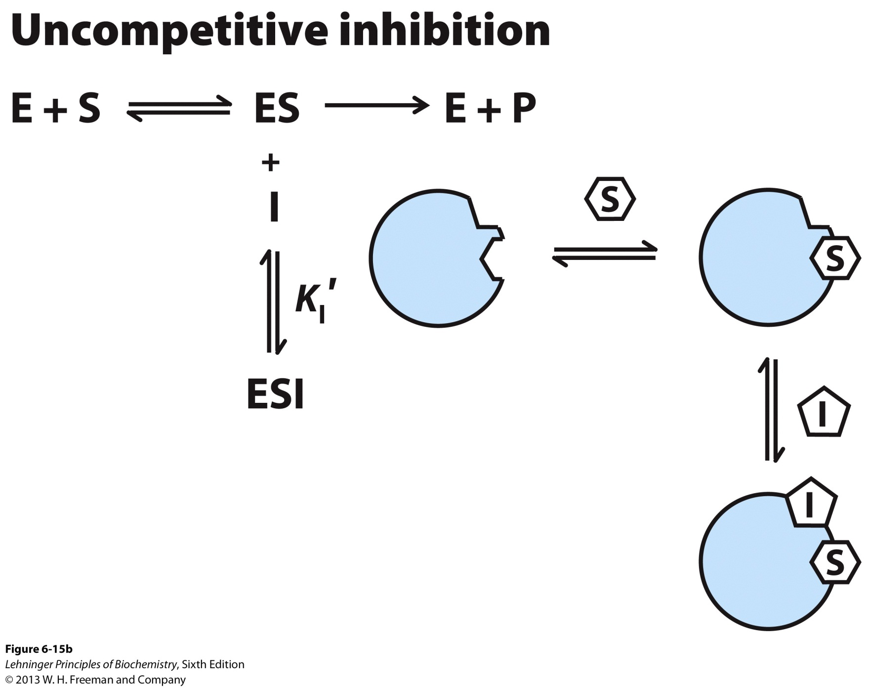
8Ib. Uncompetitive Inhibitors.

Slide 39
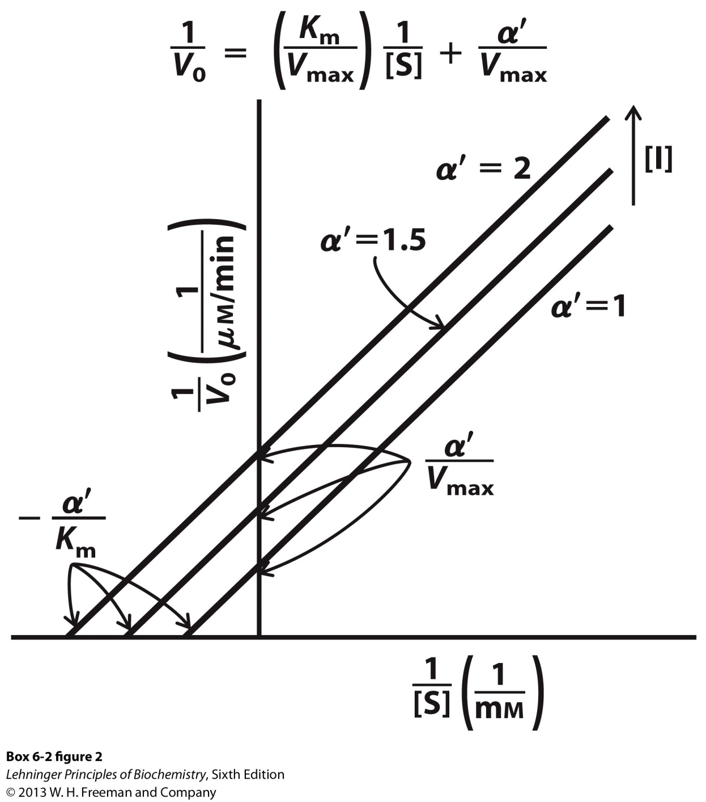
8Ib. Uncompetitive Inhibitors.
α’ $= 1+ \frac{[I]}{{K\text{’}}_{I}}$
$${K′}_{I} = \frac{\left[ES\right][I]}{[ESI]}$$

Slide 40
8Ic. Mixed Inhibitors.
Mixed inhibitors bind with or without substrate.
Bind to regulatory site.
Inhibit both substrate binding and catalysis.
They decrease V_{max} and can change K_{m}.
The Lineweaver-Burk plots show lines that intersect left from the y-axis.
Noncompetitive inhibitors are mixed inhibitors such that there is no change in K_{m}.

Slide 41
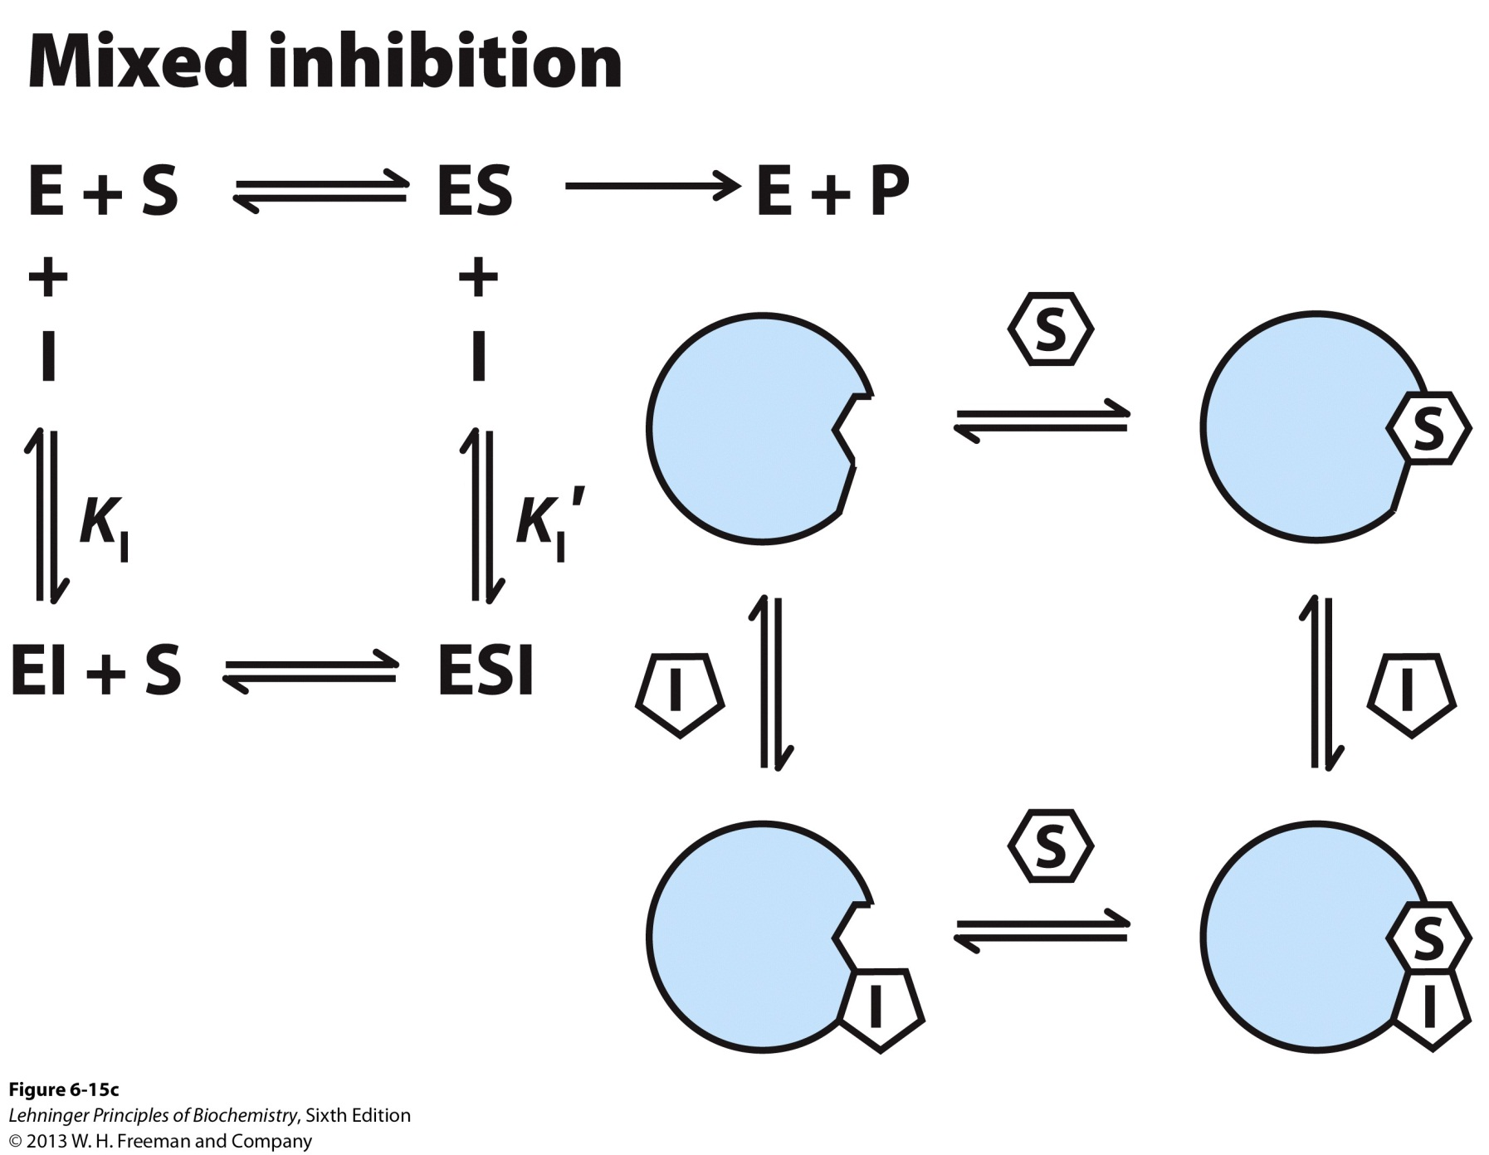
8Ic. Mixed Inhibitors.

Slide 42
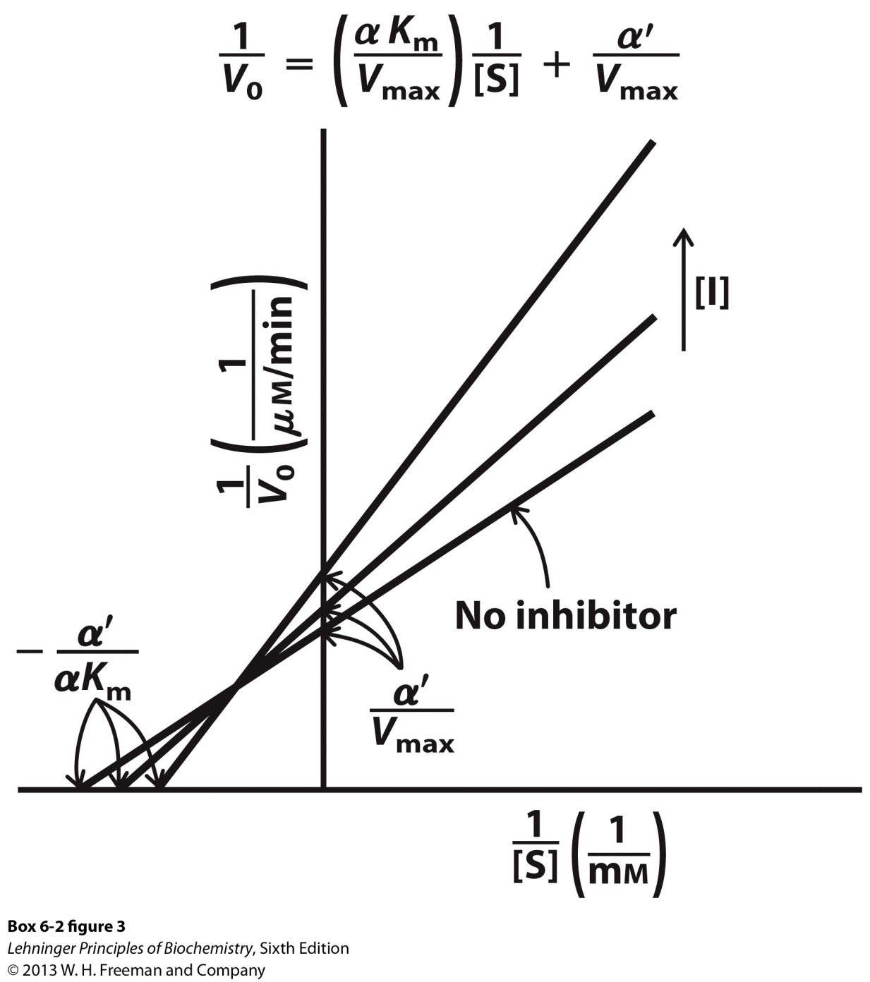
8Ic. Mixed Inhibitors.
When α’ = α (rare), then you have noncompetitive inhibition and K_{m} is unchanged.

Slide 43
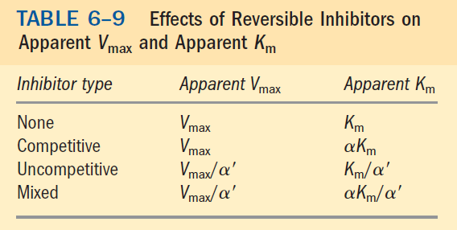
8Id. Summary of Reversible Inhibitors.

Slide 44
8II. Irreversible Inhibitors.
Irreversible inhibitors (inactivators) react with the enzyme
One inhibitor molecule can permanently shut off one enzyme molecule by covalently binding with or destroying a functional group on an enzyme that is essential for the enzyme activity.
Or by noncovalently associating with the enzyme in a highly stable way.
A special class of irreversible inhibitors is the suicide inactivators. They cause mechanism-based inactivation by hijacking the normal enzyme reaction mechanism to inactivate it.
- Used in rational drug design.

Slide 45
Time to Pair Up into Teams of
Three People
Provide Brief Answers to the Following:

Slide 46
1. Enzymes help accelerate the rate of a reaction but do not change the equilibria of the reaction. Which ΔG is affected?
ΔG’° or ΔG‡

Slide 47
2. What enzyme theory can help explain a hypothetical situation where your enzyme catalyzed rate is slower than your uncatalyzed rate?

Slide 48
3. Why would an activation barrier for decomposition be important for the stability of biomolecules?

Slide 49
4. Besides enzyme kinetics, in what other biochemical system have we seen a hyperbolic dependence plot?

Slide 50
5. How is the steady-state assumption in enzyme kinetics similar to but not the same as a reaction at equilibrium?

