Slide 1
Factors that affect Protein Activity
and
Protein Mechanism
Chapter 6 (Page 212-218, 225-231)

Slide 2
1. Factors that affect Enzyme Activity
Inhibitors
Proteolytic activation
Protein modifications
Subunit cooperativity and modulators
pH

Slide 3
1I. Proteolytic Activation
In the ribosome, some proteins are synthesized as INACTIVE precursors.
XXXX-E E + XXXX
i.e. Trypsin begins as trypsinogen
Protease
Inactive
Active

Slide 4
1I. Proteolytic Activation
Nomenclature:
Proprotein- For a protein precursor
Proenzyme- Precursor for an enzyme
Zymogen- Precursor for a protease

Slide 5
1II. Protein Modifications
Some proteins following synthesis undergo covalent modifications other than cleavage, which affects their activity.
An example of this is the addition or removal of a phosphate group
Protein Kinase
Protein Phosphatase
E-OH: Ser, Thr, Tyr

Slide 6
1II. Protein Modifications
The covalent modification may affect catalysis.
By allowing the protein to adopt a conformation that may make it more or less active
By altering substrate-binding affinity
The binding of phosphate, a negatively charged molecule, could create electrostatic repulsion for a negatively charge substrate

Slide 7
1III. Subunit Cooperativity and Modulators
Several enzymes are multimeric and their subunits engage in cooperativity (similar to hemoglobin binding of O₂) in terms of their catalytic function.
These enzymes are generally called allosteric enzymes because they function through reversible, noncovalent binding of regulatory compounds called allosteric modulators.

Slide 8
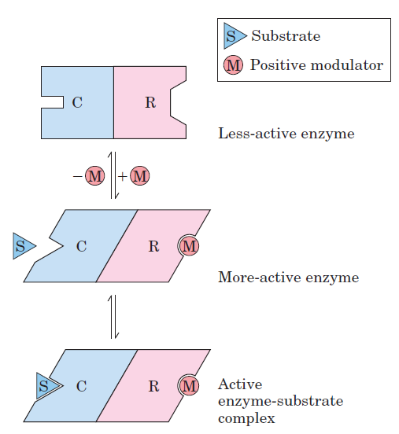
1III. Subunit Cooperativity and Modulators

Slide 9
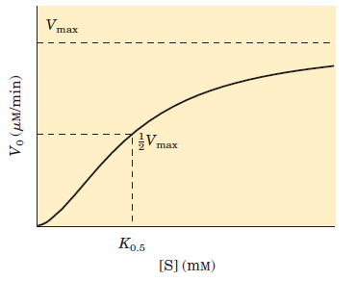
1III. Subunit Cooperativity and Modulators
Sigmoidal kinetic behavior is indicative of subunit cooperativity. This behavior is similar to hemoglobin binding of O_{2.}

Slide 10
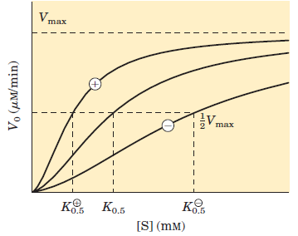
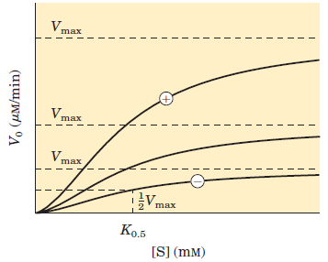
1III. Subunit Cooperativity and Modulators
The effect of positive (+) and negative (-) modulators.
V_{max} remains constant but K_{0.5} changes.
V_{max} changes but
K_{0.5} does not change.

Slide 11
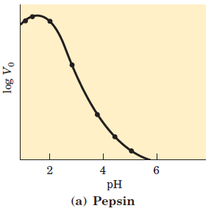
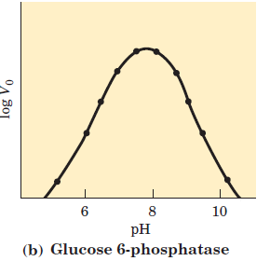
1IV. pH Effect
Enzymes have an optimum pH (or pH range) at which their activity is maximal.
V_{max} @ pH 1.6
V_{max} @ pH 7.8

Slide 12
1IV. pH Effect
AA side chains in the active site may act as weak acids and bases with critical functions that depend on a specific ionization state.
AA ionization state is important for protein structural integrity.
The pH range over which an enzyme undergoes (greatest) changes in activity can provide a clue to the type of AA residue involved.
A change in activity near pH 7.0 could indicate the presence of an important His.

Slide 13
1IV. pH Effect
Recall that pKa values can shift based on the chemical environment.

Slide 14
2. Understanding Enzyme Mechanism
Requires
Identification of all
Substrates
Cofactors
Products
Regulators (Inhibitors and activators)

Slide 15
2. Understanding Enzyme Mechanism
B. Knowledge of
The temporal sequence of enzyme intermediate formations
The structure of each transition state
The structure of the enzyme intermediates
The rates of intermedate interconversions
The energy contributed by all reacting and interacting groups, intermediate complexes, and transition states
As of yet, the entirety of parameters involved in the mechanism of action is not known for any enzyme or protein in general.

Slide 16
The Mechanism of Action of
Chymotrypsin

Slide 17
1. Chymotrypsin
A 25 kDa proteolytic enzyme (serine protease) that catalyzes the cleavage of peptide bonds by a hydrolysis reaction. It cleaves proteins and peptides at the carboxyl terminal of a tryptophan, tyrosine, and phenylalanine AA residue.

Slide 18
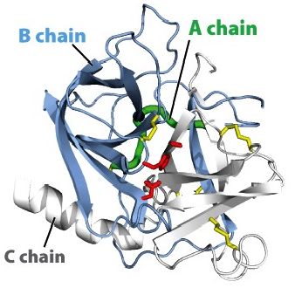
2. Chymotrypsin Protein Structure
His57, Asp102, and Ser195 form the catalytic triad.

Slide 19
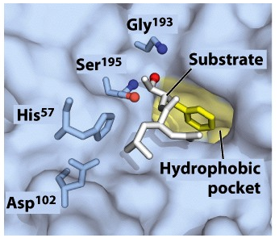
2I. Active Site of Chymotrypsin with Substrate

Slide 20
3. Chymotrypsin Mechanism
The free enzyme.
pKa > 12.0 during the course of the reaction
pKa significantly decreases

Slide 21
3. Chymotrypsin Mechanism
The substrate.
Stabilized in the oxyanion hole.
Interacts with the hydrophobic pocket.

Slide 22
3. Chymotrypsin Mechanism
Step 1: Substrate binding.
When substrate binds, the side chain of the residue adjacent to the peptide bond to be cleaved nestles in a hydrophobic pocket on the enzyme, positioning the peptide bond for attack.

Slide 23
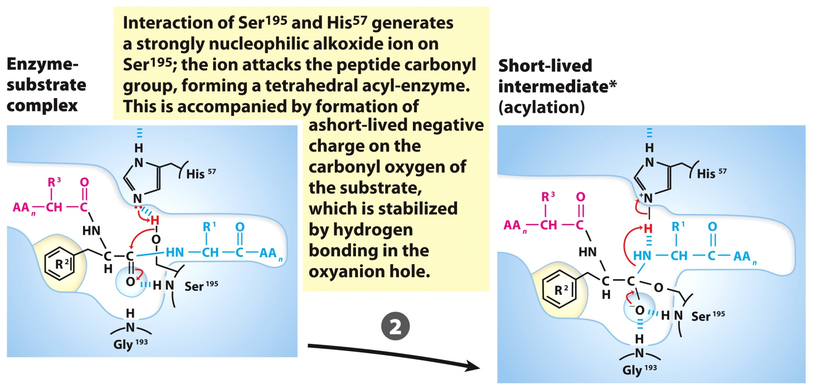
3. Chymotrypsin Mechanism
Step 2: Nucleophilic Attack.

Slide 24
3. Chymotrypsin Mechanism
Step 3: Substrate Cleavage.
Instability of the negative charge on the substrate carbonyl oxygen leads to collapse of the tetrahedral intermediate; reformation of a double bond with carbon displaces the bond between carbon and the amino group of the peptide linkage, breaking the peptide bond. The amino leaving group is protonated by His57, facilitating its displacement.

Slide 25
3. Chymotrypsin Mechanism
Step 4: Water comes in.
An incoming water molecule is deprotonated by general base catalysis, generating a strongly nucleophilic hydroxide ion. Attack of hydroxide on the ester linkage of the acyl-enzyme generates a second tetrahedral intermediate, with oxygen in the oxyanion hole again taking on a negative charge.

Slide 26
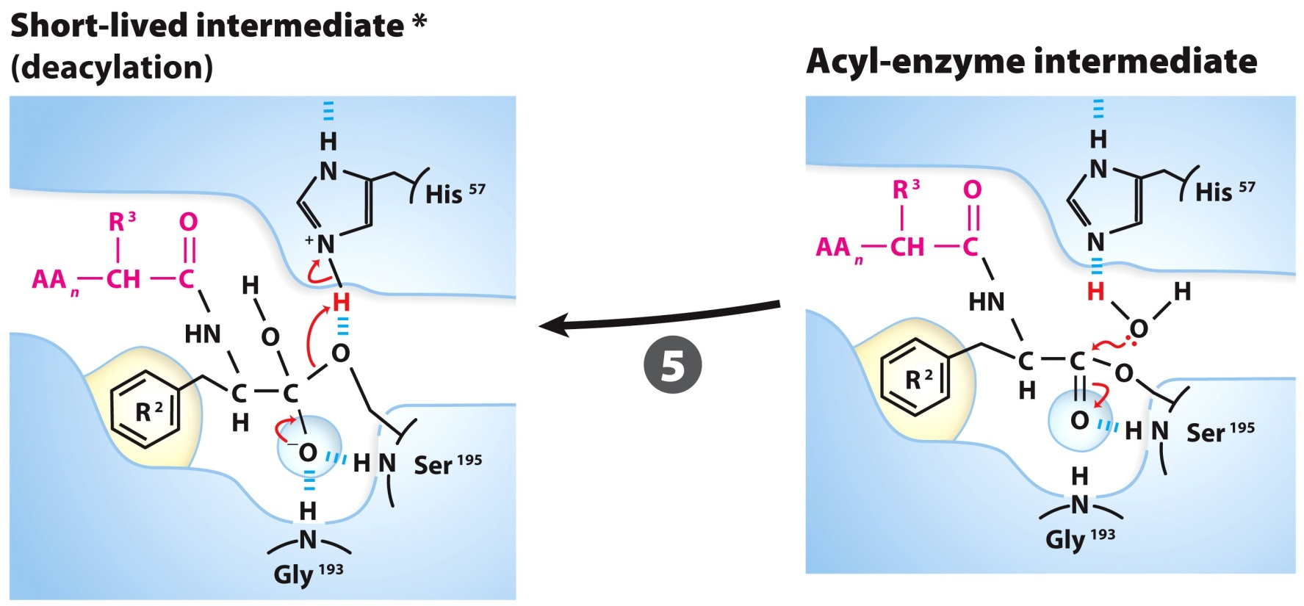
3. Chymotrypsin Mechanism
Step 5: Water attacks.
Collapse of the tetrahedral forms the second product, a carboxylate anion, and displaces Ser195.

Slide 27
3. Chymotrypsin Mechanism
Step 6: Break-off from the enzyme.
Collapse of the tetrahedral intermediate forms the second product and displaces Ser195.

Slide 28
3. Chymotrypsin Mechanism
Step 7: Product dissociates.

Slide 29
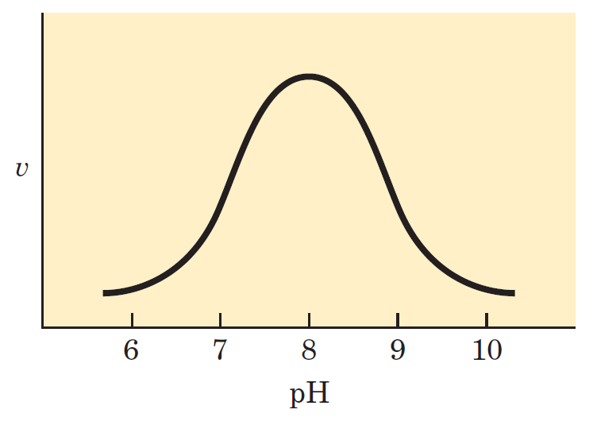
4. Evidence for Chymotrypsin Mechanism
The rate dependence of chymotrypsin-catalyzed cleavage on pH shows a maximal velocity at nearly pH 8.0. The velocity was measured at low [substrate] so that
$$V ∝ \frac{k_{cat}}{K_{m}}$$

Slide 30
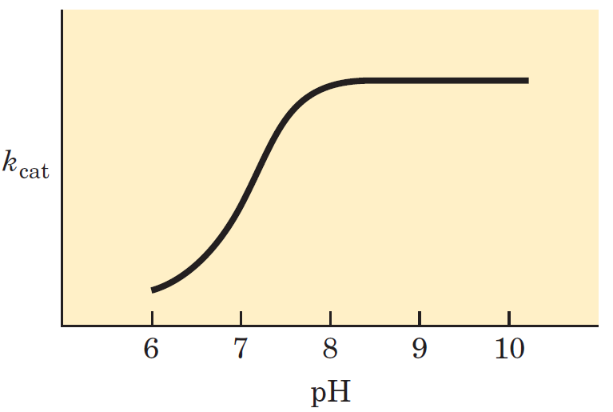
4. Evidence for Chymotrypsin Mechanism
The turnover number (k_{cat}) declines at low pH due to protonation of His57. The protonated His57 can not extract a proton from Ser195.

Slide 31
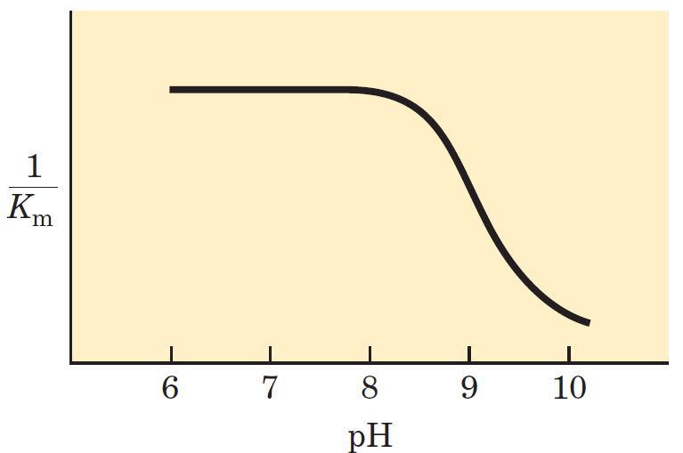
4. Evidence for Chymotrypsin Mechanism
The changes in 1/K_{m} reflect the deprotonation of Ile16, which engages in a salt bridge with Asp194. The loss of the salt bridge closes the hydrophobic pocket where the aromatic AA inserts. The substrate has a weaker affinity to the active site.

Slide 32
The Mechanism of Transferrin Mediated Iron Delivery to Cells
Courtesy of
Anne B. Mason, Ph.D.
University of Vermont Department of Biochemistry

Slide 33
Iron Facts
Iron comprises 90% of the mass of the earth’s core
Iron is the second most common metal in the earth’s crust
Iron in its ferric form (Fe³⁺) is insoluble in water (10⁻¹⁸ M)
Most iron exists as ferric oxide hydrate=rust
Iron in its ferrous form (Fe²⁺) is extremely reactive via Fenton reactions

Slide 34
Iron Facts
All but two organisms require iron for life.
Borrelia burgdorferi
Lactobacillus plantarum
Posey & Gherardini Science 288:1651-1653 (2000)
It is important to maintain Fe homeostasis, a
balance of the levels of Fe in the body.

Slide 35
The Problem with Free Fe in the Body
Free Fe refers to Fe not bound by a biomolecule. Fe³⁺ is the dominant form of Fe in our environment and though it is fairly harmless and mostly insoluble, it can be oxidized to Fe²⁺.
Fe²⁺ can generate reactive oxygen species. Uncontrolled levels of these species cause great harm to the body.

Slide 36
Iron-Bound Biomolecules are Important to the Body
Metal binding by biomolecules maintains Fe in a bioavailable form. Many of these Fe-bound biomolecules play important roles.
Transport of small molecules
O₂ and CO₂ (as in hemoglobin)
Cofactor in important enzymes
Facilitates redox reactions

Slide 37
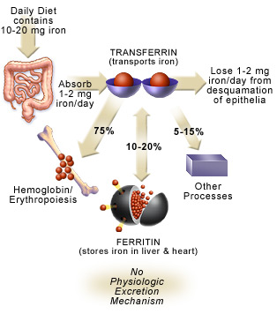
Iron Uptake
Heme (15-35% absorbed)
Red meat
Fish
Poultry
Non-heme (2-20%)
Lentils
Beans
Fortified cereals
Control completely
at level of uptake
CDC

Slide 38
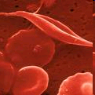
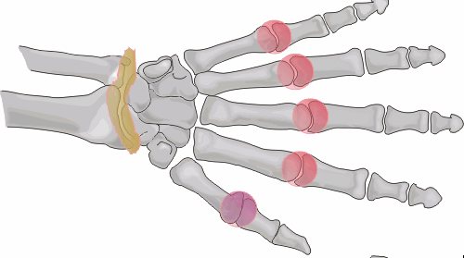
Iron Related Diseases
WHO considers iron deficiency to be the #1 nutritional disorder world-wide with ~80% of diets iron deficient
Iron related diseases
Sickle cell anemia
Thalassemia
Iron overload
Hemochromatosis (1 in 250 persons of Northern European descent)
Acquired iron overload (from multiple transfusions)
Iron implicated in a wide variety of other diseases, i.e., heart
and liver disease, diabetes, neurodegenerative diseases, cancer and restless leg syndrome

Slide 39
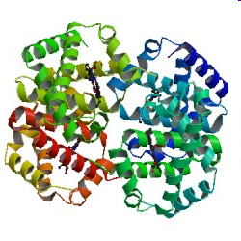
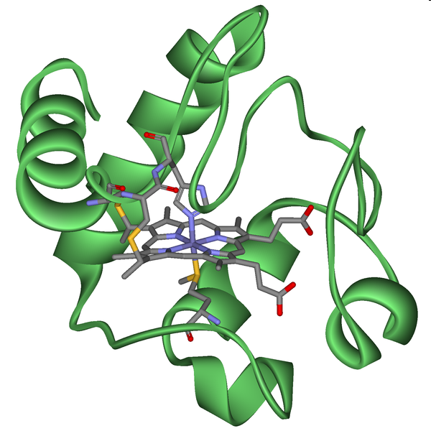
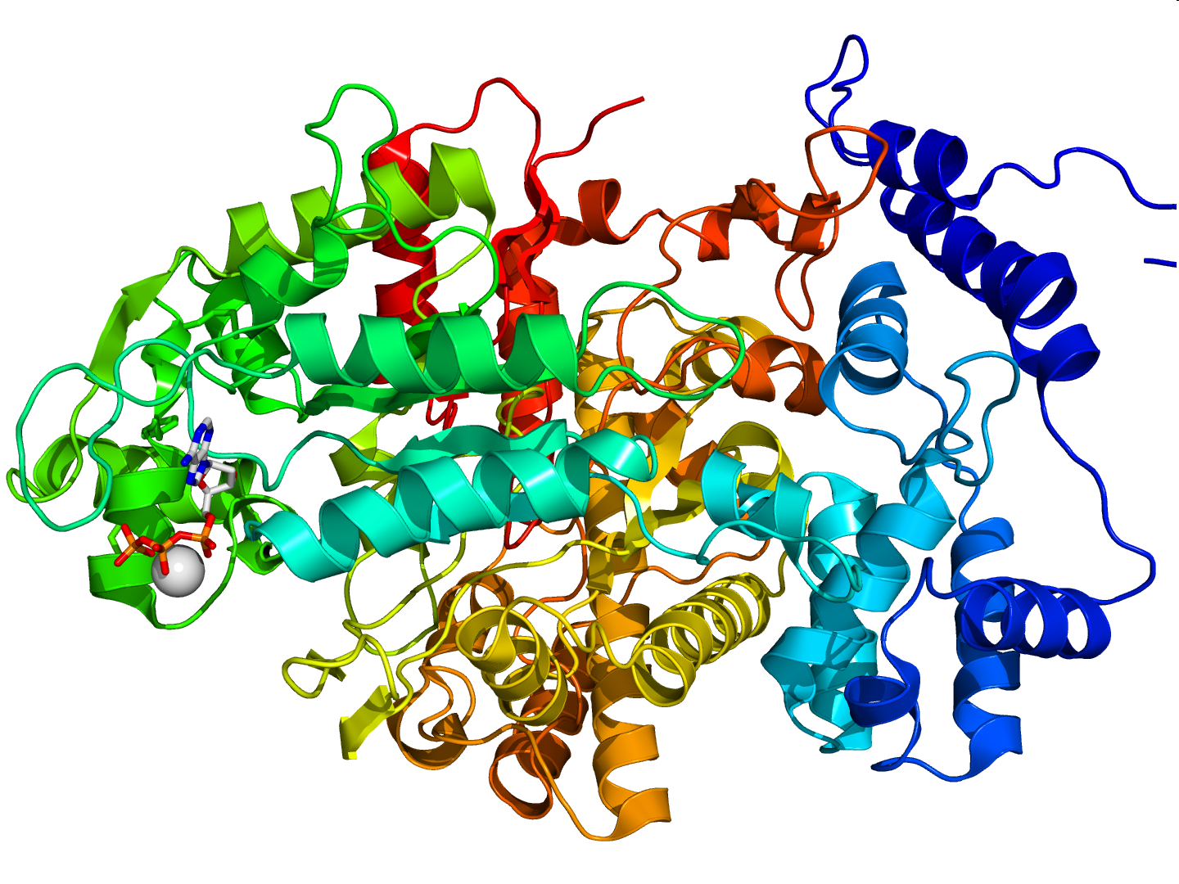
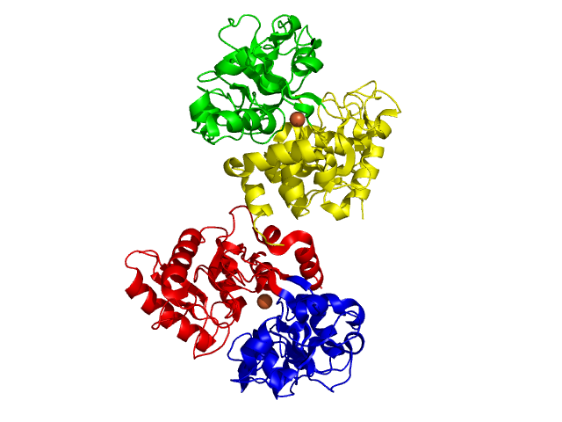
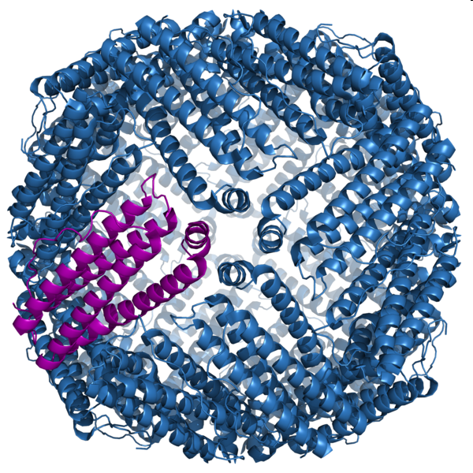
Iron Containing Proteins
Protein | Function
Hemoglobin | Oxygen transport
Myoglobin | Oxygen storage
Cytochromes | Electron transport/ATP synthesis
Ribonucleotide reductase | Deoxyribonucleotide synthesis
Aconitase | Citric acid cycle
Transferrin | Iron transport
Lactoferrin | Iron binding, antimicrobial
Ferritin | Iron storage
Dehydrogenases | Electron transfer
Hydroxylases | Detoxification
Hemopexin | Heme delivery
Nitric oxide synthase | Synthesis of nitric oxide
Hemoglobin
Cytochromes
Ribonucleotide Reductase
Transferrin
Ferritin
Notes:
Lots of proteins utilize iron, essential to keep it in solution and prevent it from hydrolysis

Slide 40
Transferrin Family
Protein | Source | Function
Serum transferrin | Blood | Iron transport, protection antibacterial, antioxidant
Ovotransferrin | Avian egg white | Protection, antibacterial, antioxidant
Lactoferrin | Milk and other bodily secretions | Protection, iron absorption, growth factor?
Melanotransferrin | Melanoma cells | Unknown
Inhibitor of carbonic anhydrase | Blood of many species (except primates) | Inhibits carbonic anhydrase

Slide 41
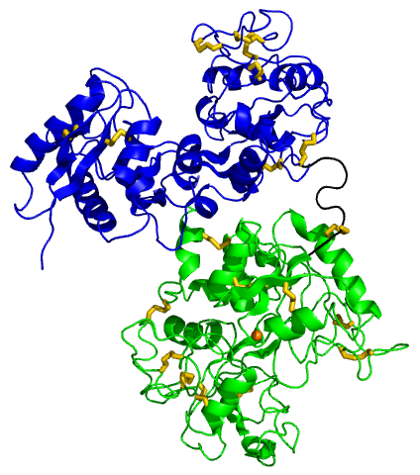
Human Serum Transferrin
N-lobe
Transferrin (TF) is an 80 kDa bilobal glycoprotein with
19 disulfide bonds
TF is synthesized in the liver
and secreted into the plasma
Plasma concentration = 25-50 μM
TF is 30% saturated with Fe
Knocking out TF in mice is lethal unless iron supplemented
C-lobe
Zuccola, HJ. PhD. Thesis (1992).

Slide 42
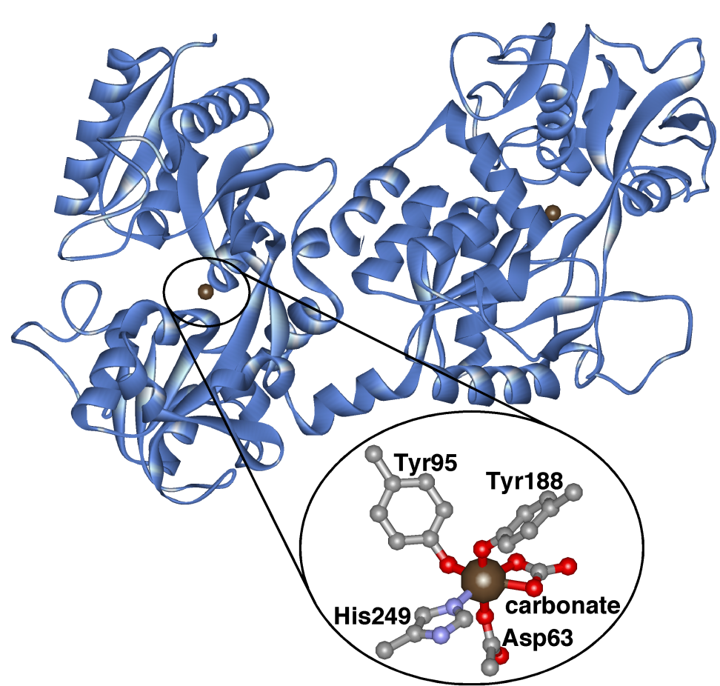
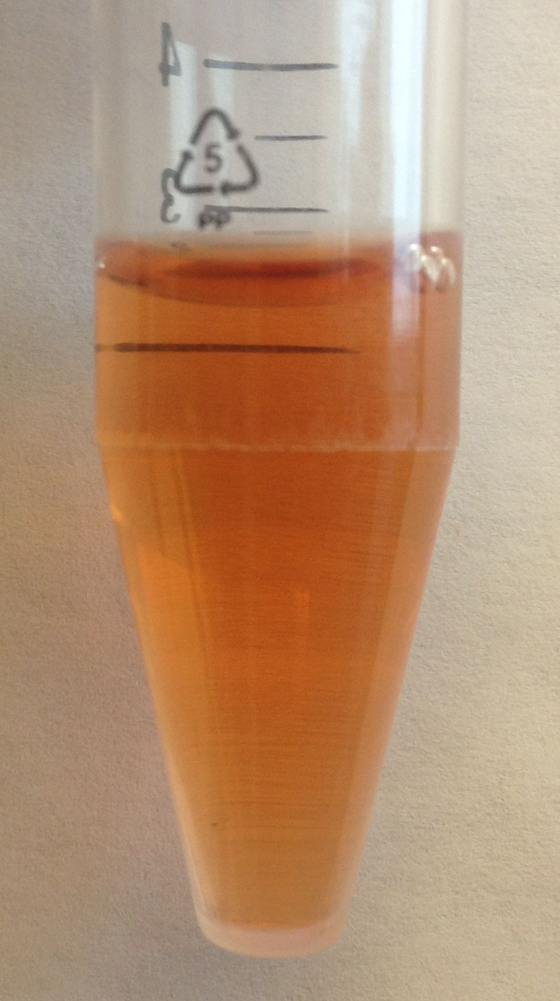
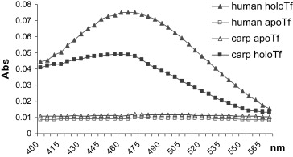
TF binds Two Fe(III) Ions
Ligand-to-metal charge transfer band (470 nm) in UV-vis produces characteristic pink color of TF
HoloTF
ApoTF
Binding AA groups come from two different domains in each lobe facilitating a change in conformation.

Slide 43
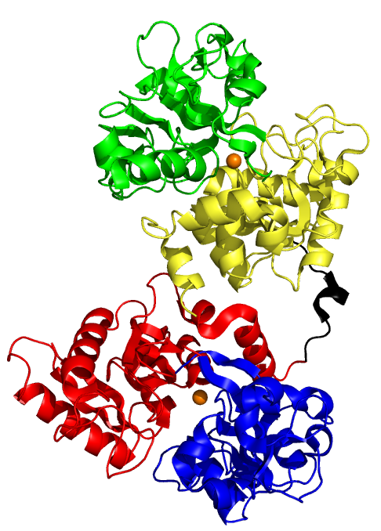
Fe(III) Binding Stabilizes TF
“Closed”
“Open”
CII
CI
CII
CI
pH 5.6 salt chelator
Fe-chelator
NI
NI
NII
NII
Diferric Human TF (High Fe affinity)
Apo Human TF
C
ΔT_{m} (HoloTF – apo TF) ~ 10 °
Notes:
Two lobes, subdomains, two iron sites, huge conformational changes in both lobes up iron removal.

Slide 44
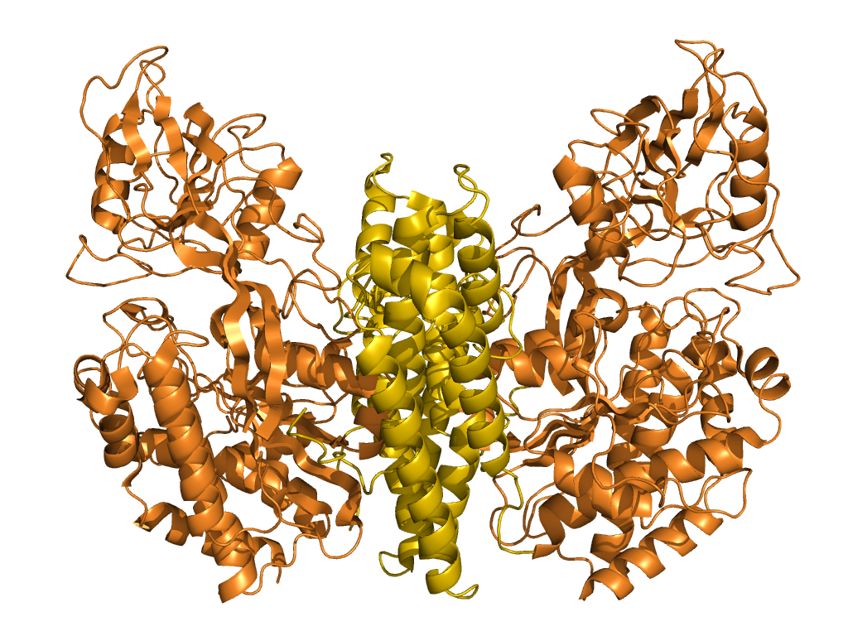
Transferrin Receptor (TFR) Transports Fe₂TF into Cells
dimer
axes
TFR is a homodimeric protein found at cell membrane
Binds two molecules of Fe₂TF
At pH 7.4 Fe₂TF preferentially binds to the TFR (K_{d} is nM affinity)
At low pH (~5.6) apoTF preferentially binds to the TFR (K_{d} is nM affinity).
Ectodomain
(AA 89 - 760)
Cytoplasmic region
(AA1 - 67)
Lawrence et al Science 286:779-782 (1999)

Slide 45
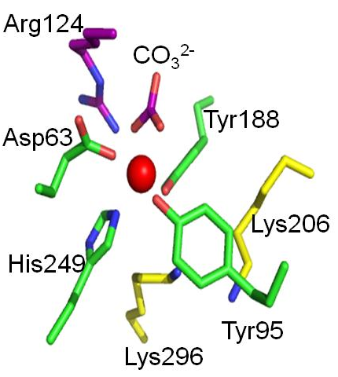
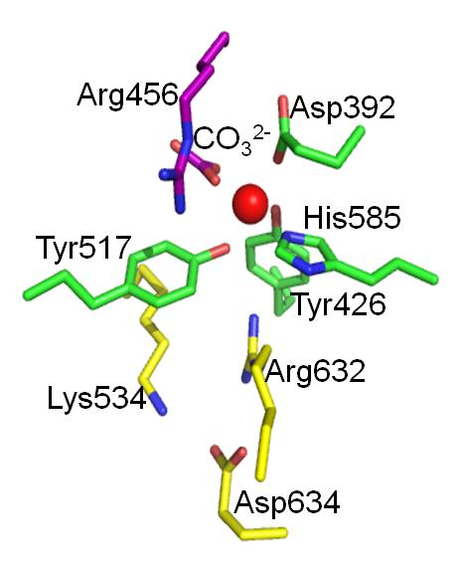
Low pH facilitates Fe release from TF
N-lobe
C-lobe
Protonation of Lys296 and Lys206 in the N-lobe and of Lys534 and Arg632 in the C-lobe at low pH favors the “open” protein conformation and low Fe(III) binding.

Slide 46
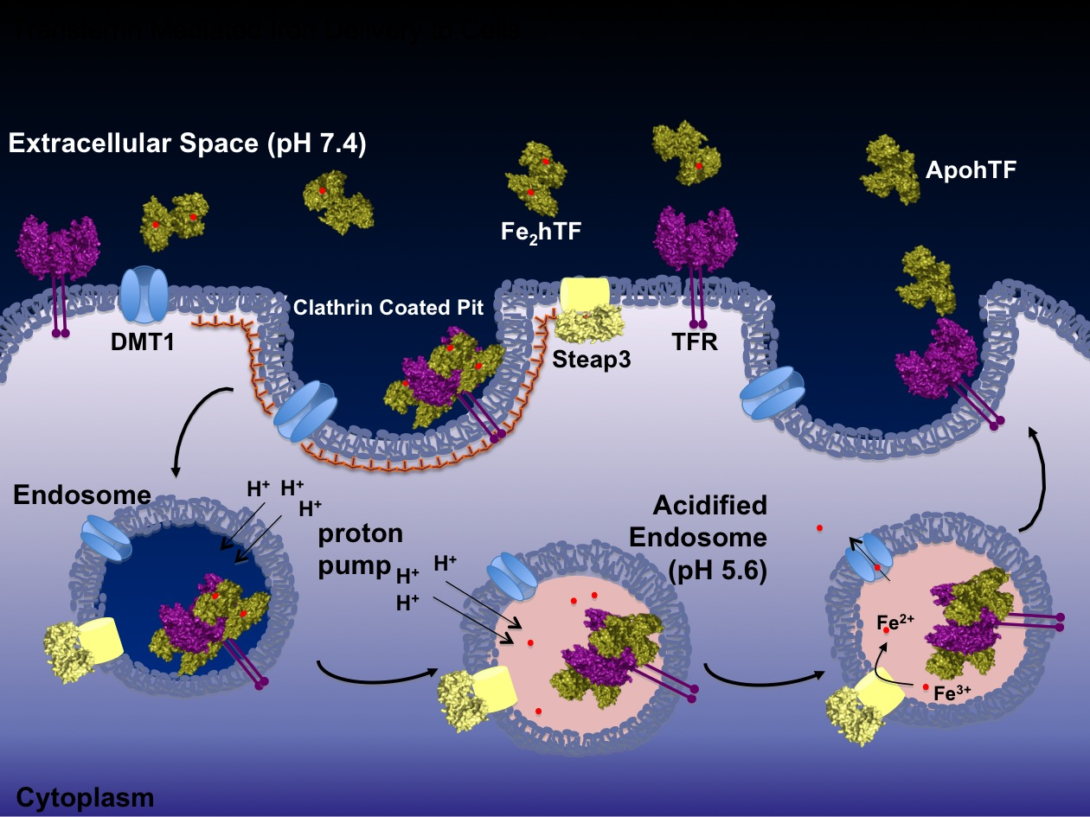
Transferrin Mediated Iron Delivery to Cells
Transferrin Mediated Iron Delivery to Cells
Receptor Mediated Endocytosis
Divalent Metal Transporter 1
Steere et al Biochem Biophys Acta 1820: 326-333 (2012)

Slide 47
Transferrin Mediated Iron Delivery to Cells
Transferrin Mediated Iron Delivery to Cells
Receptor Mediated Endocytosis
Two Fe₂TF molecules bind to TFR.
The (Fe₂TF)₂-TFR complex is internalized into the cell via endocytosis.
In the endosome, a decrease of pH from 7.4 to 5.6 causes for a release of Fe(III) from TF.
The enzyme Steap3 reduces Fe(III) to Fe(II).
Fe(II) escapes the endosome via the divalent metal transporter I (DMTI) and is bound by other proteins for use in different ways.

Slide 48
Transport of Fe from Transferrin to Hemoglobin
Fe₂TF (Blood)
75% of iron in the body is in hemoglobin
Acquisition of iron from transferrin is the rate limiting step in heme synthesis in developing red blood cells
Ferrochelatase is an enzyme bound to the inner membrane of the mitochondria
Ferrochelatase inserts Fe²⁺ into protoporphyrin-IX forming heme.
TFR
Fe₂TF-TFR
Endosome & pH decrease
Fe³⁺
Steap3
Fe²⁺
DMT1 & Ferrochelatase
Hemoglobin

Slide 49
Paper Assignment on
Enzymes

Slide 50
Sistema de Bibliotecas (biblioteca.uprrp.edu)

Slide 51
Web of Science (Find in Bases de Datos Suscritos)

Slide 52
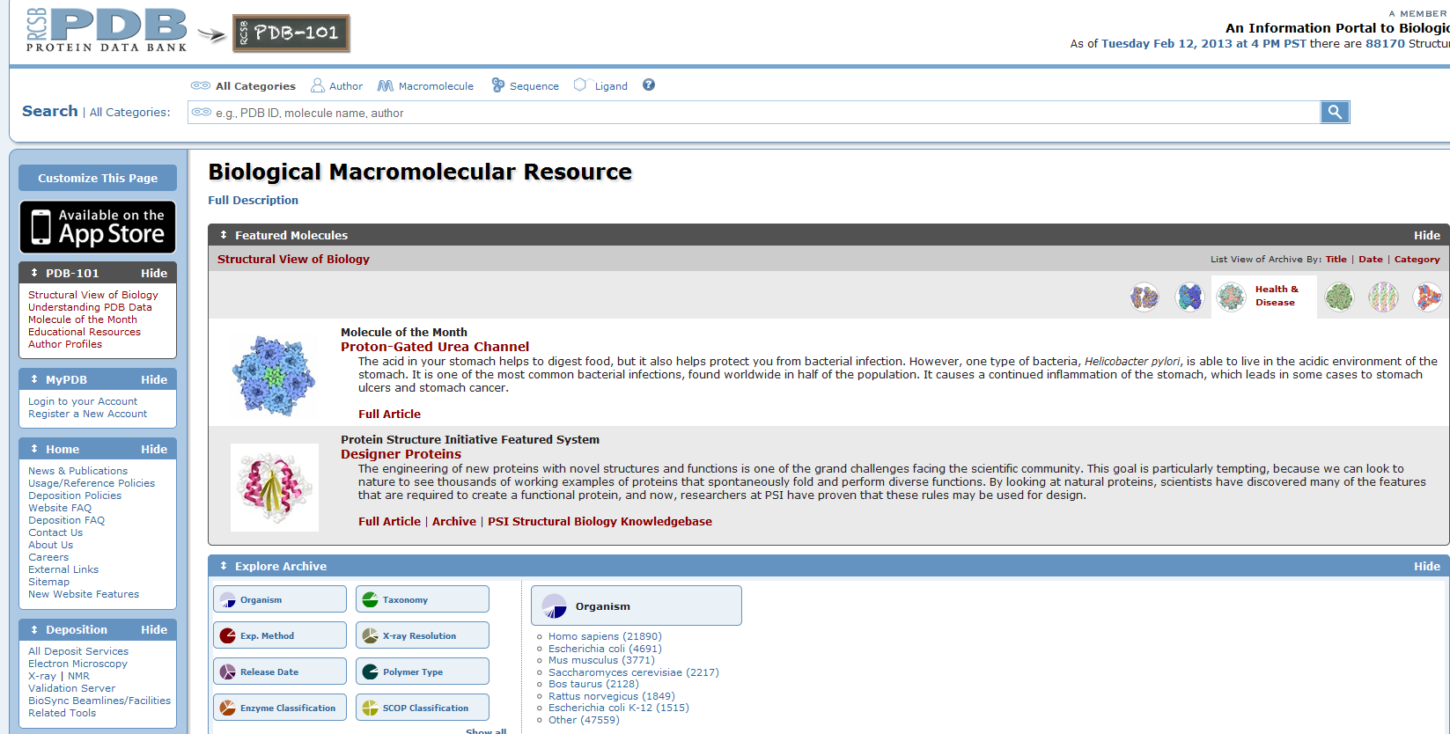
Protein Data Bank (www.rcsb.org/)

Slide 53
Protein Data Bank (www.rcsb.org/)

