Slide 1
Carbohydrates:
Monosaccharides and Disaccharides
Chapter 7 (Page 238-247)

Slide 2
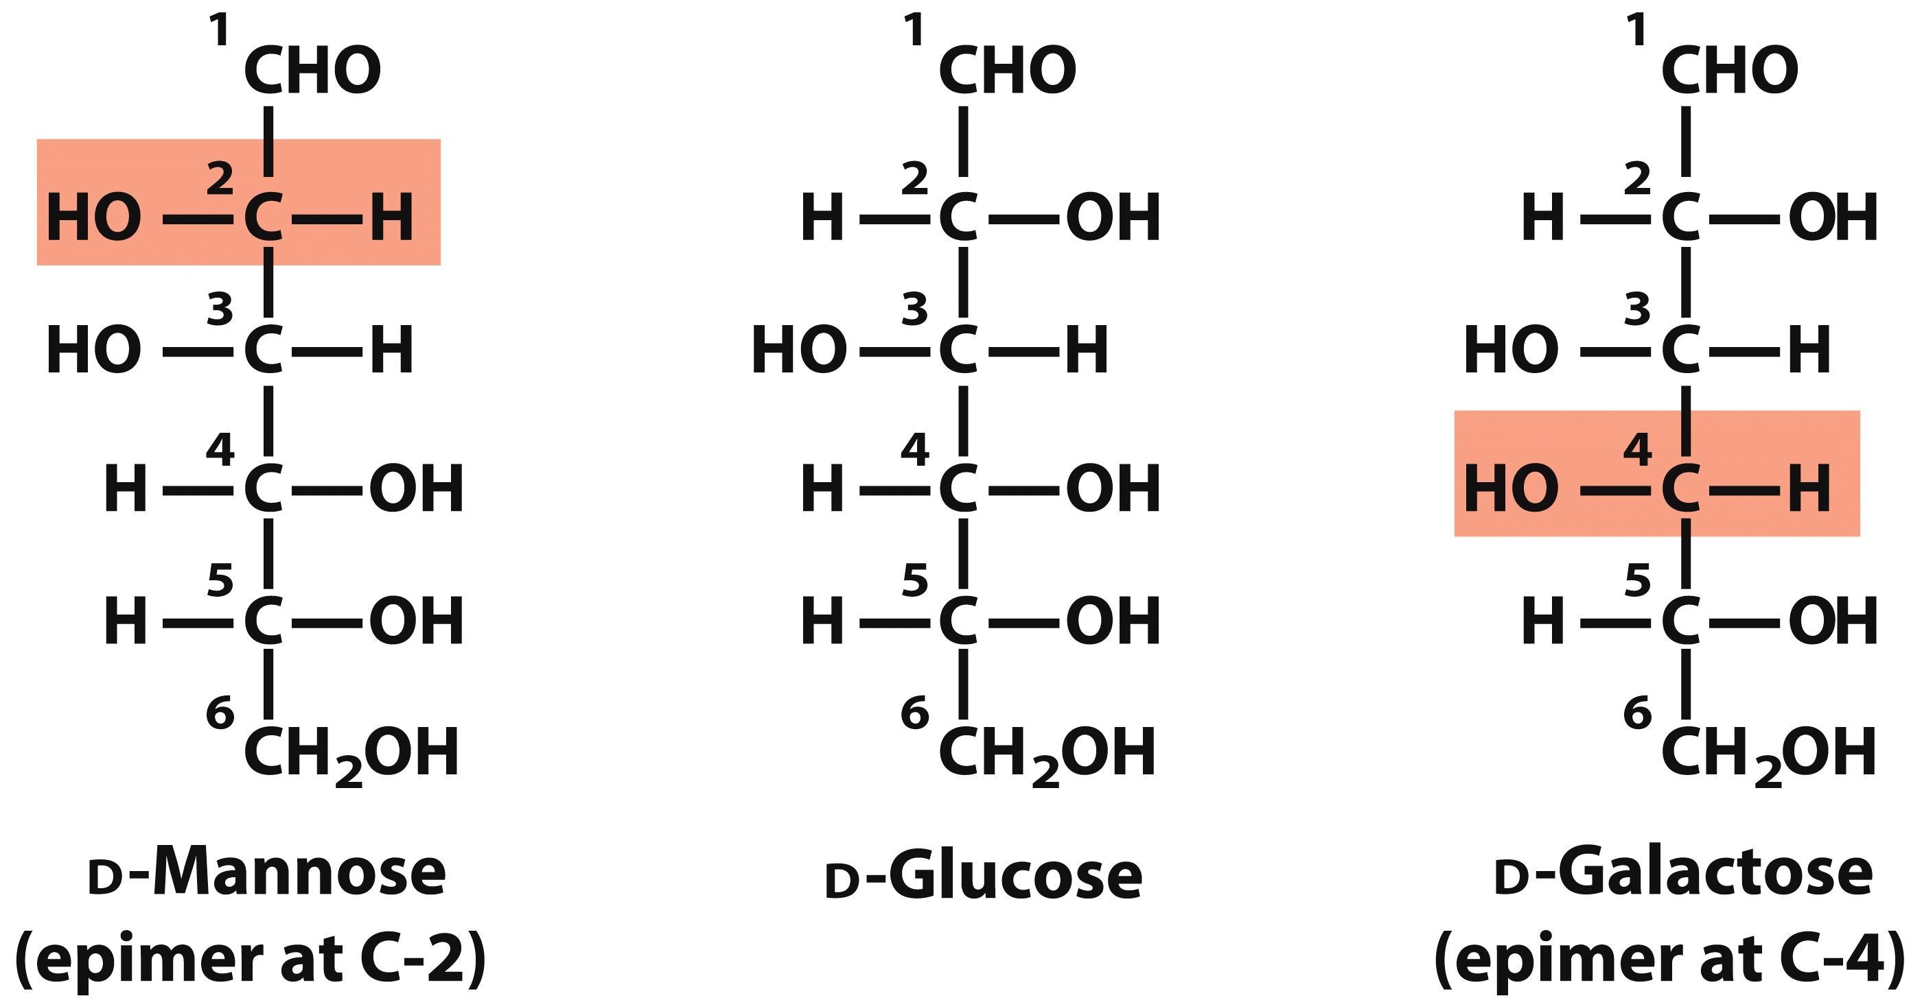
Epimers

Slide 3
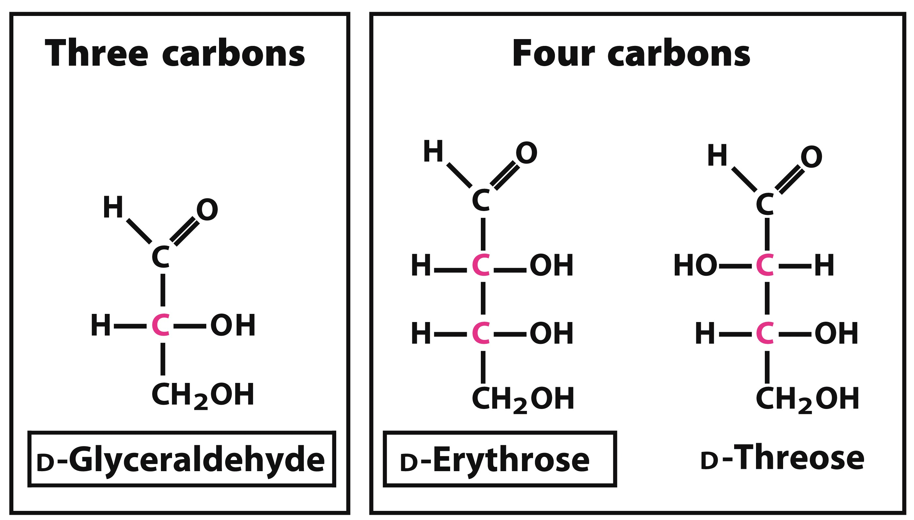
D-Aldoses

Slide 4
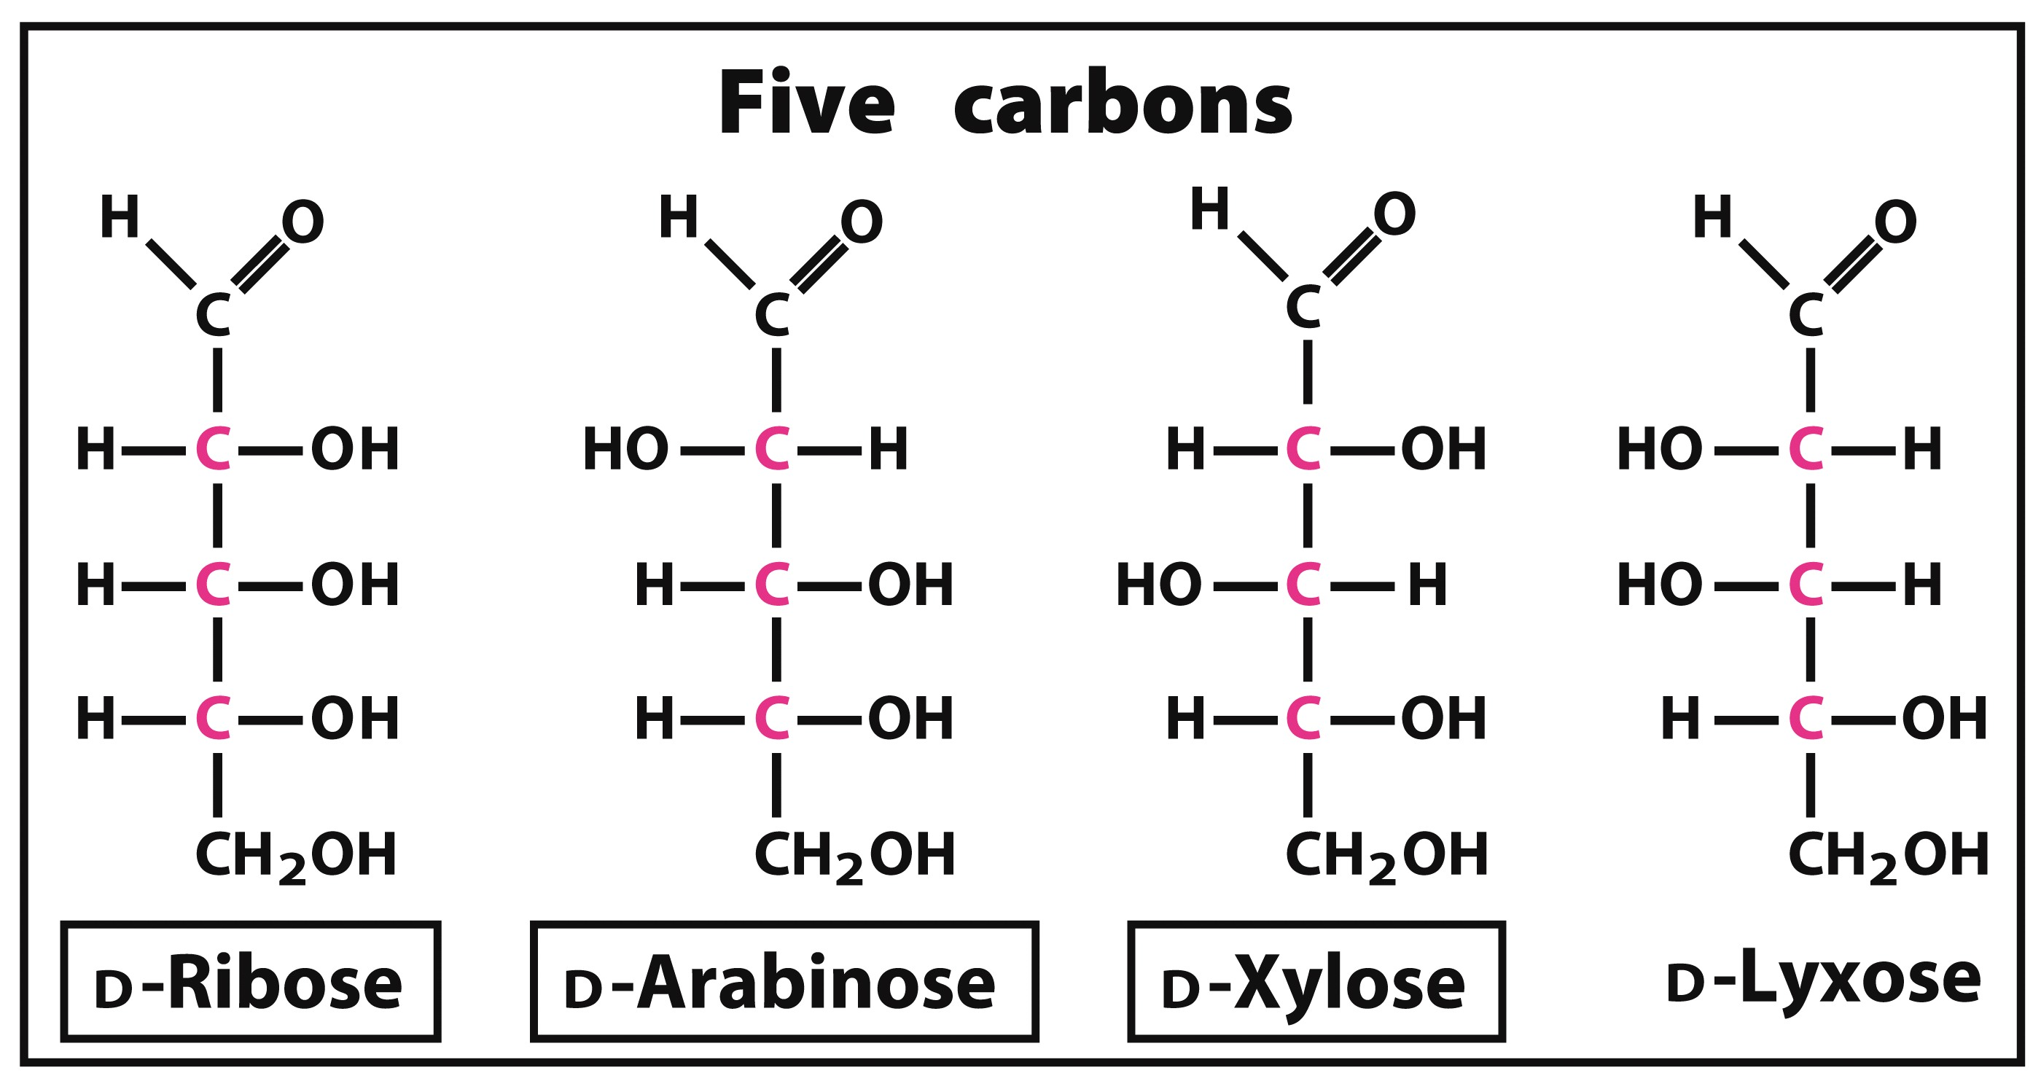
D-Aldoses

Slide 5
D-Aldoses

Slide 6
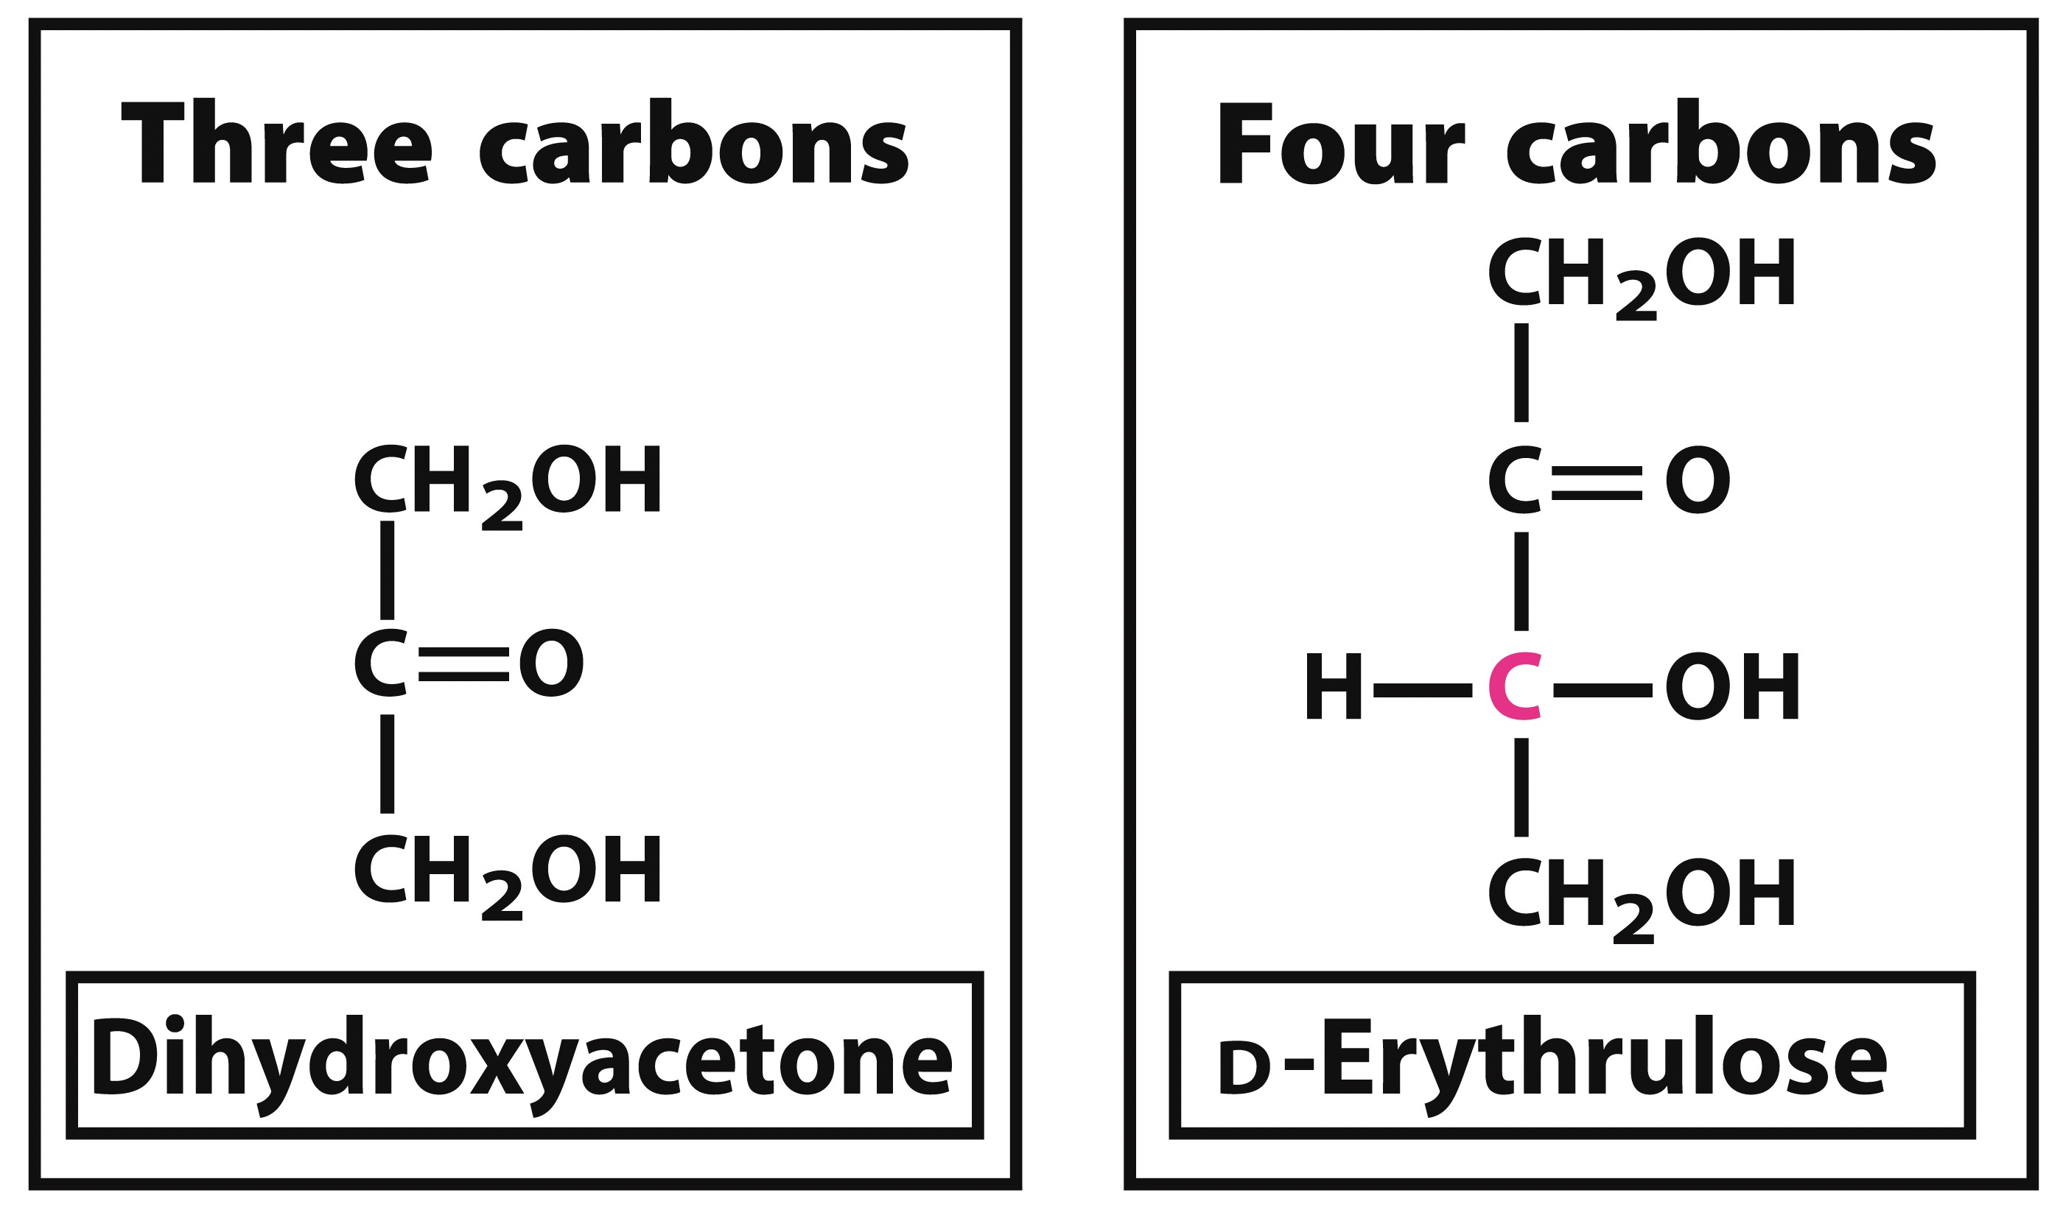
D-Ketoses

Slide 7
D-Ketoses

Slide 8
D-Ketoses

Slide 9
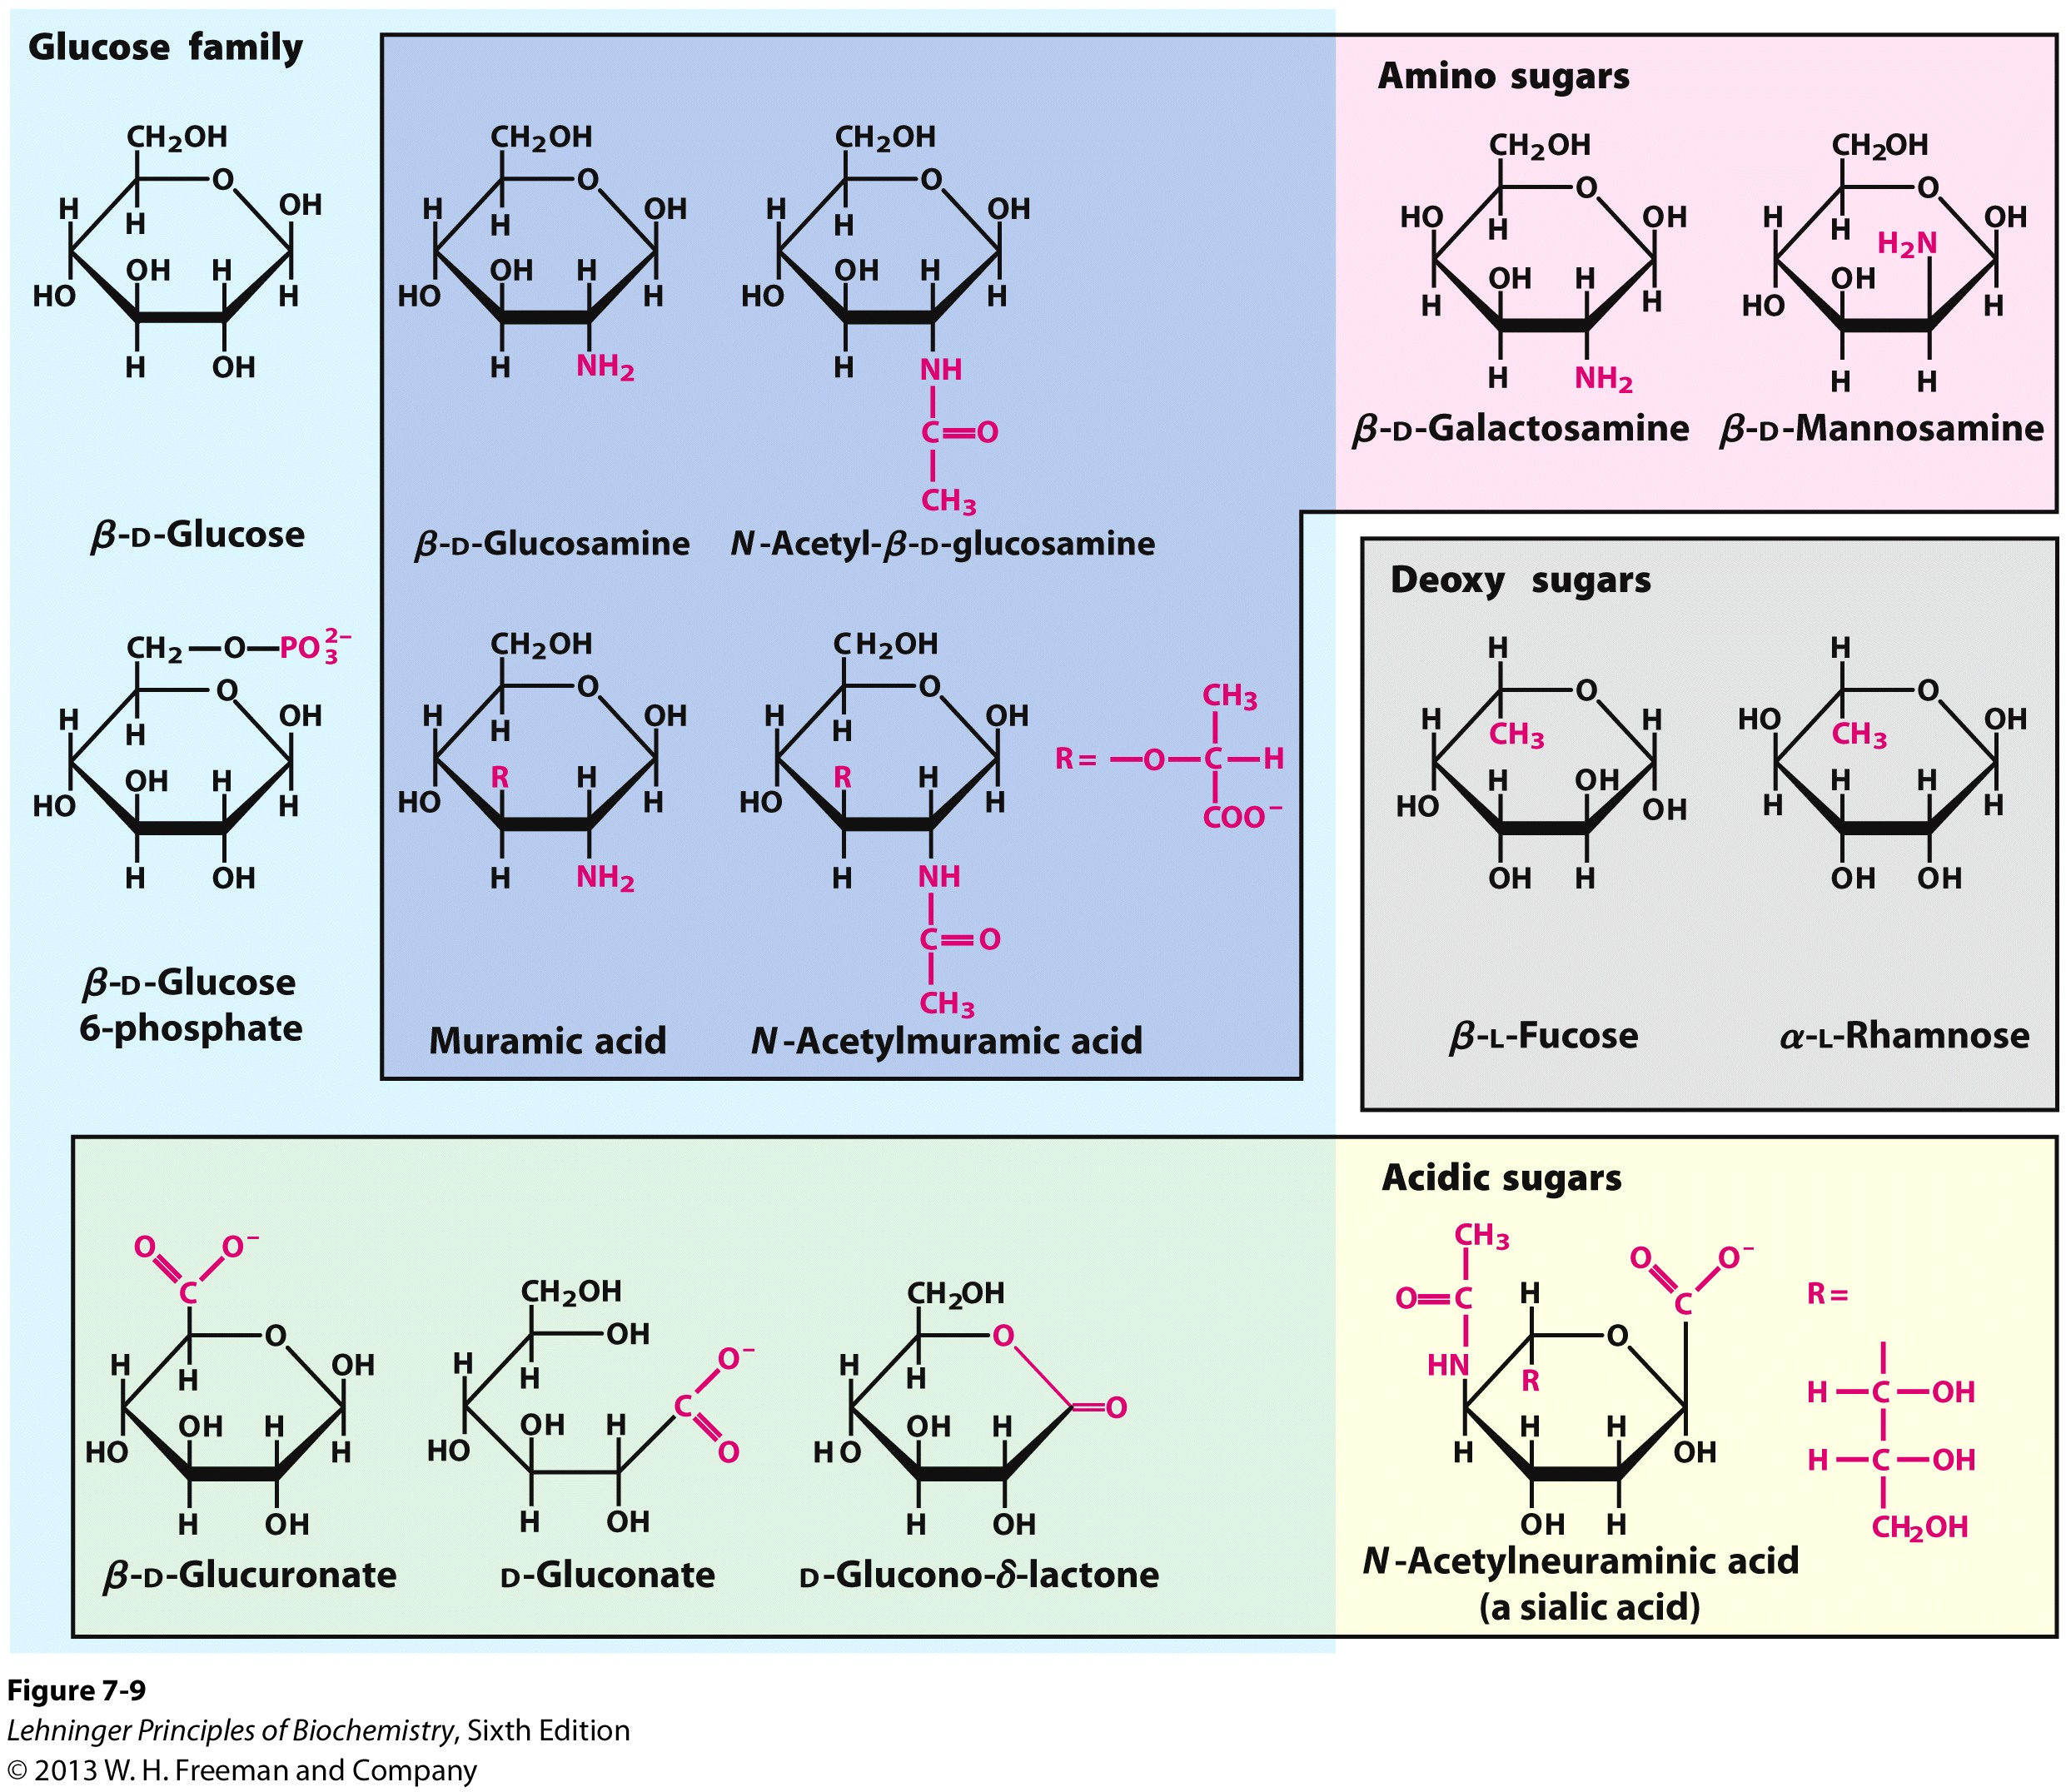
Hydroxyl group replacement

Slide 10
Carbon oxidation to a carboxyl group

Slide 11
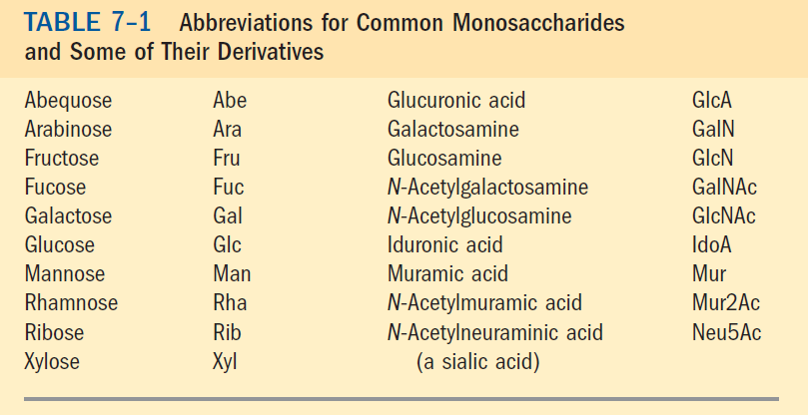
Monosaccharide Abbreviations

