Slide 1
Disaccharides and Polysaccharides
-Structure and Function-
Chapter 7 (Page 244-266)

Slide 2
Monosaccharides

Slide 3
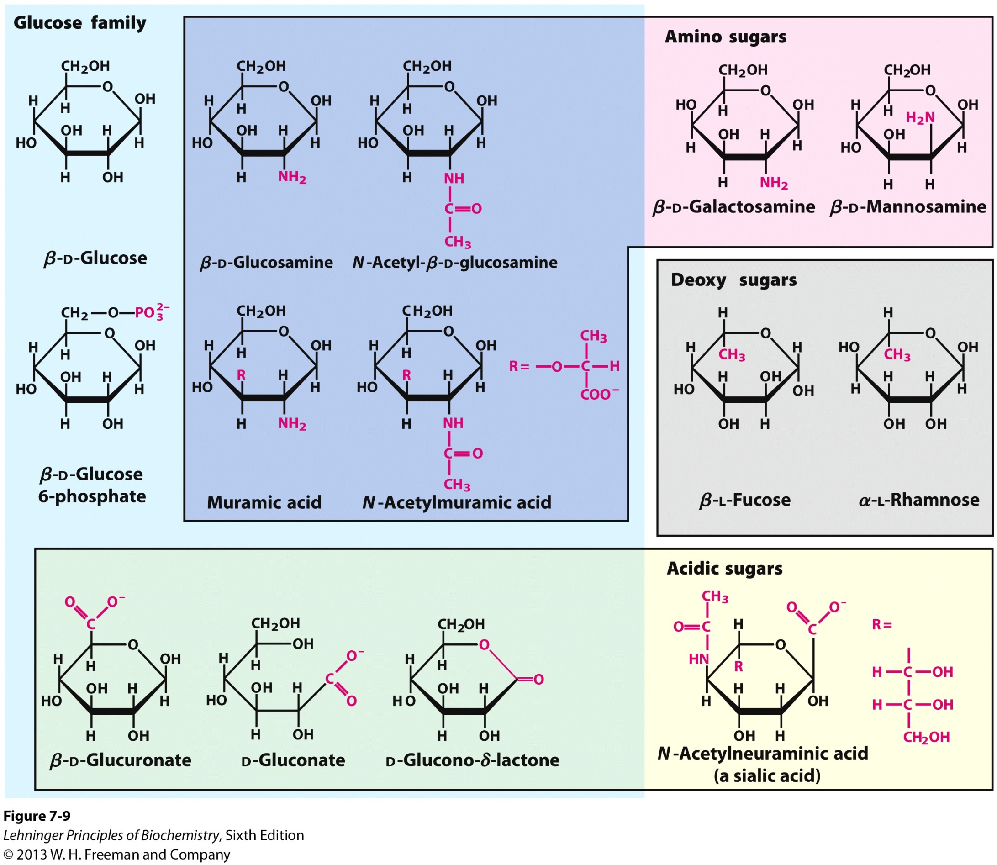
1. Monosaccharide Derivatives- A. Hydroxyl Group Substitutions
Glucose: An aldose.
Amine group substitutions
Phosphate group substitutions
Methyl or H group substitutions

Slide 4
1. Monosaccharide Derivatives- B. Carbon atom Oxidation to a Carboxyl Group
6
Lactone group
Oxidation of C6 yields:
Uronic Acid
Oxidation of aldehyde carbon yields:
Aldonic Acid

Slide 5
2. Monosaccharides are Reducing Agents
A. Sugars must be in linear form to serve as reducing agents.
Aldose

Slide 6
2. Monosaccharides are Reducing Agents
B. Aldose-Ketose isomerization under conditions typical of redox experiments allows ketoses to serve as reducing agents.

Slide 7
2. Monosaccharides are Reducing Agents
C. Today the reducing ability of certain sugars such as glucose is used to quantify the sugars via a colorimetric assay.
UV-Vis to observe this colored product.

Slide 8
Disaccharides

Slide 9
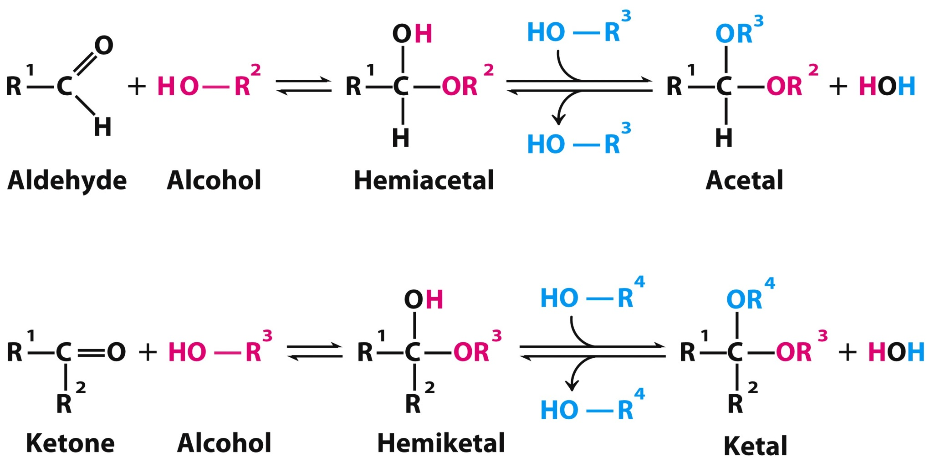
1. The Glycosidic Bond
Two sugar molecules can be joined via a glycosidic bond between an anomeric carbon and a hydroxyl carbon following the general reaction leading from a hemiacetal to an acetal.

Slide 10
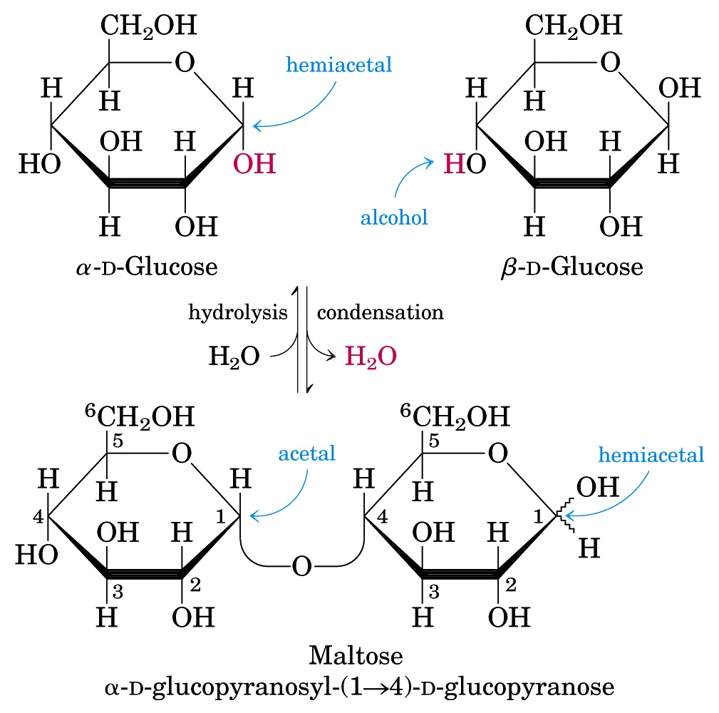
1I. The Glycosidic Bond in Sugars is O-linked

Slide 11
1II. The Glycosidic Bond can produce a Reducing Sugar.
This ring can’t open up and is no longer reducing.
This ring can open up to an aldehyde and is still reducing.
Nonreducing Sugar
Reducing Sugar

Slide 12
1III. The Glycosidic Bond can produce a Nonreducing Sugar
Two sugar molecules can be also joined via a glycosidic bond between two anomeric carbons.
The product has two acetal groups and no hemiacetals.
There are no reducing ends, this is a nonreducing sugar.

Slide 13
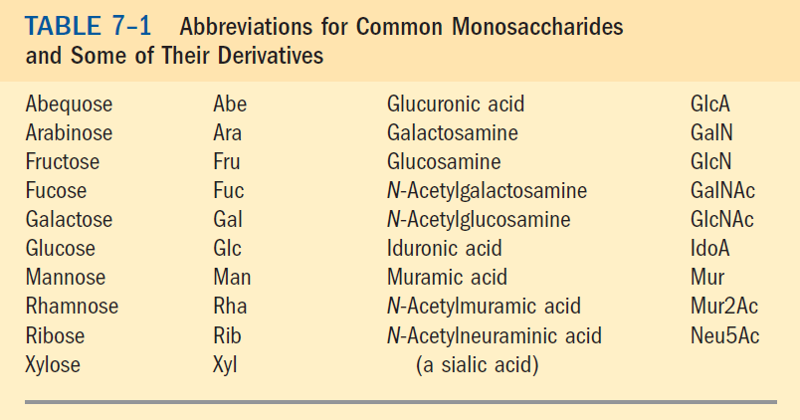
2. Nomenclature
Know the abbreviation for the two sugars in a disaccharide assuming the sugar is the D-isomer.

Slide 14
2. Nomenclature
B. List the abbreviation for the sugar on left (must be nonreducing).
C. (Specify the anomeric configuration and carbon # followed by an open-ended arrow if connected to a non-anomeric carbon or double-headed arrow if anomeric carbon. List the carbon # and anomeric configuration on the adjacent sugar.)
D. List the abbreviation for the sugar on right.
Glc (α1→4)Glc

Slide 15
Polysaccharides

Slide 16
1. The Properties of Polysaccharides
Natural carbohydrates are usually found as polymers called polysaccharides or glycans.
They can play roles in
Storage, structure, and information carriers via specific recognition sites
These polysaccharides can be
Homopolysaccharides
Heteropolysaccharides
Linear
Branched

Slide 17
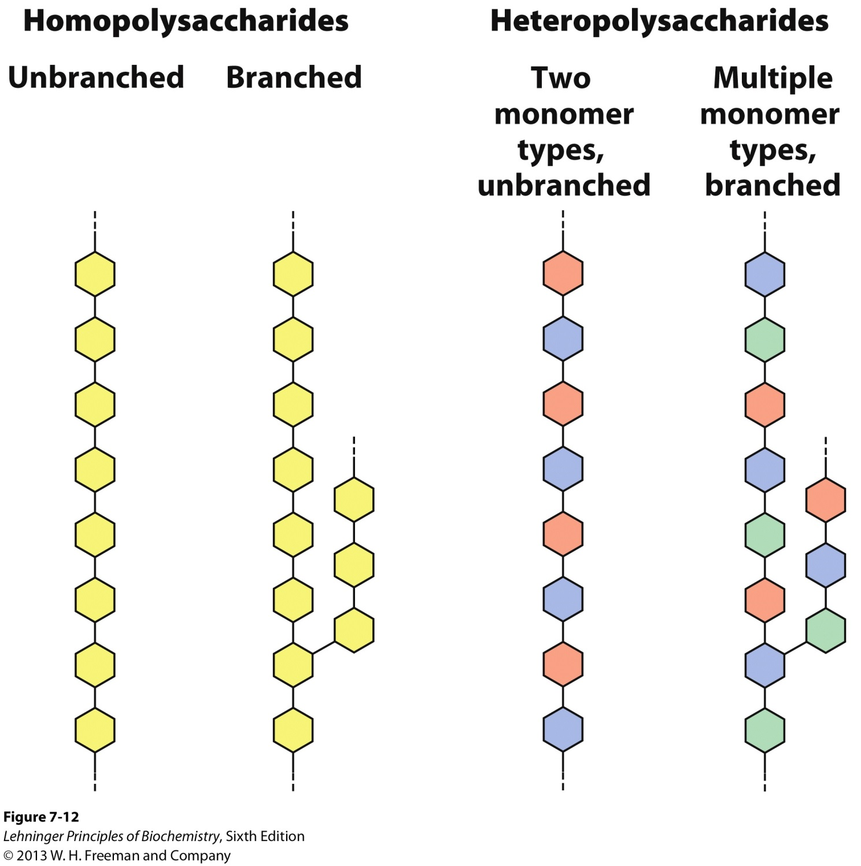
General Representation of Polysaccharides

Slide 18
1. The Properties of Polysaccharides
D. Polysaccharides do not have a defined molecular weight.
This is in contrast to proteins which are synthesized on a template (messenger RNA) of defined sequence and length, by enzymes that follow the template exactly.
For polysaccharide synthesis there is no template.
Polysaccharides are synthesized by enzymes that catalyze the polymerization of monomeric units without any specified stopping point.
Polysaccharides can have hundreds or thousands of units.

Slide 19
1. The Properties of Polysaccharides
E. The 3-D structure of these molecules can be described in terms of the dihedral angles ϕ (phi) and Ψ (psi) as in peptide bonds.
The bulkiness of the pyranose ring and its substituents, their size, and shape place constraints on the ϕ and Ψ angles.

Slide 20
2. Storage Polysaccharides- Glycogen
Glycogen is a branched homopolysaccharide of glucose
Glucose monomers form (α1 → 4) linked chains
Branch-points with (α1 → 6) linkers every 8–12 residues
Molecular weight reaches several millions
Functions as the main storage polysaccharide in animals

Slide 21
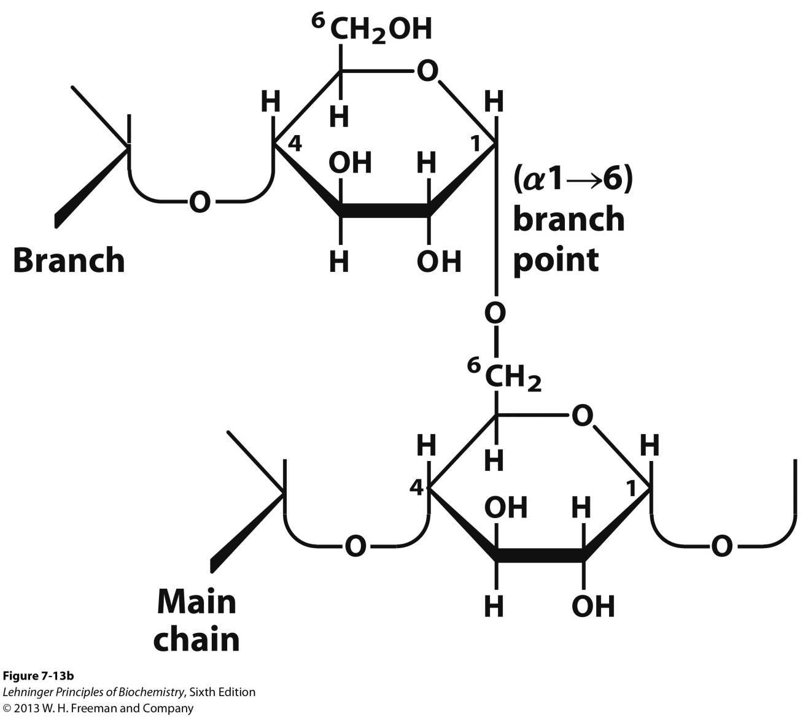
2. Storage Polysaccharides- Glycogen

Slide 22
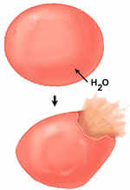
2. Storage Polysaccharides- Glycogen
How does glycogen serve as a storage biomolecule?
Glycogen stores many glucose molecules without compromising the stability of the cell. That is because…
Hepatocytes (liver cells) have [glycan] = 0.01 µM. This concentration would equal to [glucose] = 0.4 M.
But if the cell actually had
[glucose] = 0.4 M, the osmolarity of a cell would be dangerously high. Water would flow into the cell leading to cell lysis.

Slide 23
2. Storage Polysaccharides- Starch
A. Starch is a mixture of two homopolysaccharides of glucose that form double-helical structures
Amylose is an unbranched polymer of (α1 → 4) linked residues
Amylopectin is branched like glycogen but the branch-points with (α1 → 6) linkers occur every 24–30 residues, less frequently and less compact than glycogen
Molecular weight of amylopectin is up to 100 million
B. Starch is the main storage polysaccharide in plants

Slide 24
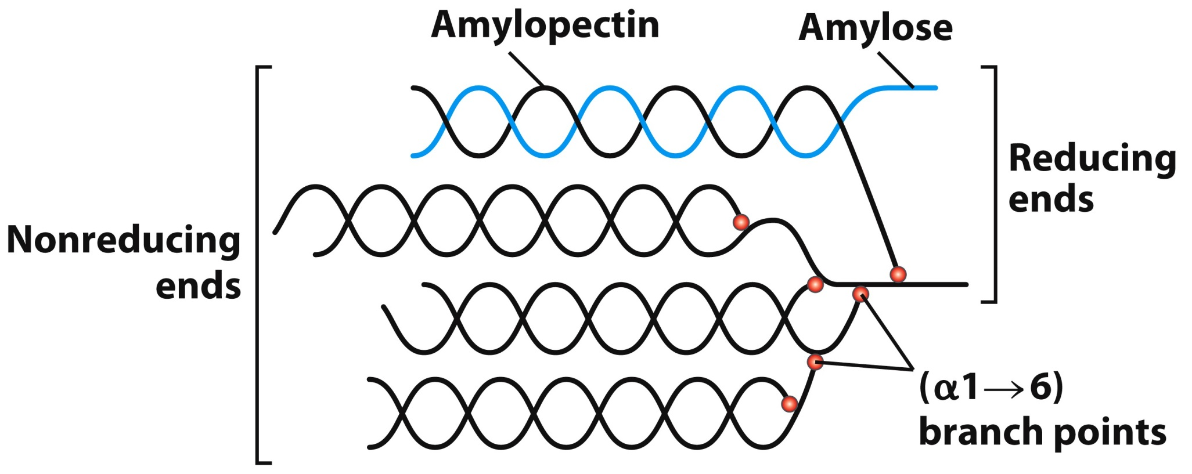
2. Storage Polysaccharides- Starch

Slide 25
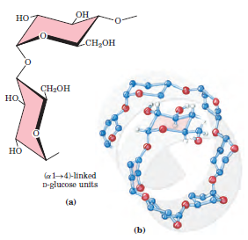
2. Storage Polysaccharides- Structure
C. The most stable 3-D structure for starch and glycan is a tightly coiled left-handed helix stabilized by interchain hydrogen bonds.
In the amylose helix, there are six residues per turn.

Slide 26
2. Storage Polysaccharides- Metabolism of Glycogen and Starch
Glycogen and starch often form granules in cells. Glycogen is metabolized in the granules of hepatocytes (liver cells) and starch in the granules of chloroplasts.
Granules contain enzymes that synthesize and degrade these polymers, which help to maintain their homeostasis
Glycogen and amylopectin have one reducing end but many nonreducing ends. Degradative enzymes act at the nonreducing ends to remove a glucose one at a time for energy use.

Slide 27
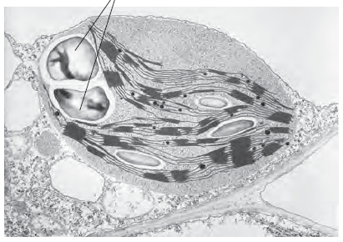
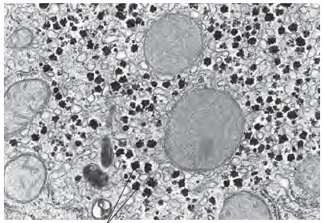
2. Storage Polysaccharides- Metabolism of Glycogen and Starch
Starch Granules in chloroplast.
Glycogen Granules in hepatocytes (liver cells).

Slide 28
3. Structural Polysaccharides- Cellulose
Cellulose is a branched homopolysaccharide of glucose that exist in an extended conformation
Glucose monomers form (β1 → 4) linked chains
Hydrogen bonds form between adjacent monomers
Additional H-bonds exist between chains
The abundance of H-bonds makes these polysaccharides rather water-insoluble
Very sturdy structures that appear as extended fibers
Most abundant polysaccharide in nature
- Cotton is nearly pure fibrous cellulose

Slide 29
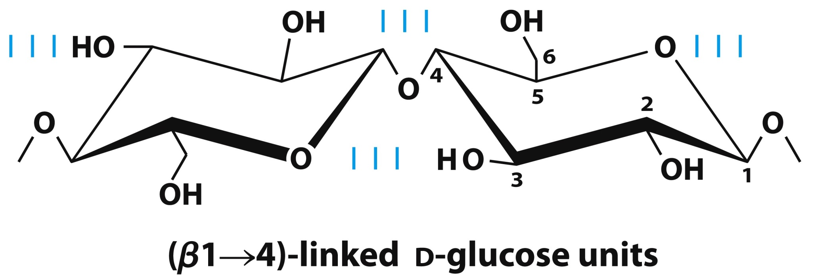
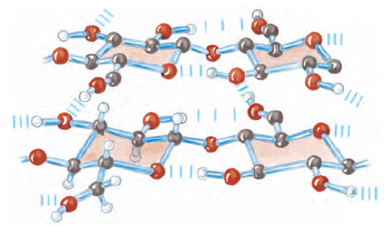
3. Structural Polysaccharides- Cellulose

Slide 30
3. Structural Polysaccharides- Cellulose Metabolism
The fibrous structure and water-insolubility make cellulose a difficult substrate to act on.
Fungi, bacteria, and protozoa secrete cellulase, which allows them to use wood (which is made of cellulose) as source of glucose.
Most animals cannot use cellulose as a fuel source because they lack the enzyme to hydrolyze (β1 →4) linkages .
Termites live symbiotically with microorganisms that produces cellulase.

Slide 31
3. Structural Polysaccharides- Chitin
Chitin is a linear homopolysaccharide of N-acetylglucosamine
N-acetylglucosamine monomers form (β1 → 4)-linked chains
Forms extended fibers that are similar to those of cellulose
Hard, insoluble, cannot be digested by vertebrates
Structure is tough but flexible, and water-insoluble
Found in cell walls in mushrooms, and in exoskeletons of insects, spiders, crabs, and other arthropods

Slide 32
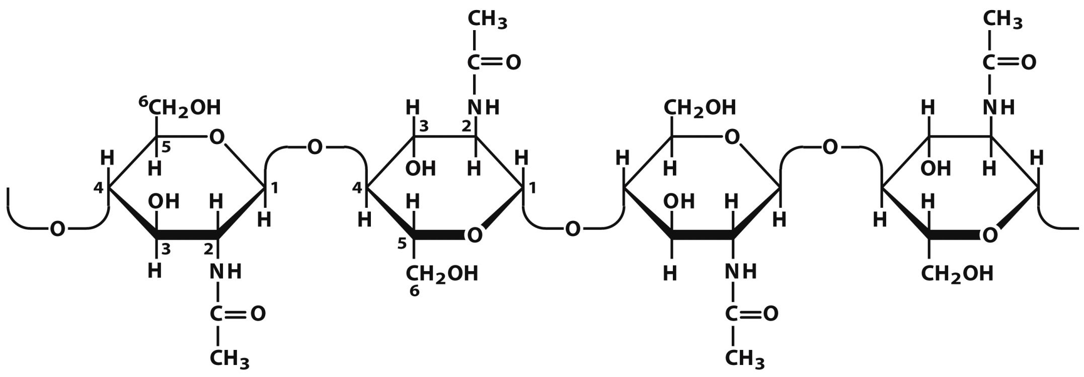
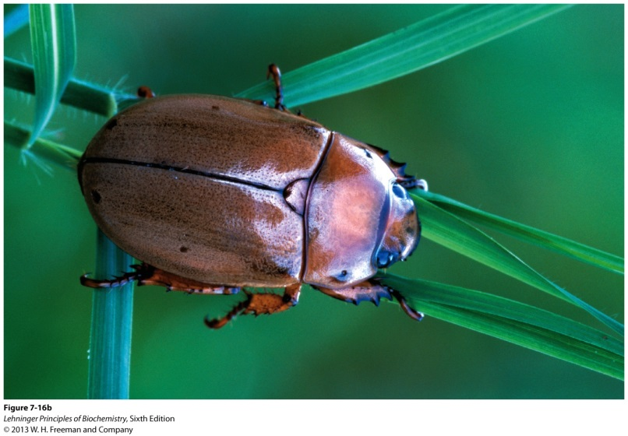
3. Structural Polysaccharides- Chitin

Slide 33
3. Structural Polysaccharides- Glycosaminoglycans
Are linear polymers of repeating disaccharide units
With one monomer that is either
N-acetyl-glucosamine or N-acetyl-galactosamine
The polysaccharides are negatively charged due to substitutions on the monosaccharide units
Uronic acids (C6 oxidation)
Sulfate esters
Exist as extended hydrated molecules
Minimizes negative charge repulsion
Form an interlocking meshwork with fibrous proteins in the extracellular matrix of multicellular animals, which provide
Connective tissue
Lubrication of joints

Slide 34
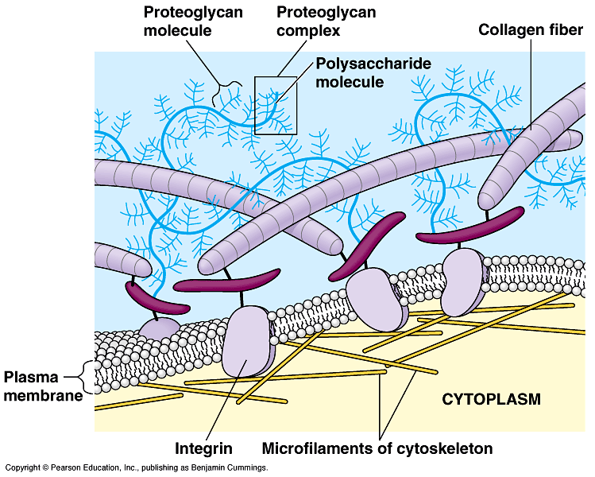
Extracellular Matrix

Slide 35
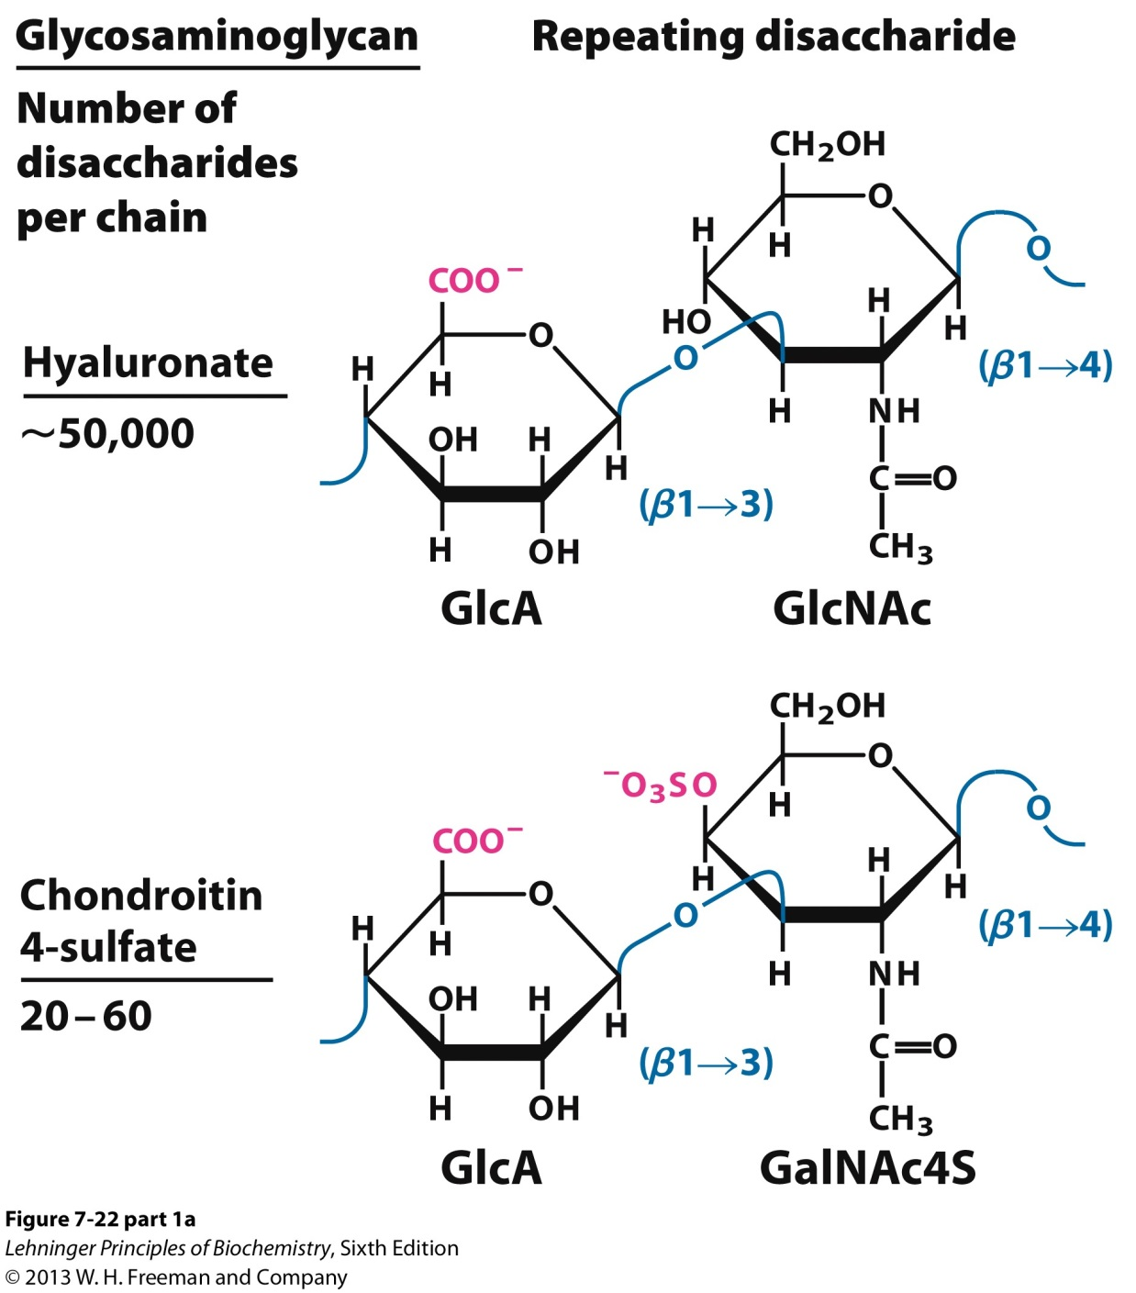
3. Structural Polysaccharides- Glycosaminoglycans
Hyaluronates:
A. Form clear, highly viscous solutions that serve as lubricants in joints and on eyes.
B. Provide tensile strength and elasticity in the extracellular matrix of cartilage and tendons because of strong interactions with other components.

Slide 36
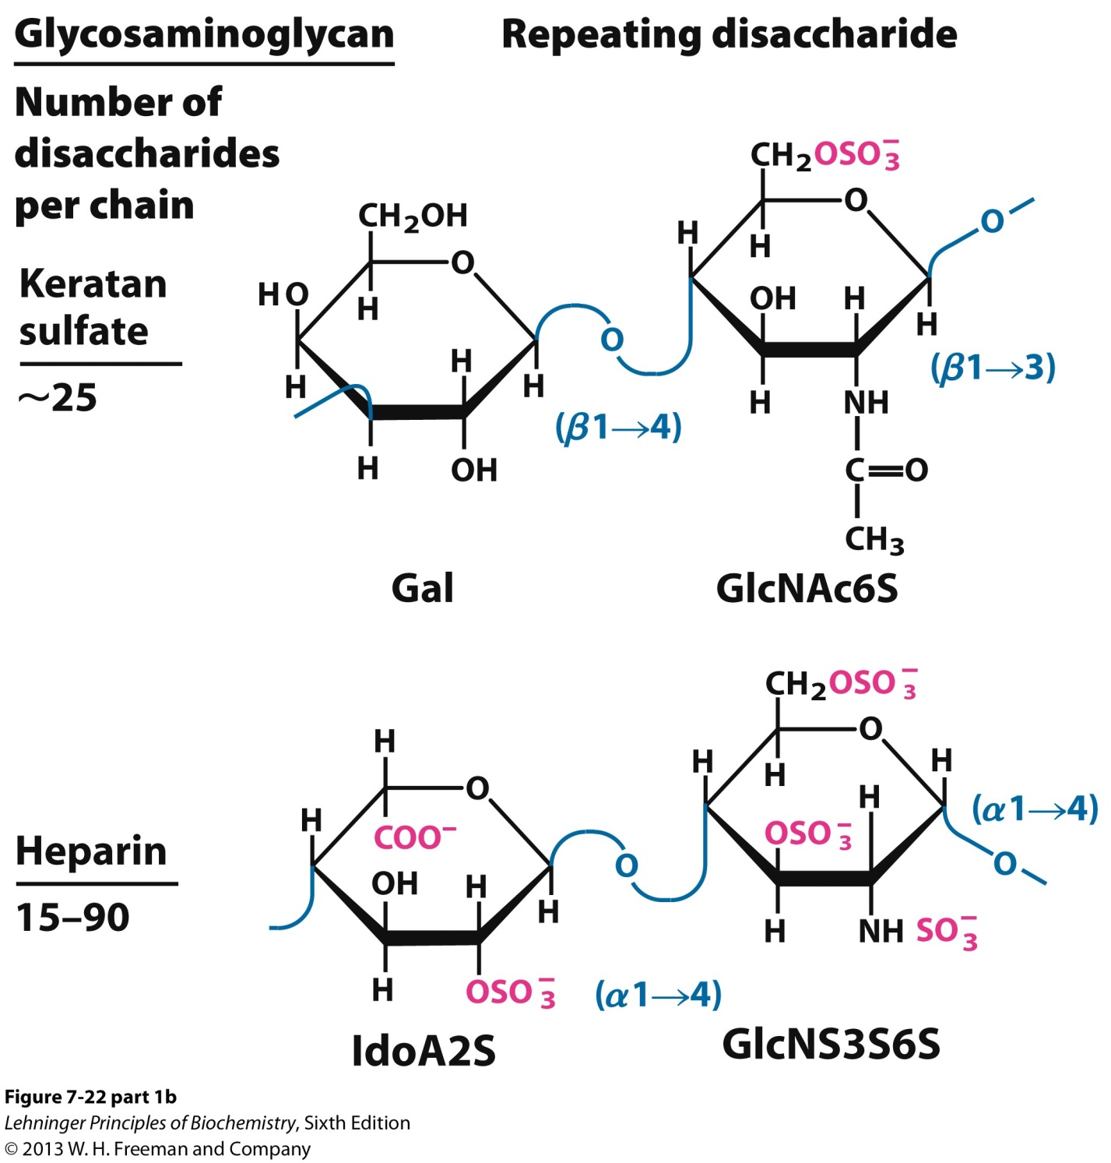
3. Structural Polysaccharides- Glycosaminoglycans

Slide 37
4. Polysaccharides as Information Carriers via Glycoconjugates
Polysaccharides (and oligosaccharides) are information carriers by serving as destination labels for some proteins and as mediators of cell-cell interactions and interactions between cells and the extracellular matrix. This is often achieved via covalent attachment to a protein or a lipid.
Glycoconjugates-
Glycoproteins
Glycolipids
Proteoglycans

Slide 38
4I. Glycoproteins
Proteins with small oligosaccharides attached:
Carbohydrate attached via its anomeric carbon
About half of mammalian proteins are glycoproteins and are found on outer face of plasma membrane, in the extracellular matrix, and in the blood
Carbohydrates play role in protein-protein recognition
Only some bacteria glycosylate few of their proteins

Slide 39
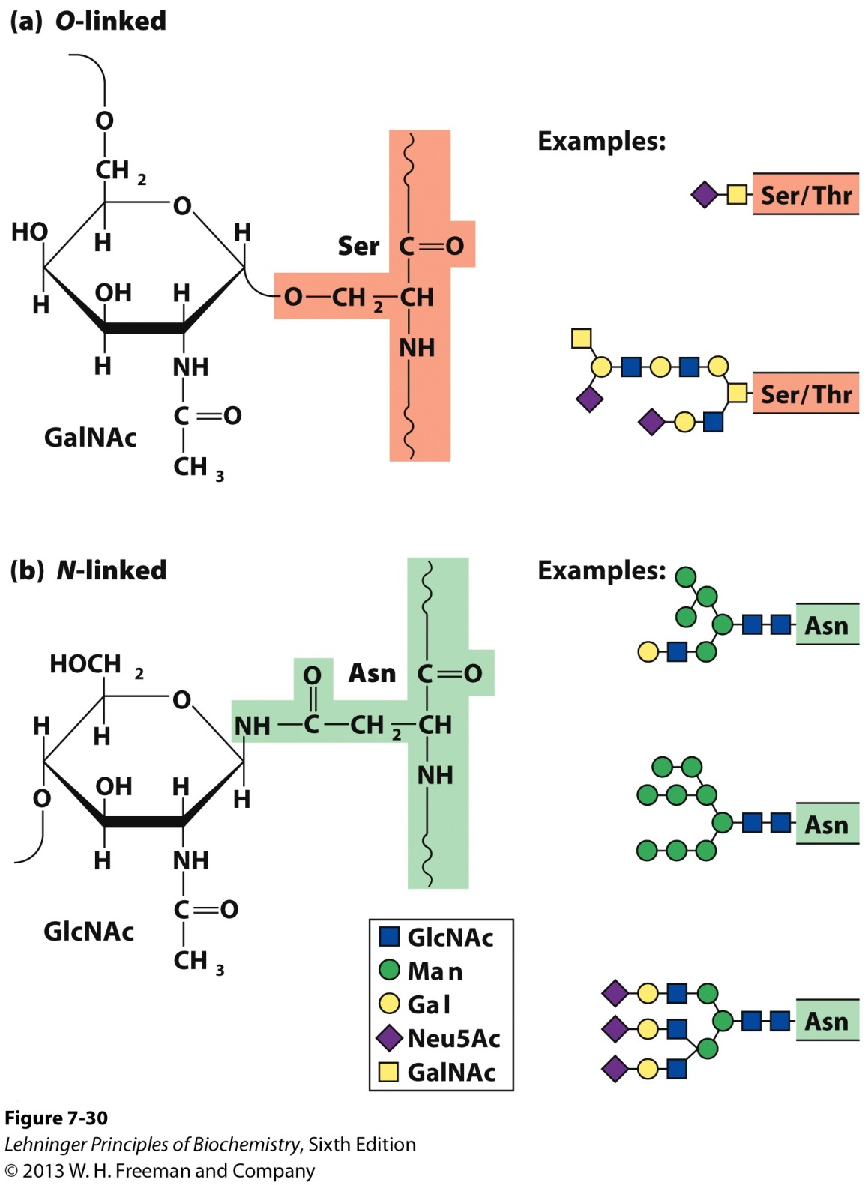
4I. Glycoproteins are O- or N- linked
O-linked via peptide-OH groups.
N-linked via peptide-NH groups.

Slide 40
4II. Glycolipids
Lipids with covalently bound oligosaccharide:
Lipids contain a polar head group (in this case sugar bound) found on the outer surface of the cell membrane and a hydrophobic tail within the cell membrane of plants and animals
On outer surface, glycolipids present a site of recognition for extracellular molecules
In vertebrates, ganglioside carbohydrate composition determines blood groups (A, B, AB, O)

Slide 41
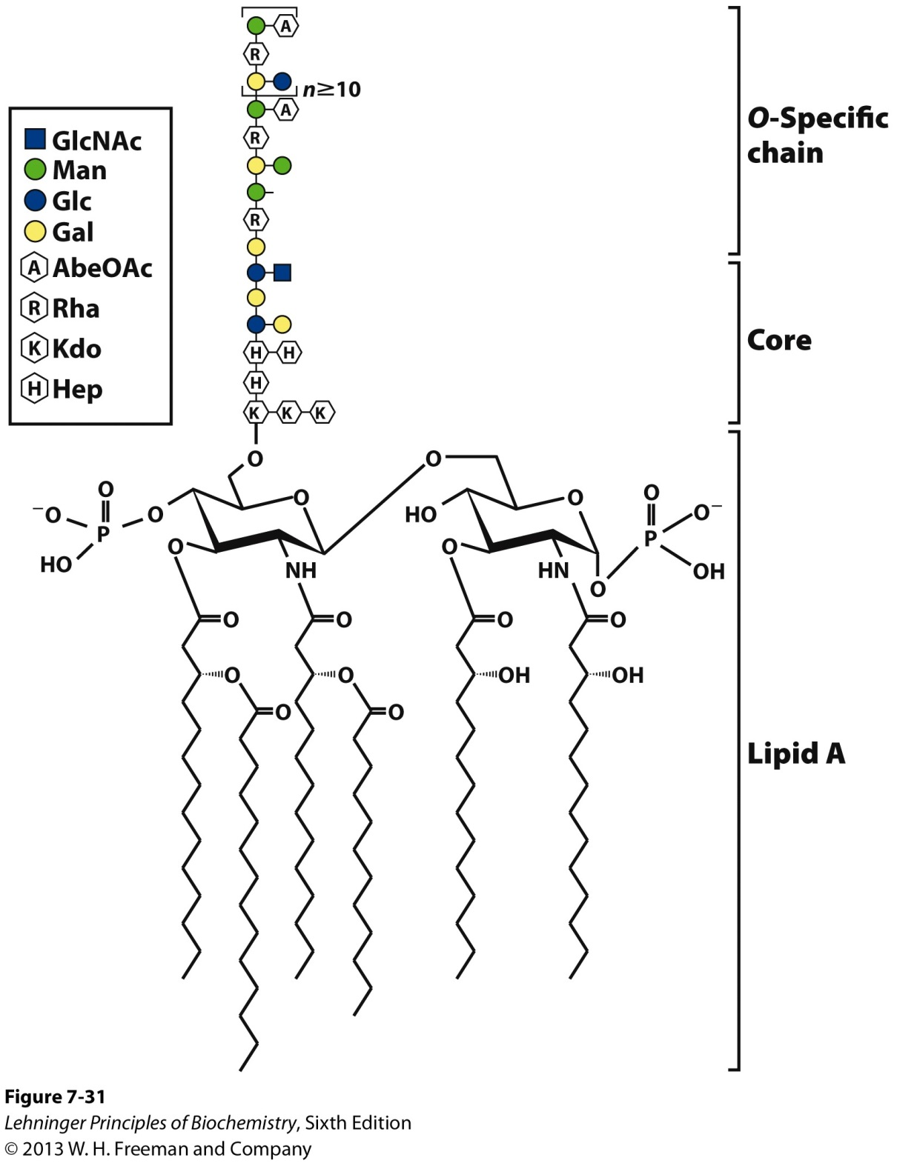
4II. Glycolipids
Lipopolysaccharides are the dominant surface feature of gram-negative bacteria (E. coli).
These molecules are prime targets of the antibodies produced by the vertebrate immune system in response to bacterial infection.

Slide 42
4III. Proteoglycans
Sulfated glucoseaminoglycans attached to a large rod-shaped protein in cell membrane
Syndecans: protein has a single transmembrane domain
Glypicans: protein is anchored to a lipid membrane
Interact with a variety of receptors from neighboring cells and regulate cell growth
Are major components of connective tissue such as cartilage and provide strength and resilience

Slide 43
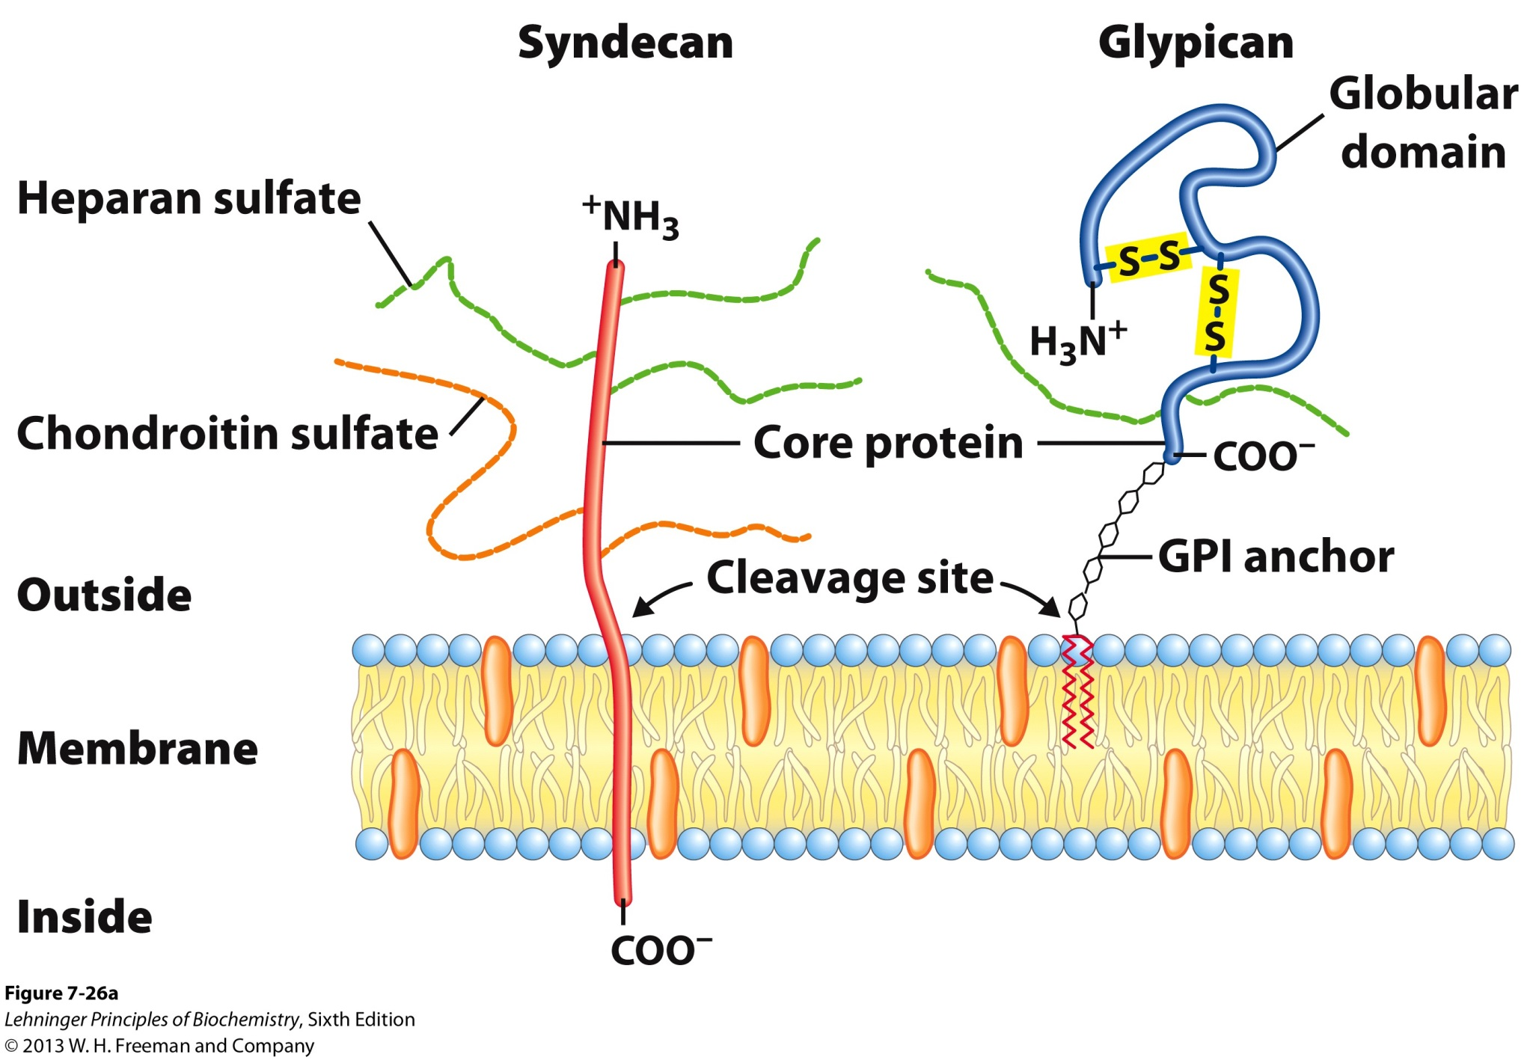
4III. Proteoglycans
GPI: glycophosphatidylinositol
Nonpolar AA engage in hydrophobic interactions with the plasma membrane lipids

Slide 44
4IIIb. Proteoglycan Linkages
Different glycosaminoglycans are linked to the core protein via a trisaccharide bridge
B. Linkage from anomeric carbon of xylose to serine hydroxyl typically in the –Ser-Gly-X-Gly sequence
C. Our tissues have many different core proteins; aggrecan is the best studied

Slide 45
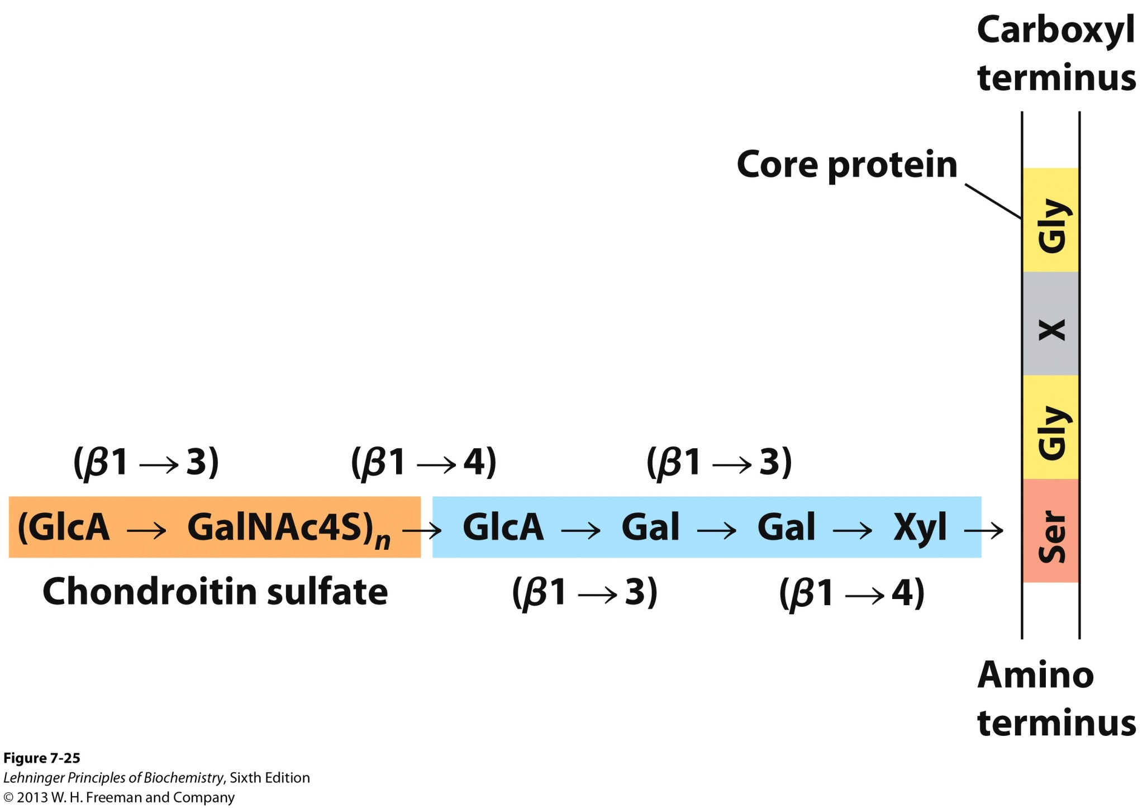
4IIIb. Proteoglycan Linkages

Slide 46
4IIIc. Proteoglycan Aggregates
Hyaluronan and aggrecan form huge (MW > 2x10⁸) noncovalent aggregates
Hold lots of water (1000× its weight) and as a result provides lubrication
Very low friction material
Covers joint surfaces: articular cartilage
Reduced friction
Load balancing

Slide 47
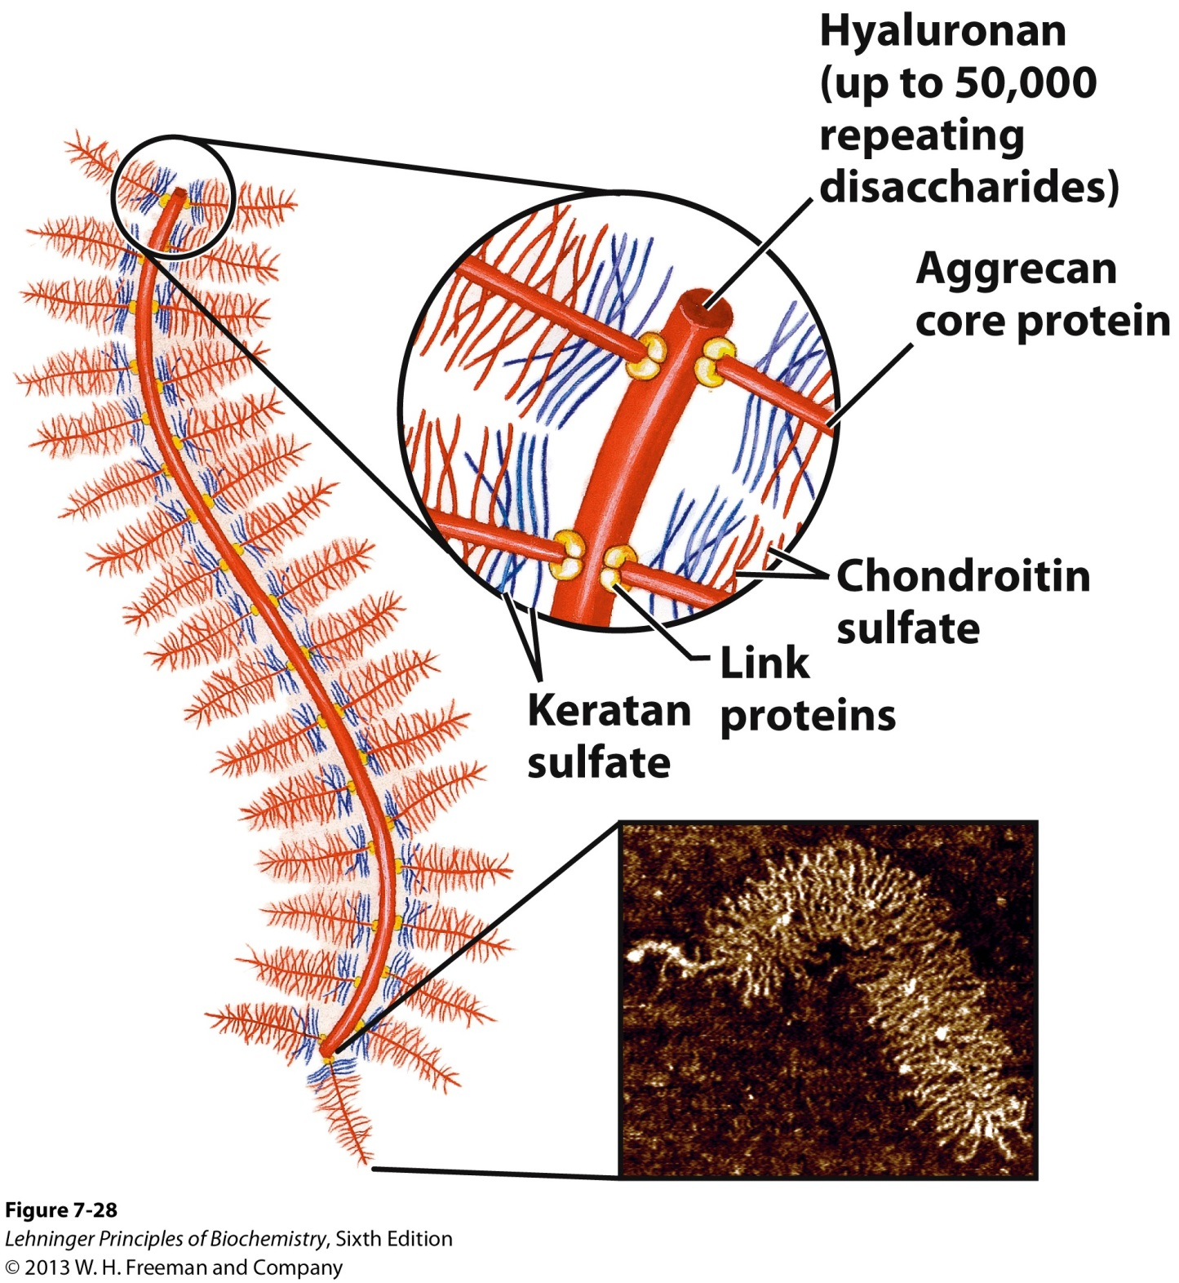
4IIIc. Proteoglycan Aggregates

Slide 48
4IVa. Extracellular Matrix (ECM)
Material outside the cell:
Strength, elasticity, and physical barrier in tissues
Main components
- Proteoglycan aggregates
- Collagen fibers
- Elastin (a fibrous protein)
ECM is a barrier for tumor cells seeking to invade new tissues
- Some tumor cells secrete heparinase that degrades ECM

Slide 49
4IVb. Interaction of the Cells with ECM
Some integral membrane proteins are proteoglycans
Syndecans
Other integral membrane proteins are receptors for extracellular proteoglycans
Integrins
These proteins link cellular cytoskeleton to the ECM and transmit signals into the cell to regulate:
- cell growth
- cell mobility
- apoptosis
- wound healing

Slide 50
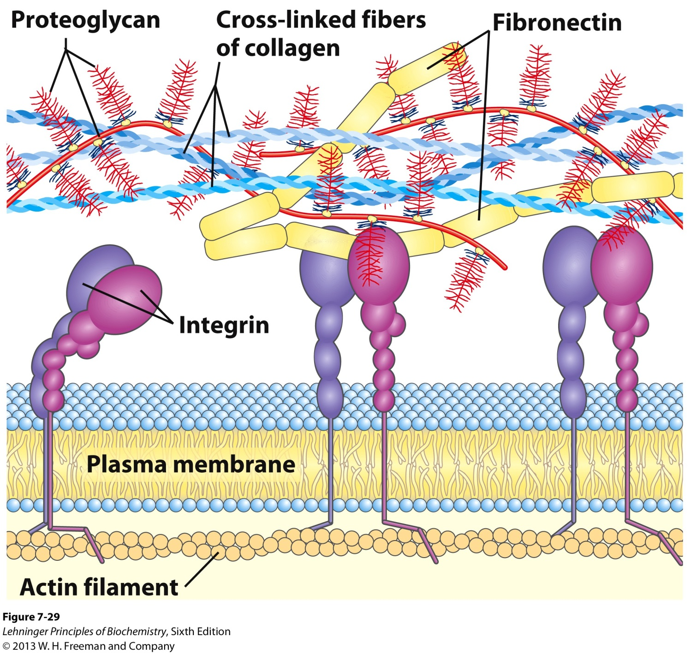
4IVb. Interaction of the Cells with ECM

Slide 51
4V. Oligosaccharides in Recognition (Sugar Code)
Oligosaccharides with unique structures are components of a variety of glycoproteins or glycolipids on the outer surface of the plasma membranes.
Their oligosaccharides moieties are bound by extracellular proteins called lectins with high specificity and affinity. These oligosaccharide moieties are seen a sugar code to trigger interactions with a cell.
Viruses that infect animal cells, such as the influenza virus, bind to the cell surface glycoproteins as the first step in infection.

Slide 52
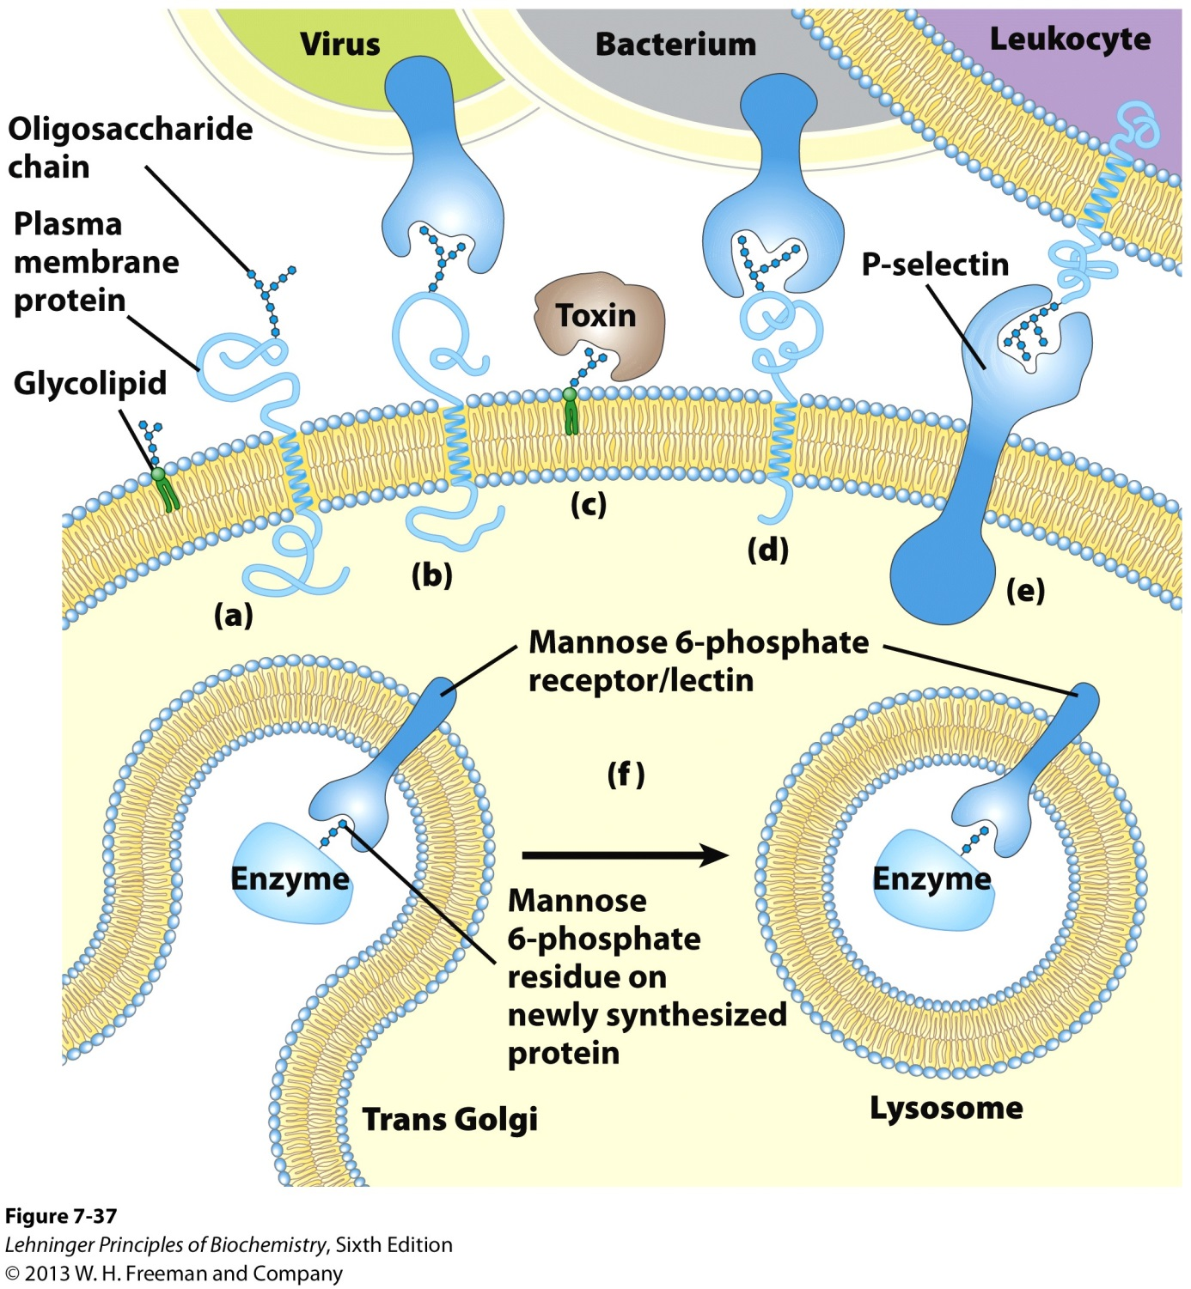
4V. Oligosaccharides in Recognition (Sugar Code)

