Slide 1
Introduction to Nucleotides and
Nucleic Acids
Chapter 8 (Page 273-283)

Slide 2
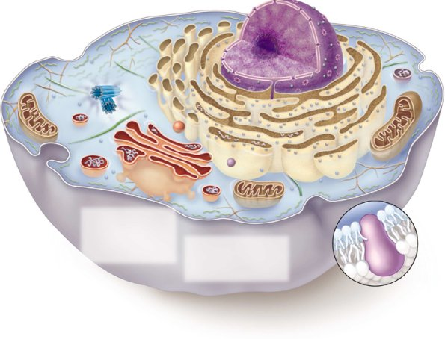
Fundamental Biology of Life
Nucleus:
Site of transcription
Ribosomes on endoplasmic reticulum:
Site of translation
Transcription
Translation
DNA RNA Protein
Replication

Slide 3
Nucleotides (Nucleosides)

Slide 4
1. Nucleotides- General Function
Participate in:
Energy exchange processes in metabolism (ATP)
Metabolic intermediates
Cellular response to extracellular stimuli and intracellular signal transduction (cAMP)
Structural components of enzyme and enzyme cofactors (NAD⁺)
The constituents of nucleic acids, the molecular repositories of genetic information
I. Deoxyribonucleic acid (DNA)
II. Ribonucleic acid (RNA)

Slide 5
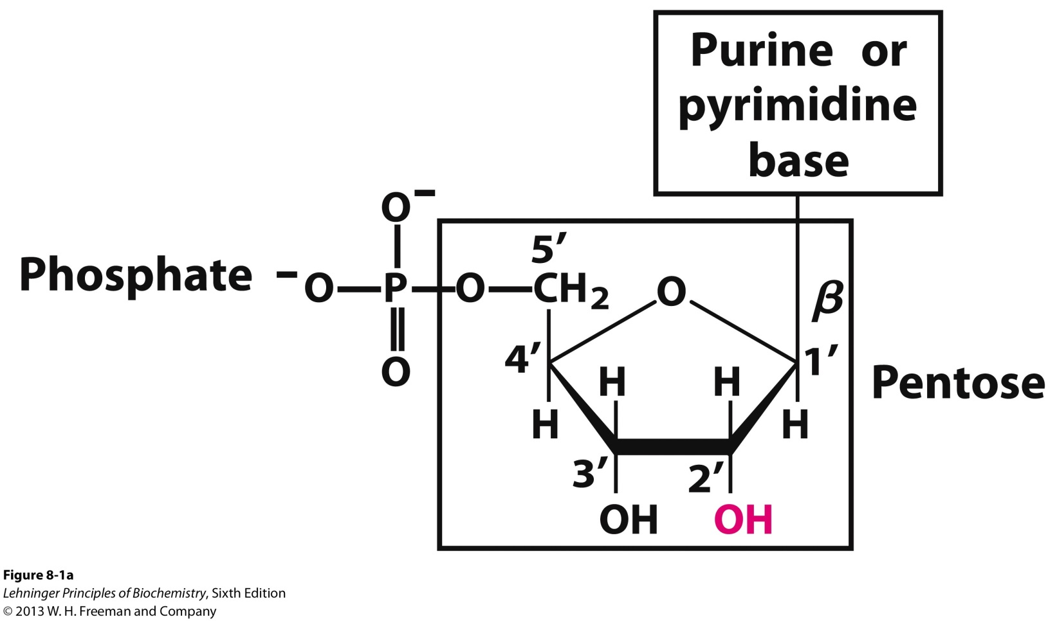
2. Nucleotide Composition
Have three characteristic components
Nucleobase (Nitrogen-containing base)
Pentose
Phosphate
*

Slide 6
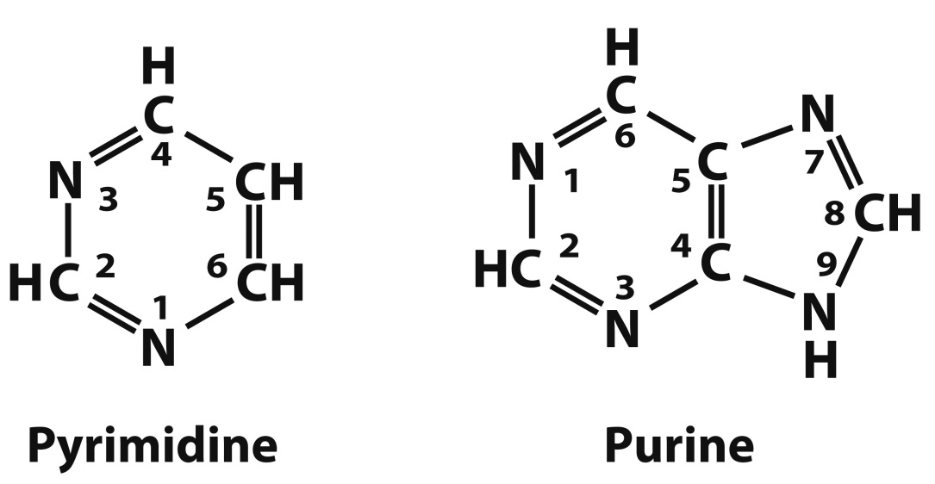
2I. Nucleobase
Derivatives of pyrimidine or purine
B. Nitrogen-containing heteroaromatic molecules
C. Planar or almost planar structures
D. Absorb UV light around 250–270 nm
*
*

Slide 7
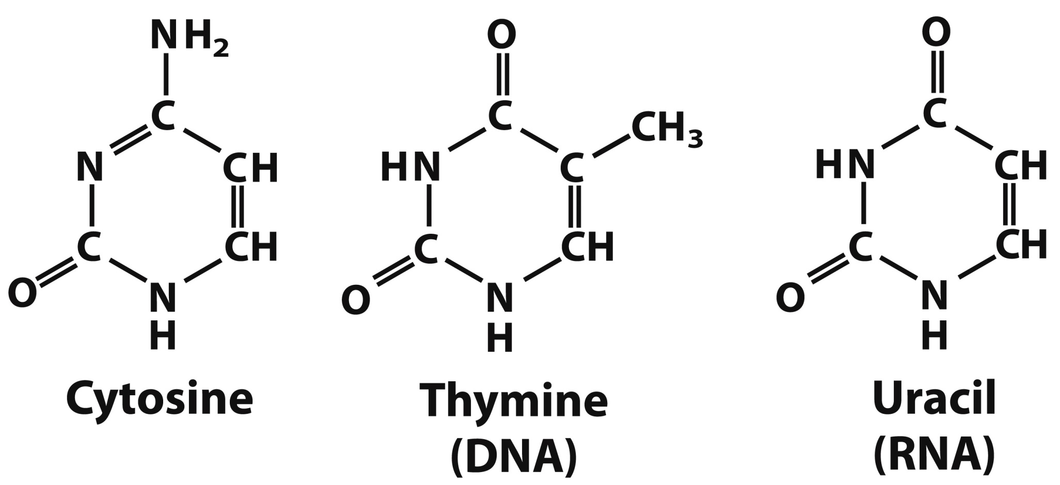
2IA. Pyrimidine Bases
4
3
5
2
6
1
*
*
*

Slide 8
2IA. Pyrimidine Bases
A. Cytosine is found in both DNA and RNA
Thymine is found only in DNA
Uracil is found only in RNA
B. All are good H-bond donors and acceptors
C. Cytosine pK_{a} at N3 is 4.5
Thymine pK_{a} at N3 is 9.5
D. They are neutral molecules at pH 7

Slide 9
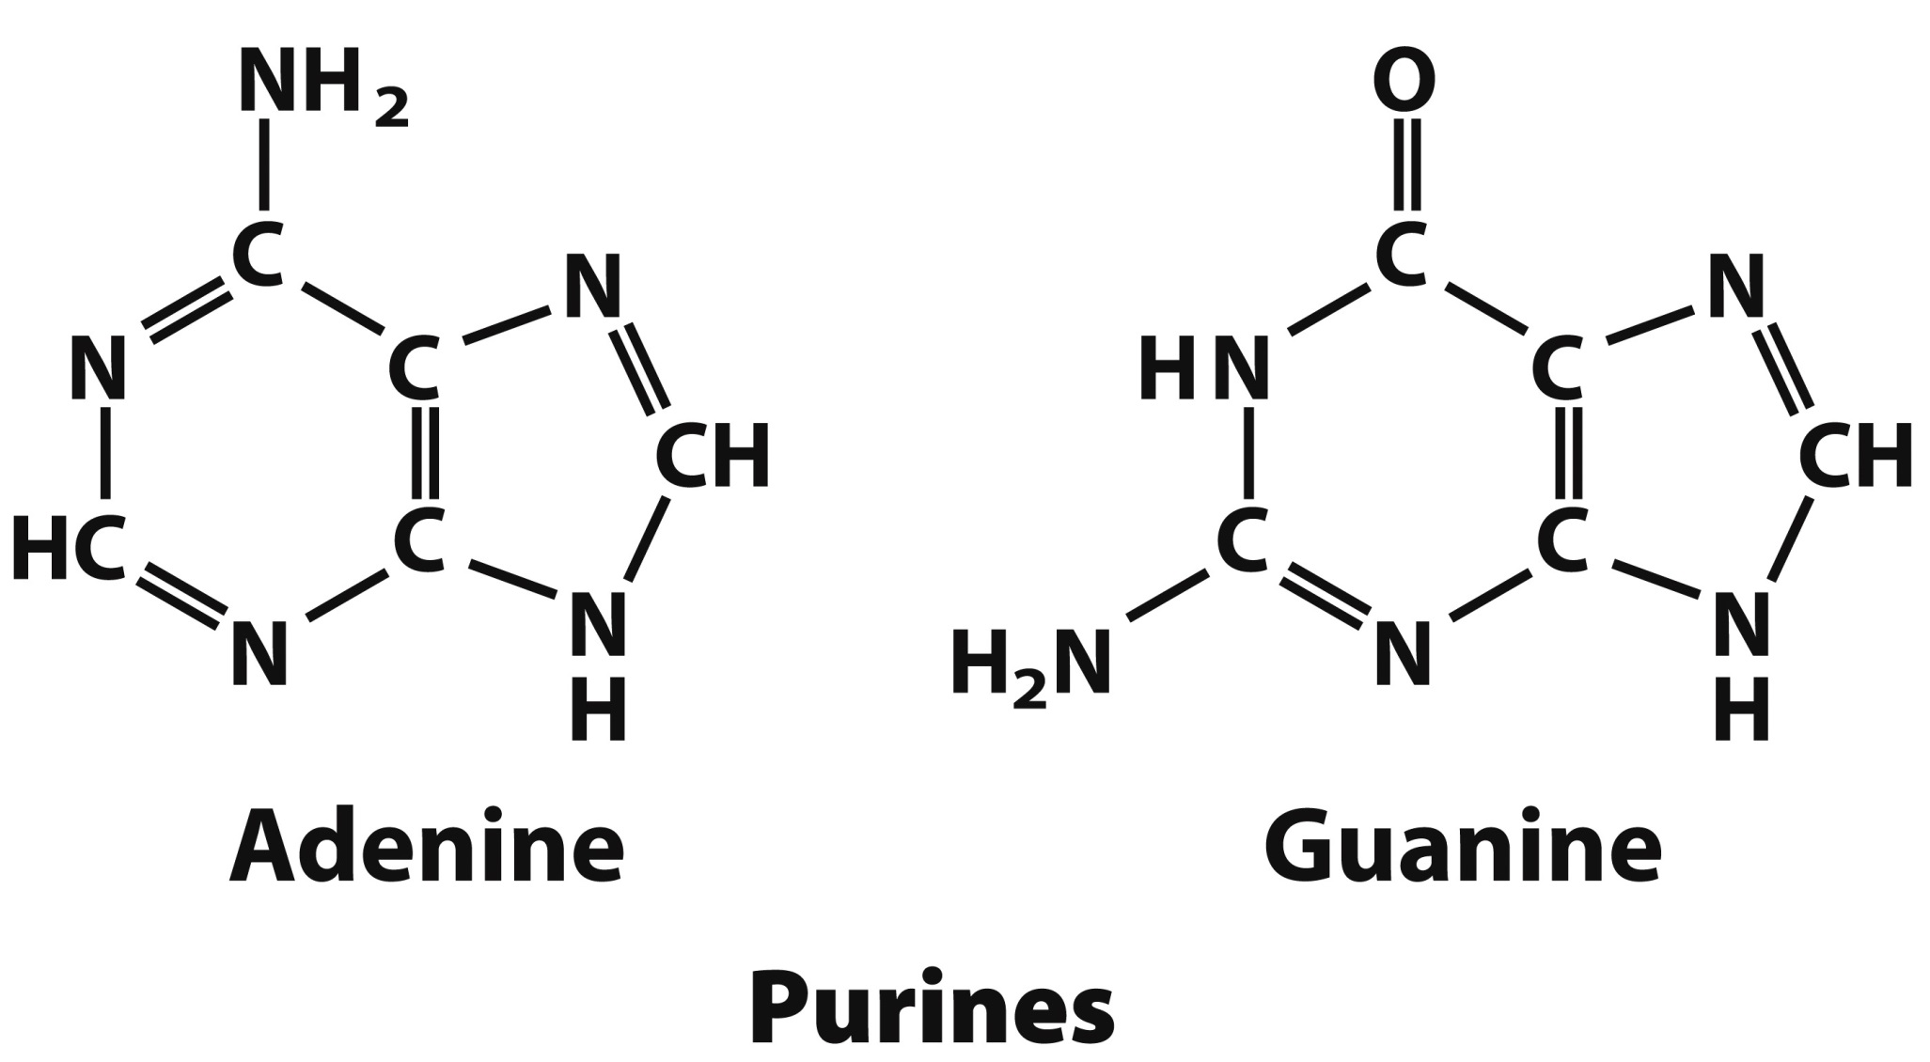
2IB. Purine Bases
6
1
5
7
2
4
8
3
9
*
*

Slide 10
2IB. Purine Bases
Adenine and guanine are found in both RNA and DNA
B. Also good H-bond donors and acceptors
C. Adenine pK_{a} at N1 is 3.8
Guanine pK_{a} at N7 is 2.4
D. Neutral molecules at pH 7

Slide 11
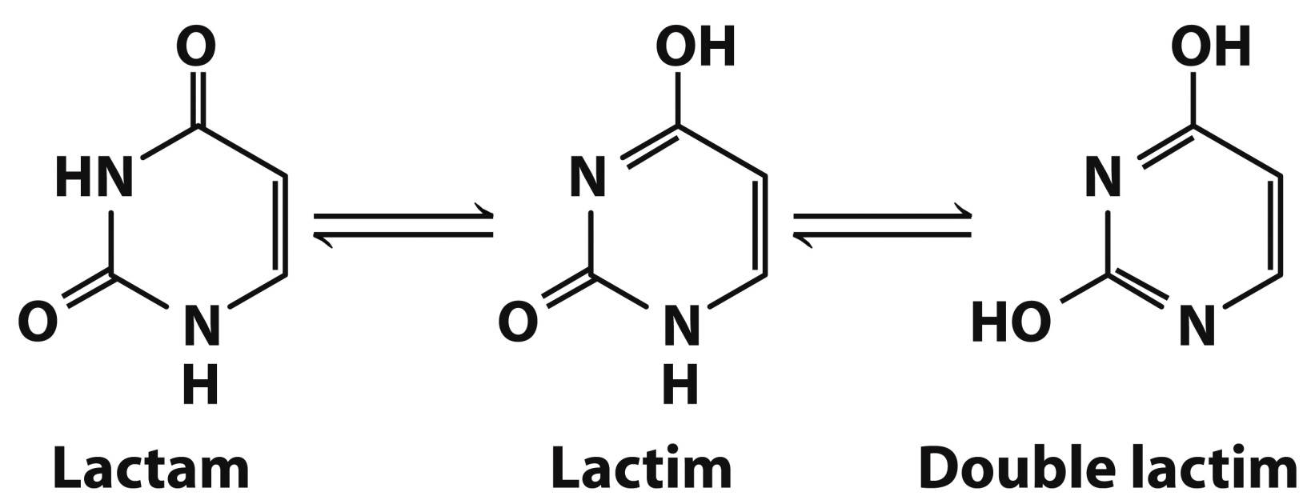
2IC. Tautomerism of Nucleobases
The nucleobases can exist in different structural isomeric forms called prototropic tautomers, which differ in the location of protons.
The nucleobases undergo lactam-lactim tautomerism
The lactam form dominates at neutral pH

Slide 12
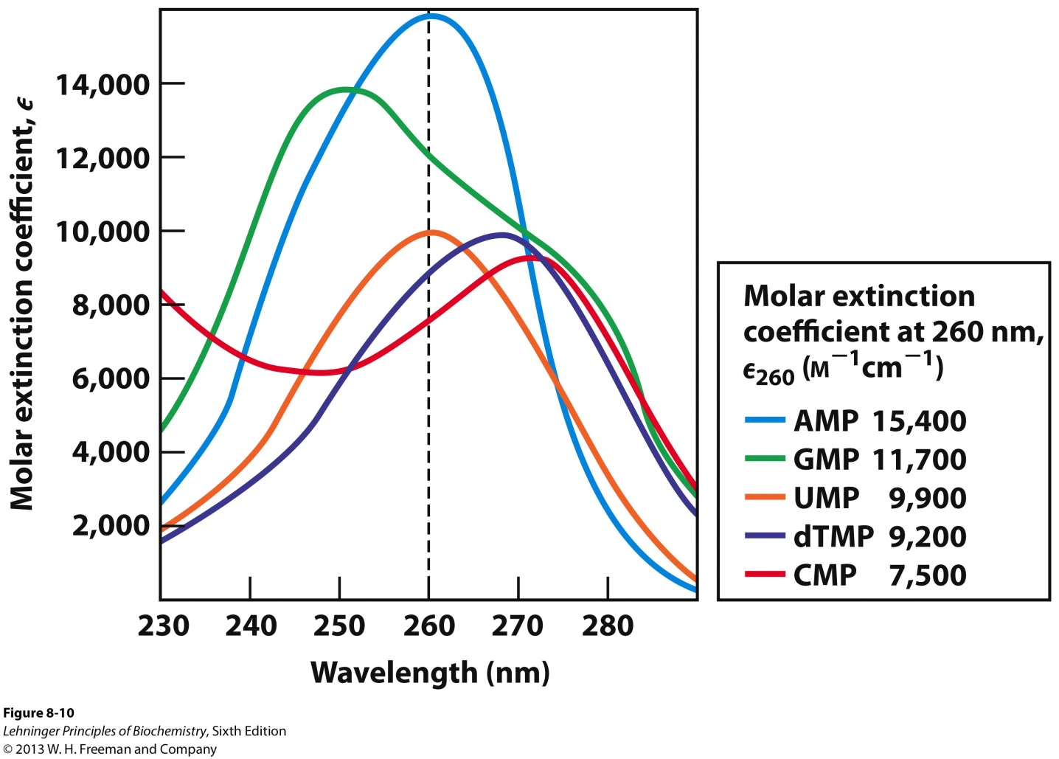
2ID. UV Absorption of Nucleobases
The absorption of UV light at 250-270 nm by nucleobases is due to π → π* electronic transitions.
These absorbances can be used to quantify nucleic acids.

Slide 13
*

Slide 14
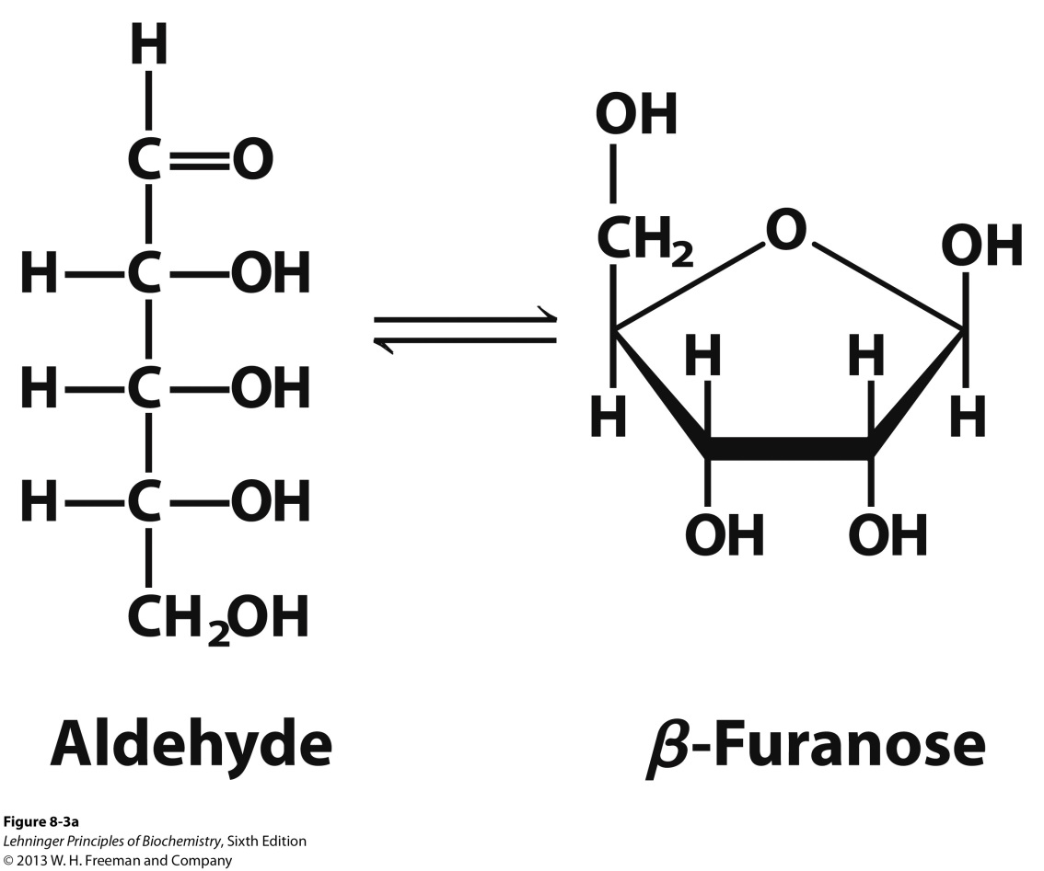
2II. Pentoses
The carbon numbers are given a prime (‘) designation to distinguish them from the numbered atoms of the nitrogenous bases.
Nucleic acids can have two kinds of pentoses.
H
Present in RNA
Present in DNA
β-2’-deoxy-D-
ribofuranose
D-ribose
β-D-ribofuranose

Slide 15
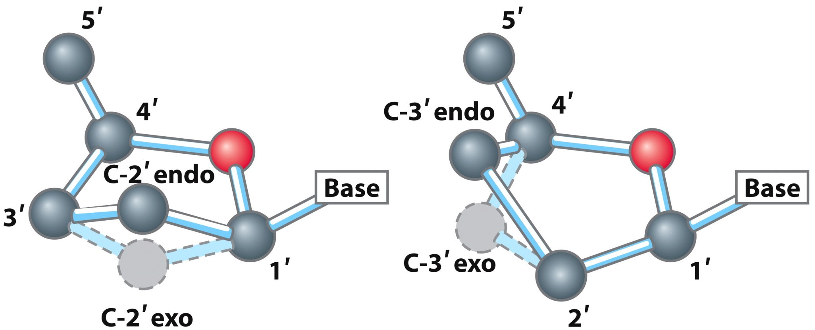
2II. Pentoses
C. The pentose ring is not planar but occurs in one of four “puckered” conformations.
Four of the five atoms are in a single plane.
The fifth atom is on either the same (endo) or the opposite (exo) side of the plane relative to the C-5’ atom.

Slide 16
2IIA. β-N-Glycosidic Bond
In nucleotides the pentose ring is attached to the nucleobase via an N-glycosidic bond:
The bond is formed to the anomeric carbon of the sugar in β configuration
And to
Position N1 in pyrimidines
Position N9 in purines
This bond is quite stable toward hydrolysis, especially in pyrimidines
Bond cleavage is catalyzed by acid

Slide 17
*

Slide 18
2III. Phosphates
The phosphate group is typically esterified to the 5’ carbon of pentose.
The phosphate group can be in other positions.
3’-monophosphate
2’-monophosphate
2’,3’-cyclic
monophosphate

Slide 19
3. Nucleoside Composition
Have two of the three characteristic components of nucleotides
Nucleobase (Nitrogen-containing base)
Pentose

Slide 20
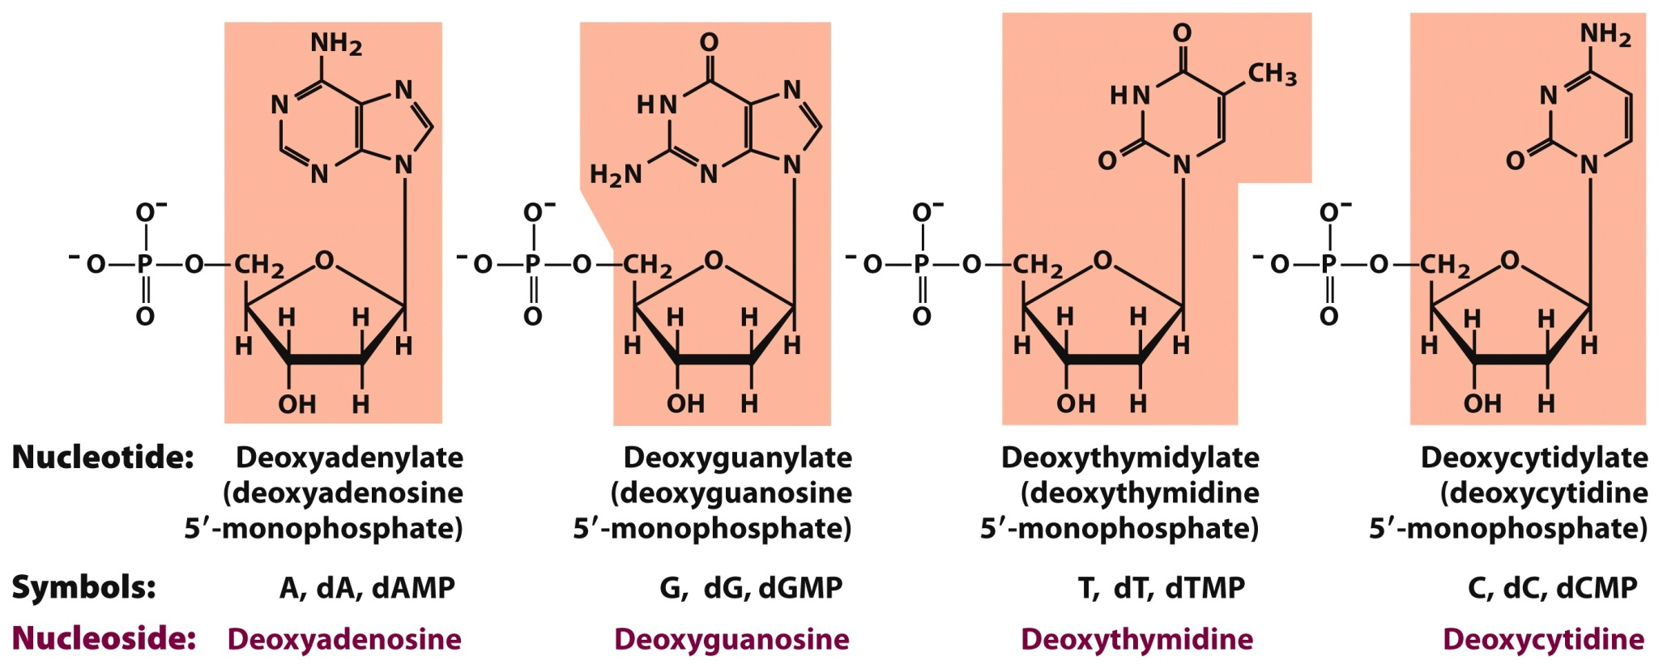
4. Nomenclature- Deoxyribonucleotides
You need to know structures, names, and symbols.

Slide 21
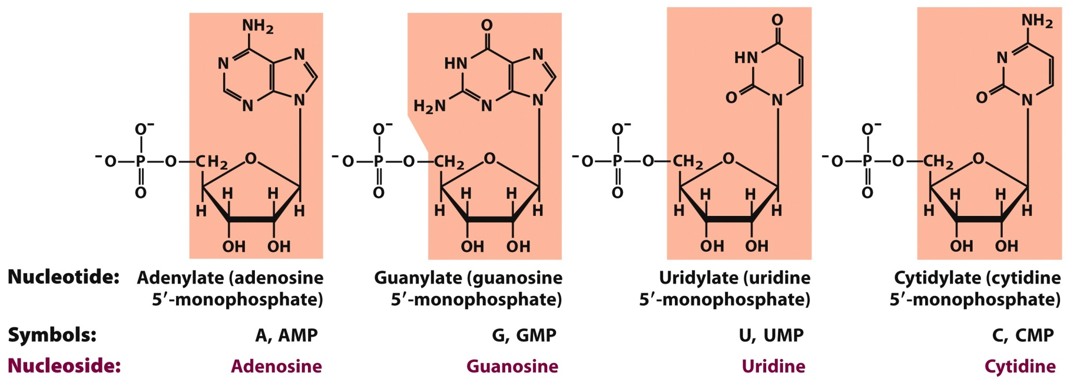
4. Nomenclature- Ribonucleotides
You need to know structures, names, and symbols.

Slide 22
5. Nucleic Acids can contain Unusual Nucleobases
Modification of nucleobases is done after RNA/DNA synthesis:
5-Methylcytosine is common in eukaryotes, also found in bacteria
N⁶-Methyladenosine is common in bacteria but not found in eukaryotes
Modifications serve an epigenetic marker role:
Way to mark own DNA so that cells can degrade foreign DNA (prokaryotes); a defense mechanism
Way to mark which genes should be active (eukaryotes)

Slide 23
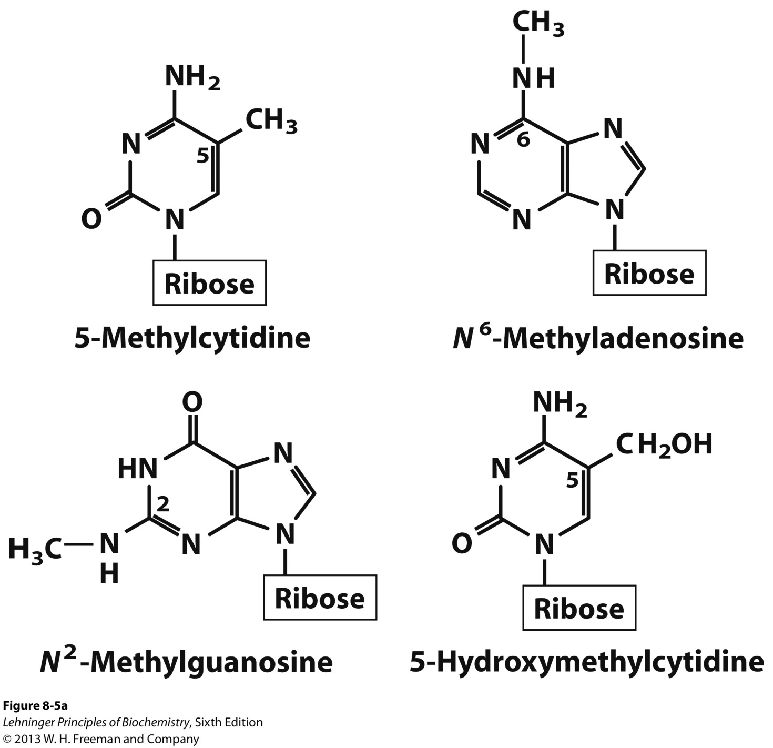
5. Nucleic Acids can contain Unusual Nucleobases

Slide 24
Nucleic Acids

Slide 25
1. Nucleic Acids- General Function
Nucleic acids are biologically occurring polynucleotides in which the nucleotide residues are linked in a specific sequence by phosphodiester bonds.
They participate in:
Storage of genetic information (Deoxyribonucleic acid; DNA)
Transmission of genetic information (messenger ribonucleic acid; mRNA)
Processing of genetic information (ribozymes)
Protein synthesis (transfer RNA (tRNA) and ribosomal RNA (rRNA))

Slide 26
2. Levels of Nucleic Acid Structure
Primary Level
The nucleotide sequence of a nucleotide strand and its covalent structure
Secondary Level
Any regular, stable structure taken up by some or all of the nucleotides in a nucleic acid
C. Tertiary Level
The complex folding of large chromosomes within eukaryotic chromatin (Chapter 24)

Slide 27
Primary Level of Nucleic Acid
Structure

Slide 28
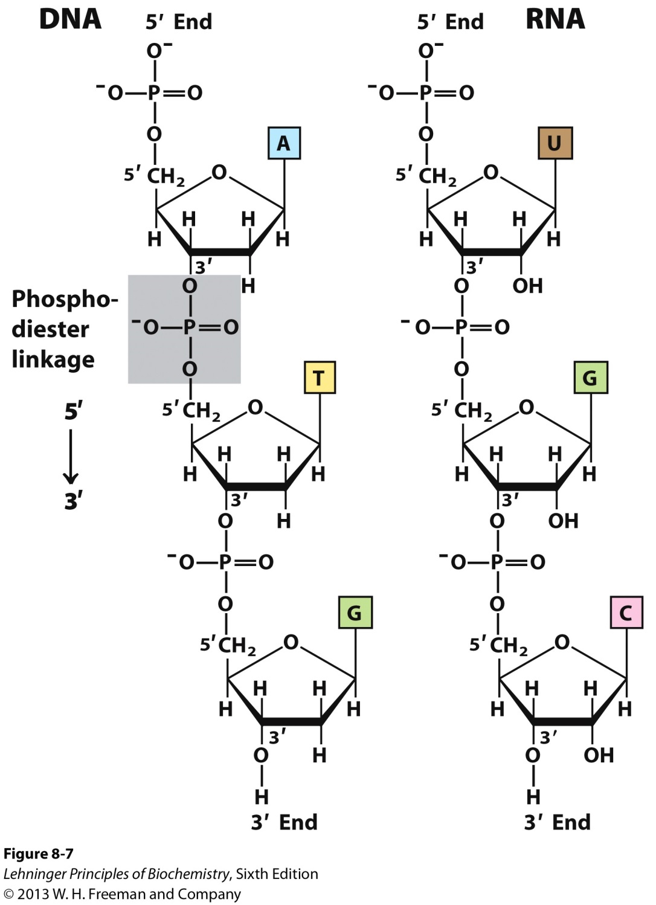
DNA and RNA

Slide 29
1. General Structure of Nucleotide Strands in Nucleic Acid
The successive nucleotides of both DNA and RNA are covalently linked through phosphate-group “bridges,” in which the 5’-phosphate group of one nucleotide unit is joined to the 3’-hydroxyl group of the next nucleotide.
The covalent backbones of nucleic acids consist of alternating phosphate and pentose residues
The backbone is hydrophilic
The hydroxyl groups of the sugar residues form hydrogen bonds with water
The phosphate groups are completely ionized and negatively charged at pH 7

Slide 30
1. General Structure of Nucleotide Strands in Nucleic Acid
B. The nucleobases may be regarded as side groups
C. All phosphodiester linkages have the same orientation along the chain with distinct 5’ and 3’ ends.
D. The 5’ end lacks a nucleotide at the 5’ position and the 3’ end lacks a nucleotide at the 3’ position.
Other groups may be present on one or both ends.
E. The nucleotide sequences are arranged as linear polymers
No branching or cross-links

Slide 31
1. General Structure of Nucleotide Strands in Nucleic Acid
F. The DNA backbone is fairly stable
Hydrolysis accelerated by enzymes (DNAse)
DNA’s half-life is 521 years
DNA strands of a reasonable length could last 1 million years if preserved properly

Slide 32
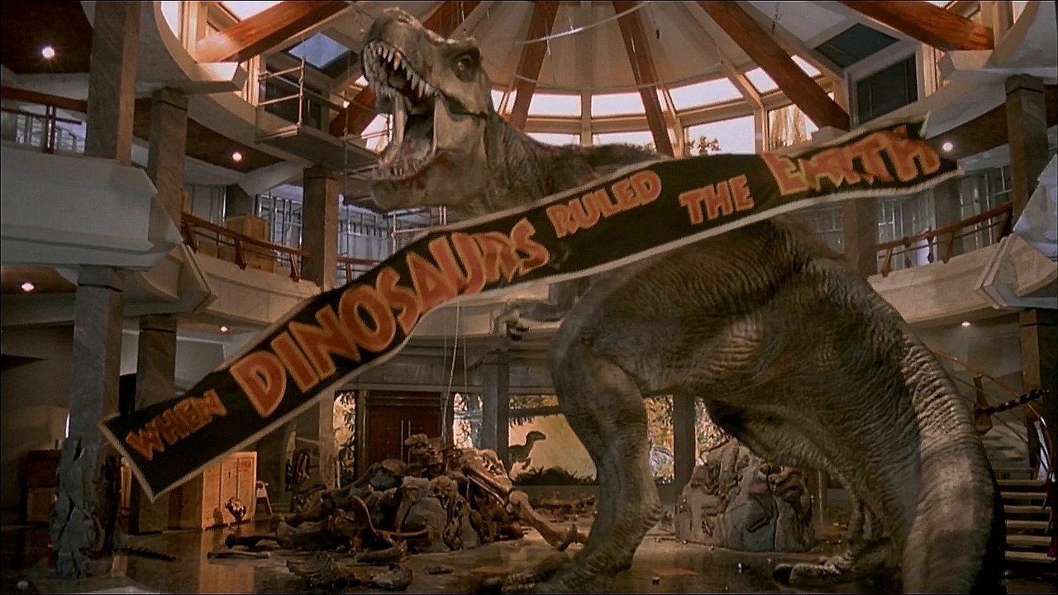
Is Jurassic Park Possible??????????????????????????

Slide 33
1. General Structure of Nucleotide Strands in Nucleic Acid
G. The RNA backbone is unstable
In water, RNA lasts for a few years
In cells, mRNA is degraded in few hours

Slide 34
2. Hydrolysis of RNA
RNA is unstable under alkaline conditions
In the body hydrolysis is catalyzed by enzymes called RNases
Rnase P is a ribozyme (enzyme made of RNA) that processes tRNA precurors
Dicer is an enzyme that cleaves double-stranded RNA into oligonucleotides (50 or fewer nucleotides)
- Helpful in defense against viral genomes

Slide 35
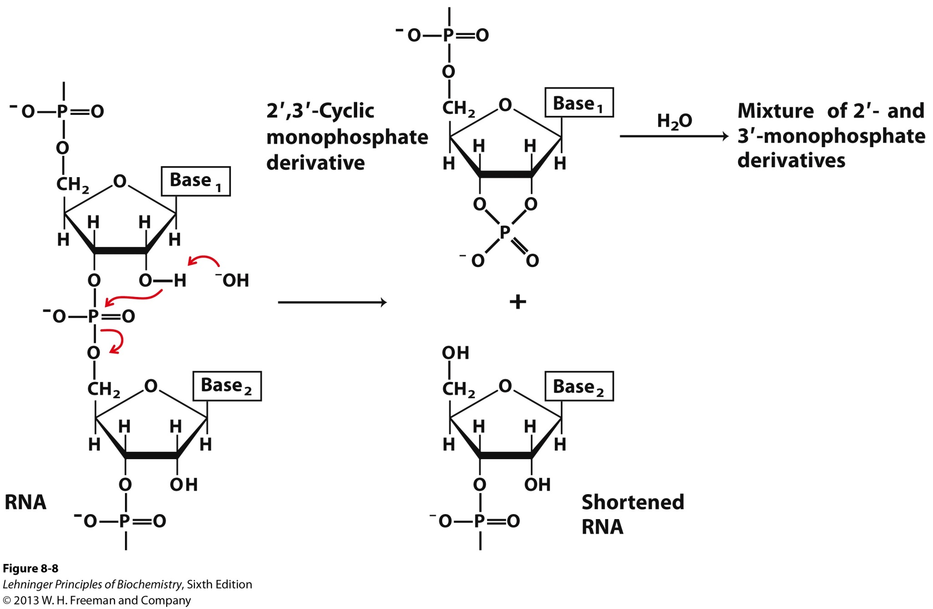
2I. Mechanism of Base-catalyzed RNA Hydrolysis

Slide 36
3. Representation of Nucleotide Sequences
By convention , the sequence of a single strand of nucleic acid is always written with the 5’-end at the left and the 3’-end at the right.
5’ 3’
For a nucleic acid that consists of the AGCTA sequence, you can write the following :
P = phosphate group; OH = 3’ end
pA-G-C-T-A_{OH}
pApGpCpTpA
pAGCTA
5’-AGCTA-3’

Slide 37
Secondary Level of Nucleic Acid
Structure (DNA)

Slide 38
1. Discovery of DNA Structure
“This structure has novel features which are of considerable biological interest”
―Watson and Crick, Nature, 1953
One of the most important discoveries in biology
The pathway to discovery illustrates important factors about science
Missteps in modeling
Value of knowledge
Value of collaboration
Cost of sharing data too early

Slide 39
2. Covalent Structure of DNA (1868-1935)
Friedrich Miescher (1868) isolates “nuclein” from cell nuclei
Hydrolysis of nuclein
- phosphate
- pentose
- and a nucleobase
Chemical analysis
- phosphodiester linkages
- pentose is ribofuranoside
Structure of DNA:
1929
(Levene & London)
Structure of DNA:
1935
(Levene & Tipson)

Slide 40
3. DNA Molecules have Distinctive Base Compositions
Erwin Chargaff and colleagues (late 1940s) found that the four nucleotide bases of DNA occur in different ratios in the DNAs of different organisms and that the amounts of certain bases are closely related.
The base composition of DNA generally varies from one species to another.
DNA isolated from different tissues of the same species have the same base composition.
In all cellular DNA
# of A = # of T
# of G = # of C
# of purines (A + G) = # of pyrimdines (T + C)

Slide 41
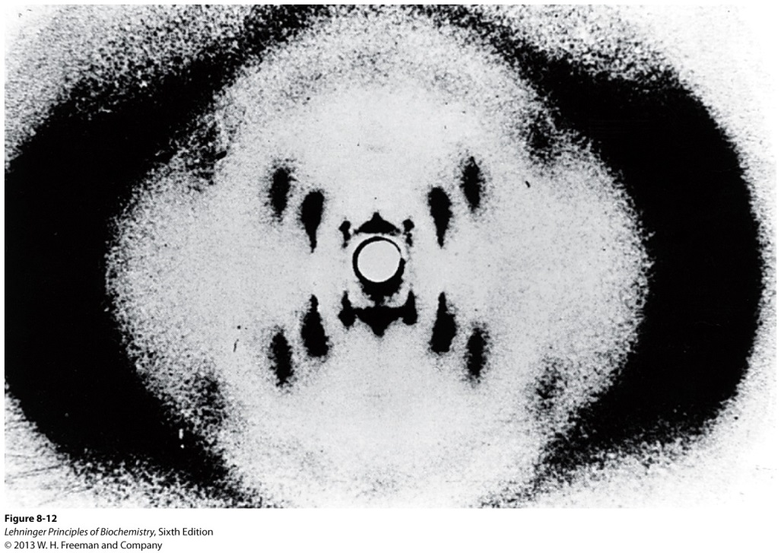
4. X-Ray Diffraction Pattern of DNA

Slide 42
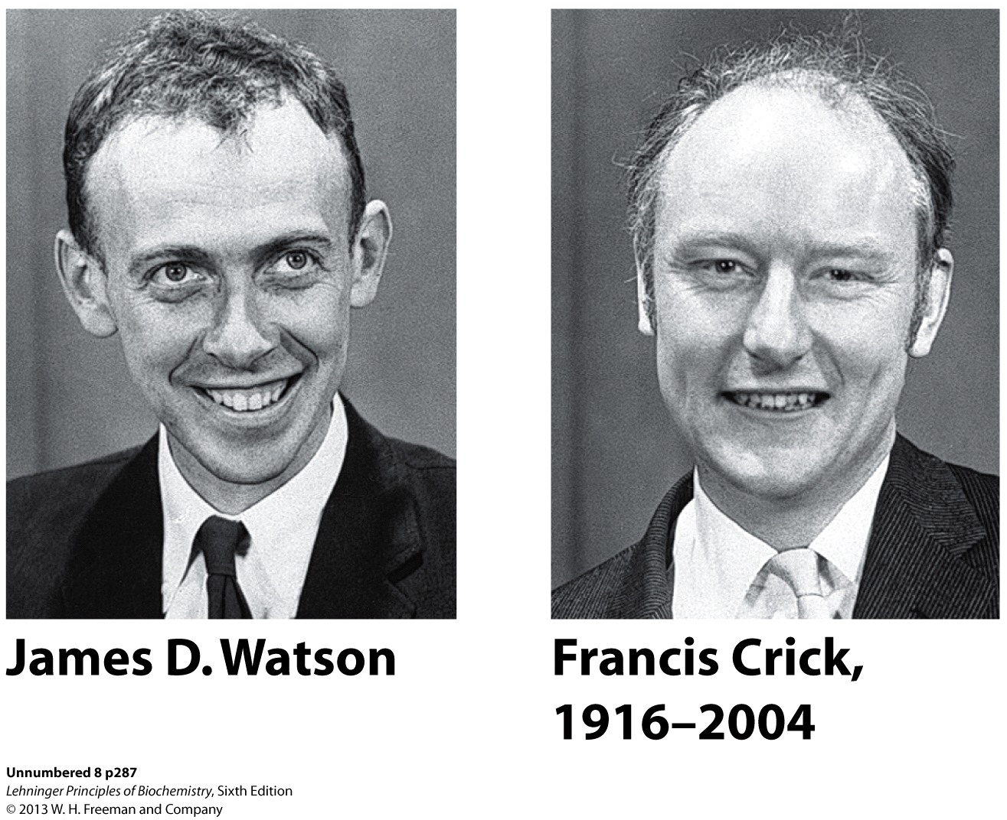
5. The Nobel Prize for Solving the Structure of DNA goes to…

Slide 43
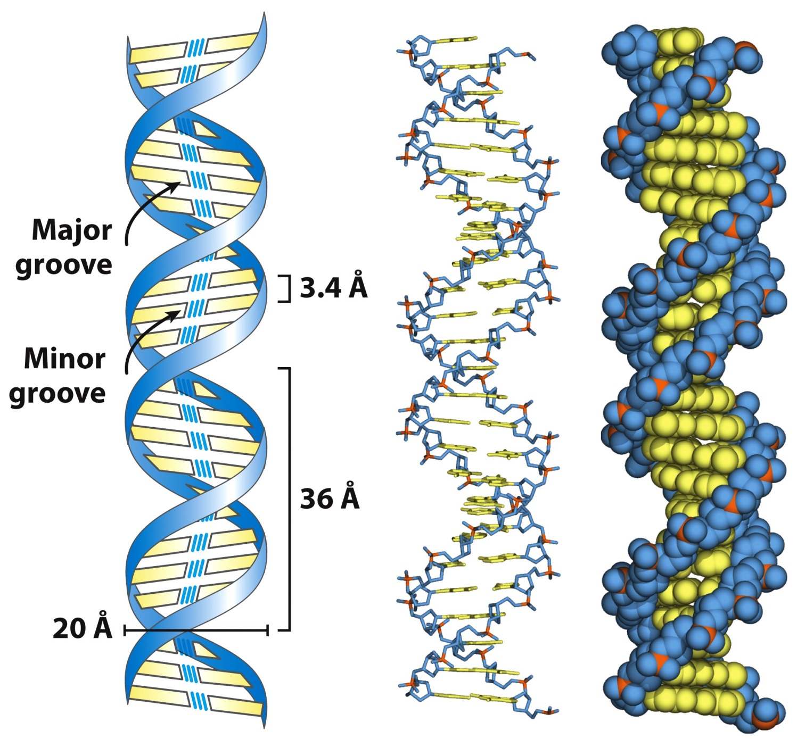
6. Watson-Crick Model of DNA

Slide 44
6. Watson-Crick Model of DNA
The DNA structure consists of:
Right-handed double helix
Hydrophilic backbone of alternating deoxyribose and phosphate groups faces outwards and interacts with H₂O
The furanose ring of each deoxyribose in the C-2’ endo conformation
The purine and pyrimidine bases, which are hydrophobic and relatively insoluble in water, stacked inside the double helix stabilized by hydrophobic interactions and perpendicular to the long axis

Slide 45
6. Watson-Crick Model of DNA
E. Base pairing occurs in which a nucleobase in one strand is paired in the same plane with a base on the other strand due to hydrogen bond interactions.
Purine pairs with a pyrimidine
A pairs with T
C pairs with G
The base pairing of the two strands creates a major groove and a minor groove on the surface of the duplex

Slide 46
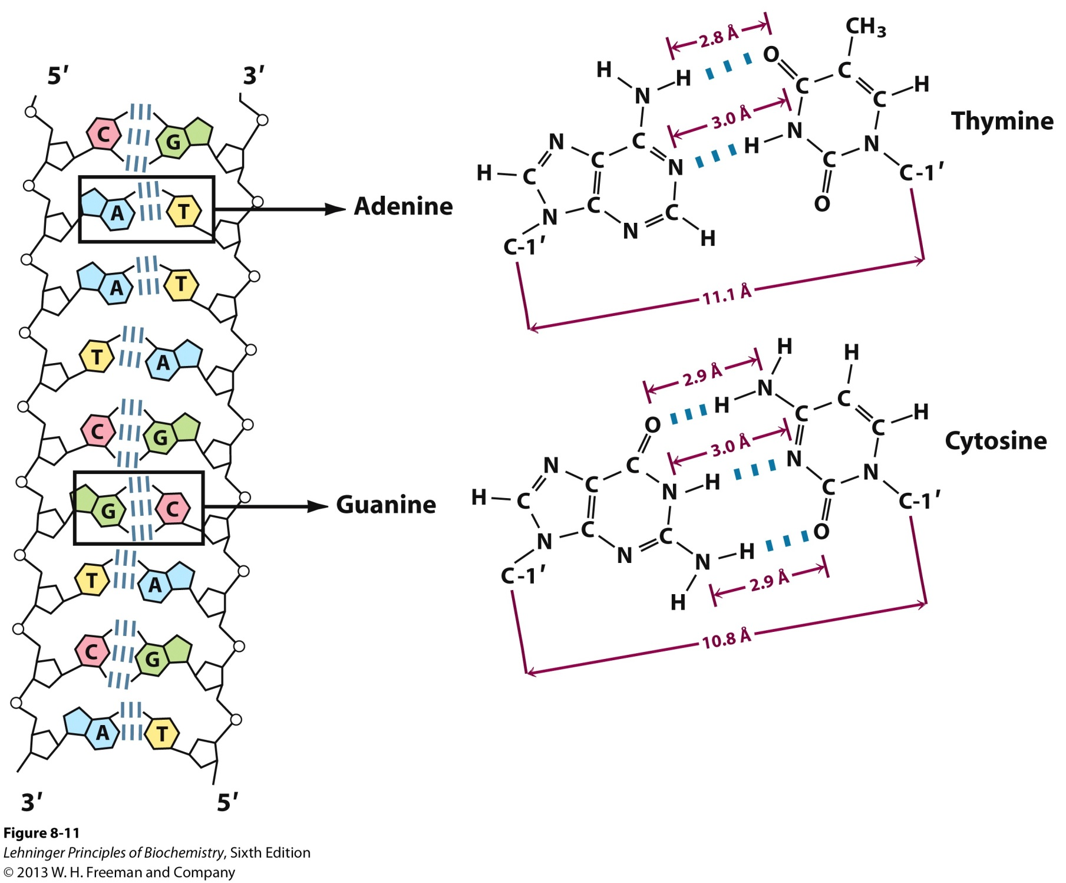
6. Watson-Crick Model of DNA

Slide 47
6. Watson-Crick Model of DNA
F. The DNA strands interact in an antiparallel orientation with the sequences being complementary to one another
5’-ATGCTA-3’
3’-TACGAT-5’
G. The stacked bases are 3.4 Å apart
H. Each turn of the helix (measured from one minor groove to the next minor groove)
Includes 10.5 base pairs stacked
Covers 36 Å

