Slide 1
Nucleic Acid Structure and Stability
Chapter 8 (Page 283-302)

Slide 2
Secondary Level of
Nucleic Acid Structure (DNA)

Slide 3
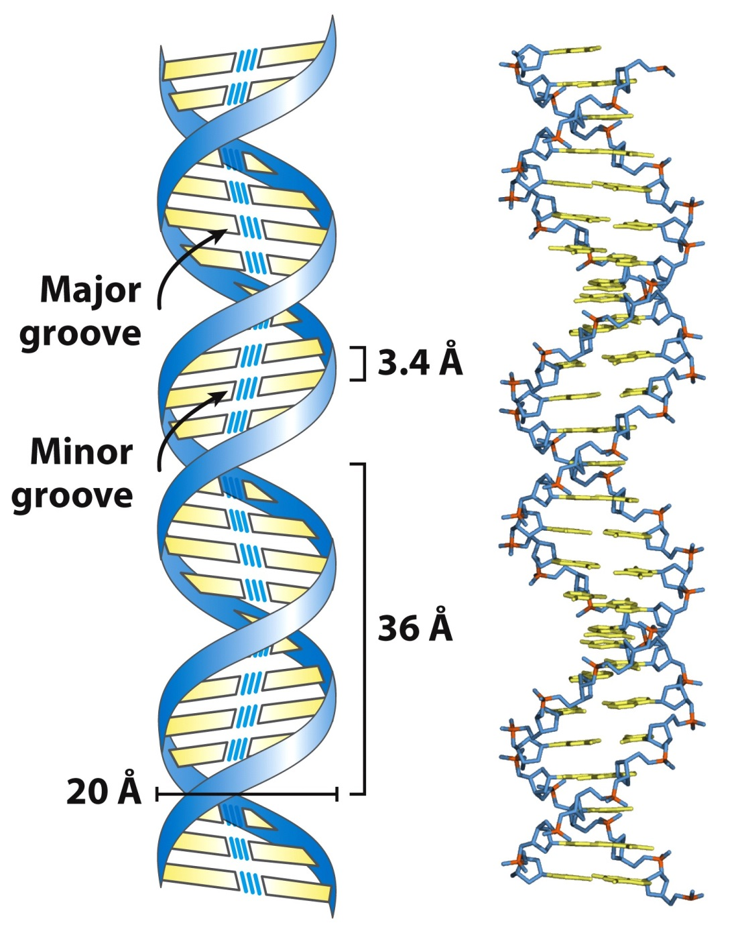
1. Watson-Crick Model of DNA

Slide 4
1I. Replication based on Watson-Crick Model of DNA
Strand separation occurs first.
Each strand serves as a template for the synthesis of a new strand specified by the base-pairing rules.
Synthesis is catalyzed by enzymes known as DNA polymerases.
Newly made DNA molecule has one daughter strand and one parent strand.

Slide 5
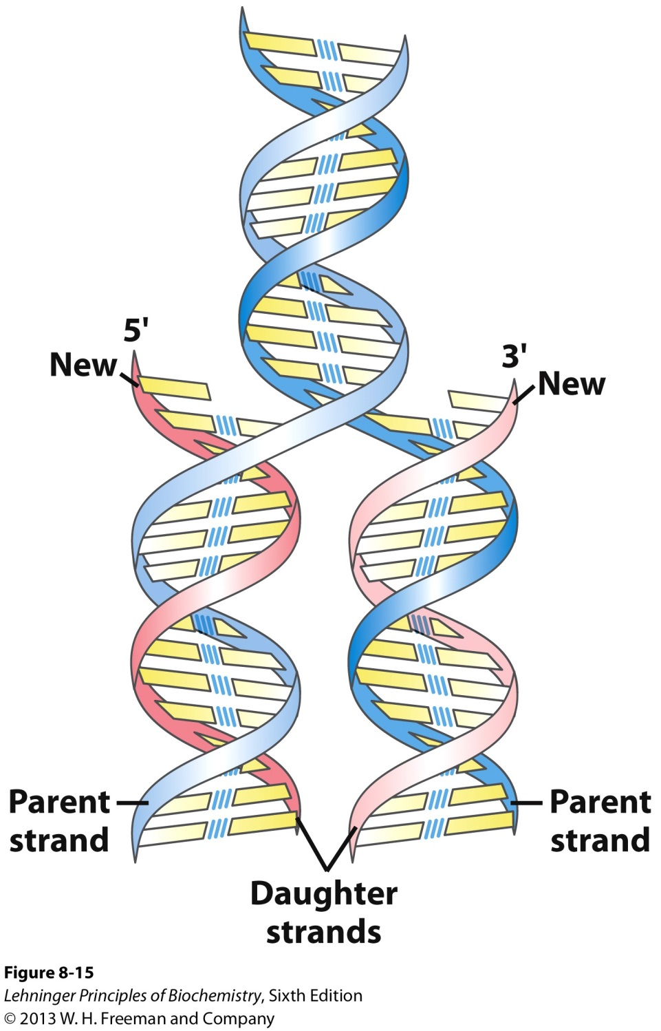
1I. Replication based on Watson-Crick Model of DNA

Slide 6
2. Structural Variants of DNA
There are two main classes of DNA structural variations.
Different three-dimensional forms due to nucleotide conformations.
Unusual DNA sequence structures.

Slide 7
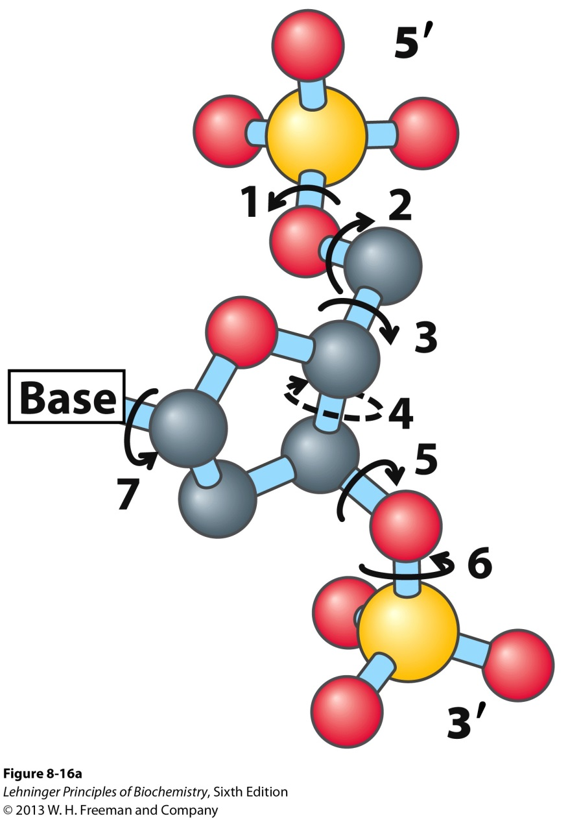
2I. DNA Structural Variations arising from Nucleotide Conformation
The conformation of a nucleotide in DNA is affected by rotation about seven different bonds.
Rotation around bond 7 results in different 3-D structures.
Restricted rotation around bond 4 results in ring-puckering (endo and exo conformations).

Slide 8
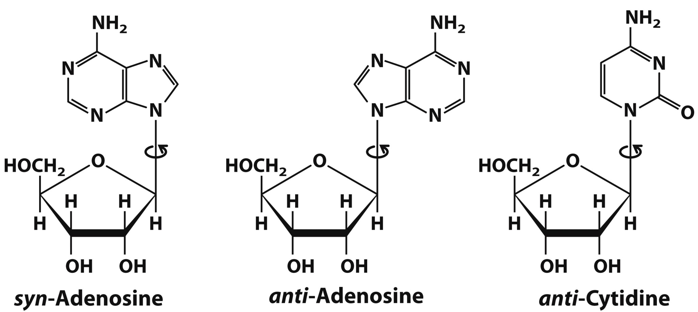
2Ib. Conformation of the Nucleobases.
For purine bases, only two conformations with respect to the attached ribose units are sterically permitted, anti and syn. Pyrimidines generally occur in the anti conformation due to steric hindrance between C-2 of the pyrimidine and the sugar.
2

Slide 9
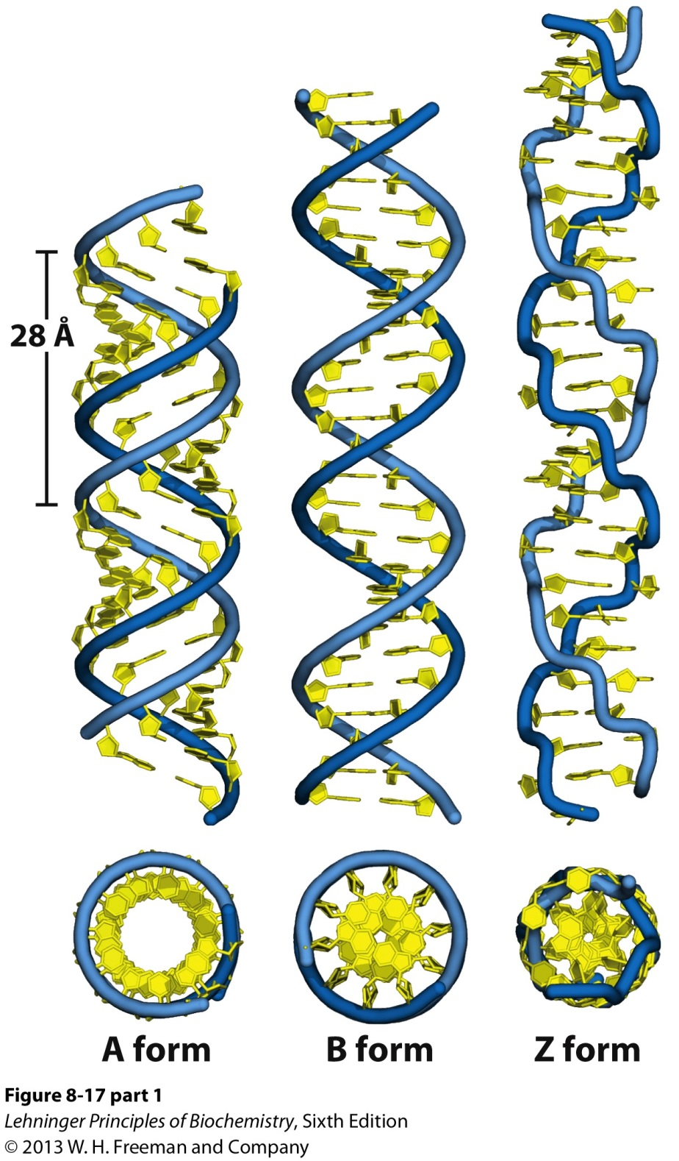
2Ic. A, B, and Z forms of DNA.
The Watson-Crick structure is referred to as the B-form DNA. This form is the most stable structure for a random-sequence DNA molecule under physiological conditions.

Slide 10
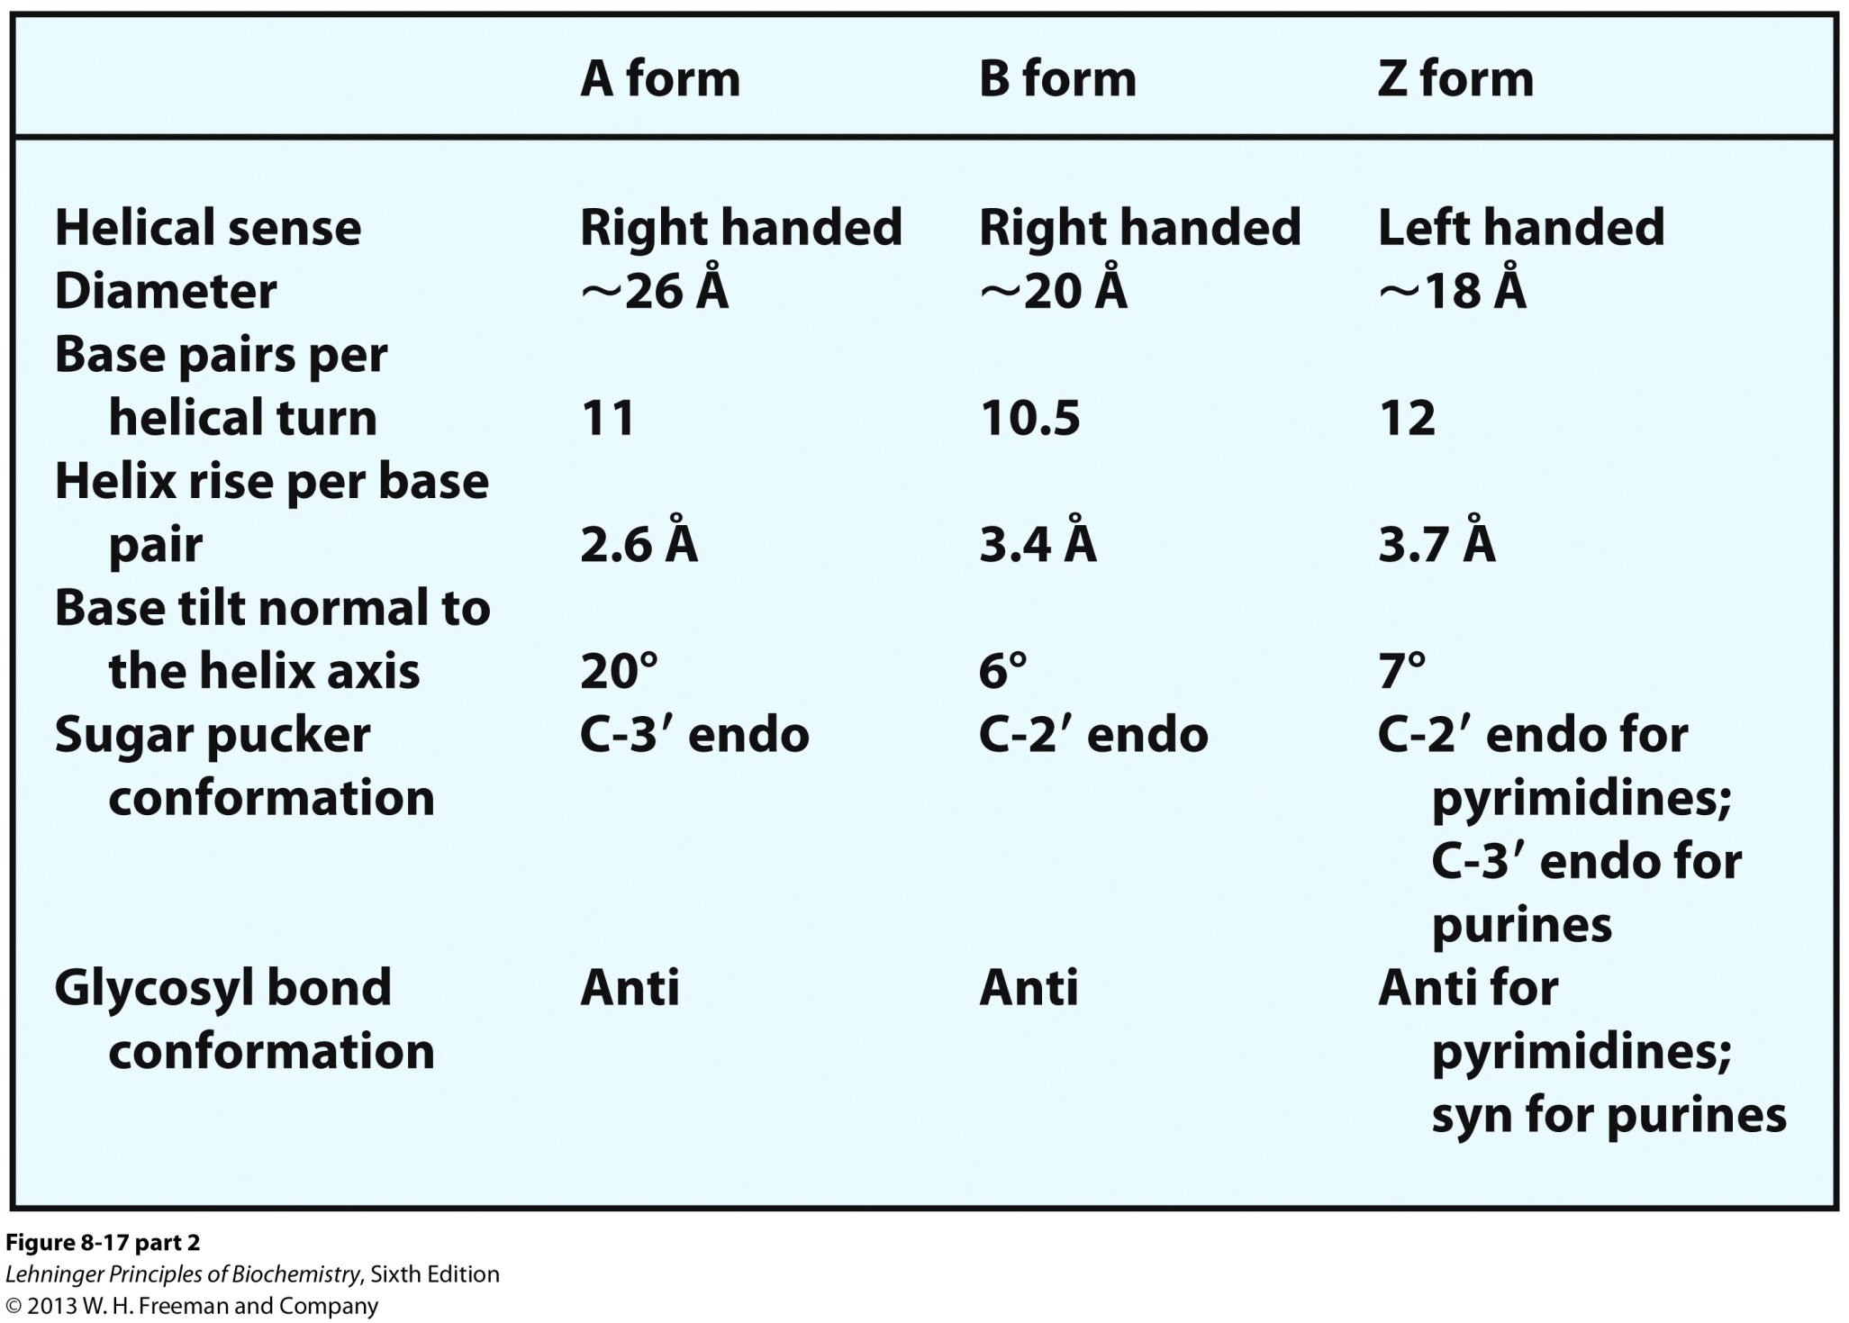
2Ic. A, B, and Z forms of DNA.

Slide 11
2Id. A form of DNA.
The right-handed A form is favored in nonaqueous solutions.
Most DNA crystallize in this form due to dehydration from crystallization methods.
The helix is wider than the B form and has 11 base pairs per helical turn (rather than 10.5).
The plane of the base pairs is tilted about 20° with respect to the helix axis.
Deeper major groove
Shallower minor groove

Slide 12
2Ie. Z form of DNA.
The backbone of the left-handed helix takes on a zigzag appearance and the structure is more slender and elongated.
There are 12 base pairs per helical turn.
Prominent form when pyrimidines alternate with purine, especially alternating C and G.
The purine adopts a syn conformation while the pyridimine is in the anti conformation.
The major groove is barely apparent but minor groove is deepen yet narrow.
Does exist in vivo though not abundantly.

Slide 13
2II. Unusual DNA Sequence Structures
Palindrome (word/phrase spelled identically read either forward or backward)
Sequence of double-stranded nucleic acid with inverted repeats of base sequence having twofold symmetry.
The sequence is superimposed by rotating 180° about the horizontal axis then 180° about the vertical axis.

Slide 14
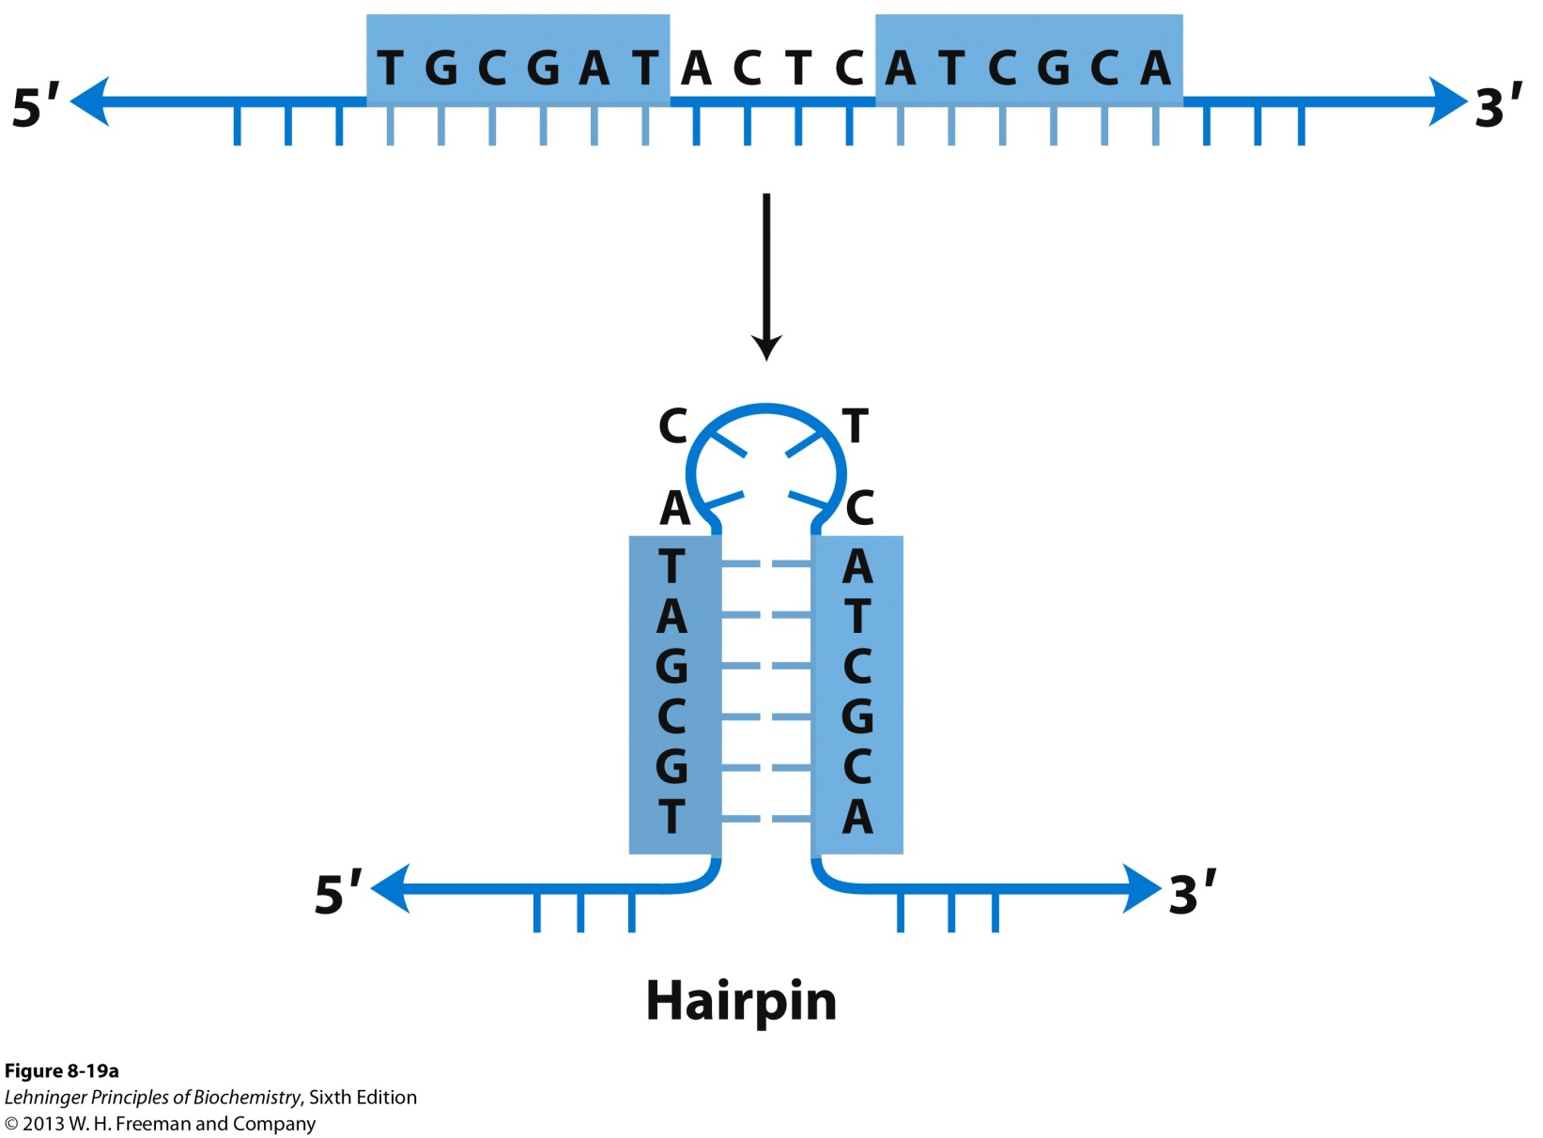
2II. Unusual DNA Sequence Structures
Such sequences are self-complementary within each strand and can form a hairpin

Slide 15
2II. Unusual DNA Sequence Structures
Or form a cruciform with two strands

Slide 16
2II. Unusual DNA Sequence Structures
B. Mirror repeat
Has a symmetric sequence within each strand.
Involves superimposition of one repeat on the other repeat by a single 180° rotation about the vertical axis.
Does not have complementary sequences within the same strand and can not form hairpins or cruciforms.

Slide 17
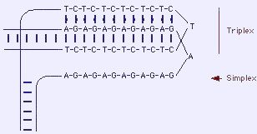
2II. Unusual DNA Sequence Structures
Present in H-DNA, a triplex DNA structure.

Slide 18
2II. Unusual DNA Sequence Structures
C. Triplex DNA
This structure appears during important DNA metabolic events (replication, recombination, transcription).
It contains a polypyrimidine or polypurine tract.
- Can consist of two pyrimidine strands with one purine strand or two purine strands with one pyrimidine strand.
Involves parallel and antiparallel strand base pairing.

Slide 19
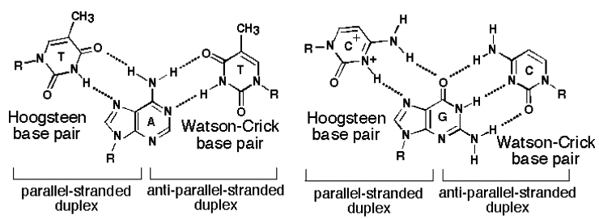
2II. Unusual DNA Sequence Structures
Hoogsteen pairing of the nucleobases occurs in these structures.

Slide 20
2II. Unusual DNA Sequence Structures
D. G tetraplex
Four-stranded helix
This structure occurs readily for DNA sequences with a very high proportion of guanosine residues.
The orientation of the strands can be antiparallel or all parallel.

Slide 21
Secondary Level of
Nucleic Acid Structure (RNA)

Slide 22
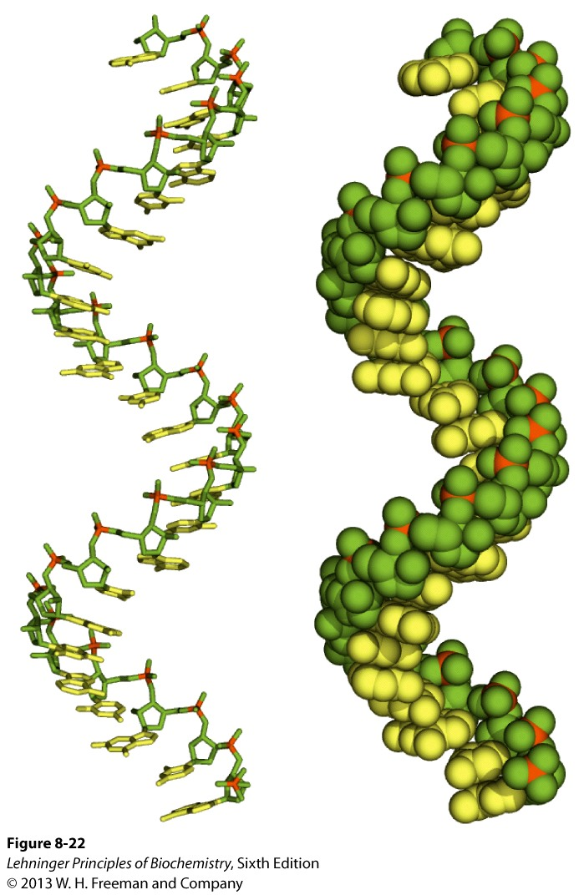
1. Single-stranded RNA

Slide 23
1. Single-stranded RNA
Transcription
Translation
DNA RNA Protein
Replication
The product of DNA transcription is always single-stranded RNA. RNA does not have a simple, regular secondary structure. Generally,
Right-handed helix dominated by base-stacking interactions.
Base-stacking is strongest between two purines.
A pyrimidine in between two purines is often displaced to enable the two purines to interact.

Slide 24
2. RNA can form a Double-Helix
RNA can base-pair with complementary regions of either RNA or DNA.
G-C
A-U (or the occasional T)
G-U (fairly common but a folding phenomenon)
The RNA double-helix takes on the A-form right-handed double helix.
B or Z forms have not been observed in vivo.

Slide 25
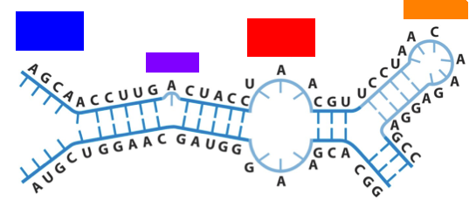
2. RNA can form a Double-Helix
Breaks in the A-form helix caused by mismatched or unmatches bases in one or both strands are common and result in bulges, internal loops, and hairpen loops.
Hairpen Loop
Internal Loop
Bulge

Slide 26
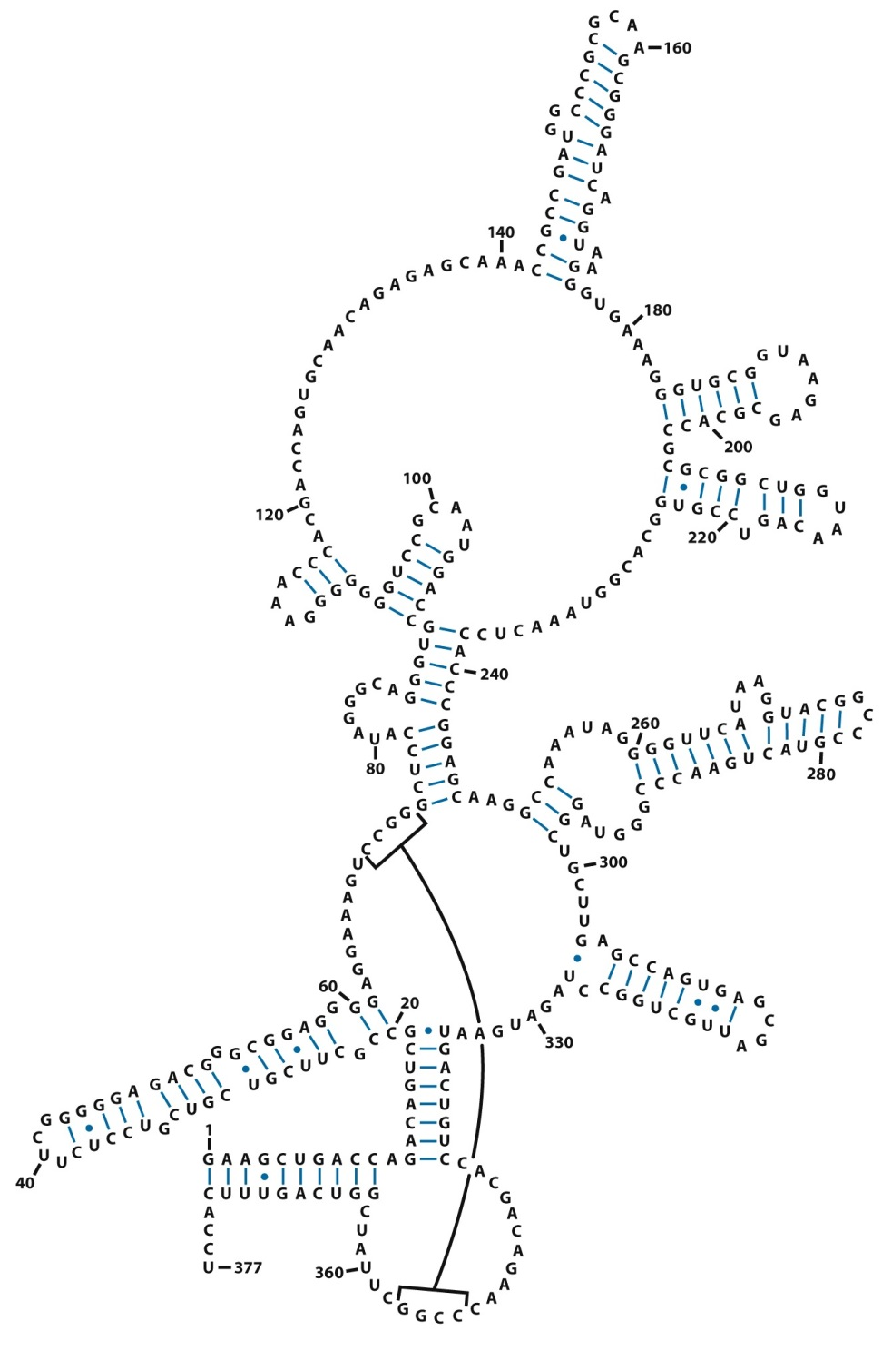
3. RNA can form Complex Structures
There are extensive base-paired helical structures in many RNAs.
The hairpins that result from these structures are the most common type of secondary structure in RNA.

Slide 27
Tertiary Level of
Nucleic Acid Structure (DNA)

Slide 28
1. Circular vs Linear DNA
DNA strands exist in double-helical structures in two forms:
Circular (Circular DNA) as is common in viruses, bacteria, and archaea. This form is also present in eukaryotic cells.
Linear (Linear DNA), which is the dominant form in humans.
Circular DNA
Linear DNA

Slide 29
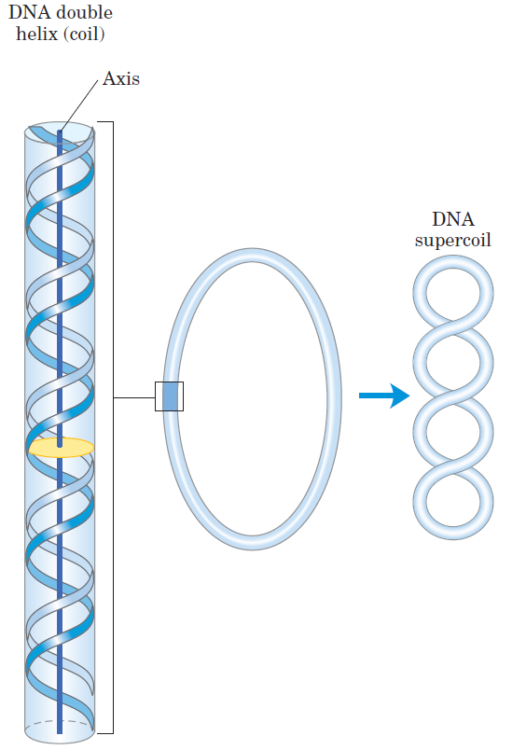
2. DNA Supercoiling
Cellular DNA is extremely compacted and requires a high degree of structural organization.
The folding mechanism must not only pack the DNA but also permit access to the information in the DNA.
The compact structure is achieved by supercoiling.
Relaxed State

Slide 30
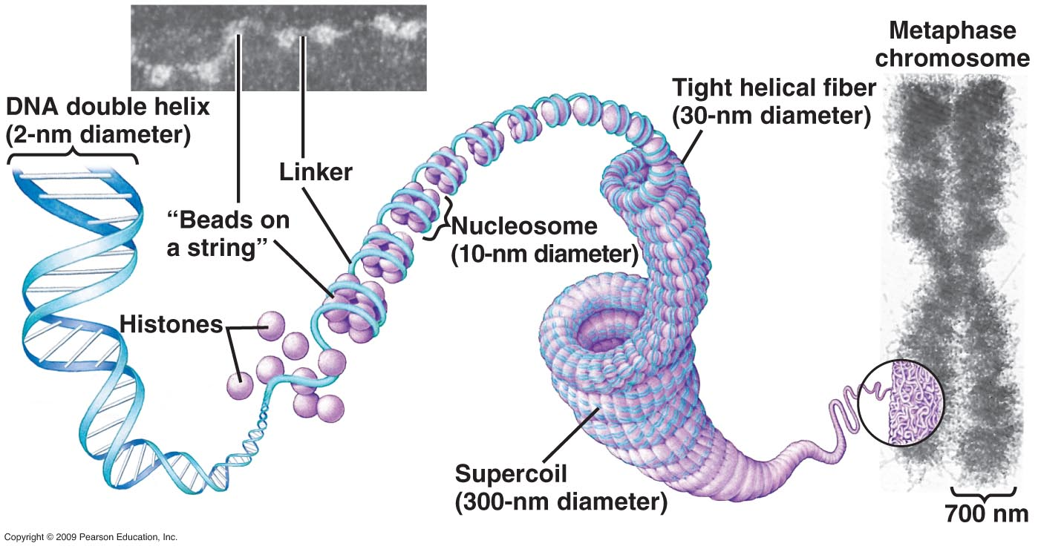
3. Compaction of DNA in a Eukaryotic Chromosome
The chromosome is a single large DNA molecule and its associated proteins, which stores and transmits genetic information.

Slide 31
4. Agarose Gels to Visualize DNA
Agarose gel electrophoresis is a method to determine the size of DNA but can also provide insight into DNA forms.
DNA migrates through a highly cross-linked agarose matrix in response to an electric field.
The phosphates on the DNA are negatively charged and the molecule migrates to the positively charged electrode.
Three factors affect migration rate
Size of the DNA (measured in # of base pairs (BP))
Conformation of the DNA
Ionic strength of the running buffer

Slide 32
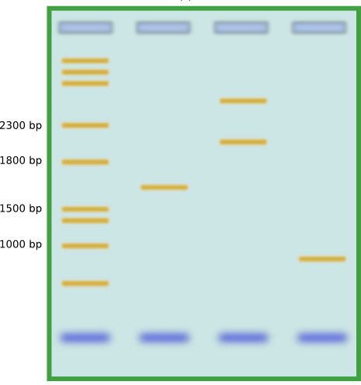
4. Agarose Gels to Visualize DNA
MW Ladder
DNA is typically visualized via ethidium bromide (EtBr) staining.
- EtBr is a DNA intercalator.

Slide 33
4. Agarose Gels can Distinguish DNA Forms
DNA conformation will affect migration rate through agarose gels.
Relaxed forms of DNA travel more slowly through the gel. With the circular form traveling slower than linear form.
Supercoiled form travels the fastest.
A restriction enzyme can be used to cut DNA at a specific site to linearize it.

Slide 34
5. DNA Isolation, Purification, and Identification
Unlike protein isolation and purification, the process is more straightforward for DNA samples
Standard centrifugation protocols can be used to isolate high quality DNA samples from organisms (lysates).
DNA isolation can be confirmed by agarose gels and the DNA can be purified from the gels using standard kits.
DNA sequence can be identified by traditional protocols such as the Sanger method.
DNA cloning can be used to amplify DNA content.

Slide 35
Nucleic Acid Stability

Slide 36
1. Inherent Stability of DNA
The role of DNA as a repository of genetic information depends on its inherent stability. This stability can be evaluated in terms of:
Denaturation
Nonenzymatic Transformations
Very slow reactions can have a significant affect on DNA structure/function

Slide 37
2. DNA Denaturation
Denaturation can be induced by high temperature or change in pH. The process is not uniform and involves:
Covalent bonds remaining intact
Therefore the genetic code remains intact
Hydrogen bonds breaking
This results in the two strands separating
Disruption of base stacking
The close interaction between stacked bases of stable DNA interferes with their UV absorbing abilities leading to a hypochromic effect- a decrease in their absorption
Denaturation results in an increase in the UV absorbance (hyperchromic effect)

Slide 38
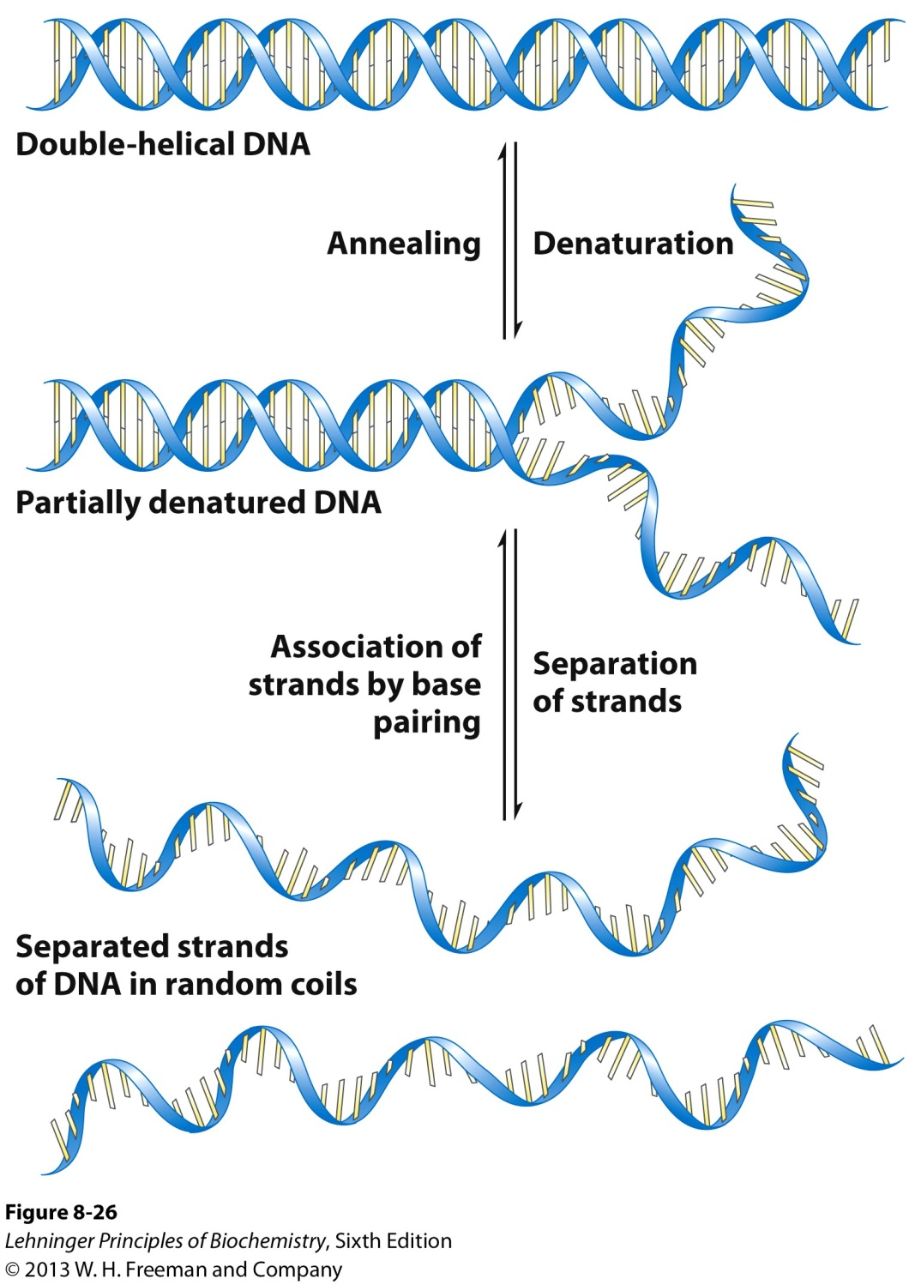
2. DNA Denaturation

Slide 39
2. DNA Denaturation
D. Renaturation is the reverse of denaturation
A rapid one-step process called annealing as long as part of the double-strand remains intact.
If the double-strand is not intact then the process is two-step, with the first being a relatively slow step in which complementary strand pairing occurs via random collisions.

Slide 40
2I. Thermal DNA Denaturation (Melting)
DNA exists as a double helix at physiological temperatures.
The two DNA strands dissociate at elevated temperatures.
The strands re-anneal when temperature is lowered.
The reversible thermal denaturation and annealing form basis for the polymerase chain reaction.
DNA denaturation is commonly monitored by UV spectroscopy at 260 nm.
RNA duplexes and RNA-DNA hybrids can also be denatured.

Slide 41
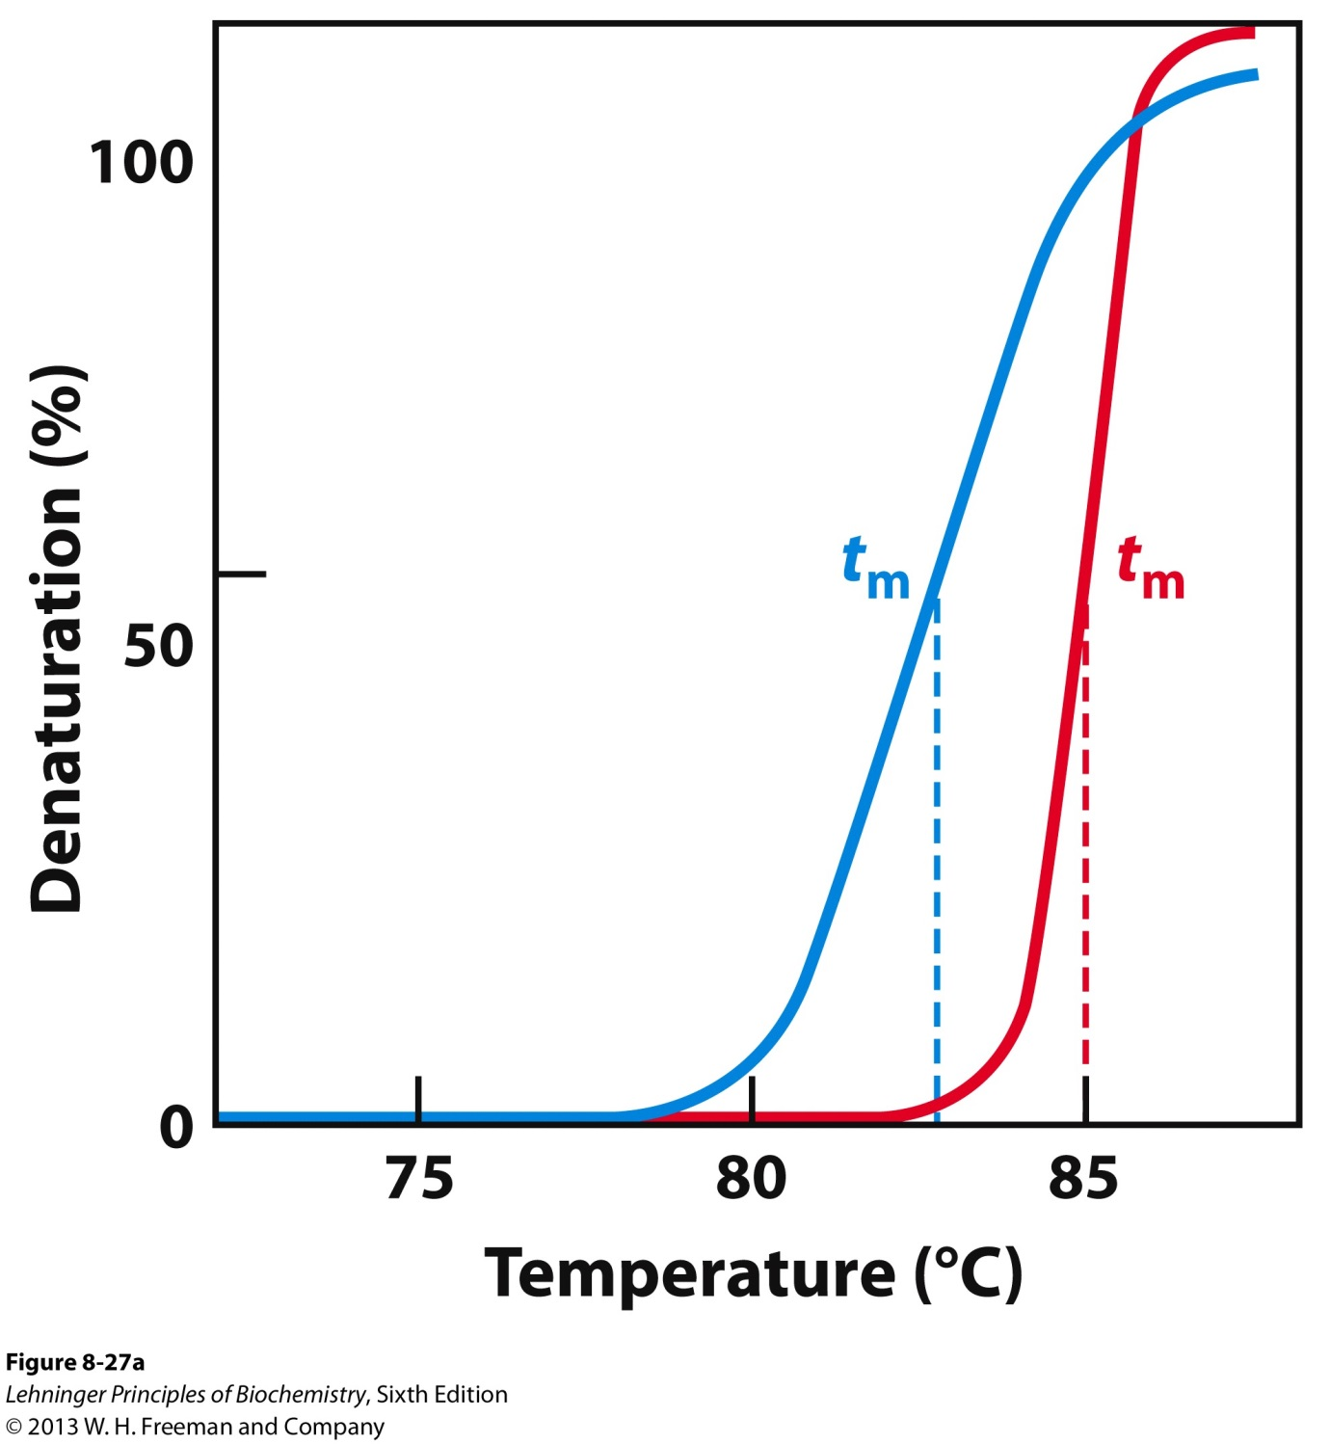
2I. Thermal DNA Denaturation (Melting)

Slide 42
2II. Factors Affecting DNA Denaturation
A. The midpoint of melting (T_{m})depends on DNA length
Longer DNA has higher T_{m}
B. T_{m} depends on pH and ionic strength
High salt increases T_{m}
C. T_{m} depends on base composition
High CG increases T_{m}
AT rich regions melt first

Slide 43
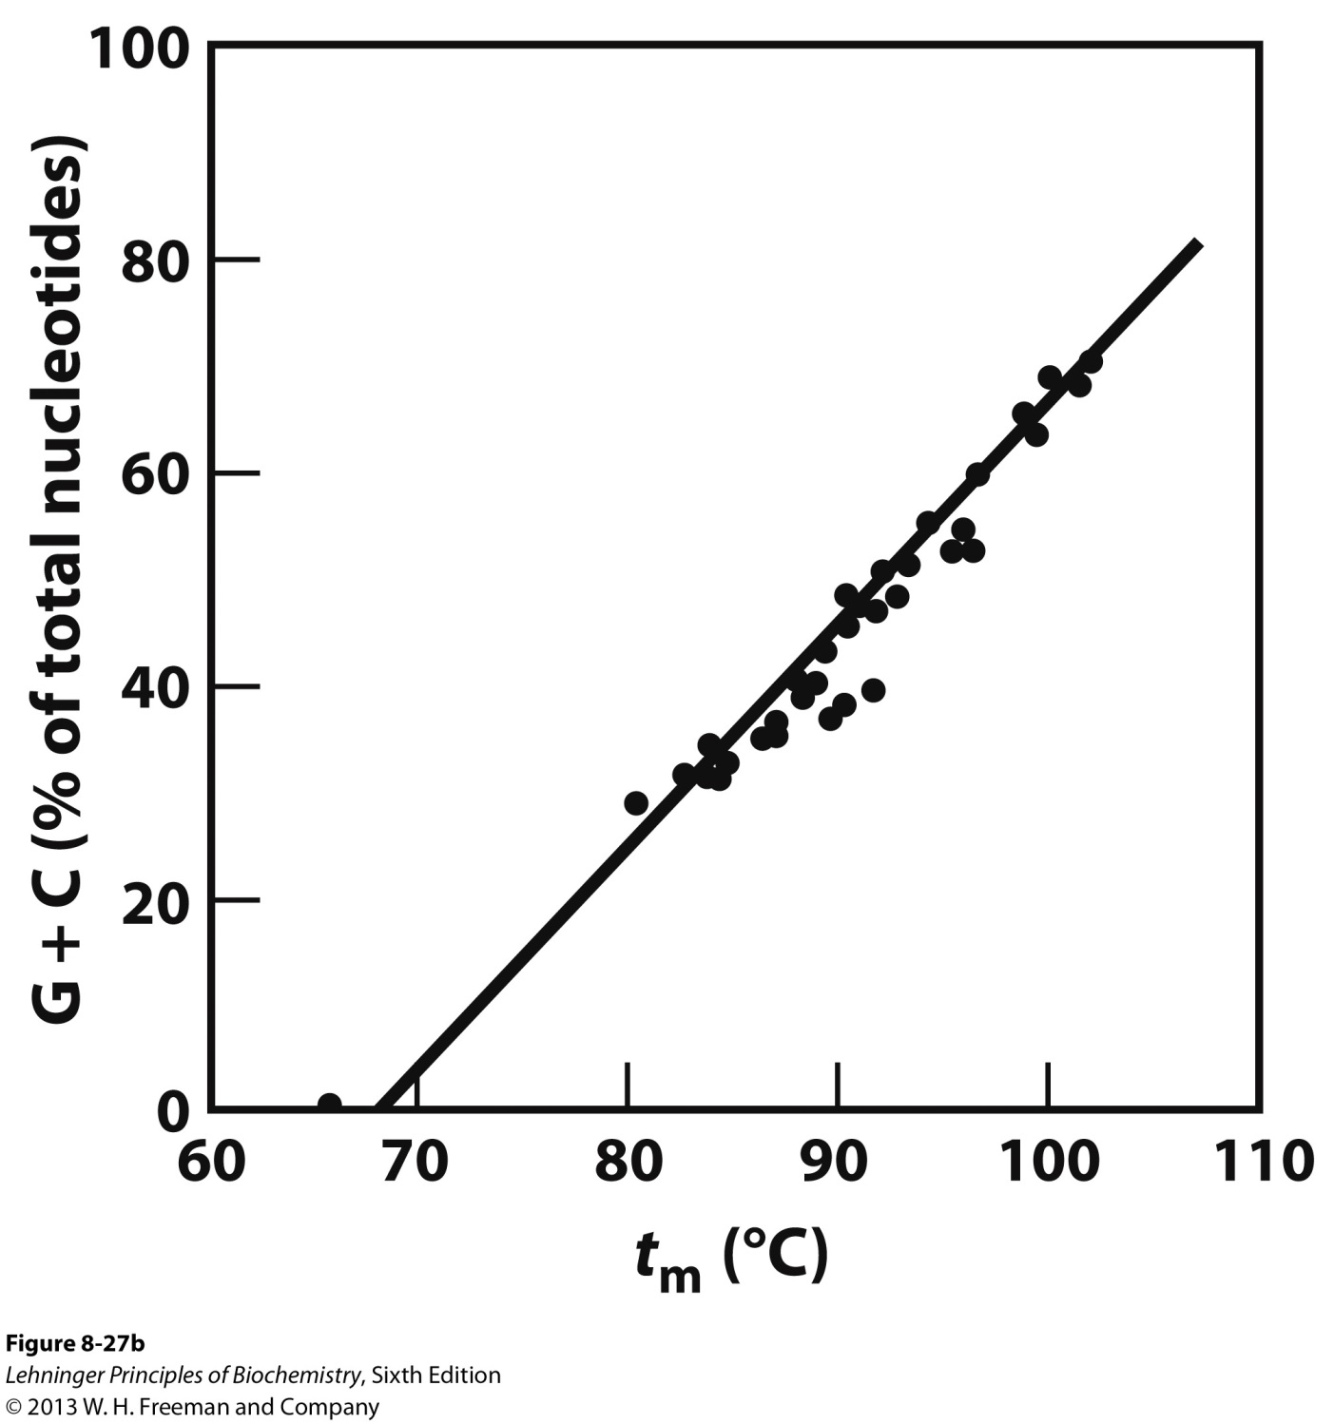
2II. Factors Affecting DNA Denaturation

Slide 44
2III. DNA Hybridization via Renaturation
The ability of two complementary DNA strands to pair with one another as DNA hybrids
Reveals evolutionary relationships
The closer the evolutionary relationship between two species, the more extensively their DNAs will hybridize
Enables modern molecular genetics techniques
Polymerase chain reaction
Site-directed mutagenesis

Slide 45
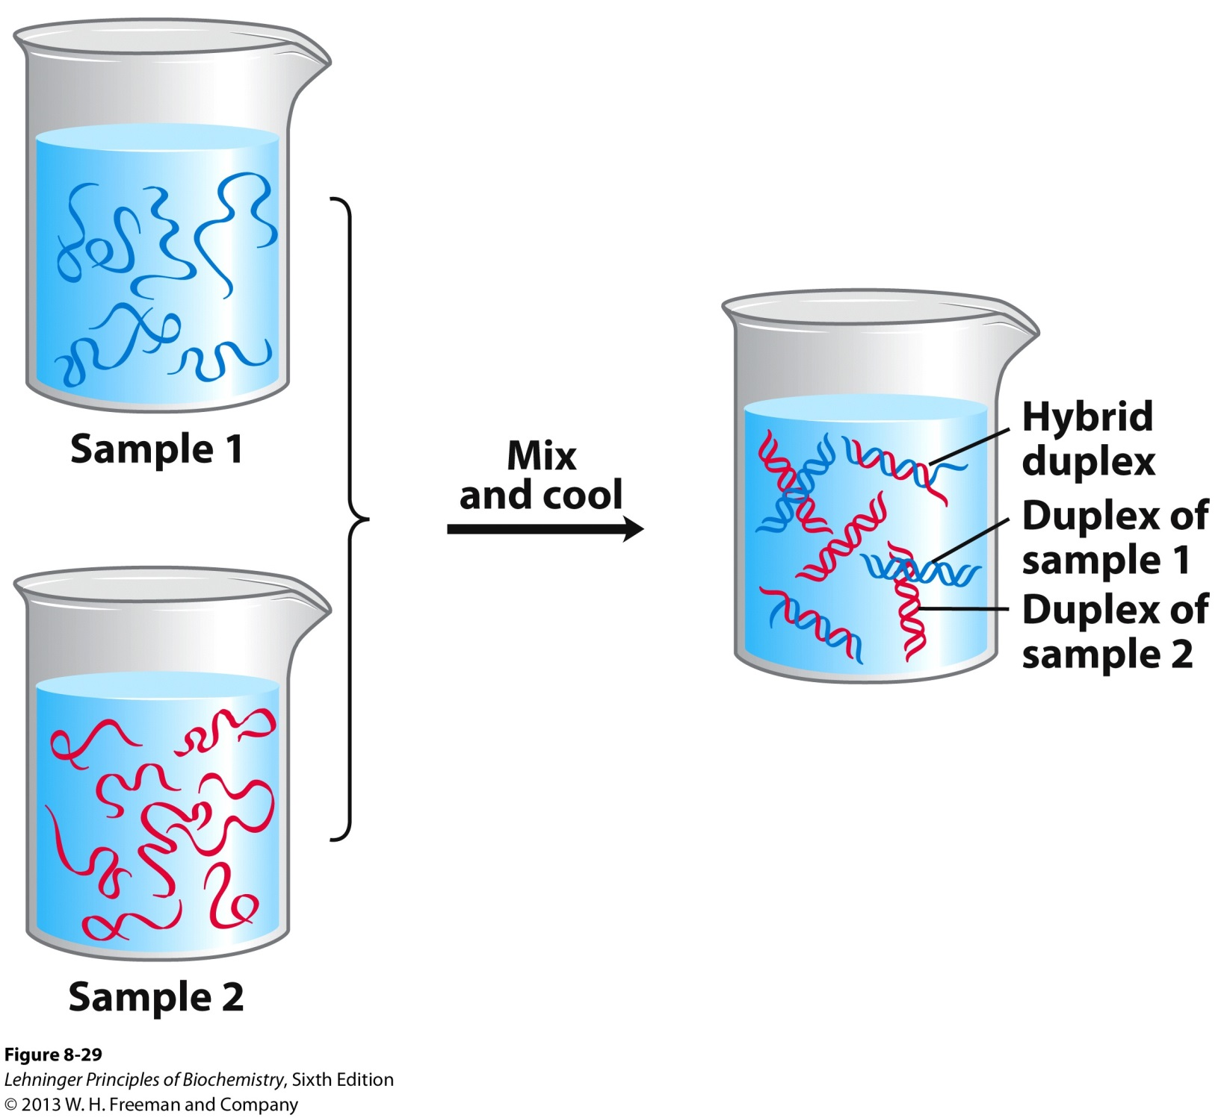
2III. DNA Hybridization via Renaturation

Slide 46
3. Nonenzymatic Transformations
Spontaneous Mutagenesis:
A. Deamination
Very slow reactions
Large number of residues
The net effect is significant: 100 C → U events /day in a mammalian cell
B. Depurination
N-glycosidic bond is hydrolyzed
Significant for purines: 10,000 purines lost/day in a mammalian cell
Fortunately, cells have mechanisms to correct most of these modifications.

Slide 47
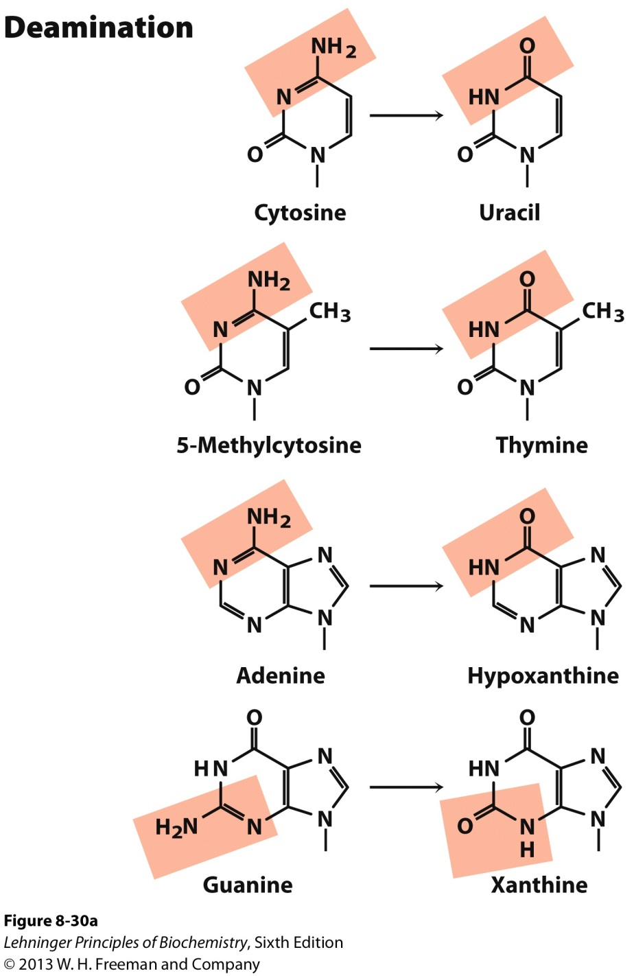
3. Nonenzymatic Transformations

Slide 48
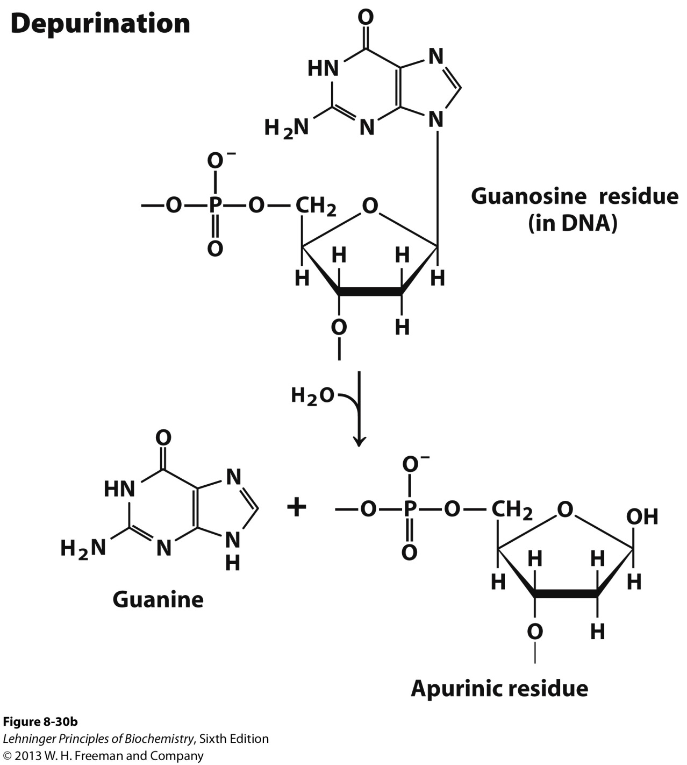
3. Nonenzymatic Transformations

Slide 49
3. Nonenzymatic Transformations
Radiation-Induced Mutagenesis:
A. UV light induces dimerization of pyrimidines, which cause kinks in DNA structure. This effect is the main mechanism for skin cancers.
B. Ionizing radiation (X-rays and γ-rays) causes ring opening and strand breaking .
Cells can repair some of these modifications, but others cause permanent and detrimental mutations. Accumulation of these type of mutations is linked to aging and carcinogenesis.

Slide 50
Nucleotide Functions

Slide 51
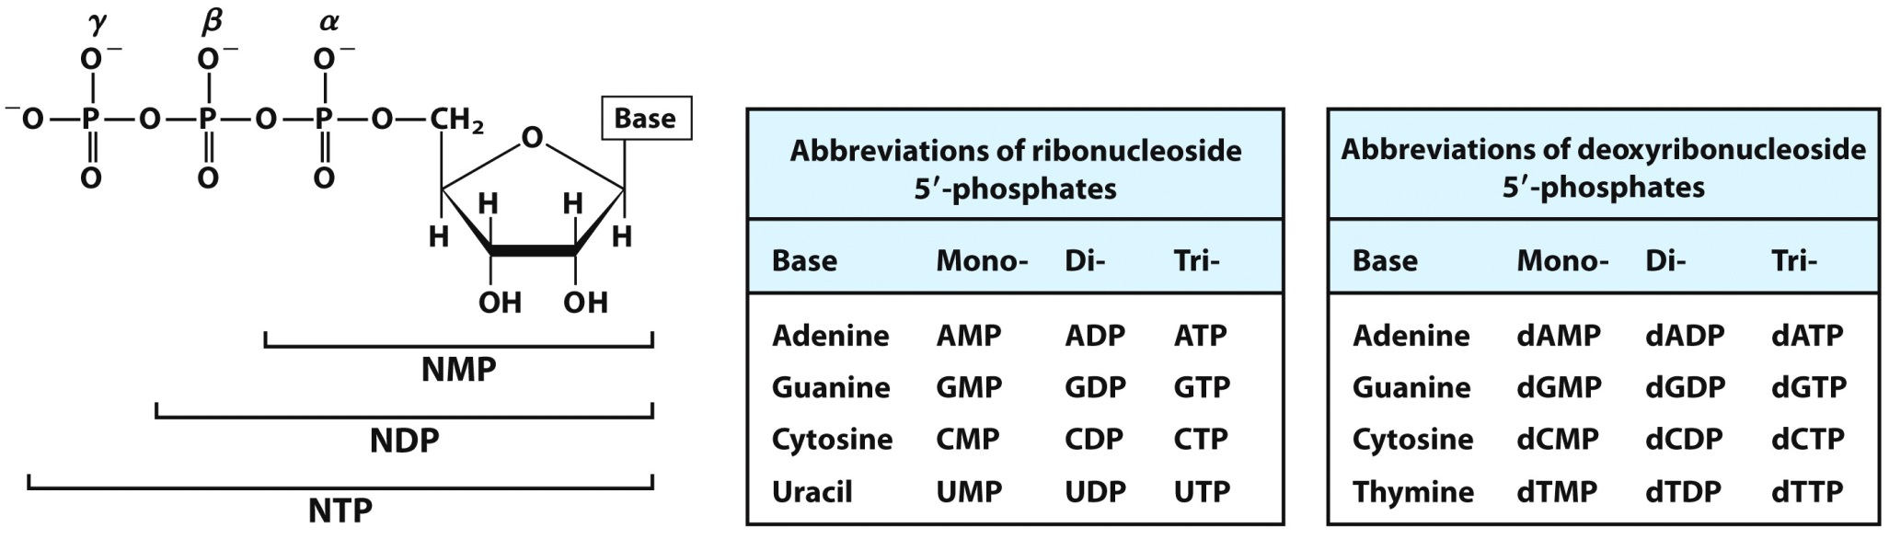
1. Nucleotides Carry Chemical Energy
Nucleotides can have one or more additional phosphate groups and are referred to as nucleoside mono-, di- and triphosphates.
Hydrolysis yields
14 kJ/mol
Hydrolysis yields
30 kJ/mol
Significant energy is released by hydrolysis of nucleoside triphosphates (typically ATP).

Slide 52
2. Nucleotides are Components of Enzyme Cofactors
A variety of enzyme cofactors serving a wide range of chemical functions include adenosine as part of their structure.

Slide 53
2. Nucleotides as Regulatory Molecules
Cells respond to external chemical signals through cell surface receptors. Within the interior of the cell, nucleotides behave as second messengers leading to adaptive changes in response to the external stimuli.

