Slide 1
The Genetic Code and
DNA Cloning/Protein Expression
Chapter 9 (Page 306-321)

Slide 2
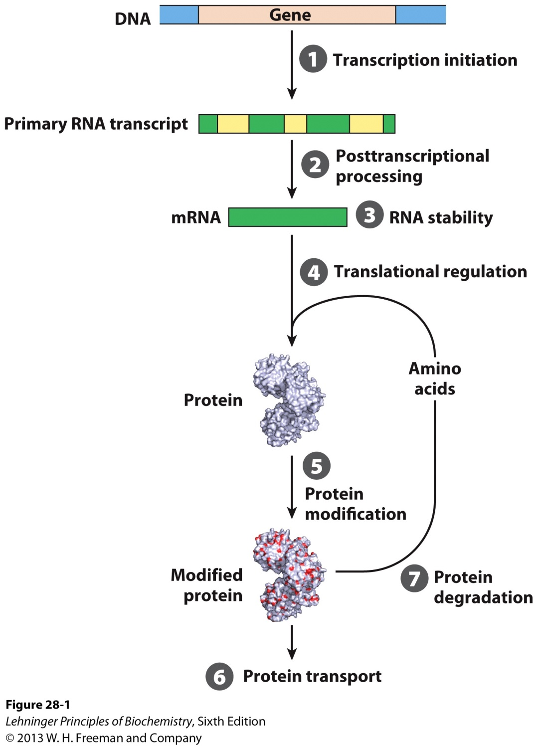
1. From DNA to Protein

Slide 3
2. The Genetic Code
Transcription
Translation

Slide 4
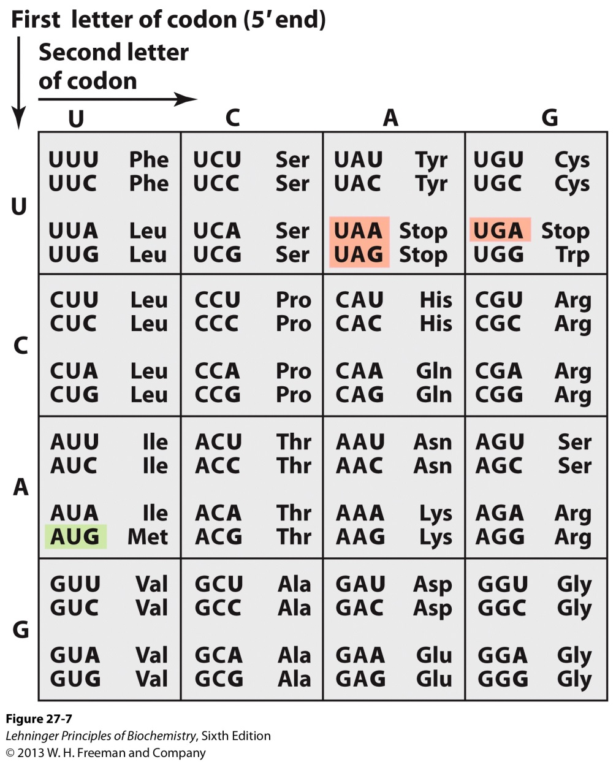
2A. The Nucleotide Code Dictionary
Three nucleotides define a codon.
More than one codon specify all AA except Met and Trp.
Certain codons are important for protein expression.
Start Codon: AUG
Stop Codon: UAA
UAG
UGA

Slide 5
Workflow for
Amplifying a Specific DNA Gene and
Expressing Protein from the Gene

Slide 6
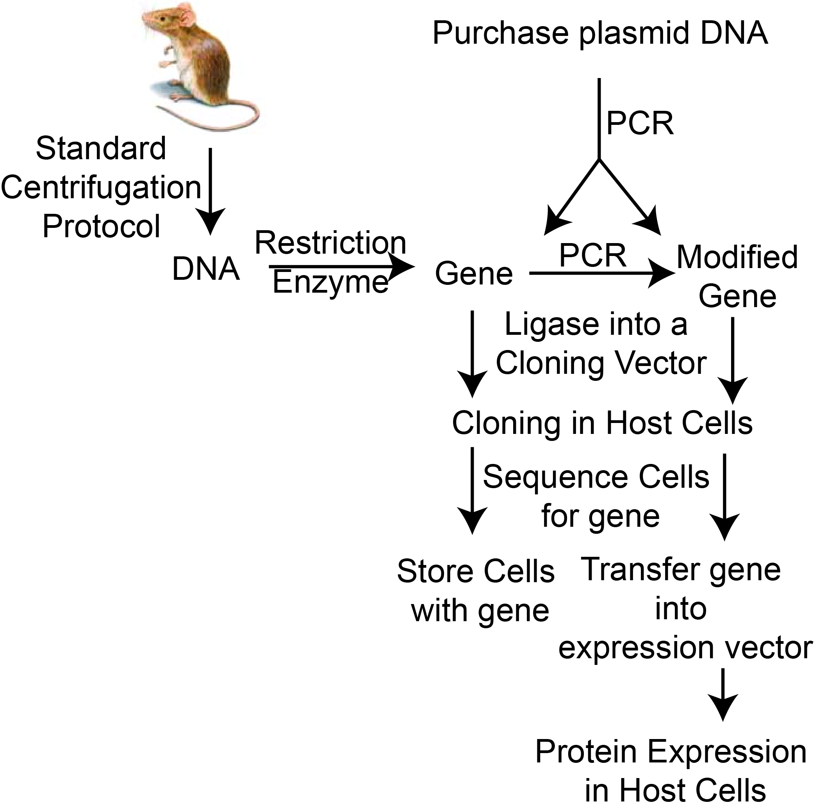
Standard Gene-Protein Expression Workflow
*

Slide 7
1. DNA Cloning
DNA cloning is the amplification of a particular gene or DNA segment by:
Separating a specific gene or DNA segment from a larger chromosome.
Attaching the gene to a small molecule of carrier DNA.
Replicating this modified DNA millions of times through increase in cell number and the creation of multiple copies of the cloned DNA in each cell.

Slide 8
2. Essential Tools for DNA Cloning
Some Enzymes Used in DNA Cloning
Enzyme(s) | Function
Type II restriction endonucleases | Cleave DNA at specific base sequences
DNA ligase | Joins two DNA molecules or fragments
DNA polymerase | Fills gaps in duplexes by stepwise addition of nucleotides to 3’ ends

Slide 9
3. Six General Procedures for DNA Cloning
There are six general procedures that are involved in this process.
Cutting DNA at precise locations using sequence-specific endonucleases commonly called restriction enzymes.
Selecting a small molecule of DNA called cloning vectors, which are capable of self-replication.
Covalently joining the DNA of interest with the cloning vector via DNA ligase to form recombinant DNA.

Slide 10
3. Six General Procedures for DNA Cloning
Transferring recombinant DNA into a host cell.
Let the host produce multiple copies of recombinant DNA.
Identify the host cells that contain recombinant DNA.

Slide 11
3. Six General Procedures for DNA Cloning

Slide 12
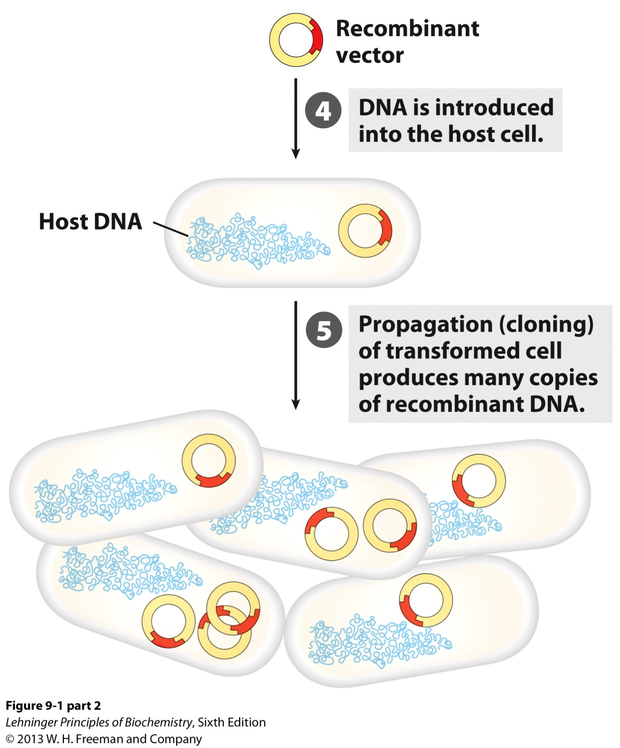
3. Six General Procedures for DNA Cloning
6
Store Cells with Recombinant DNA
Check Host Cell for Recombinant DNA

Slide 13
DNA Cloning for Protein Expression

Slide 14
1. Modify DNA Gene for Protein Expression
DNA cloning for protein expression requires modification of the gene using the nucleotide code for guidance.
Modify the gene of interest so that it includes recognition sequences in the gene for restriction enzymes that would enable the gene to be inserted into the cloning vector and expression vector.
Include another recognition sequence in the gene that would enable the gene to be recognized by the expression machinery of the expression host cell.
Also include nucleotide sequences that signal the initiation and termination of protein expression.

Slide 15
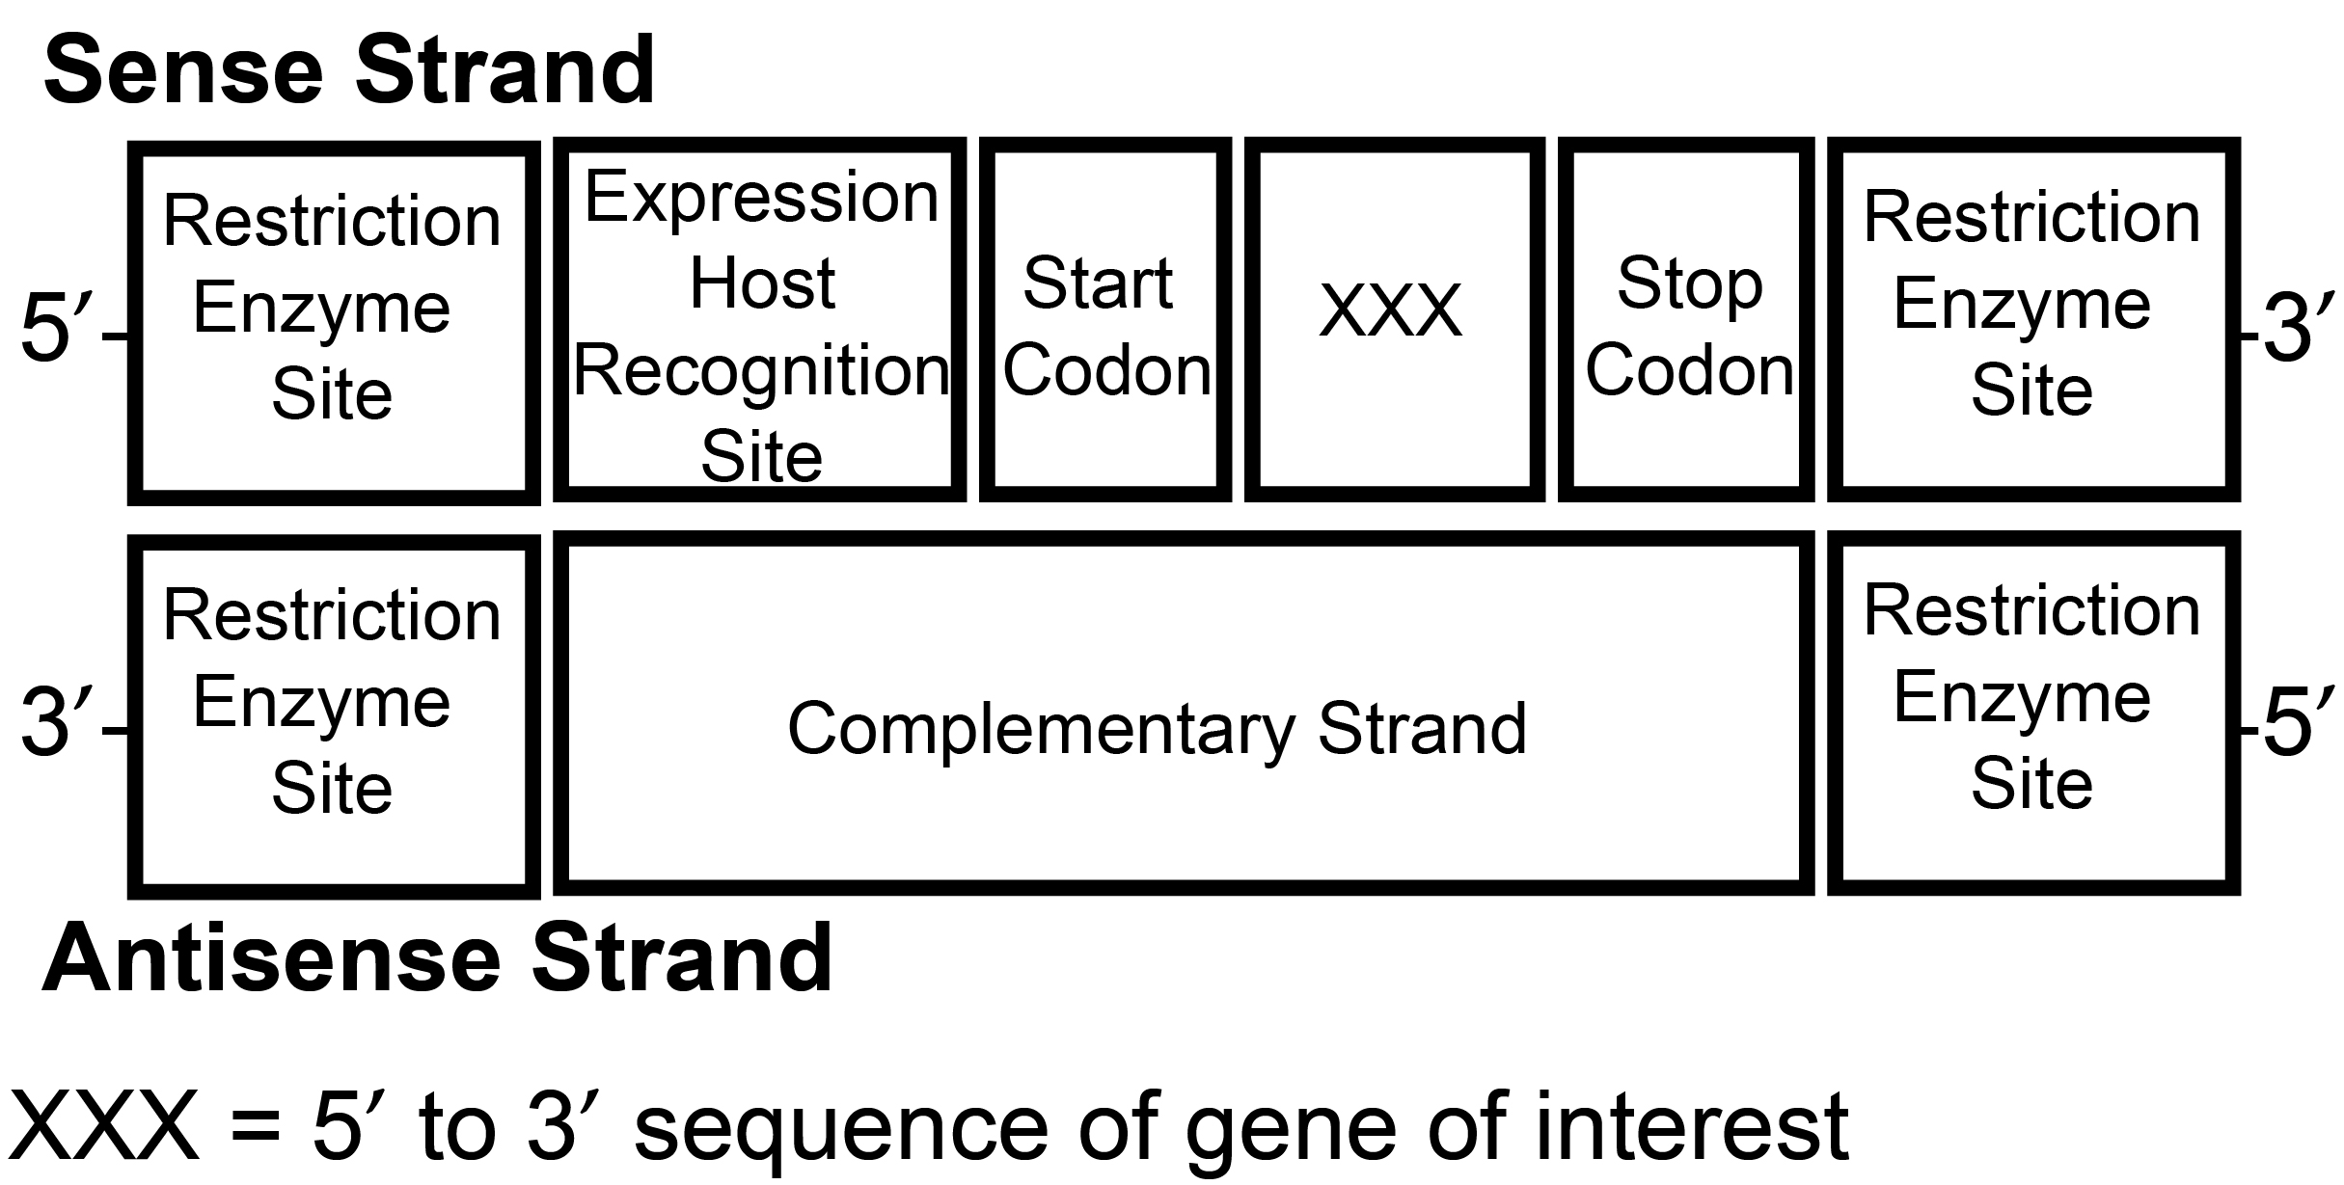
1A. The Modified Gene
General Depiction of the Modified Gene:

Slide 16
1A. The Modified Gene
A. The sense strand of the gene (5’ to 3’ sequence) must have the appropriate sequences to facilitate cloning and protein expression.
The sense strand (coding strand) has the same sequence as the mRNA.
The antisense strand (template strand) is the template for transcription.
B. The polymerase chain reaction (PCR) can be used to create the modified gene.

Slide 17
2. Restriction Endonucleases (Restriction Enzymes)
Cleave DNA phosphodiester bonds at specific sequences
Common in bacteria
Used by bacteria to eliminate infectious viral DNA
Some make staggered cuts
Called sticky ends
Some make straight cuts
Called blunt ends
Large number are known
Several are commercially available

Slide 18
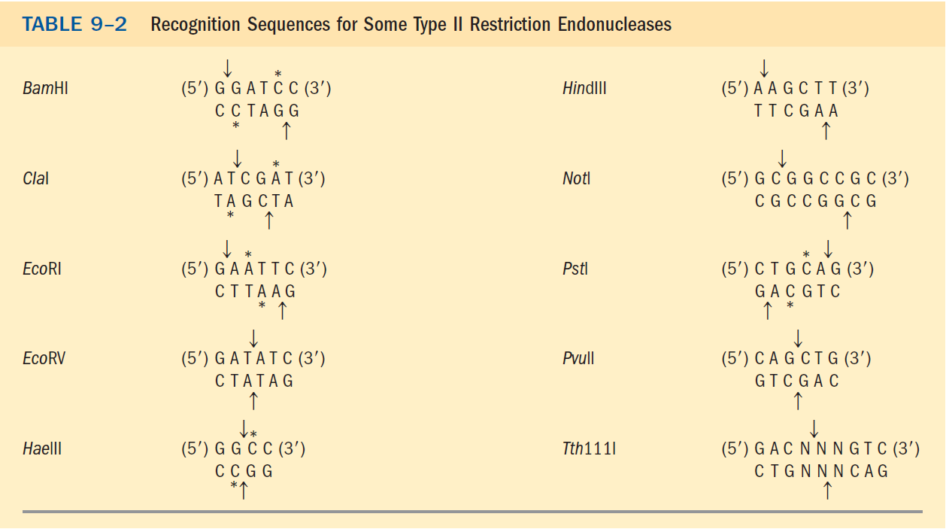
2. Restriction Endonucleases (Restriction Enzymes)
Arrows indicate site where phosphodiester bonds are cleaved.
* Indicates site of methylation by DNA methylase.

Slide 19
2. Restriction Endonucleases (Restriction Enzymes)

Slide 20
2. Restriction Endonucleases (Restriction Enzymes)
The base-pairing complementary sticky ends greatly facilitates the ligation reaction.
Blunt ends ligate less efficiently.

Slide 21
3. DNA Ligase
Enzyme that covalently joins two DNA fragments
Normally functions in DNA repair
Human DNA ligase uses ATP
Bacterial DNA ligase uses nicotinamide adenine dinucleotide (NAD⁺)

Slide 22
4. Cloning Vectors
The choice of vector to clone DNA depends on the size of DNA.
Plasmids
Circular DNA molecules that are separate from the bacterial genomic DNA
Can replicate autonomously
- Origins of replication for use in bacteria and/or yeast
Carry antibiotic resistance genes
Allows cloning of DNA up to 15,000 bp

Slide 23
4. Cloning Vectors
To clone whole chromosomes (up to 300,000 bp)
Bacterial Artificial Chromosome (BAC)
For use in bacteria
Yeast Artificial Chromosome (YAC)
For use in yeast

Slide 24
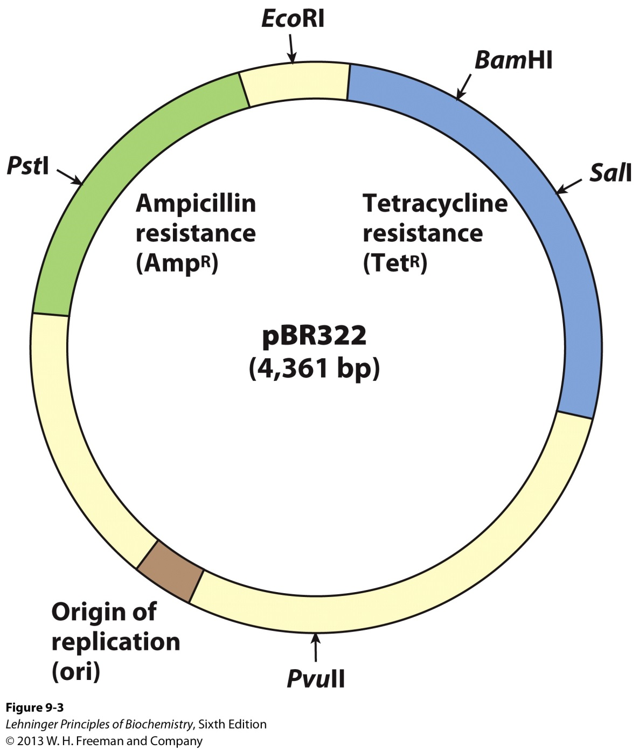
4A. Plasmid pBR322

Slide 25
4A. Plasmid pBR322
pBR322 has an origin of replication (ori), a sequence where replication is initiated by cellular enzymes.
The plasmid contains two genes that confer resistance to different antibiotics (tetracycline and ampicillin) to allow identification of the plasmid in host cells.
Antibiotics kill bacteria
Plasmids with certain antibiotics resistance allows growth (selection) of bacteria that have taken up the plasmid on plates made with the antiobiotics.

Slide 26
4A. Plasmid pBR322
Several unique recognition sequences (i.e. EcoRI) are targets for different restriction endonucleases, providing sites where the plasmid can later be cut to insert foreign DNA.
The small size of the plasmid (4,361 bp) facilitates its entry into cells and the biochemical manipulation of the DNA.

Slide 27
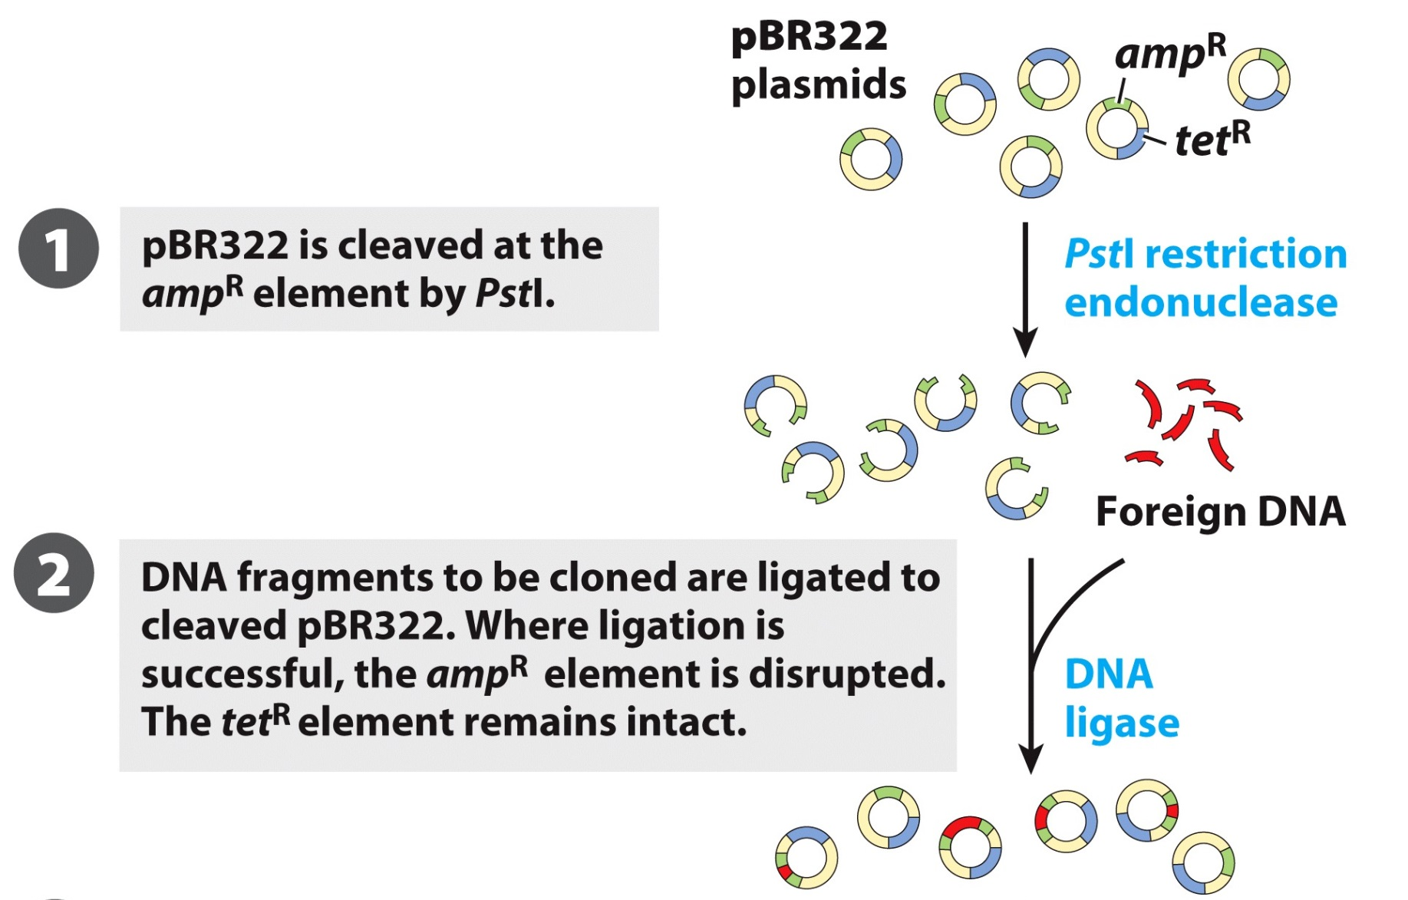
4AI. Transformation of Plasmid pBR322

Slide 28
4AI. Transformation of Plasmid pBR322

Slide 29
4AI. Transformation of Plasmid pBR322
The process by which recombinant DNA enters a host cell is called transformation.
One approach is by cooling the cells and DNA at 0 °C in a calcium chloride solution and then heat shocking the cells at 42 °C for five minutes.
Another approach is subjecting the cells and DNA to a high-voltage pulse called electroporation.

Slide 30
4AII. Identification of Empty Plasmids

Slide 31
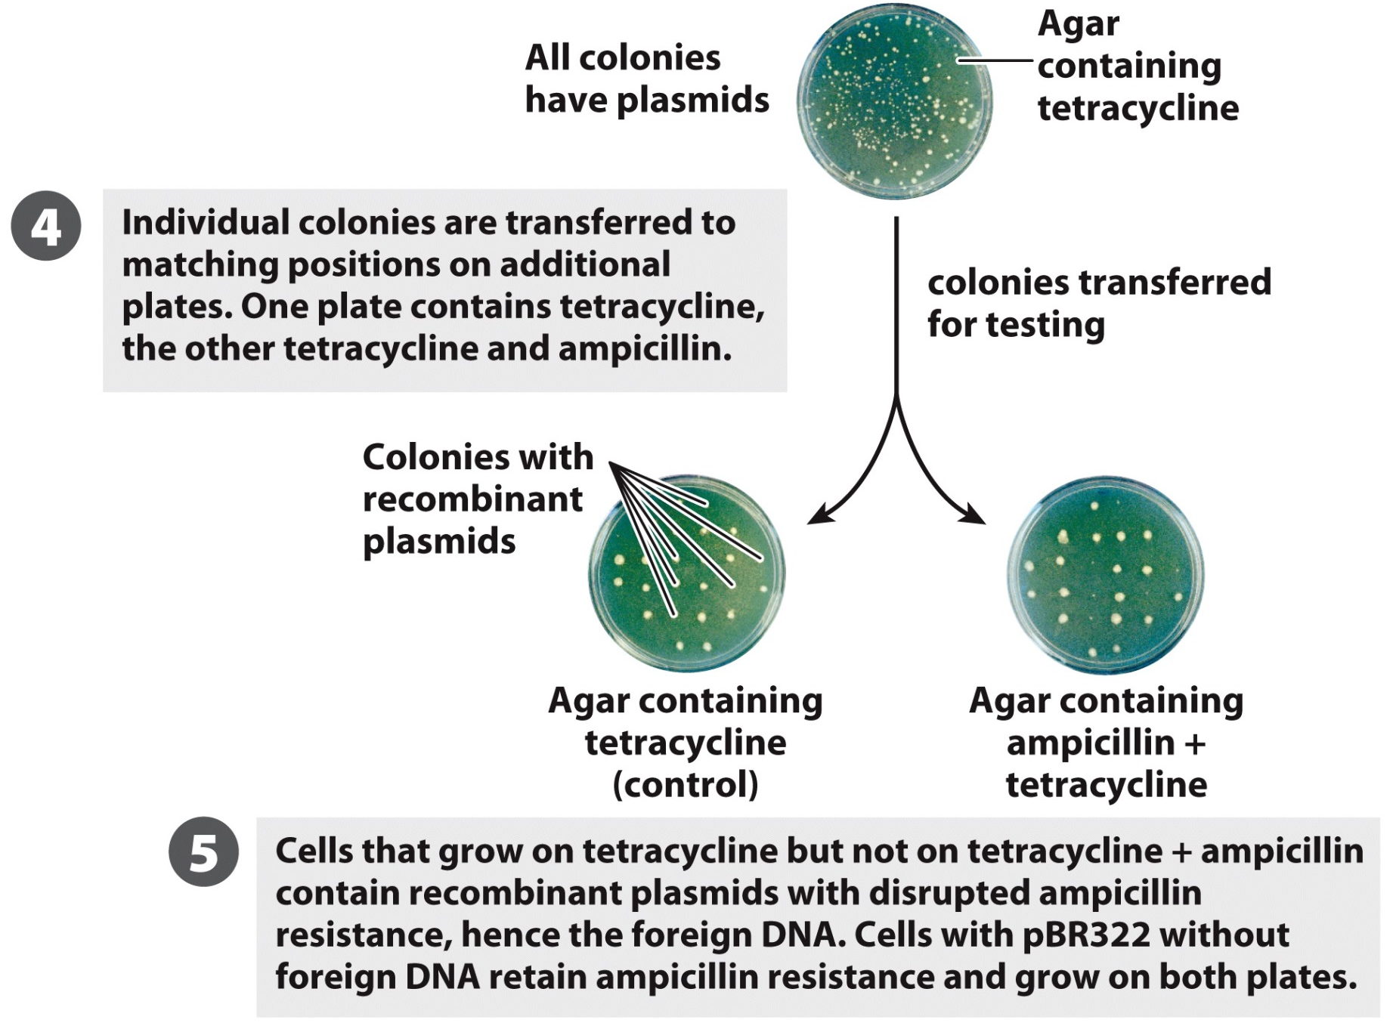
4AII. Identification of Empty Plasmids

Slide 32
4B. Bacterial Artificial Chromosomes
BACs are simply plasmids designed for the cloning of very long segments (up to 300,000 bp) of DNA.
They generally include selectable markers such as sites for antiobiotic resistance (typically chloramphenicol) and origin of replication.

Slide 33
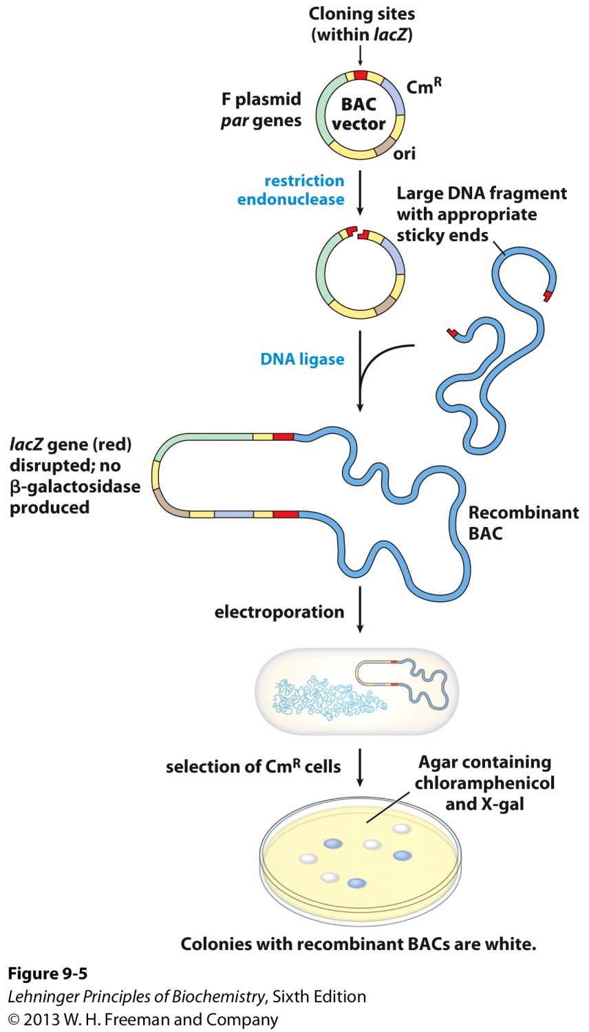
4B. Bacterial Artificial Chromosomes

Slide 34
4C. Yeast Artificial Chromosomes
YACs include:
Origin of replication.
Two selectable markers.
Specialized telomeric sequences needed for stability.

Slide 35
4C. Yeast Artificial Chromosomes
The telomeric ends protect the vector.

Slide 36
4C. Yeast Artificial Chromosomes

Slide 37
5. DNA Confirmation
DNA Ladder
Sample
Use restriction enzyme to separate gene from vector.
Run DNA sample on agarose gel.
Cut out band corresponding to the gene.
Purify and sequence DNA (Sanger Method).

Slide 38
6. Expression of Cloned Genes
To study the protein product of the gene it is necessary to remove the gene from the cloning vector.
Special plasmids, called expression vectors, contain sequences that allow transcription of the gene. The gene can be inserted with the appropriate digestion of the vector and ligase.
Expression vectors differ from cloning vectors by having:
Promoter sequences
Operator sequences
Code for ribosome binding site
Transcription termination sequences

Slide 39
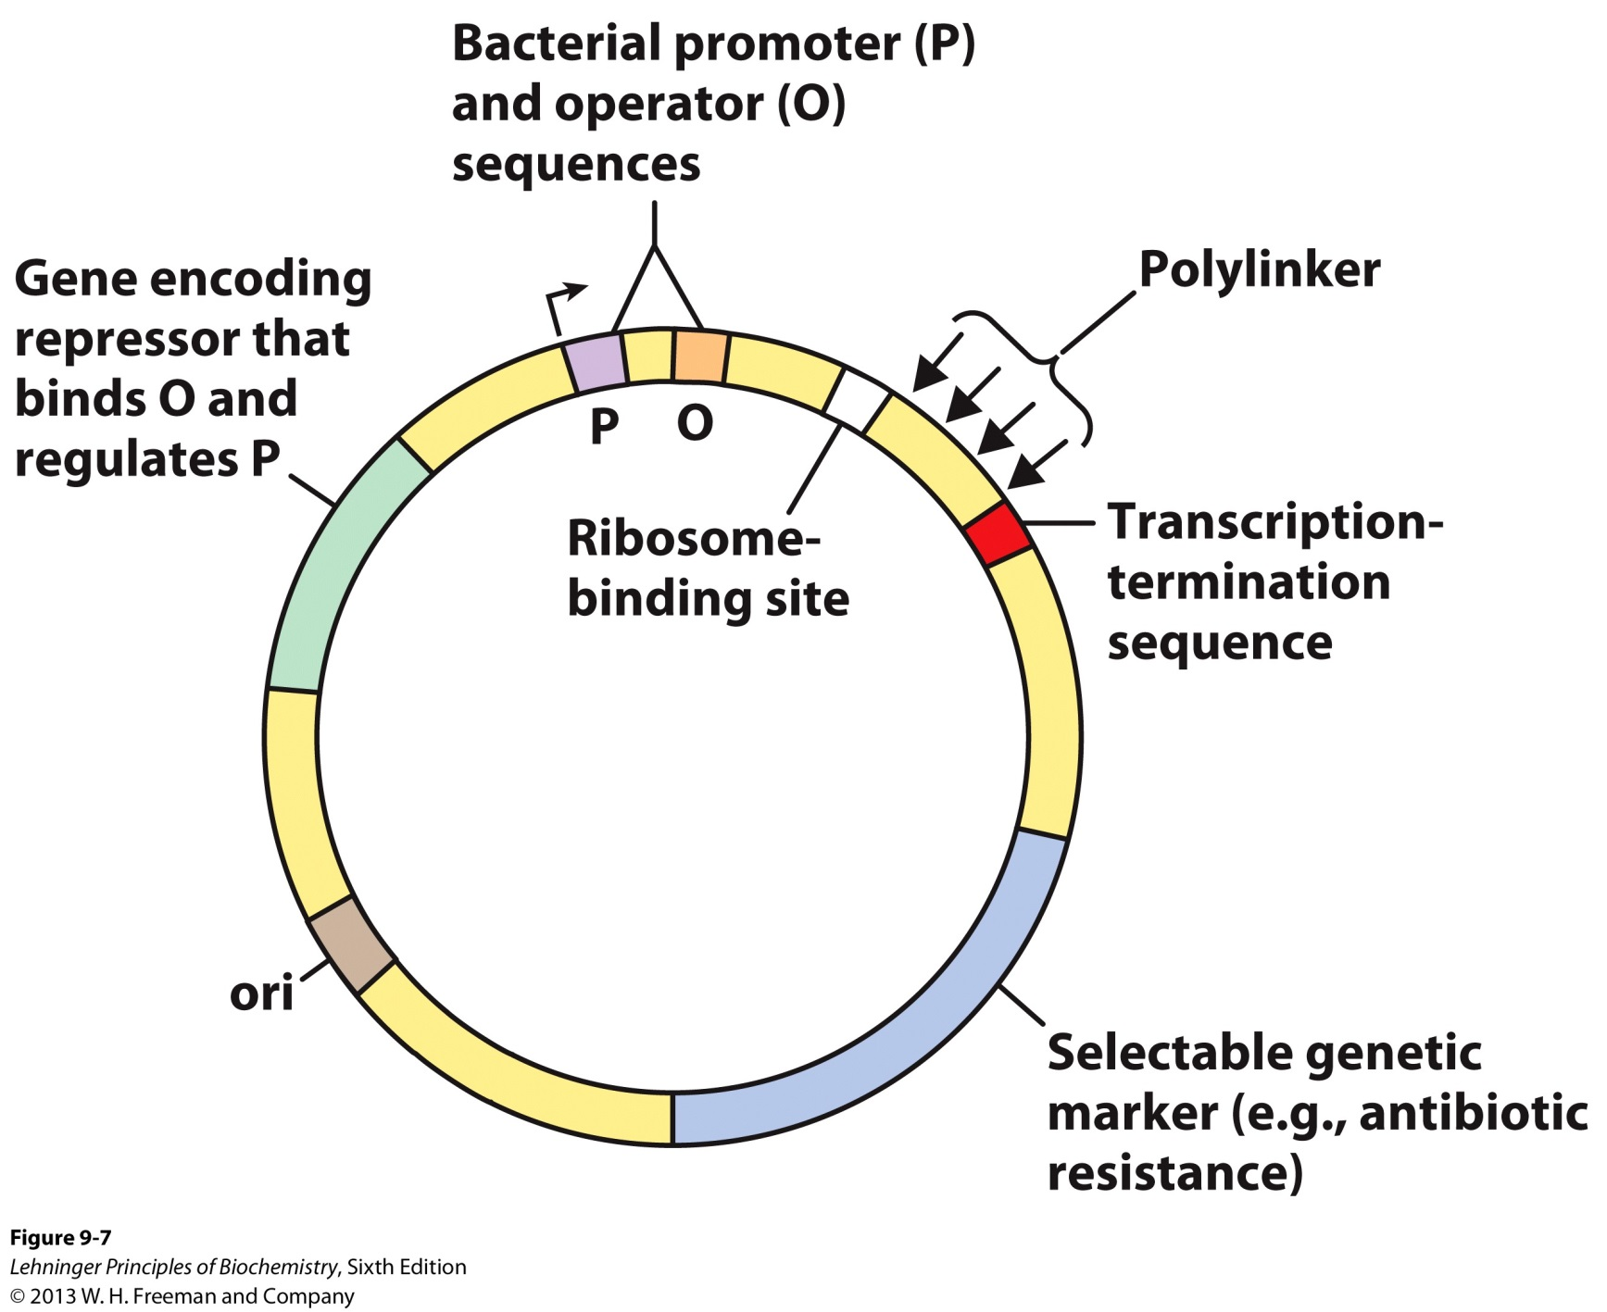
6A. Typical Expression Vector
Insert gene here.

Slide 40
6A. Typical Expression Vector
The vector must be specific to the host cell.
-Expression from bacterial cell typically done to obtain nonglycosylated mammalian protein
The promoter allows efficient transcription of the inserted gene and the operator permits regulation.
The ribosome-binding site provides sequence signals for the efficient translation of mRNA derived from the gene.
The gene to be expressed must include a sequence specific to the host cell, which is important for ribosomal binding.
-Bacteria: Shine-Dalgarno sequence AGGAGGU
-Eukaryotes: Kozak sequence GCCGCCRCCAUGG
R: Purine

Slide 41
Creating the Modified Gene

Slide 42
1. Polymerase Chain Reaction (PCR)
Used to amplify DNA in the test tube
Can amplify regions of interest (genes) within linear DNA
Can amplify complete circular plasmids
2. Mix together
Target DNA
Primers (oligonucleotides complementary to target)
Nucleotides: dATP, dCTP, dGTP, dTTP
Thermostable DNA polymerase

Slide 43
1. Polymerase Chain Reaction (PCR)
3. Place the mixture into thermocycler
Melt DNA at about 95°C
Cool separated strands to about 50–60°C
Primers anneal to the target
Polymerase extends primers in 5’→3’ direction
After a round of elongation is done, repeat steps

Slide 44
1. Polymerase Chain Reaction (PCR)

Slide 45
1. Polymerase Chain Reaction (PCR)

Slide 46
1. Polymerase Chain Reaction (PCR)

Slide 47
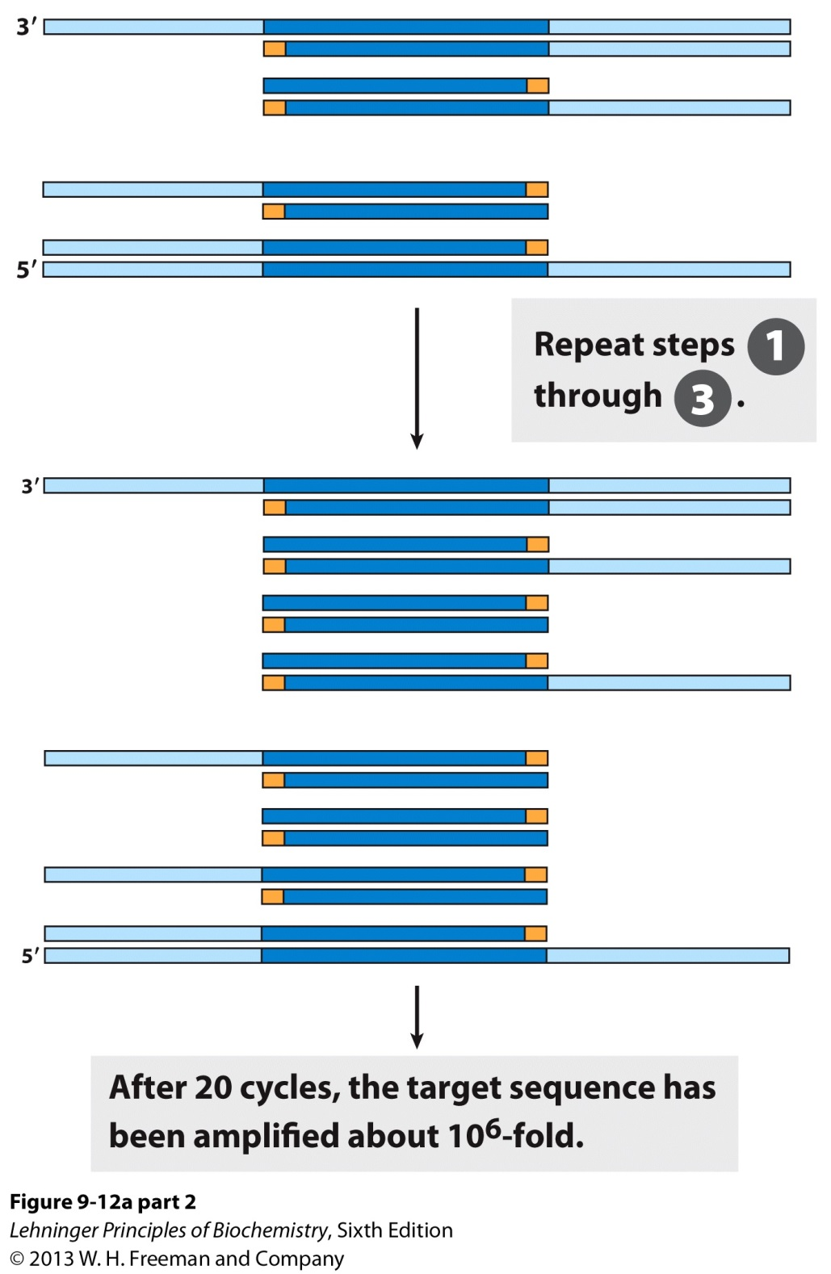
1. Polymerase Chain Reaction (PCR)

Slide 48
2. Creating the Primers for a Desired Gene
Coding Sequence (CDS)
Recall-

Slide 49
2. Creating the Primers for a Desired Gene
Say you want to clone a gene using a vector with a EcoRI cut site and want to express protein in a eukaryotic cell also with a EcoRI cut site. The gene will have to be modified by performing PCR with the following primers.
5’-GAATTC-Kozak sequence-ATG-XXX-3’
3’- X_{c}X_{c}X_{c}-ATTCTTAAG-5’
XXX: 18-20 nucleotides
X_{c}X_{c}X_{c}: Complementary strand

Slide 50
3. Recombinantly Expressed Proteins will have a Met (Leu) at the N-terminus.
The typical start codon codes for a Met and consequently that AA will be part of the expressed protein sequence.
N-terminal Met can be removed with methionine aminopeptidase.

Slide 51
Gene Mutations to study
Mutant Proteins or
Improve Protein Purification

Slide 52
1. Alterations in Cloned Genes Produce Modified Proteins
Cloning techniques can be used to produce protein products altered from their native forms.
Site-directed mutagenesis
A DNA segment can be removed and replaced with a synthetic one that is identical to the original except for the desired change.
Oligonucleotide-directed mutagenesis
A specific DNA sequence change can be performed.

Slide 53
1A. Site-directed Mutagenesis.

Slide 54
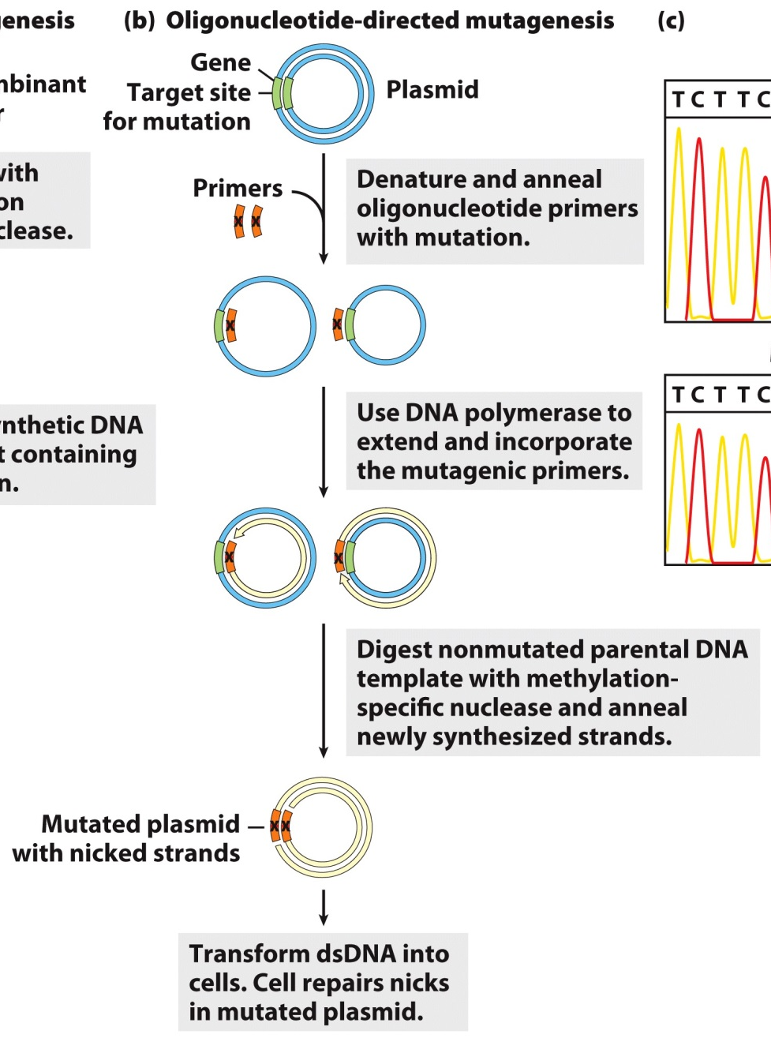
1B. Oligonucleotide-directed Mutagenesis.

Slide 55
2. Tagging a Recombinant Protein for Enhanced Purification
Purification of natural proteins is difficult.
Recombinant proteins can be tagged with specific amino acids sequences for purification by inserting the gene encoding the protein in a vector encoding the AA sequence at either end of the gene.
The protein is then purified by affinity purification. The protein tag binds to the affinity resin.

Slide 56
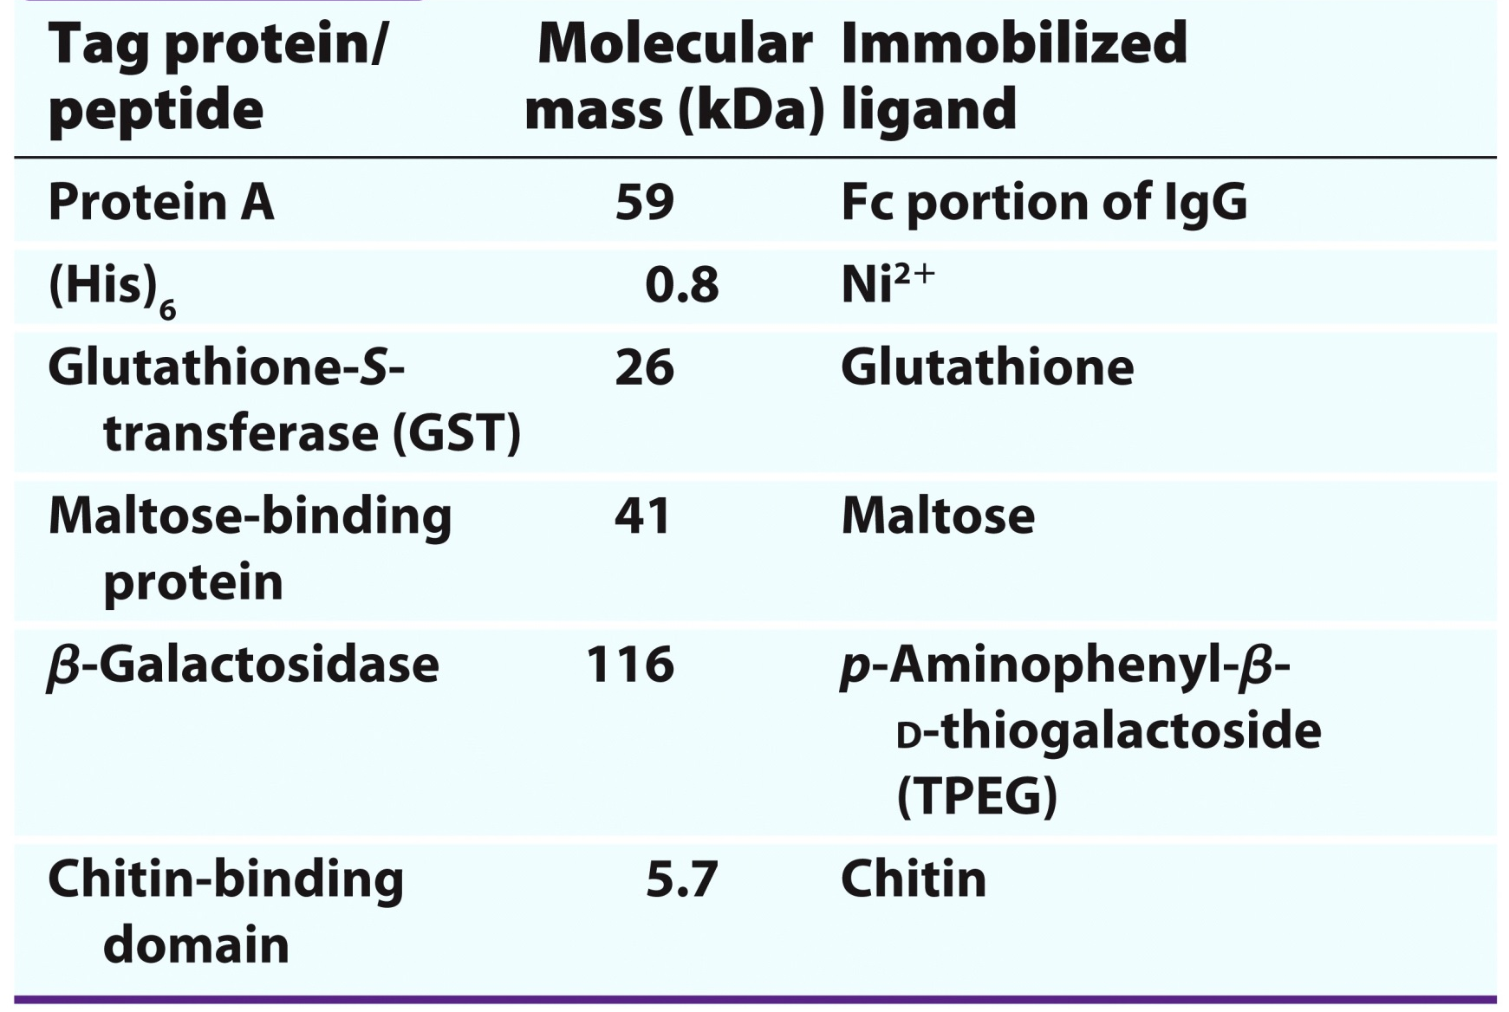
2A. Commonly Used Protein Tags

Slide 57
2B. General Method for Tagging a Protein

Slide 58
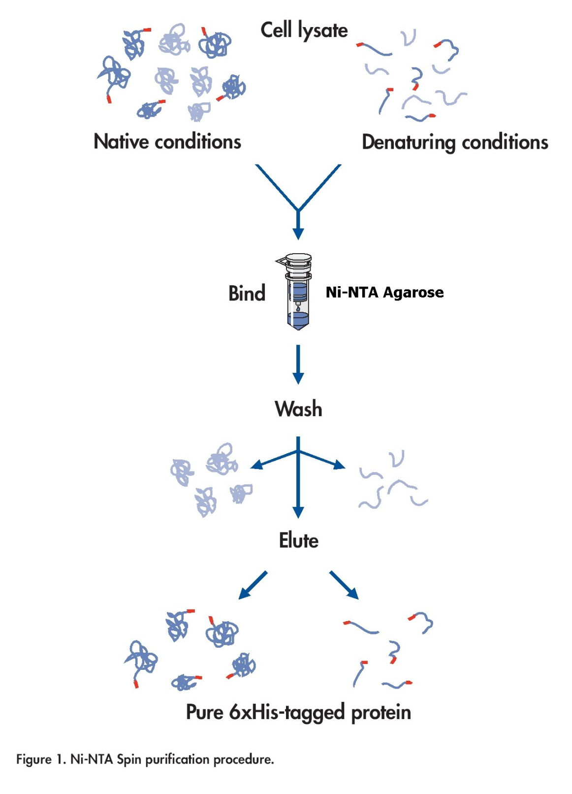
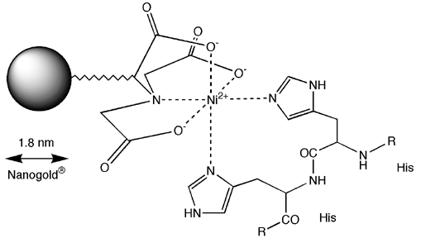
2C. Affinity Purification of His-Tag with Ni(II)-NTA Column
Resin:
Use Imidazole Buffer

