Slide 1
Introduction to Metabolism
With an Emphasis on Glucose
Pratt and Cornelly Chapter 12
Nelson and Cox Chapter 11 (Page 393-397)

Slide 2
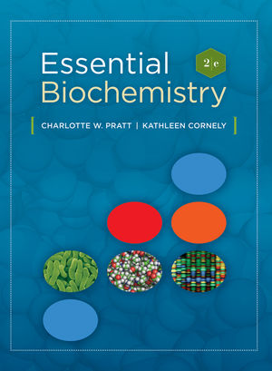
Essential
Biochemistry
Second Edition
Charlotte W. Pratt | Kathleen Cornely
Chapter 12
Overview of Metabolism and Free Energy
Copyright © 2011 by John Wiley & Sons, Inc.

Slide 3
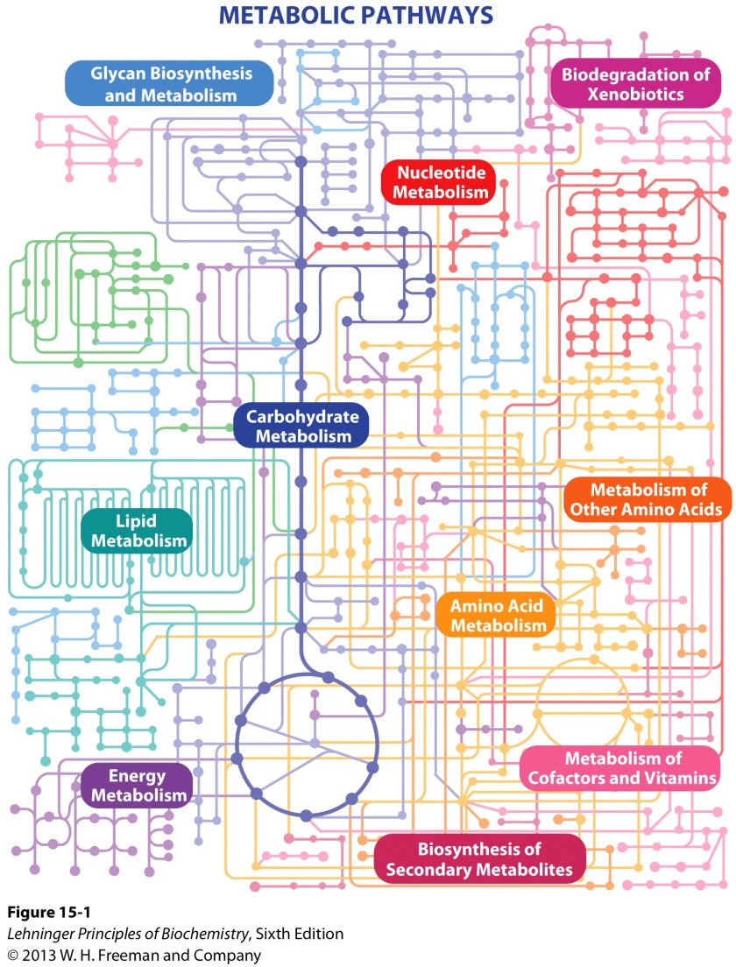
1. General Definition for Metabolism
Metabolism is the set of processes by which organisms consume and produce matter and energy in the synthesis and degradation of biomolecules.

Slide 4
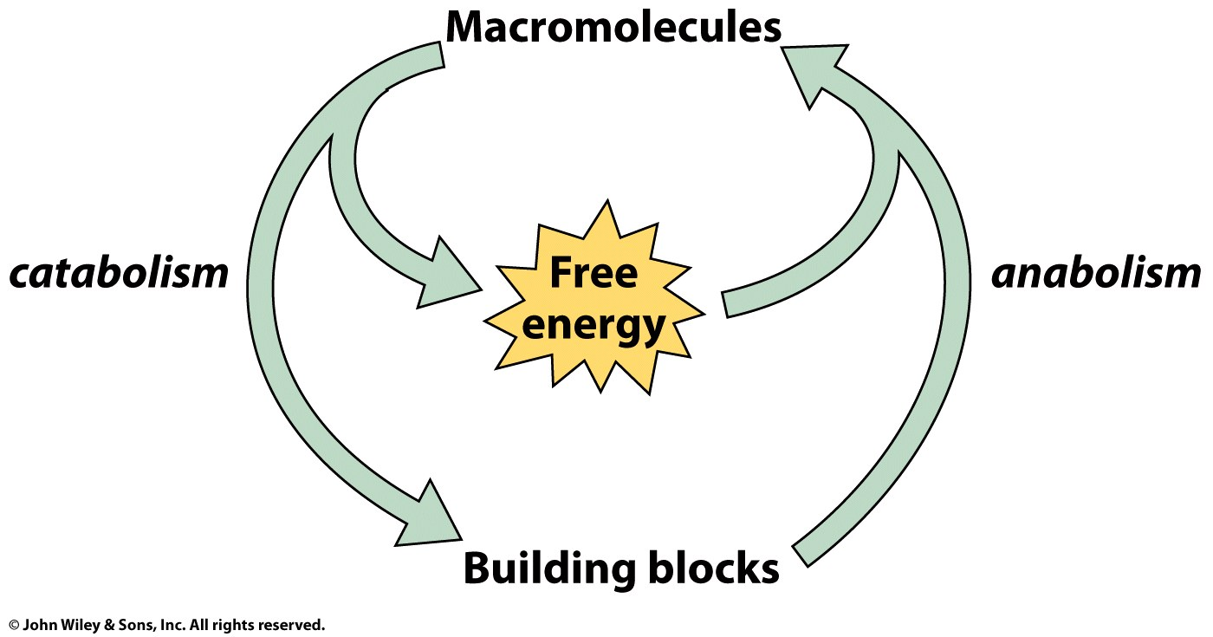
1. General Definition for Metabolism
Catabolism: Cells break large molecules to release free energy and small molecules.
Anabolism: Cells use the free energy and small molecules to rebuild larger molecules.
The set of all catabolic and anabolic activities constitutes an organism’s metabolism.

Slide 5
2. Organism Classification Based on Metabolic Requirements
Chemoautotrophs
i.e. Microbes
Obtain the majority of their metabolic building blocks and free energy from simple inorganic compounds CO₂, N₂, H₂, and S₂.
Photoautotrophs
i.e. Green Plants
Require little more than CO₂, H₂O, a source of nitrogen, and sunlight.
Heteroautotrophs
i.e. Animals
Directly or indirectly obtain all their building materials and free energy from organic compounds produced by chemo- or photoautotrophs

Slide 6
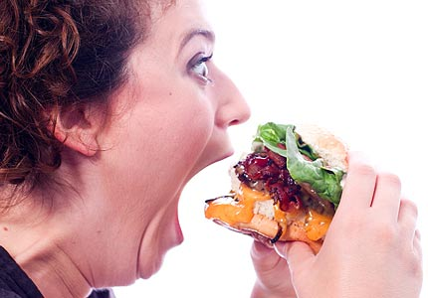
3. Fuel obtained from Food
Digestion
Food provides us with four major types of biomolecules: amino acids, nucleotides, monosaccharides, and fatty acids. These are typically in a macromolecular polymeric form.
Digestion breaks biomolecules into monomeric form yielding significant amount of energy.
Notes:
Tricacylglycerols are not technically polymers of fatty acids.

Slide 7
4. Hydrolytic Enzymes Degrade Biopolymers Initiating Energy Yielding Catabolic Pathways
Proteins
Polysaccharides
Triacylglycerols
Nucleic Acids
DNAse/RNAse
Protease
Amylase
Lipase
Amino Acids
Monosaccharides
Fatty Acids
Nucleotides
Catabolism of nucleotides yields an insignificant amount of metabolic energy.
Citric Acid Cycle in Mitochondria
Produces 90% of the energy used by aerobic human cells.
Notes:
Biological polymers are degraded by hydrolysis. Digestion takes place extracellularly in the mouth, stomach, and small intestine and is catalyzed by hydrolytic enzymes. The monomers get

Slide 8
5. Excess Monomers Stored in Polymeric Form
Some tissues are specialized for the long-term storage of nutrients that are not catabolized for energy.
Fatty acids are stored as triacylglycerols in adipose tissue.
Monosaccharides are stored as glycogen in liver and muscle.
Branch structure allows for efficient addition and removal of sugar units.

Slide 9
6. Excess Monomers Converted as Source of other Biomolecules
A. While amino acids can be used to generate more proteins, proteins are not a storage pool for amino acids.
Excess AA can be converted to carbohydrates or to fats.
B. AA and glucose are required for synthesis of nucleotides.
Notes:
Many proteins are quickly chewed up by proteases.

Slide 10
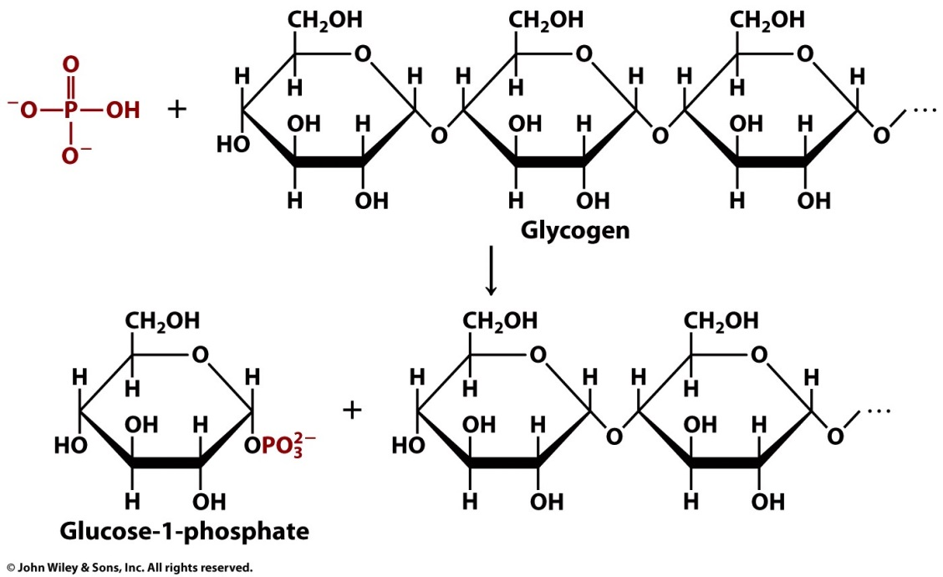
7. Mobilization of Stored Polymers to Extract Monomers
AA, monosaccharides, and fatty acids are known as metabolic fuels. When these fuel supplies are exhausted, the body mobilizes its stored resources by convertings its biopolymers into their monomeric units.
Most of the body’s tissues uses glucose as primary metabolic fuel.
Liver mobilized to break down glycogen via phosphorolysis.

Slide 11
7. Mobilization of Stored Polymers to Extract Monomers
When glycogen stores are depleted, amino acids are mobilized to generate energy.
Regardless of needs for amino acids, cellular proteins are continuously degraded via two major mechanisms.
Lysosome: An organelle containing proteases and other hydrolytic enzymes.
Proteasome: A barrel-shaped multiprotein complex.
- A protein has to be covalently tagged at a Lys residue with a small protein called ubiquitin (C- terminus) in order to be hydrolyzed by the proteasome.

Slide 12
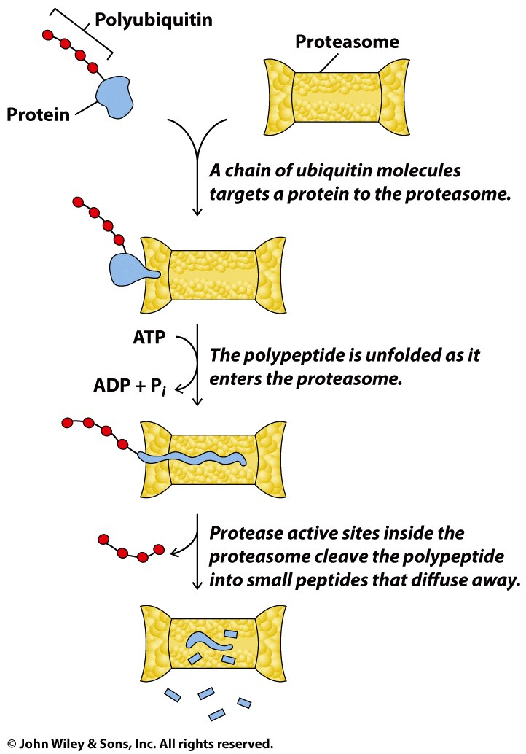
7. Mobilization of Stored Polymers to Extract Monomers
- A chain of at least 4 ubiquitins is required to mark a protein for destruction by the proteasome.

Slide 13
7. Mobilization of Stored Polymers to Extract Monomers
C. Only when the supply of glucose and amino acid runs low does adipose tissue mobilize its fat stores.
A lipase yields fatty acids, which are released into the bloodstream.
The released fatty acids bind to circulating proteins (i.e. albumin) due to their poor aqueous solubility.
Even if a diet include almost no fat, it is very hard to mobilize stored fat.

Slide 14
8. Metabolic Pathways
The interconversion of a biopolymer and its monomeric units is usually a one or few enzyme-catalyzed step process.
However, many steps are required to break down the monomeric compounds or synthesize them from smaller precursors.
- Intermediates in these steps are called metabolites.
These series of reactions are known as metabolic pathways.
Notes:
Metabolic pathways can be seen from different perspectives: The metabolic, the regulatory enzymes, the exchange of energy.

Slide 15
9. Metabolism Overview

Slide 16
9. Metabolism Overview
Metabolic pathways are all connected.
Pathway activity is regulated.
The flux, or flow of intermediates, through a metabolic pathway is regulated in various ways according to substrate availability and the cell’s need for the pathway’s product.
Flux is regulated by extracellular signals to avoid wasteful processes.
Not every cell carries out every pathway.
Notes:
Not all steps in the metabolism are reversible. Alternate routes are used to regenerate building blocks and polymers. Cells do not synthesize polymers when monomers are in short supply…that would be a wasteful process.

Slide 17
9. Metabolism Overview
Each cell has a unique metabolic repertoire.
There are many biosynthetic reactions that are not fuel yielding, which are cell specific.
Organisms may be metabolically interdependent.
Organisms may depend on one another for survival based on each other’s specific set of metabolites.
Humans survive on vitamins that we are unable to synthesize.
Notes:
Cells do not synthesize polymers when monomers are in short supply…that would be a wasteful process.

Slide 18
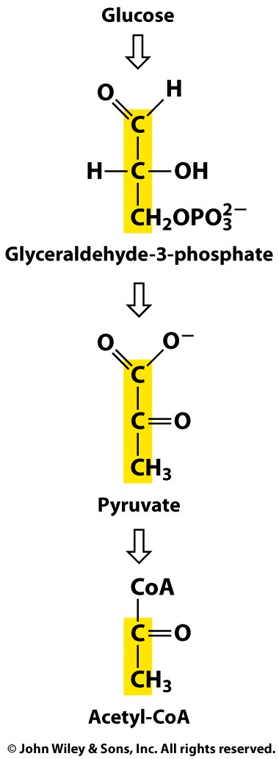
10. Important Metabolites in these Metabolic Pathways

Slide 19
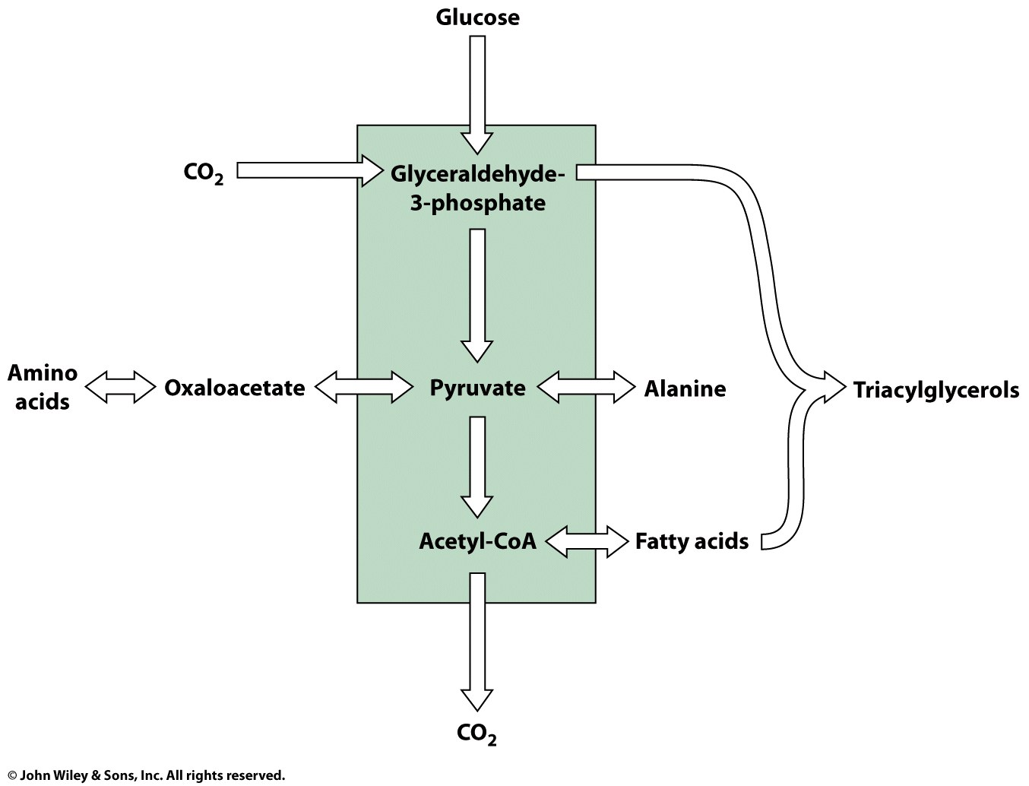
10. Important Metabolites in these Metabolic Pathways

Slide 20
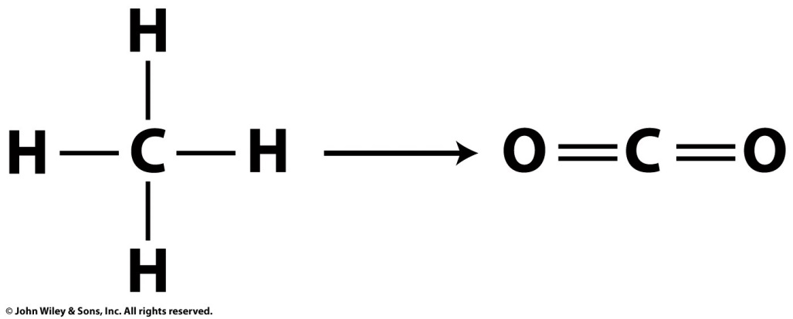
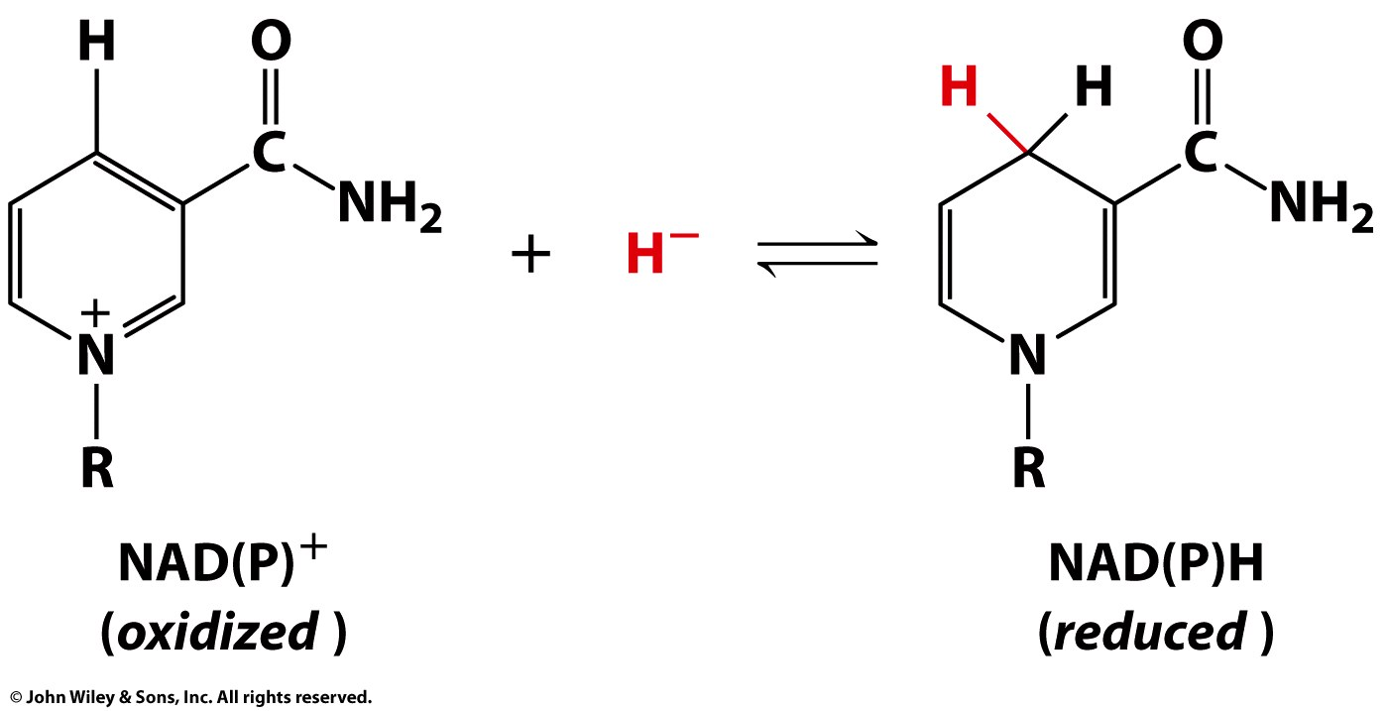
11. Redox Reactions are Important to Metabolic Pathways
The catabolism of amino acids, monosaccharides, and fatty acids is a process of oxidizing carbon atoms, and the synthesis of these compounds involves carbon reduction.
There are electron donor and acceptor molecules facilitating redox of metabolites.
Notes:
Nicotinamide adenine dinucleotide or nicotinamide adenine dinucleotide phosphate

Slide 21
12. Free Energy Changes in Metabolic Reactions
All reactions occur in vivo with a net decrease in free energy.
ΔG < 0
ΔG = ΔG’° + RT ln [P]/[S]
At equilibrium ΔG = 0,
ΔG’° = -RT ln K_{eq}
Measurements of standard free energy are valid under biochemical standard states: 298 K, 1 atm, pH 7.0
Notes:
A reaction with a positive standard free energy change may proceed in vivo, depending on the concentrations of reactants in the cell.

Slide 22
12. Free Energy Changes in Metabolic Reactions
A biochemical reaction may appear to be thermodynamically unfavorable but it can proceed in vivo when it is coupled to a second reaction whose value of ΔG is very large and negative such as cleavage of ATP.
ΔG’° = -30.5 kJ/mol
ΔG’° = -13.8 kJ/mol
A
ΔG’°
(kJ/mol)
Glucose + P_{i} → Glucose-6-phosphate + H₂O +13.8
ATP + H₂O → ADP + P_{i} -30.5
Glucose + ATP → Glucose-6-phosphate + ADP -16.7
Notes:
A reaction with a positive standard free energy change may proceed in vivo, depending on the concentrations of reactants in the cell.

Slide 23
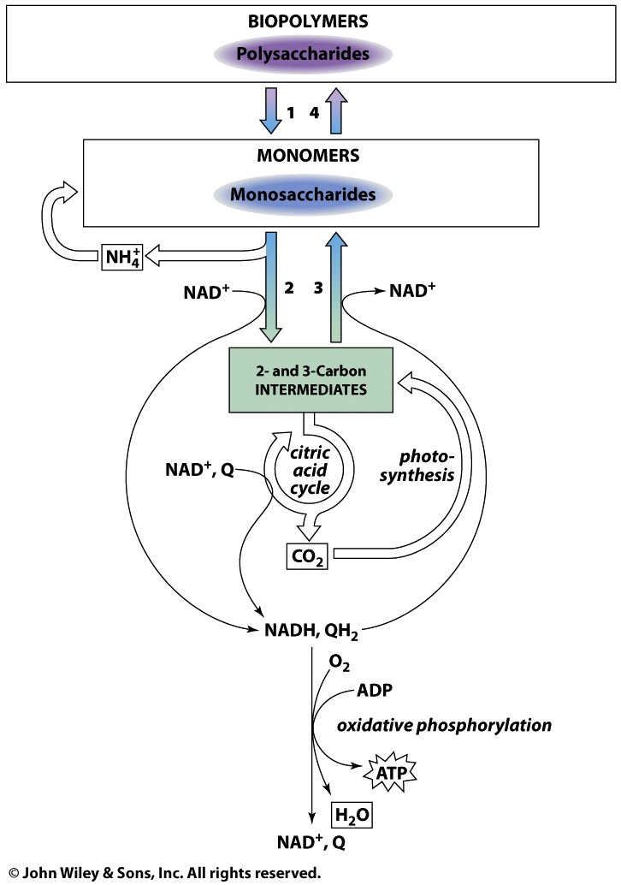
13. Will Focus on Metabolism from the Perspective of Glucose
GLUCOSE
Notes:
There are different ways you can look at metabolism: from the perspective of the metabolites, from the regulatory enzymes, or the exchange of energy.

Slide 24
Glucose Regulated Transport into Cells

Slide 25
1. Basal Glucose Level
Energy-yielding metabolism in erythrocytes depends on a constant supply of glucose from the blood plasma, where the glucose concentration is maintained ~ 5 mM.
Two main factors are important for maintaining a homeostasis of glucose and for glucose uptake into cells:
Transporters
Hormones

Slide 26
2. GLUT1 and Basal Glucose Level
Glucose enters the erythrocyte by facilitated diffusion via Glucose Transporter 1 (GLUT1) at a rate ~50,000 times greater than uncatalyzed transmembrane diffusion.
GLUT1 is responsible for the low-level of basal glucose uptake required to sustain respiration in all cells.
Expression levels of GLUT1 in cell membranes are increased by reduced glucose levels and decreased by increased glucose levels.

Slide 27
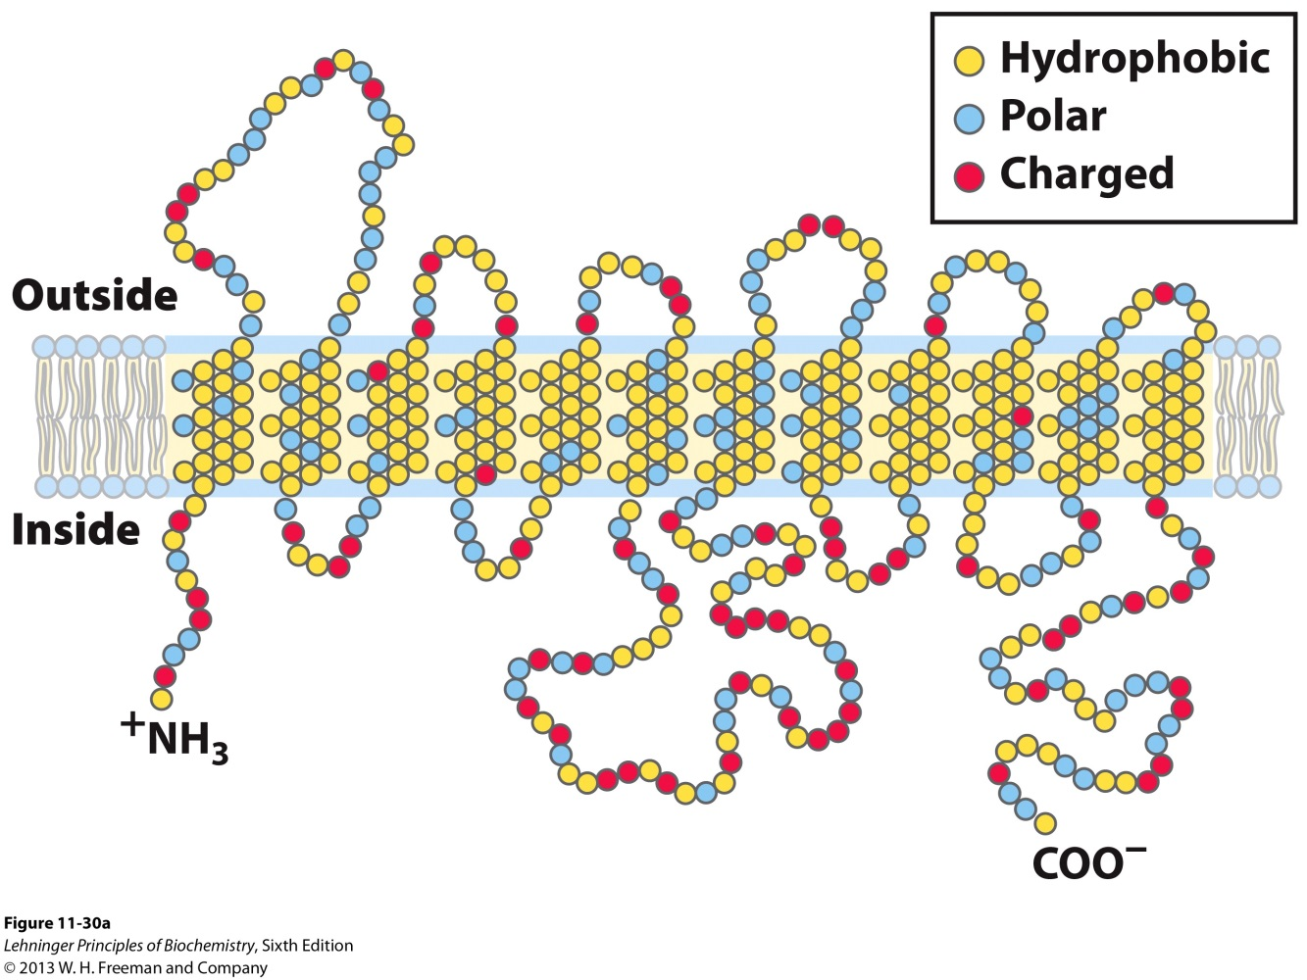
2I. GLUT1 Structure
The detailed structure of GLUT1 is not known, but it is known to be a type III integral protein (MW 45 kDa) with 12 hydrophobic domains likely transmembrane.
Notes:
FIGURE 11–30 Membrane topology of the glucose transporter GLUT1. (a) Transmembrane helices are represented here as oblique (angled) rows of three or four amino acid residues, each row depicting one turn of the α helix. Nine of the 12 helices contain three or more polar or charged residues (blue or red), often separated by several hydrophobic residues (yellow). This representation of topology is not intended to depict three-dimensional structure. (b) A helical wheel diagram shows the distribution of polar and nonpolar residues on the surface of a helical segment. The helix is diagrammed as though observed along its axis from the amino terminus. Adjacent residues in the linear sequence are connected, and each residue is placed around the wheel in the position it occupies in the helix; recall that 3.6 residues are required to make one complete turn of the α helix. In this example, the polar residues (blue) are on one side of the helix and the hydrophobic residues (yellow) on the other. This is, by definition, an amphipathic helix. (c) Sideby-side association of four amphipathic helices, each with its polar face oriented toward the central cavity, can produce a transmembrane channel lined with polar (and charged) residues. This channel provides many opportunities for hydrogen bonding with glucose as it moves through.

Slide 28
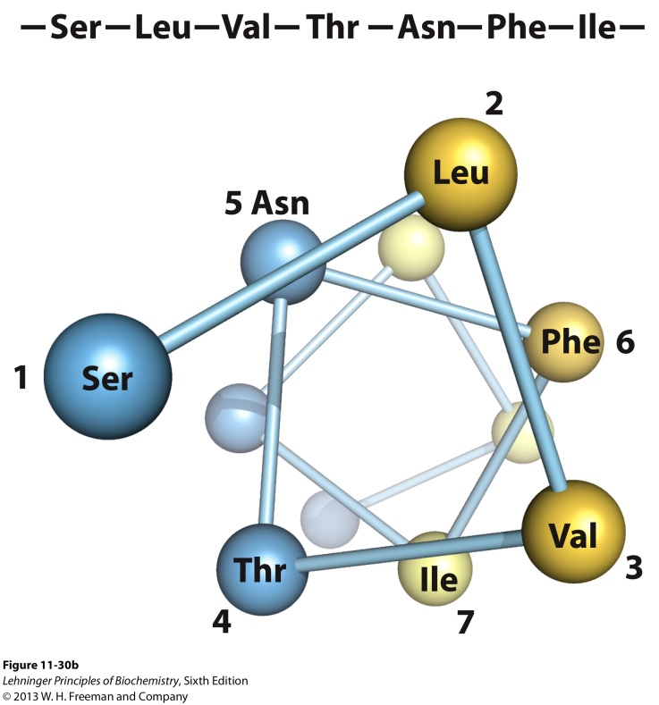
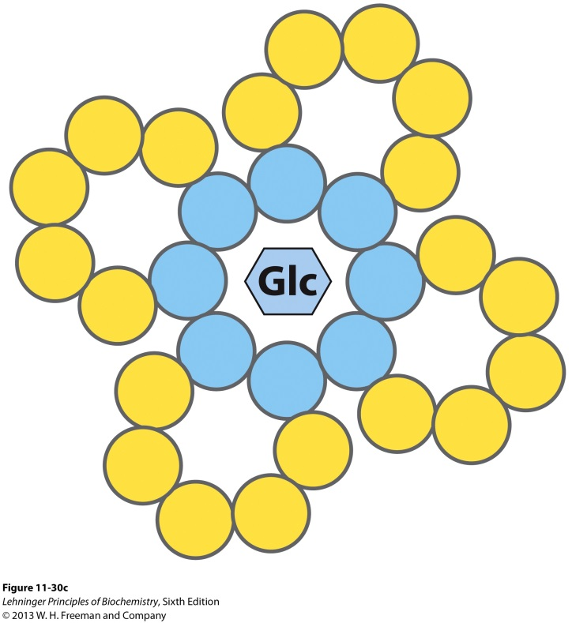
2I. GLUT1 Structure
A side by side assembly of several helices is believed to produce a transmembrane channel lined with hydrophilic residues that can hydrogen bond with glucose as it moves through it.
Notes:
FIGURE 11–30 Membrane topology of the glucose transporter GLUT1. (a) Transmembrane helices are represented here as oblique (angled) rows of three or four amino acid residues, each row depicting one turn of the α helix. Nine of the 12 helices contain three or more polar or charged residues (blue or red), often separated by several hydrophobic residues (yellow). This representation of topology is not intended to depict three-dimensional structure. (b) A helical wheel diagram shows the distribution of polar and nonpolar residues on the surface of a helical segment. The helix is diagrammed as though observed along its axis from the amino terminus. Adjacent residues in the linear sequence are connected, and each residue is placed around the wheel in the position it occupies in the helix; recall that 3.6 residues are required to make one complete turn of the α helix. In this example, the polar residues (blue) are on one side of the helix and the hydrophobic residues (yellow) on the other. This is, by definition, an amphipathic helix. (c) Sideby-side association of four amphipathic helices, each with its polar face oriented toward the central cavity, can produce a transmembrane channel lined with polar (and charged) residues. This channel provides many opportunities for hydrogen bonding with glucose as it moves through.

Slide 29
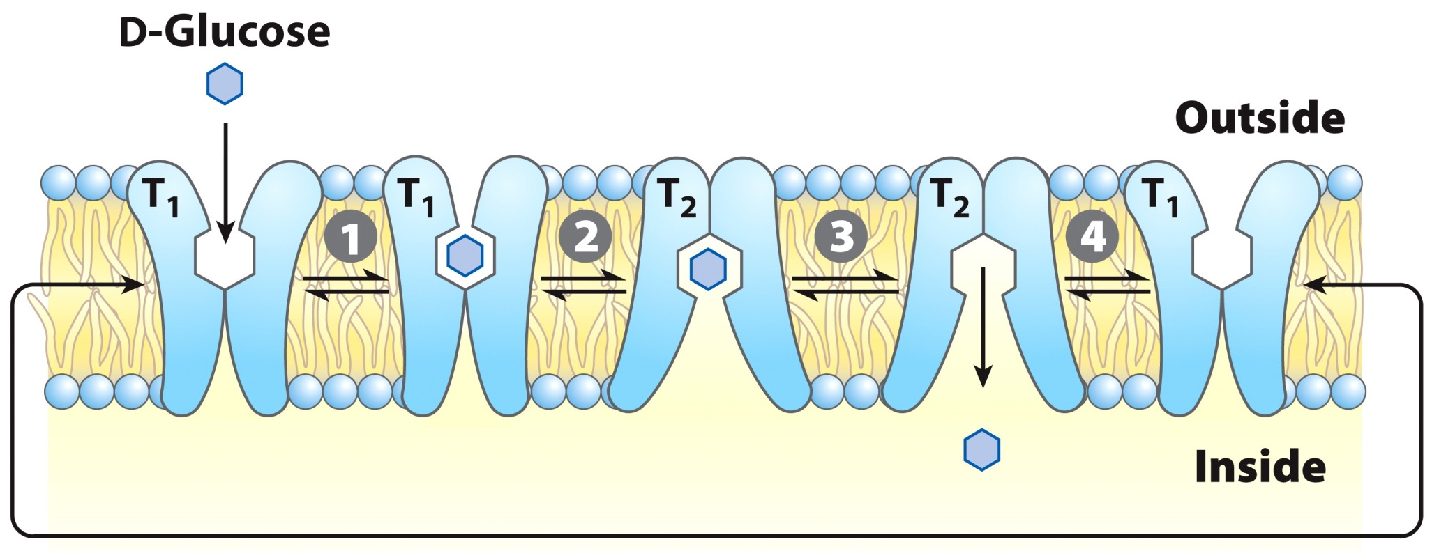
2II. Model for Glucose Transport
The transporter exists in two conformations:
T₁- With the glucose-binding site exposed on the outer surface of the plasma membrane.
T₂- With the glucose-binding site exposed on the inner surface.
A stereospecific binding site
Notes:
The transporter exists in two conformations: T₁, with the glucose-binding site exposed on the outer surface of the plasma membrane, and T₂, with the binding site exposed on the inner surface. Glucose transport occurs in four steps. 1 Glucose in blood plasma binds to a stereospecific site on T₁; this lowers the activation energy for 2 a conformational change from glucose_{out} • T₁ to glucose_{in} • T₂, effecting the transmembrane passage of the glucose. 3 Glucose is released from T₂ into the cytoplasm, and 4 the transporter returns to the T₁ conformation, ready to transport another glucose molecule.

Slide 30
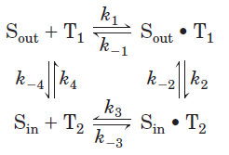
2III. Glucose Transport Kinetics
Formally, such a transport process can be described by the equations:

Slide 31
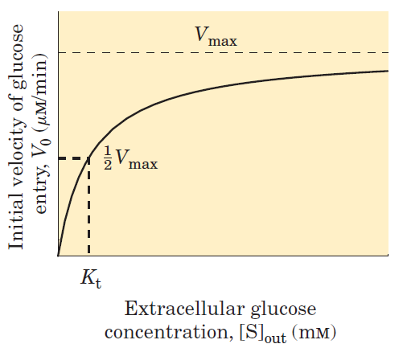
2III. Glucose Transport Kinetics
The rate equations for this transport process can be derived exactly as for enzyme-catalyzed reactions (initial rate kinetics) yielding an equation comparable to the Michaelis-Menten equation resulting in a hyperbolic plot:
K_{transport} = K_{transport}
K_{t} = [S] when V_{max}/2
K_{t} = 1.5 mM
Passive Diffusion
Saturability
Specificity
Notes:
At [glucose] = 5 mM, 3 x K_{t} and so protein is nearly saturated with substrate. GLUT1 shows hallmark characteristics of passive transport carrier: high rates of diffusion down a concentration gradient, saturability, and specificity.

Slide 32
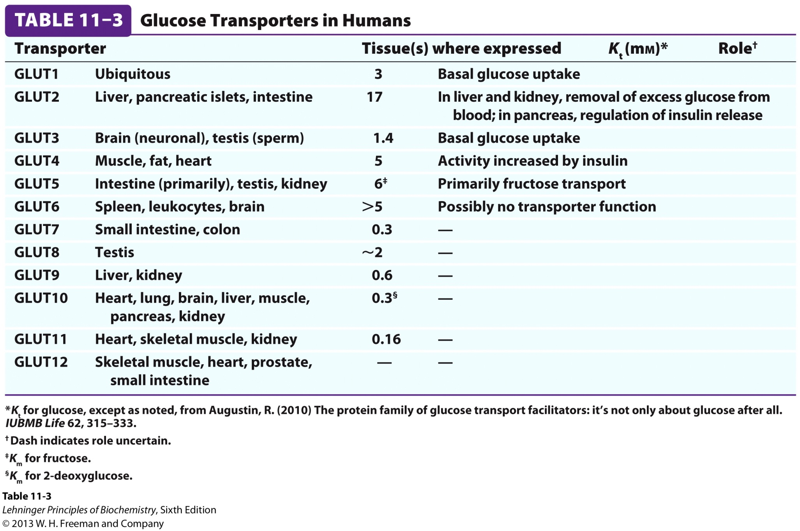
2IV. Glucose Transporters in Humans
Notes:
Twelve glucose transporters are encoded in the human genome.

Slide 33
2IV. Glucose Transporters in Humans
In liver, GLUT2 transports glucose out of hepatocytes when liver glycogen is broken down to replenish blood glucose.
GLUT2 has a K_{t} ~ 66 mM and responds to increased levels of intracellular glucose (produced by glycogen breakdown) by increasing outward transport.
Skeletal muscle and adipose tissue have GLUT4 (K_{t} = 5mM) which responds to an increase in blood sugar following food ingestion as stimulated by hormones.
Notes:
Twelve glucose transporters are encoded in the human genome.

Slide 34
3. Hormones Regulate the Non-basal Glucose Level and Uptake of Glucose
Several peptide hormones are responsible for facilitating metabolism of ingested glucose namely:
Glucagon-like peptide 1 (GLP-1)
Glucagon
Insulin

Slide 35
3I. GLP1, Glucagon, and Insulin Origins
GLP1 and glucagon are products of the proteolytic cleavage of proglucagon.
Proglucagon (Prohormone protein)
Proteolytic Cleavage
GLP1 (31 AA peptide)
Glucagon (29 AA peptide)
Several other bioactive peptides
- GLP1 is formed by proprotein convertase 1 (PC1).
- Glucagon is formed by PC2.
Whalley, N.M. et al. J. Endocrinol. 211, 99-106, 2011.
Insulin is a 51 AA peptide hormone produced by β pancreatic cells.

Slide 36
3II. Glucagon and Insulin are part of a Feedback System to Control Blood Glucose Levels
Glucagon and insulin display opposite effects.
Glucagon raises blood glucose levels when blood sugar is too low by causing the liver to convert glycogen into glucose.
Insulin decreases blood glucose levels by enabling the cellular uptake of glucose for catabolic purposes.
Together they control homeostasis of glucose.

Slide 37
3III. GLP1 regulates the Activity of Glucagon and Insulin
GLP1 exhibits its effect via signaling by binding to the GLP1 receptor (GLP1R).
GLP1R is expressed in the pancreas and the brain.
Binding to GLP1R at the two sites produces two physiologically different results.
At the pancreas, GLP1 controls the levels of insulin and glucagon.
At the brain, GLP1 controls hunger.

Slide 38
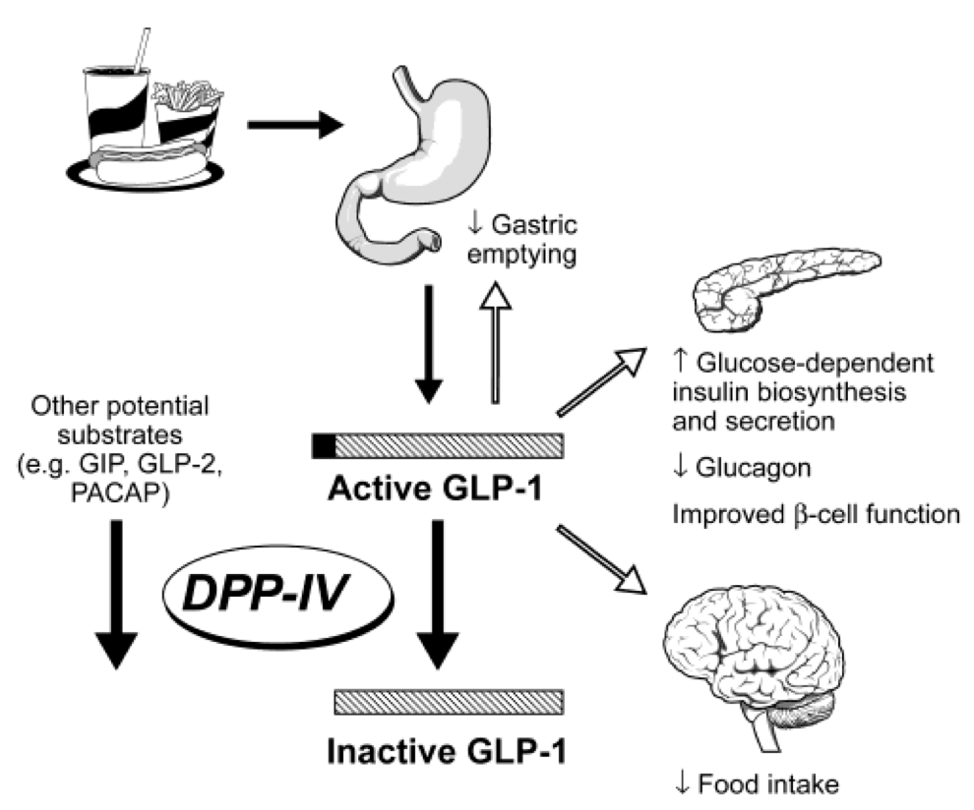
3III. GLP1 regulates the Activity of Glucagon and Insulin
Pancreas

Slide 39
3III. GLP1 regulates the Activity of Glucagon and Insulin
Dipeptidyl peptidase IV

Slide 40
3III. GLP1 regulates the Activity of Glucagon and Insulin
X
Notes:
The identification of the enzyme responsible for the metabolism and regulation of GLP-1 provided a new opportunity for regulating GLP-1 levels that didn’t require injection of GLP-1. After the DPP4 inhibitor was developed in 2000 and showed higher insulin levels and better glucose tolerance after a meal drug companies began to race to develop DPP4 inhibitors. Merck’s drug sitagliptin went on sale last year and has been used as an anti-diabetic therapy; an indirect method to elevate insulin levels. What I hope this example has demonstrated is the value of this information when understanding the physiological metabolism and regulation of peptides and more importantly in the development of new drugs. So how to identify these substrates like GLP-1? Typically, this is accomplished using in vitro assays with recombinant enzymes…

Slide 41
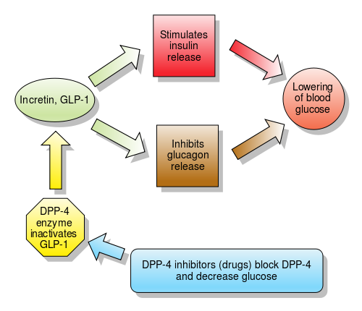
3III. GLP1 regulates the Activity of Glucagon and Insulin

Slide 42
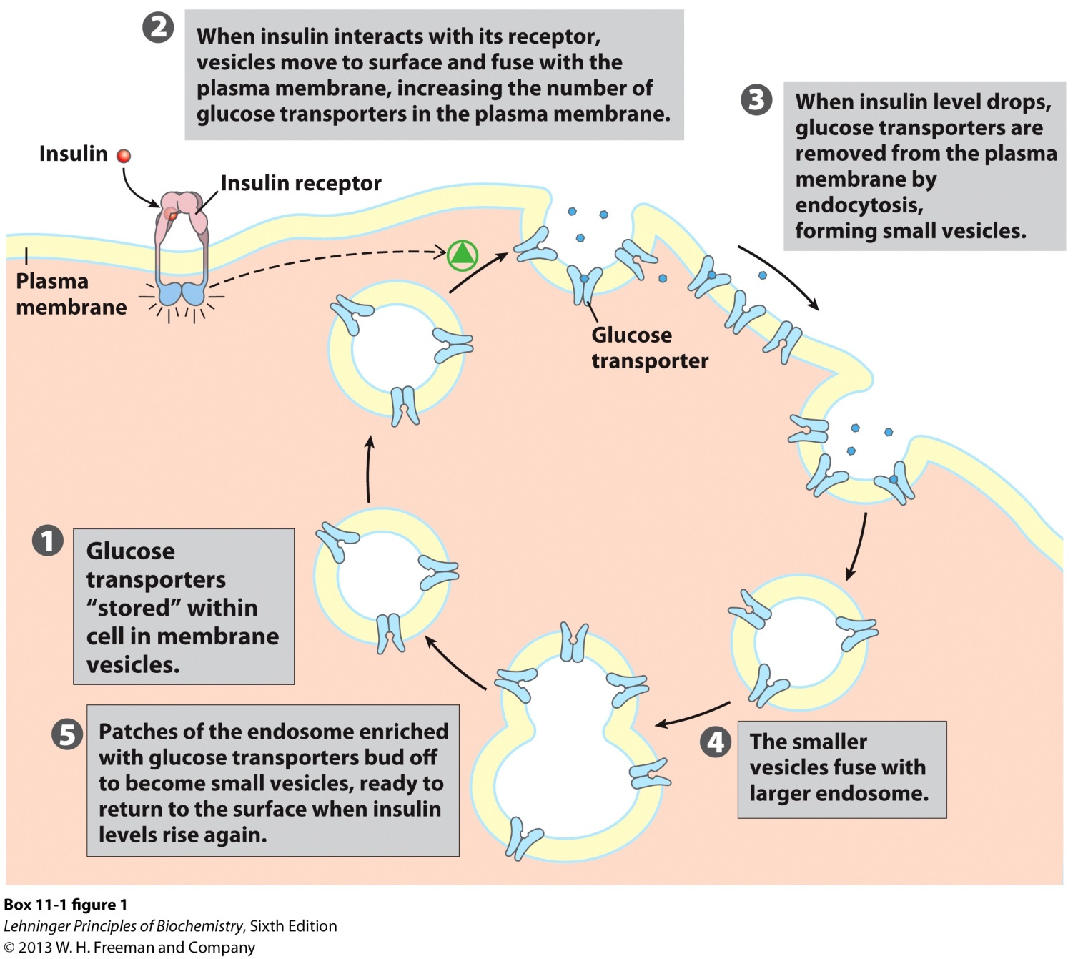
3IV. Insulin Signals to GLUT4 to Promote Uptake of Glucose

